Slide 1
Analysing compositional time-use data in paediatric populations
Dr Jill Haszard, Department of Medicine & Biostatistics Unit
Dr Kim Meredith-Jones
Assoc Prof Sheila Williams
Prof Rachael Taylor

Slide 2

Predictors of healthy development in childhood
Diet
Environment
Stress
Sleep
Physical activity
Sedentary behaviour
Notes:
There are many modifiable predictors of healthy development in childhood. But we need not only a good understanding of what the influencing factors are on the growth and health of children but the strength of their influence to allow us to develop effective and appropriate programmes and policies to protect and enhance their lives.

Slide 3



Sleep and physical activity
Lower risk of obesity
Healthier dietary habits
Improved behaviour
Better academic performance
Fewer mental health disorders
Sedentary behaviour
Higher risk of obesity
Mental health disorders
Less healthy dietary habits
Poorer academic performance
Behavioural issues
Notes:
Evidence to date suggests that both physical activity and sleep are beneficial for the healthy growth and development of children whereas sedentary behaviour may be detrimental. However, most of the literature examines these time-use behaviours in isolation or with inappropriate statistical analyses, despite the fact that these variables are likely to be related to each other and co-dependent.

Slide 4

Baseline measures from an obesity-prevention cluster-RCT in children
PLAY – 574 children aged 8 years of age (recruited through schools)
Farmer, V.L., Williams, S.M., Mann, J.I., Schofield, G., McPhee, J.C., & Taylor, R.W. (2017). The effect of increasing risk and challenge in the school playground on physical activity and weight in children: a cluster randomised controlled trial (PLAY). International Journal of Obesity, 41(5), 793-800.
Notes:
I’m going to briefly go through how these statistical analyses are recommended to be carried out and show how we can present the estimates of association in a useful, meaningful way that is not misleading. As an example, I’ll be using data from one of our randomized controlled trials in children. The PLAY study, recruited children from primary schools in Auckland and Dunedin and had 574 eight-year old children with data on sleep physical activity and sedentary behaviour.

Slide 5

How to measure these activities
Accelerometers measure 24-hour time use
ActiCal (Mini-Mitter, Bend, OR)
Worn at the waist for 7 days
Measures ‘counts’ in 15-second epochs
Different levels of counts/epoch are assigned to the different levels of activity: sleep, sedentary, light, moderate, and vigorous physical activity
Notes:
We measured these time-use variables with one device – an accelerometer, which was worn around the waist for 7 days. This measures gross motor activity, not unlike your fitbit and records ‘counts’ in 15 second epochs. The number of counts per epoch are assigned to the different levels of activity: sleep, sedentary, light, moderate, and vigorous activity, so that a high number of counts indicates a high level of activity.

Slide 6
The 24-hour window
Notes:
When we take this data from the accelerometer, we have data for a complete 24 hour window. Every epoch is assigned to one of the activity levels. We usually split these up into these four types of activity: sleep, sedentary, light (which would be ordinary playing, walking activity) and moderate to vigourous physical activity (that would get the heart rate going a bit). For our PLAY children at 8 years of age we can see that, on average, they spend about 41% of their day asleep, about a third sedentary, and only 5% of their day being very active. As the 24-hour window is set, when we increase time spent in one of these activities, time spent in one or more of the other activities must necessarily decrease. This is the nature of compositional data.

Slide 7
Compositional data
Relative distribution, not absolute
The sum of the parts is constrained (eg 100% or 24 hours)
A strong history in geology
Microbiota (relative abundance of microbiota in a faecal sample)
Macronutrient intake (fat/protein/carbohydrate)
How a consulting statistician allocates their work-time
Many others!
Notes:
Compositional data has a relative distribution so that the sum of all parts is constrained – for example constrained to 100% or to 24 hours. There is a strong history in compositional data analysis in geology but it also starting to appear in many other areas of research.

Slide 8
Problems with analysing compositional data
Not independent
Collinearity
Finite time period (constrained)
Violate the basic assumptions for multivariate statistical methods (such as regression), which were developed for unconstrained data
Notes:
The problem with compositional data is that the variables are not independent, there is collinearity and the data is constrained. These all violate the basic assumptions for the multivariate statistical methods that we commonly use and which were developed for use with unconstrained data.

Slide 9
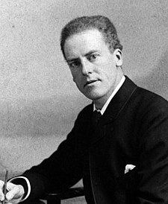

Karl Pearson (1897): “spurious correlation” with ratio variables
John Aitchison (1982): proposed a log-ratio approach
Notes:
These problems were first recognized by Pearson back in 1897 when he warned about the spurious correlation that occurs with ratio variables but compositional data were not properly addressed until the 1980s when John Aitchison published his monograph proposing a log-ratio approach to dealing with compositional data.

Slide 10
Log-ratio approach
Transform data into log-ratios: now in real space
Can use: additive log-ratios, centered log-ratios, or isometric log-ratios
Isometric log-ratios are recommended because the relative positions of the data points are preserved from the constrained (simplex) to the unconstrained, real space
Notes:
To overcome the difficulties with analyzing data in constrained space, we can simply transform the data into log-ratios, and this creates variables that are then in real, unconstrained space. You can use additive log-ratios, centered log-ratios, or isometric log-ratios. Iso-metric log-ratios are the most complex to use but are recommended because the relative positions of the data points are preserved from the constrained space to the unconstrained space.

Slide 11
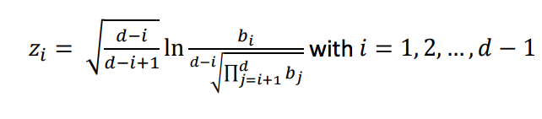
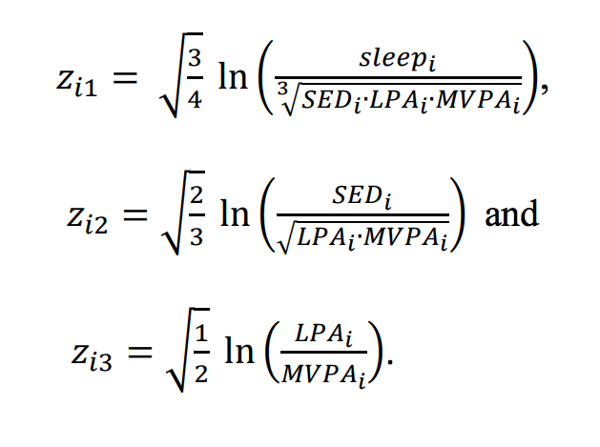
Isometric log-ratios
With 24-hour time-use variables these become:
Notes:
If, like I was, you’re unclear about what an isometric log-ratio is, the formula is up there. It’s not straightforward but using our four variable example – sleep, sedentary, light, and mvpa, we put these into the formula above and get three variables out – our four variables become three and all three of these variables are entered into our regression model as a set of coordinates.

Slide 12
Interpretation: need to have meaningful estimates!
To be able to judge the strength of association with a variable like BMI z-score we need to have meaningful estimates.
*Note that we measure body mass index (BMI) in children using z-scores based on standard growth charts
Notes:
So this all seems relatively straightforward so far. However, a major problem with using isometric log-ratios in a regression model is interpreting the estimates at the end. We need to be able to judge the strength of association so that readers can make practical use of the results to inform programmes and policy. The estimates must be in a meaningful form. I’m going to show you an example of this with the PLAY data and using BMI z-score as the outcome. BMI z-score is a measure of weight status that is used in children, where positive values suggest higher than average weight and negative values suggest lower than average weight.

Slide 13
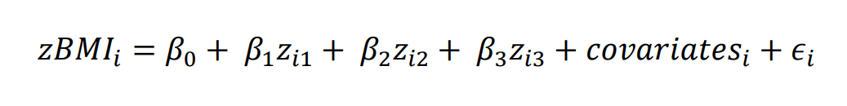
Regression model to estimate BMI z-score:
Notes:
We set up our regression model with BMI z-score as the outcome, and with the isometric log-ratio coordinates and any other covariates that we might have…

Slide 14
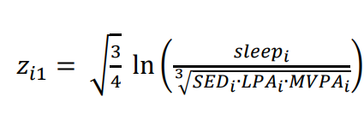
Interpretation
Note that the first isometric log-ratio coordinate is proportional to the log-ratio of sleep to the geometric mean of all other components (i.e. sedentary, light PA, and MVPA).
We can use the regression coefficient of this coordinate to provide a meaningful estimate of association.
Notes:
What we note is that that first isometric log-ratio coordinate is proportional to the log-ratio of sleep to the geometric mean of all other components. We can use this fact and take the regression coefficient for this first coordinate to provide a meaningful estimate of association with SLEEP (because it is the numerator).

Slide 15
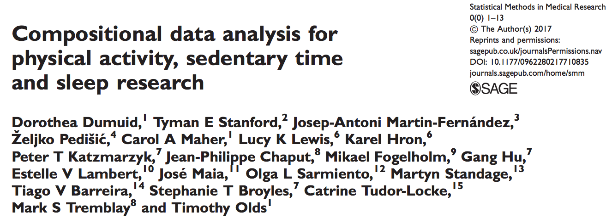
Interpretation
Dumuid et. al. present a formula for back-transforming the coefficient of the first isometric log-ratio coordinate, using a proportional change to the mean composition.
Notes:
I’m not going to go into the details of how this is done, but in this publication they have worked it all through and provide a little formula to transform the coefficient into something meaningful.

Slide 16
Estimates for other components
(sedentary, light, mvpa)
Permute the components and create a set of coordinates for each component
Run a regression model for each set of coordinates
Notes:
To then find estimates for the other behaviours, besides just sleep, we need to permute the variables for the calculation of the isometric log-ratio coordinates and run the regression model for each different set of log-ratio coordinates – there is a set of coordinates for each of the four time-use variables. This is just so that the regression coefficient for the first isometric log-ratio coordinate can be interpreted in terms of that certain behavior - the model is effectively the same, just presented differently.

Slide 17
24 hour time-use in 8 year-olds and BMI z-score (n=574)
Component | Regression coefficient (SE) | P-value | 10% relative difference in minutes | Estimated difference (95% CI) in BMI z-score with a 10% increase in component
Sleep | -0.89 (0.44) | 0.041 | 57 | -0.13 (-0.25, -0.01)
Sedentary | 0.23 (0.32) | 0.480 | 46 | 0.03 (-0.05, 0.11)
Light PA | 1.37 (0.31) | <0.001 | 32 | 0.15 (0.08, 0.21)
MVPA | -0.70 (0.15) | <0.001 | 6.9 | -0.06 (-0.09, -0.03)
Notes:
Here is the result of running four regression models, with four sets of isometric log-ratio coordinates. You can see the regression coefficients from the first isometric log-ratio in the first column there. These numbers don’t mean anything to us in terms of BMI z-score. We can see that two are negative and two are positive, which indicate the direction of the relationship but not how strongly related to BMI z-score they are. Using the method described, we can translate that coefficient in terms of the difference in BMI z-score for a 10% lower allocation in time from all other behaviours to the behavior in question. So, for sleep we can see that for a 10% greater time spent sleep (that is about 57 minutes on average), this is associated with a 0.13 lower BMI z-score. This is a reasonably small effect although certainly not negligible it isn’t too exciting). From this, we can see that the strongest associations are with sleep and light physical activity, where light physical activity was associated with a higher BMI z-score.

Slide 18
Presentation of estimates in minutes compared to proportions
Component | 10% relative difference in minutes | Estimated difference (95% CI) in BMI z-score with a 10% increase in component | Estimated difference (95% CI) in BMI z-score with a 10 minute increase in component
Sleep | 57 | -0.13 (-0.25, -0.01) | -0.02 (-0.05, -0.001)
Sedentary | 46 | 0.03 (-0.05, 0.11) | 0.01 (-0.01, 0.02)
Light PA | 32 | 0.15 (0.08, 0.21) | 0.05 (0.03, 0.07)
MVPA | 6.9 | -0.06 (-0.09, -0.03) | -0.09 (-0.13, -0.05)
Notes:
We’ve used a 10% reallocation here because the distribution of the four time-use variables is uneven, but a set number of minutes has been commonly used to present estimates in previous publications. I’ve done this for the PLAY data here, using a 10 minute reallocation and put that next to the 10% estimates found previously. If we use the 10 minute reallocation you can see that now MVPA looks to be the variable most strongly related to BMI z-score. But this is only because a 10 minutes more MVPA is substantial – much more than a 10% increase, where as it is an insubstantial increase in sleep. This is not a great way to compare which variable is most strongly associated with BMI z-score.

Slide 19
Presentation of estimates for 10% reallocation between components
Component | …to sleep | …to sedentary | …to light PA | …to MVPA
From sleep… |  | 0.11 (-0.03, 0.24) | 0.28 (0.14, 0.42) | -0.30 (-0.50, -0.09)
From sedentary… | -0.08 (-0.19, 0.03) |  | 0.14 (0.04, 0.24) | -0.34 (-0.48, -0.21)
From light PA… | -0.17 (-0.25, -0.09) | -0.11 (-0.18, -0.04) |  | -0.37 (-0.51, -0.23)
From MVPA… | 0.06 (0.02, 0.09) | 0.07 (0.04, 0.10) | 0.09 (0.06, 0.13)
Notes:
While there have only been a few studies present 24-hour time-use data analysed compositionally, these studies have often presented estimates in terms of reallocation of time from one behavior to one other, which is not only unrealistic in real life but can give misleading estimates.

Slide 20
Presentation of estimates for 10% reallocation between components
Component | …to sleep | …to sedentary | …to light PA | …to MVPA
From sleep… |  | 0.11 (-0.03, 0.24) | 0.28 (0.14, 0.42) | -0.30 (-0.50, -0.09)
From sedentary… | -0.08 (-0.19, 0.03) |  | 0.14 (0.04, 0.24) | -0.34 (-0.48, -0.21)
From light PA… | -0.17 (-0.25, -0.09) | -0.11 (-0.18, -0.04) |  | -0.37 (-0.51, -0.23)
From MVPA… | 0.06 (0.02, 0.09) | 0.07 (0.04, 0.10) | 0.09 (0.06, 0.13)
Notes:
Using the PLAY data we see that if we reallocate 10% of sleep time to MVPA this results in a substantial negative association with BMI z-score, leaving the reader to conclude that maybe we should be recommending that children replace sleep with MVPA – which is highly misleading. Similarly, we see that reallocating time from light physical activity to sedentary is also associated with lower BMI z-score, suggesting that we should be recommending children to be more sedentary! These misleading results arise because of the uneven distribution in time for each variable and because of the assumption that reallocating time from one behavior to another is reasonable, and indeed even possible and ignoring the codependence of the behaviours.

Slide 21
In summary
Compositional data should be analysed appropriately: using log-ratios
Presentation of the results from a regression model needs to be appropriate & interpretable:
  use proportion of time reallocated, not minutes,
  report reallocation from one component to all others, not from one component to another.
Notes:
In conclusion…

Slide 22
Acknowledgements
Co-authors:
Professor Rachael Taylor (Principal Investigator)
Dr Kim Meredith-Jones (Accelerometry)
Associate Professor Sheila Williams (Biostatistician)
To the authors of the publications I have drawn on today (see references)
Many thanks to all of the participants and researchers involved in the PLAY study

Slide 23
References
Dumuid, D., Stanford, T. E., Martin-Fernández, J.-A., Pedišić, Ž., Maher, C. A., Lewis, L. K., Karel, H., Katzmarzyk, P. T., Chaput, J.-P., Fogelholm, M., Hu, G., Lambert, E. V., Maia, J., Sarmiento, O. L., Standage, M., Barreira. T. V., Broyles, S. T., Tudor-Locke, C., Tremblay, M. S., & Olds, T. (2017). Compositional data analysis for physical activity, sedentary time and sleep research. Statistical Methods in Medical Research. https://doi.org/10.1177/0962280217710835
Chastain S.F., Palarea-Albaladejo J., Dontje M.L., & Skelton D.A. (2015). Combined effects of time spent in physical activity, sedentary behaviors and sleep on obesity and cardio-metabolic health markers: a novel compositional data analysis approach. PLOS ONE.10:e0139984.
Aitchison, J. A concise guide to compositional data analysis. Laboratório de Estatística e Geoinformação [online], http://www.leg.ufpr.br/lib/exe/fetch.php/pessoais:abtmartins:a_concise_guide_to_compositional_data_analysis.pdf (2003).

