Slide 1
From heaven to hell…
and how to find a way back!
M. Gabriela Borgognone
Senior Biometrician
Dept. Agriculture and Fisheries
Toowoomba, QLD, Australia

Slide 2


The skill comes second nature
Unconscious competence
Able to use the skill but with effort
Conscious competence
Aware of the skill
Not proficient yet
Conscious incompetence
Unaware of both
- the skill
- lack of proficiency
Unconscious incompetence

Slide 3

Unconscious competence
Plant breeders…
Comfortable working with statisticians
Know about experimental design
Design their own replicated field trials
Understand the statistical analyses
Leave complex designs and all data analysis to the statistician
Keen to adopt new methodology
Conscious competence
Conscious incompetence
Researchers
who value
having a statistician in their team.
Unconscious incompetence

Slide 4

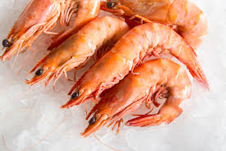
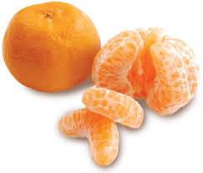

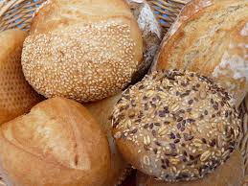
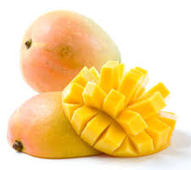
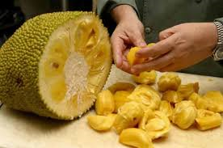
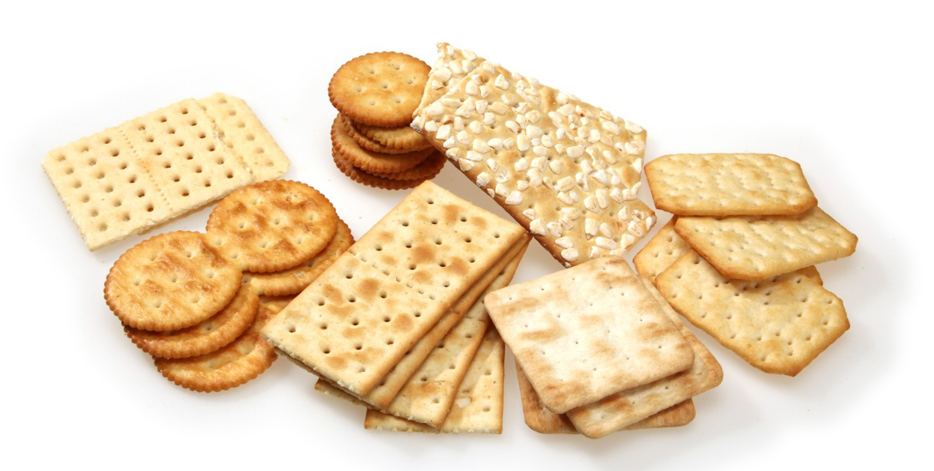
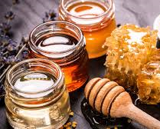
Less than 3 years ago…
Sensory studies
Food Chemistry
Shelf life studies
Consumer studies
Food Science group
Food Microbiology
Product development

Slide 5



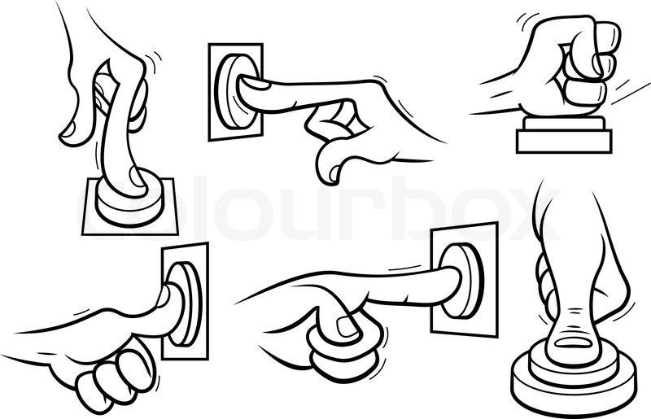

Statisticians design experiments that are “too expensive”
Statisticians just analyse data (and give you the p-value)
Statistician needed if the final goal is to publish a paper
Pilot studies / proof-of-concept are not “the real study” →
Left to their own devices for too long
Relying mainly on:
Published papers
Statistical software courses
Own past experience
Fear of variability
Try to avoid it at all costs
Some statistics workshops??

Slide 6

Statisticians design experiments that are “too expensive”
Statisticians do data analysis (and give you the p-value)
Statistician needed if the final goal is to publish a paper
Pilot studies / proof-of-concept are not “the real study” →
Left to their own devices for too long
Relying mainly on:
Published papers
Statistical software courses
Fear of variability
Try to avoid it at all costs
Some statistics workshops??

Slide 7


Slide 8

My own awareness!!!!

Slide 9

Workshop:
importance of PLANNING research studies
Unconscious competence
Scientific method
Definition of Cause & effect
Conscious competence
Descriptive ≠ Inferential statistics
Defining objectives and research questions
Experiments vs Observational studies
Design of Experiments:
Conscious incompetence
- Randomisation, replication, local control
- Experimental unit & observational unit
- Replication & pseudo-replication
- Treatments:
Must help answer the research question
Need a control treatment?
Unconscious incompetence

Slide 10
Workshop:
importance of PLANNING research studies
Unconscious competence
Scientific method
Definition of Cause & effect
Conscious competence
Descriptive ≠ Inferential statistics
Relevant: their own data, examples, problems
Interactive
Mixed people up all the time
Role play
Defining objectives and research questions
Experiments vs Observational studies
Design of Experiments:
Conscious incompetence
- Randomisation, replication, local control
- Experimental unit & observational unit
- Replication & pseudo-replication
- Treatments:
Must help answer the research question
Need a control treatment?
Unconscious incompetence

Slide 11





“Until we get skilled at this, we could perhaps run the experimental designs by you”
Improved:
Empowered
Lab
Technicians
Expensive macadamia shelf-life experiment
From no reps to 3 reps – no additional costs
Fish pilot study (analysis methodology):
Experiment had no replicates – fear of variability
From no reps to 4 reps
Same demand on time, money and samples to analyse
Peer pressure
Project involvement

Slide 12


Requests for further training:
Unconscious competence
- Understand ANOVA: assumptions, how to read the table, hypotheses, how to present means and LSDs – conclusions
Conscious competence
- How to determine sample size / number of replicates
Examples from beginning to end
Conscious incompetence
Types of variables & scales of measurement
Summary statistics
Understanding variability
Data management
Unconscious incompetence

Slide 13
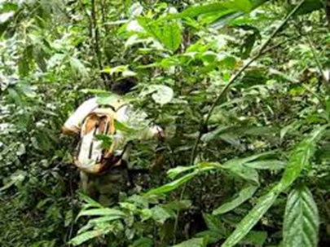






Slide 14



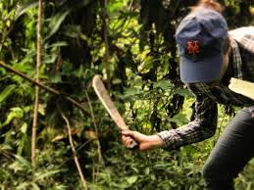
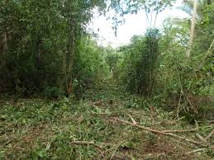

Slide 15

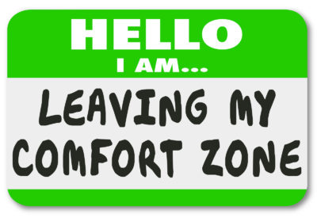
Unconscious competence
Conscious competence
Conscious incompetence
Unconscious incompetence

