Slide 1
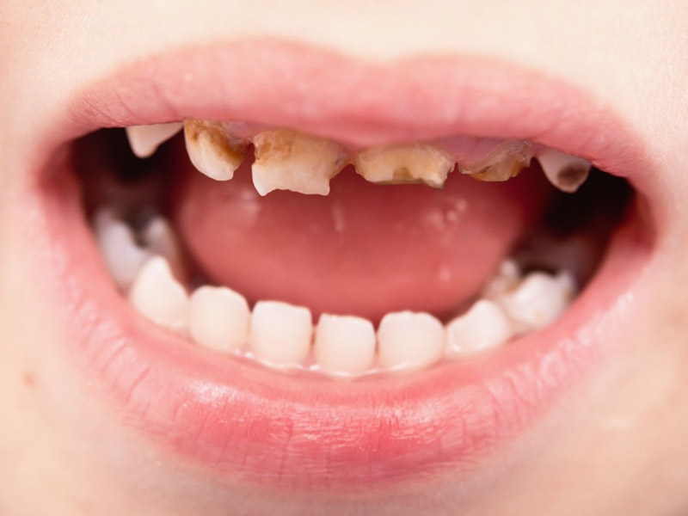
Early Childhood Dental Decay
Sarah Sonal
Masters Student
University of Canterbury
Notes:
Good Morning everyone!
My name is Sarah and I am a part 2 masters student at the University of Canterbury
My presentation today will be focused on my current masters thesis topic: Dental Decay in early childhood.

Slide 2
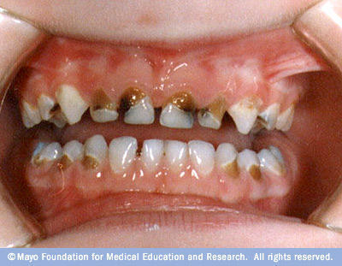
The Problem: Childhood dental decay
Inefficient treatment ➔ Extraction of tooth
Extraction ➔ Crowding, tooth migration, early eruption, speech issues
Associated with malnutrition and increased weight
Higher rates of caries in later life
When not treated in a timely manner can lead to:
  Chronic infections and absesses
  Pain
  Sleeping issues
Number one chronic health issue in paediatrics³
Notes:
So to begin: why are dental caries, or dental decay an issue in preschool age Children? They have their milk teeth that will be replaced by adult teeth later on, so why does it matter if their primary teeth have a few caries? Well caries when not treated efficiently can lead to a tooth extraction.
Premature extraction of primary teeth can result in crowding, teeth migration, early eruption of permanent teeth and potential
speech issues
Early childhood caries have also been associated with:
Malnutrition
Childhood obesity
Higher rates of caries in adulthood
And when they are not treated fast enough they can lead to chronic infections, abscesses, pain and sleeping issues
The California dental association considers tooth caries as the number one chronic health issue in early childhood
Oral Health is a key area of development for the World Health Organisation
Oral disease affects approximately half the worlds population and are predominantly preventable or treatable in the early disease stages[7].
School age children and youth are one of the key target groups for WHO oral health intervention[8].
Decayed, Filled or Missing Teeth (DFMT) are increasing in developing nations, decreasing in developed nations and
overall are slowly decreasing[9, 10, 11].
Although they are decreasing in prevalence internationally, oral diseases are still considered the most common chronic illness
for children, especially for the disadvantaged[11, 12, 13].
Paediatric dental diseases in wealthy nations disproportionately affects the marginalised.
Those in disadvantaged groups have higher rates of dental caries,
more missing teeth and are more likely to have unmet treatment needs[11, 14].
Children who come from higher income families or parents with higher education
levels have lower rates of dental diseases[11, 14].

Slide 3
Current National Statistics:
For 0-14 year olds (2015/16 NZ Health Survey):
  Maori children were more likely to have extractions than non-Maori (OR=1.39)
  Pacific Children were more likely to have extractions than non-pacific (OR=1.63)
  Children from deprived neighbourhoods' were more likely to have extractions (OR=2.55)
  Girls from deprived neighbourhoods were more likely to have extractions (OR=3.54)
Notes:
SO what are the current stats showing us?
From the 2015/16 NZ health survey there are certain children that have been identified at being a higher risk of having dental extractions.
These include:
Maori and Pacific children are at a higher risk. This held when split by gender.
Deprivation does appear to be making quite an impact too, especially for girls.
For questions if needed:
Maori and pacific controlled for age and sex
Deprivation controlled for age sex and ethnic group

Slide 4
This study:
Research question: Does early dental neglect increase dental issues in later childhood?
Aims:
1. establishing if routinely collected dental appointment records can predict dental issues at age 5
2. Are machine learning techniques better at modeling large health data over traditional modeling techniques
Primary outcome: count of decayed, missing or filled teeth
Datasets:
1. Community Dental Services clinical records
2. Hospital admission data for extracted patients
3. Deprivation data from the New Zealand Index of Multiple Deprivation
Notes:
Data includes:
Ethnicity
Last known address (for deprivation score estimates)
Appointment attendance
Gender
etc

Slide 5
Methods:
Study design: retrospective observational study
Setting: Christchurch, New Zealand
Participants:
  Age 5 years between 2014-2017
  Excluded if moved out of region before age 5
  Excluded when no known dental history
Independent variables of interest:
  Appointment attendance
  Deprivation
  Ethnicity
  Sex
  Born in Canterbury region
  Co-morbidities or hospital admissions within CDHB area
Notes:
Study Design
The study design was a retrospective observational study. The data was collected
over four years, with selection dates of 1st January 2014 to 31st December 2017.
Each year of data was equivalent to approximately 6,000 Canterbury five year old’s.
The final data-set size was 21,236 patients, representing 5,233 in 2014, 5,269 in 2015,
5,391 in 2016 and 5,343 in 2017.
Setting
The study was based in Christchurch, New Zealand. The data analysis was con-
ducted at the University of Canterbury on one of the secure statistics research
Servers
Participants
Participants were children based in the Canterbury and South Canterbury regions.
The participants were selected based on reaching age five in
a particular given year. This age was selected because at age five children begin
school and begin receiving dental treatments during school hours. Before age five,
children are booked into appointments at local Community Dental treatment cen-
tres, requiring parents or caregivers to bring children to their appointments
Participants were excluded if they moved out of the region before school age and if they had
No known dental history because they had recently moved into the region

Slide 6
Data joining and cleansing:
Dental records extracted for all patients who turned age 5 between 1st January 2014 and 31st December 2017
Deprivation data extracted for each patient based on last known address (ArcGIS for address geocoding and data joining)
Hospital admissions to Christchurch Public Hospital extracted for each patient
Missing data:
  1. ethnicity not coded for 770 patients, changed to “unknown”
  2. decile missing for 1739 patients, variable removed
  3. address data missing for 78 patients (0.37% of total dataset)

Slide 7
Analysis:
Exploratory data analysis
  Highly correlated variables and multiple collinearity found
  Variables identified as appropriate to remove
  Zero inflated outcome variable
Traditional techniques
  Poisson -> negative binomial -> zero-inflated negative binomial
  Ensemble model required due to high dimensional data
Machine learning
  Support Vector Machine vs tree methods
  Random Forest (regression)
Notes:
This can be an issue as model coefficient estimates
can have high variation between samples of data, with small differences in input
data leading to large differences in the model[25]. Overfitting of the model is highly
likely with multicollinearity[25]. Using the findCorrelation function within the R[26]
carat package[27], variables with multicollinearity were identified and removed from
the dataset during model tuning and compared to previous models. Two levels of
correlation were used, Pearson’s r of 0.9 and above followed by Pearson’s r 0.7 and
above
Poisson: did not converge
Negative binomial: modeled but high RMSE
Zero-inflated model: lowered RMSE and significant improvement over negative binomial (Voung test)
A zero-inflated negative binomial model is a mixture model containing the over-dispersed
Poisson (the negative binomial) and a logit component to model the excess zeros[30].
SVM: higher RMSE than random forest
Random forest: faster to build than SVM

Slide 8
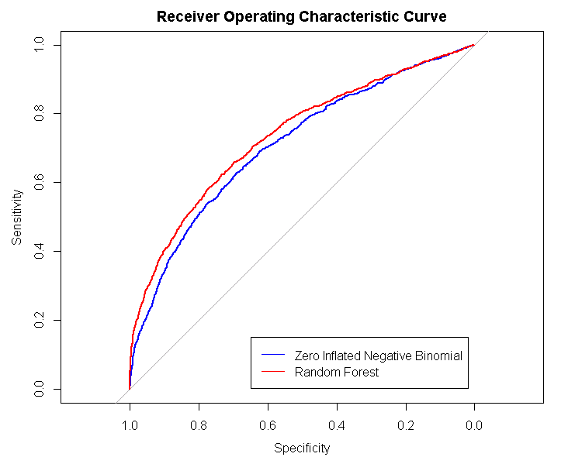
Results:
Routinely collected data can be used to predict dental issues at age 5 years
Key variables identified
Machine learning technique: Random Forest
  Lower RMSE than standard model
  Higher sensitivity (0.175 vs 0.093)
  Slightly lower specificity (0.937 vs 0.965)
Notes:
Just under 30% of the variation in decayed missing or filled teeth can be explaned by the variables in the routinely collected data
Good result as known to be other contributing factors not in this data eg diet, daily dental hygiene habits, parental factors
Top variables:
delay from referral to community dental and appointment
(exam.delay),
ethnicity (ethnic7),
elective admissions to hospital (elective),
Number of did not attend appointments (ndna),
number of dental exams (nexam),
Decile rank for education (edurankd),
decile rank for housing (hourankd),
decile rank for crime (crirankd),
decile rank for health (hlthrankd)
and decile rank for access (accrankd).
sex
Total days admitted to hospital
The line indicating the random forest model is on the outside of the zero-inflated negative
binomial model for the majority of the length, which indicates that it is performing
better for sensitivity and specificity generally. At the top of the curve, these two
lines appear to be sitting on top of each other, indicating no difference in sensitivity
and specificity. Overall the plot indicates that the random forest performs better
for sensitivity and specificity

Slide 9
Implications:
Machine learning should be used in the medical field as datasets increase in size, particularly supervised learning
Routinely collected dental data can be used along side patient survey data to predict dental outcomes at age 5
Future models could be updated regularly and used to predict appointment length to ensure resources are utilized efficiently
Notes:
The random forest model could be used in the future by Community Dental
Services Canterbury to identify children who are most as risk of oral health issues,
in conjunction with other data sources such as patient survey information. The
model can be updated with the latest data available. This information could be
used by Community Dental Service Canterbury to direct resources to ensure that
children are attending their appointments before they get to school age, to help
prevent severe ECC. This modelling technique also has the potential to predict the
severity of dental issues before the child attends an appointment, which could be
extended in length if severe ECC are expected

Slide 10
References:
1. Hayden, C., Bowler, J.O., Chambers, S., Freeman, R., Humphris, G., Richards, D., Cecil, J.E.: Obesity and dental caries in children: a systematic review and meta-analysis. Community Dentistry and Oral Epidemiology 41, 289–308 (2013). doi:10.1177/0009922811410876
2. Torriani, D.D., Ferro, R.L., Bonow, M.L.M., Santos, I.S., Matijasevich, A., Barros, A.J., Demarco, F.F., Peres, K.G.: Dental caries is associated with dental fear in childhood: Findings from a birth cohort study. Caries research 48 (4), 263–70 (2014). Copyright - Copyright (c) 2014 S. Karger AG, Basel; Last updated - 2014-09-09; CODEN - CAREBK
3. de Souza Barbosa, T., Gavião, M.B.D., Castelo, P.M., Leme, M.S.: Factors associated with oral health-related quality of life in children and preadolescents: A cross-sectional study. Oral health preventive dentistry 14 (2), 137–48 (2016). doi:10.3290/j.ohpd.a35301
4. Goettems, M.L., Shqair, A.Q., Bergmann, V.F., Cadermatori, M.G., Correa, M.B., Demarco, F.F.: Oral health self-perception, dental caries, and pain: the role of dental fear underlying this association. International Journal of Paediatric Dentistry 28 (3), 319–325 (2018). doi:10.1111/ipd.12359
5. Jordan, A.R., Becker, N., Jöhren, H.P., Zimmer, S.: Early childhood caries and caries experience in permanent dentition: A 15-year cohort study. Swiss Dental Journal 126 (2), 114–119 (2016)
6. California Society of Pediatric Dentistry: The consequences of untreated dental disease in children. https://www.cda.org/Portals/0/pdfs/untreated_disease.pdf/ Accessed 2018-01-01
7. World Health Organisation: Oral Health. [Accessed Oct. 28, 2018] (2018). http://www.who.int/news-room/fact-sheets/detail/oral-health
8. World Health Organisation: Oral health important target groups. [Accessed Oct. 28, 2018]. http://www.who.int/oral_health/action/groups/en/
9. World Health Organisation: World oral health report 2003: continuous improvement of oral health in the 21st century – the approach of thewho global oral health programme (2003)
10. Petersen, P.E., Bourgeois, D., Ogawa, H., Estupinan-Day, S., Ndiaye, C.: The global burden of oral diseases and risks to oral health. World Health Organization.Bulletin of the World Health Organization 83 (9), 661–9 (2005). Copyright - Copyright World Health Organization Sep 2005; Last updated - 2017-10-27; CODEN - BWHOA6
11. World Health Organisation: Equity, Social Determinants and Public Health Programmes. World Health Organisation, Geneva (2010). ISBN 978 92 4 156397 0
12. Mouradian, W.E., Wehr, E., Crall, J.J.: Disparities in children’s oral health and access to dental care. Journal of the American Medical Association 284 (20), 2625–2631 (2000). doi:10.1001/jama.284.20.2625. /data/journals/jama/4761/jsc00218.pdf
13. Mouradian, W.E., Huebner, C.E., Ramos-Gomez, F., Slavkin, H.C.: Beyond access: The role of family and community in children’s oral health. Journal of Dental Education 71 (5), 619–631 (2007)
14. Tickle, M.: The 80:20 phenomenon: help or hindrance to planning caries prevention programmes? Community Dental Health 19 (1), 39–42 (2002)
15. Ministry of Health: Annual data explorer 2016/17, New Zealand health survey (2017). https://minhealthnz.shinyapps.io/nz-health-survey-2016-17-annual-update/ Accessed 2018-30-01
16. Silva, P.A., Stanton, W.R.: From Child to Adult: The Dunedin Multidisciplinary Health and Development Study. Oxford University Press., Auckland (1996)
17. Thomson, W.M., Poulton, R., Milne, B.J., Caspi, A., Broughton, J.R., Ayers, K.M.S.: Socioeconomic inequalities in oral health in childhood and adulthood in a birth cohort. Community Dentistry and Oral Epidemiology 32 (5), 345–353 (2004). doi:10.1111/j.1600-0528.2004.00173.x
18. Petcu, A., Balan, A., Haba, D., Stefanache, A.M.M., Savin, C.: Implications of premature loss of primary molars. Pediatric dentistry 6 (2), 130–134 (2016)
19. Gray, D.J.: Preservation of the teeth indispensable to comfort and appearance, health and longevity, being a new edition of dental practice. Richard and John E. Taylor. [Accessed on 2018-03-13] (1842)
20. Ministry of Health: Publicly funded dental care (2017). https://www.health.govt.nz/your-health/services-and-support/health-care-services/visiting-dentist/publicly-funded-dental-care

Slide 11
References:
21. Canterbury District Health Board: Community Dental Service (2017). http://www.cdhb.health.nz/Hospitals-Services/Community-Rural-Health-Services/Community-Dental/Pages/default.aspx
22. Exeter, D.J., Zhao, J., Crengle, S., Lee, A., Browne, M.: The New Zealand indices of multiple deprivation (IMD): a new suite of indicators for social and health research in Aotearoa, New Zealand (in press) (2017). https://www.fmhs.auckland.ac.nz/en/soph/about/our-departments/epidemiology-and-biostatistics/research/hgd/research-themes/imd.html
23. Atkinson, J., Salmond, C., Crampton, P.: Nzdep2013 index of deprivation (2014)
24. Smith, B.J.: Understanding pre-school children’s Community Dental Service appointment failure: a mixed-methods study (2016).
25. Alin, A.: Multicollinearity. WIREs Computational Statistics 2, 370–374 (2010)
26. R Core Team: R: A Language and Environment for Statistical Computing. R Foundation for Statistical Computing, Vienna, Austria (2015). R Foundation for Statistical Computing. http://www.R-project.org/
27. from Jed Wing, M.K.C., Weston, S., Williams, A., Keefer, C., Engelhardt, A., Cooper, T., Mayer, Z., Kenkel, B., the R Core Team, Benesty, M., Lescarbeau, R., Ziem, A., Scrucca, L., Tang, Y., Candan, C., Hunt., T.: Caret: Classification and Regression Training. (2017). R package version 6.0-78. https://CRAN.R-project.org/package=caret
28. Hilbe, J.M.: Modeling count data. Cambridge University Press (2014). https://books.google.co.nz/books?id=aZLfAwAAQBAJprintsec=frontcoversource=gbsgesummaryrcad=0v=onepageqf=false
29. Chin, H.C., Quddus, M.A.: Modeling count data with excess zeroes: An empirical application to traffic accidents. Sociological Methods & Research 32 (1), 90–116 (2003). doi:10.1177/0049124103253459. https://doi.org/10.1177/0049124103253459
30. NCSS: Zero-inflated negative binomial regression. https://ncss-wpengine.netdna-ssl.com/wpcontent/themes/ncss/pdf/Procedures/NCSS/ZeroInflatedNegativeBinomialRegression.pdf
31. Venables, W.N., Ripley, B.D.: Modern Applied Statistics with S, 4th edn. Springer, New York (2002). ISBN 0-387-95457-0. http://www.stats.ox.ac.uk/pub/MASS4
32. Hamner, B., Frasco, M.: Metrics: Evaluation Metrics for Machine Learning. (2017). R package version 0.1.3. https://CRAN.R-project.org/package=Metrics
33. Vuong, Q.H.: Likelihood ratio tests for model selection and non-nested hypotheses. Econometrica 57 (2), 307–333 (1989)
34. Meyer, D., Dimitriadou, E., Hornik, K., Weingessel, A., Leisch, F.: E1071: Miscellaneous Functions of the Department of Statistics (e1071), TU Wien. (2014). R package version 1.6-4. http://CRAN.R-project.org/package=e1071
35. Liaw, A., Wiener, M.: Classification and regression by randomforest. R News 2 (3), 18–22 (2002)
36. James, G., Witten, D., Hastie, T., Tibshirani, R.: An introduction to statistical learning. Springer (2017). doi:10.1007/978-1-4614-7138-7.
37. Probst, P., Wright, M., Boulesteixr, A.-L.: Hyperparameters and tuning strategies for random forest (2018). https://arxiv.org/pdf/1804.03515.pdf
38. Breiman, L., Cutler, A.: Breiman and Cutler’s random forests for classification and regression (2018). https://cran.r-project.org/web/packages/randomForest/randomForest.pdf
39. Liaw, A., Wiener, M.: Classification and regression by randomforest. R News 2 (3), 18–22 (2002)
40. Parikh, R., Mathai, A., Parikh, S., Sekhar, G.C., Thomas, R.: Understanding and using sensitivity, specificity and predictive values. Indian Journal of Ophthalmology 56 (1), 45–50 (2008)
41. Lalkhen, A.G., McCluskey, A.: Clinical tests: sensitivity and specificity. Continuing Education in Anaesthesia Critical Care and Pain 8 (6), 221–223 (2008). doi:10.1093/bjaceaccp/mkn041
42. Wickham, H.: Reshaping data with the reshape package. Journal of Statistical Software 21 (12), 1–20 (2007)

Slide 12
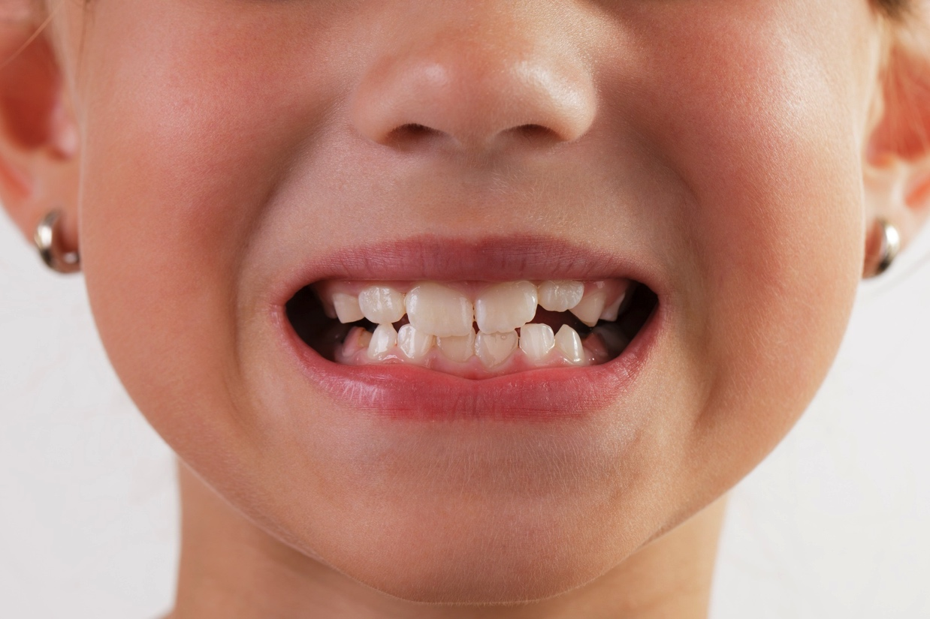
Comments? Questions?

