Slide 1


Predicting nodal metastasis among oral cancer patients
Ari Samaranayaka¹, R K De Silva²,
B S M S Siriwardena³, W A M U L Abesinghe³,
W M Tilakaratne³
1 Biostatistics Unit, University of Otago
2 Dept of Oral Diagnostic & Surgical Sciences, University of Otago
3 Dept of Oral Pathology, University of Peradeniya, Sri Lanka

Slide 2

Why?
Oral squamous cell carcinoma (OSCC) is prevalent, especially in Asia.
Survival reduced to 50% if lymph nodes metastases are present.
Gold standard treatment is surgically removal of nodal metastases, with/without followup radiotherapy.
Difficult to diagnose who has nodal metastases. Advanced scanning (CT/MRI/PET) is useful, but not good for very small tumours. Also not possible in developing countries.
About 70% of surgeries are done unnecessarily (without nodal metastases), creating severe unnecessarily side effects and costs.
Predictive models recommended to identify patients for surgery.
Models from different aetiological backgrounds are not generalizable. Metastases related to health habits. To smoking, alcohol, and HPV in Europe, to chewing of tobacco, betel, and areca in South Asian countries.
Notes:
Presence of metastases is related to health habits: To smoking, alcohol, and HPV in Europe, to chewing of tobacco, betel, and areca in South Asian countries. Therefore models from different aetiological backgrounds are not generalizable for biological reasons.
Unlike developed countries, advanced scanning is not a commonly used diagnostic tool in developing countries. Therefore data available in clinical settings are different.
Also advanced scanning commonly miss metastases smaller in size.

Slide 3
Aim
To produce a model to predict nodal metastases among patients in South Asian countries, using data easily available in clinical settings.

Slide 4
Method
Reviewed patient’s records and histological specimens at Dept of Pathology, University of Peradeniya (only head and neck pathology centre in Sri Lanka), included all patients underwent neck surgery for metastases 1998-2015. Excluded recurrent tumours, and multiple intraoral sites.
Data collected:
  Demographic: Sex, age,
  Clinical:
  Lymph node metastases (yes/no).
  Primary cancer site (tongue, buccal mucosa),
  Tstage (T1, T2, T3, T4),
  DOI= Depth of Invasion (mm),
  POI= Pattern of Invasion (i, ii, iii, iv),
Notes:
TNM staging: T=size of tumour, N=Lymph nodes, M=metastases.
Tstage is the size dimension in TNM staging (size & spread to neighboring tissue)
POI classify the arrangement of tumour cells at the advancing front:
Type1: = Large cohesive tumour islands.
Type II =small islands,
Type III= thin strands.
Type IV= individual tumour cells
DOI measurement was problematic.

Slide 5
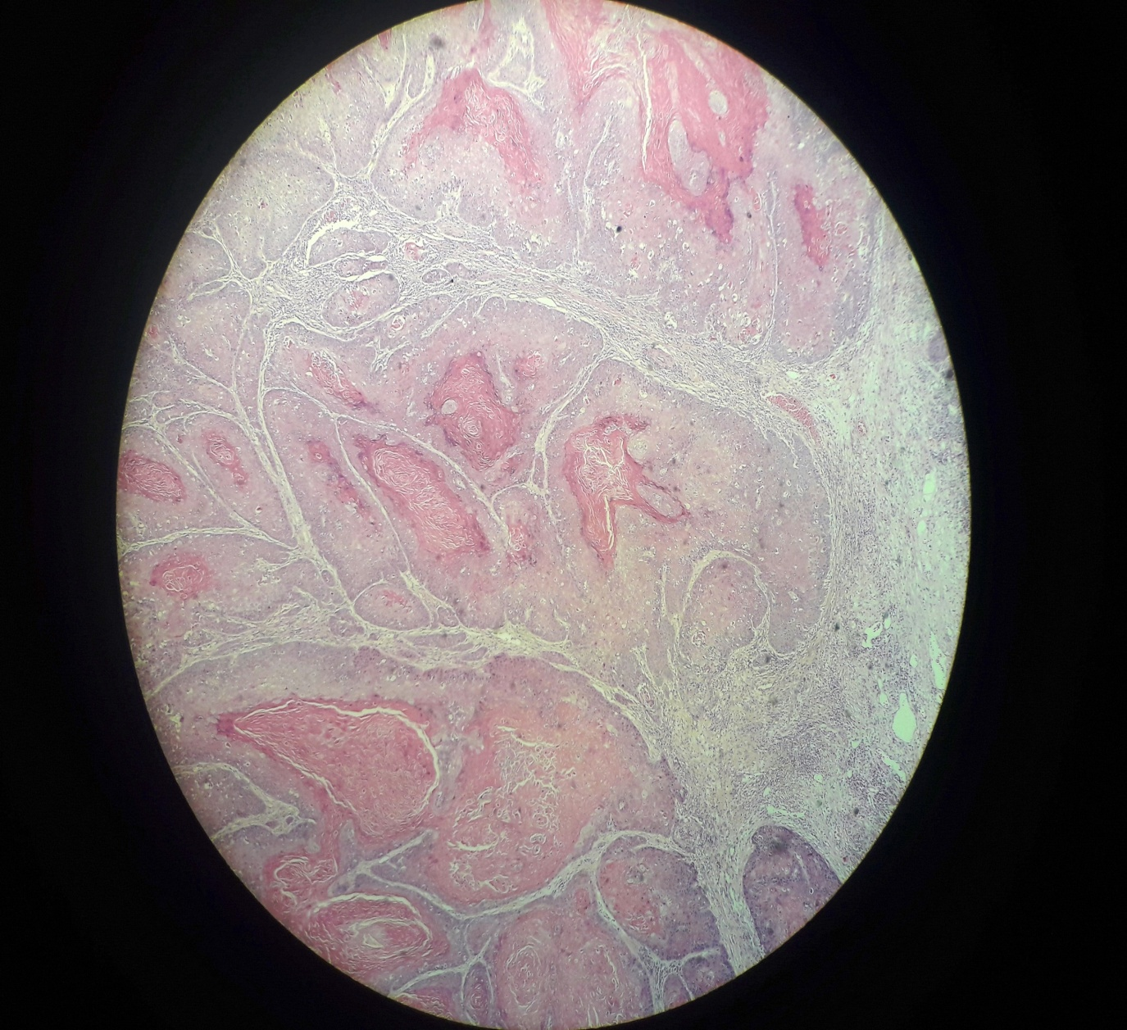
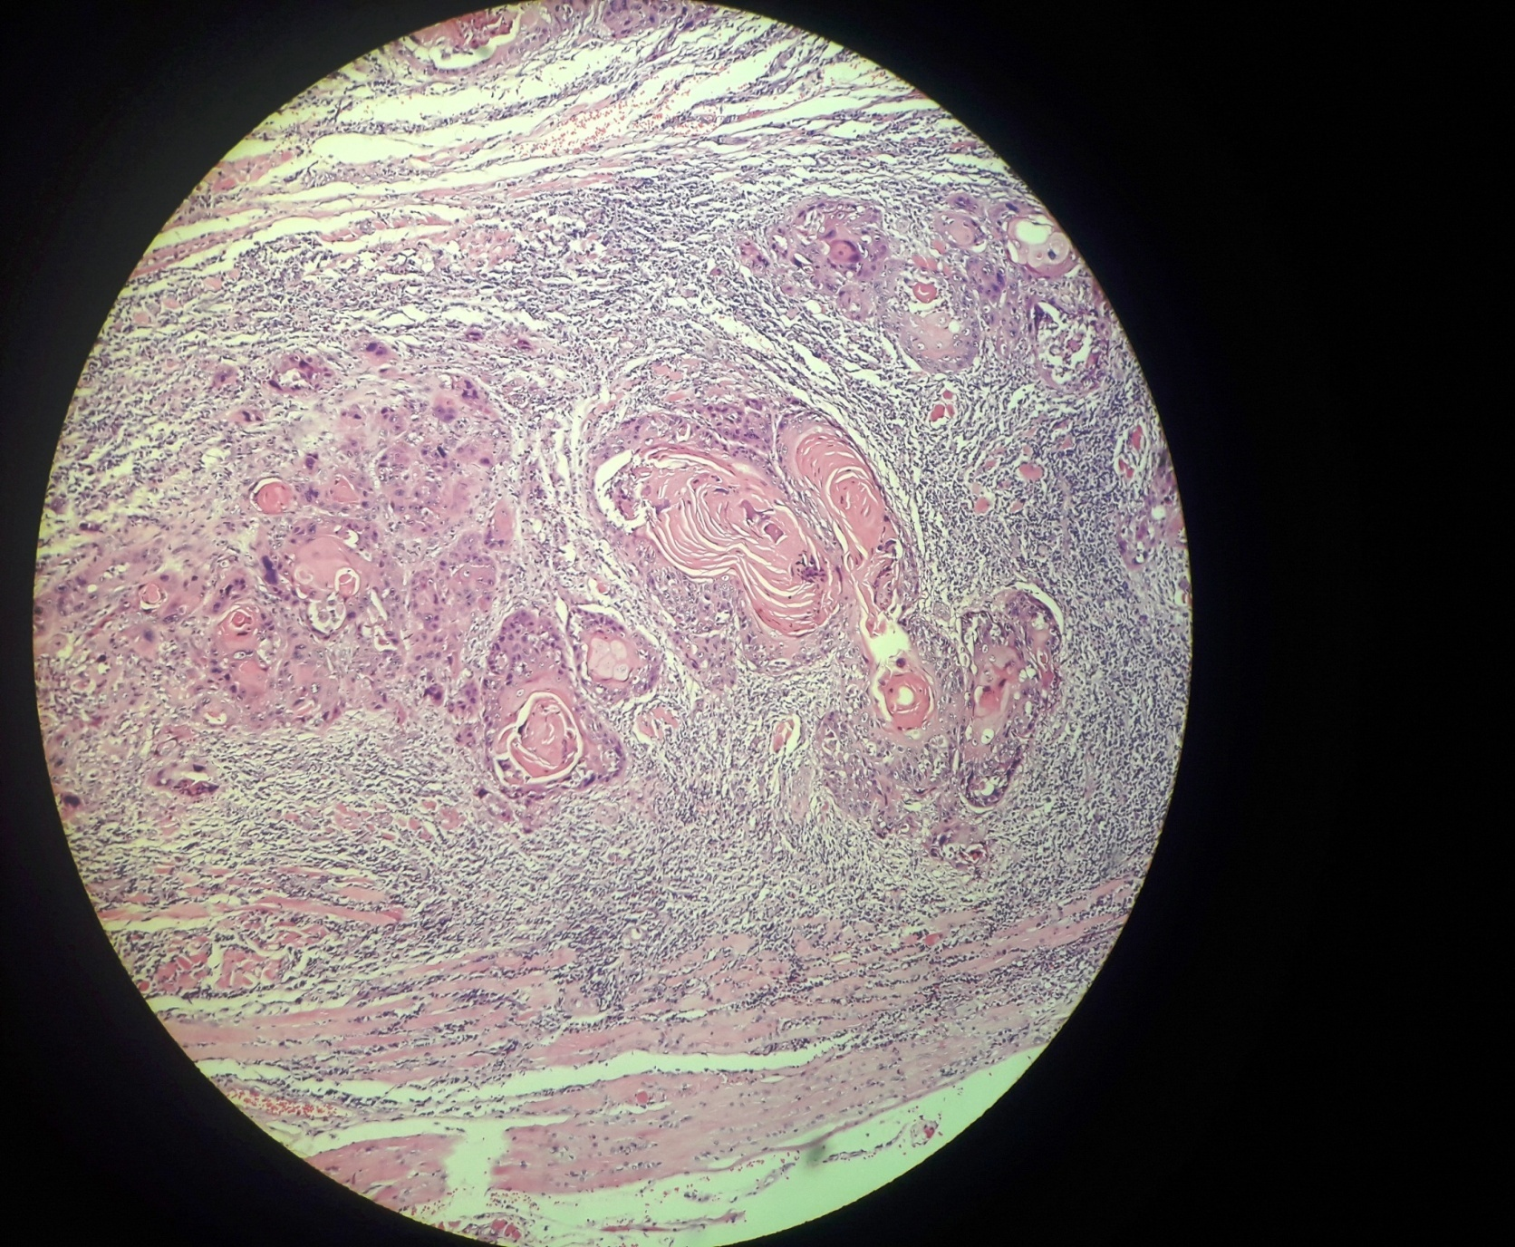
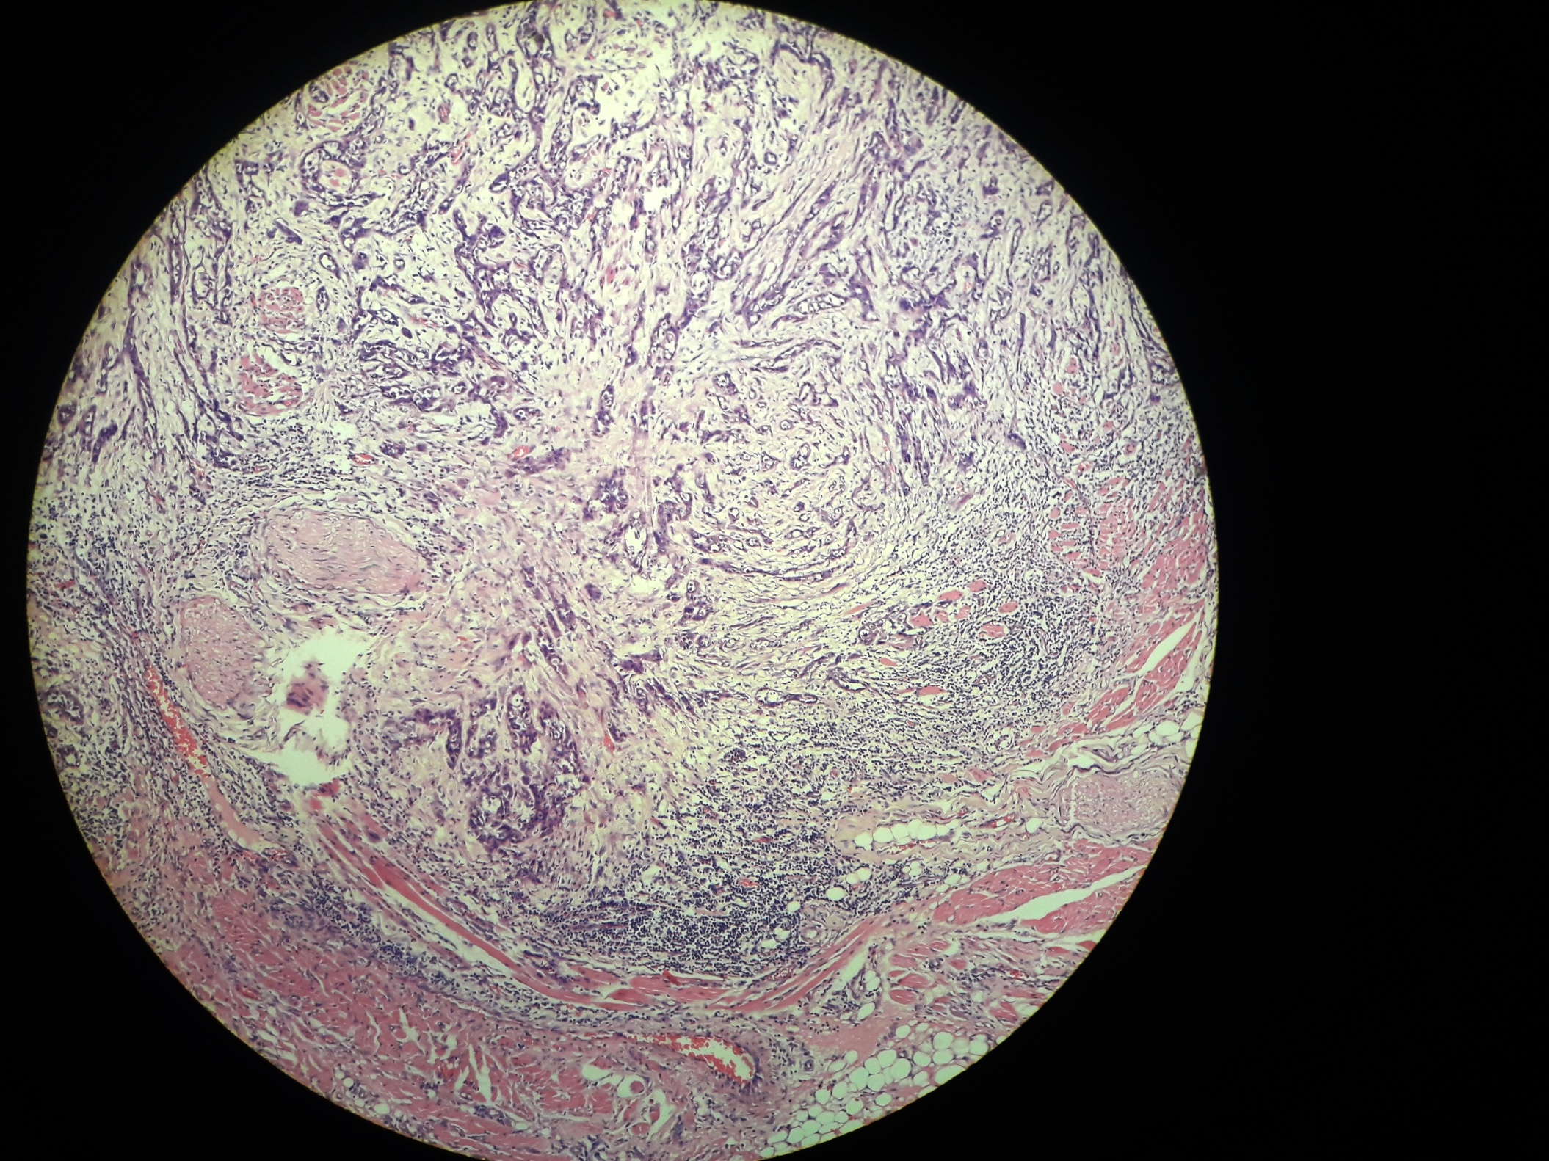
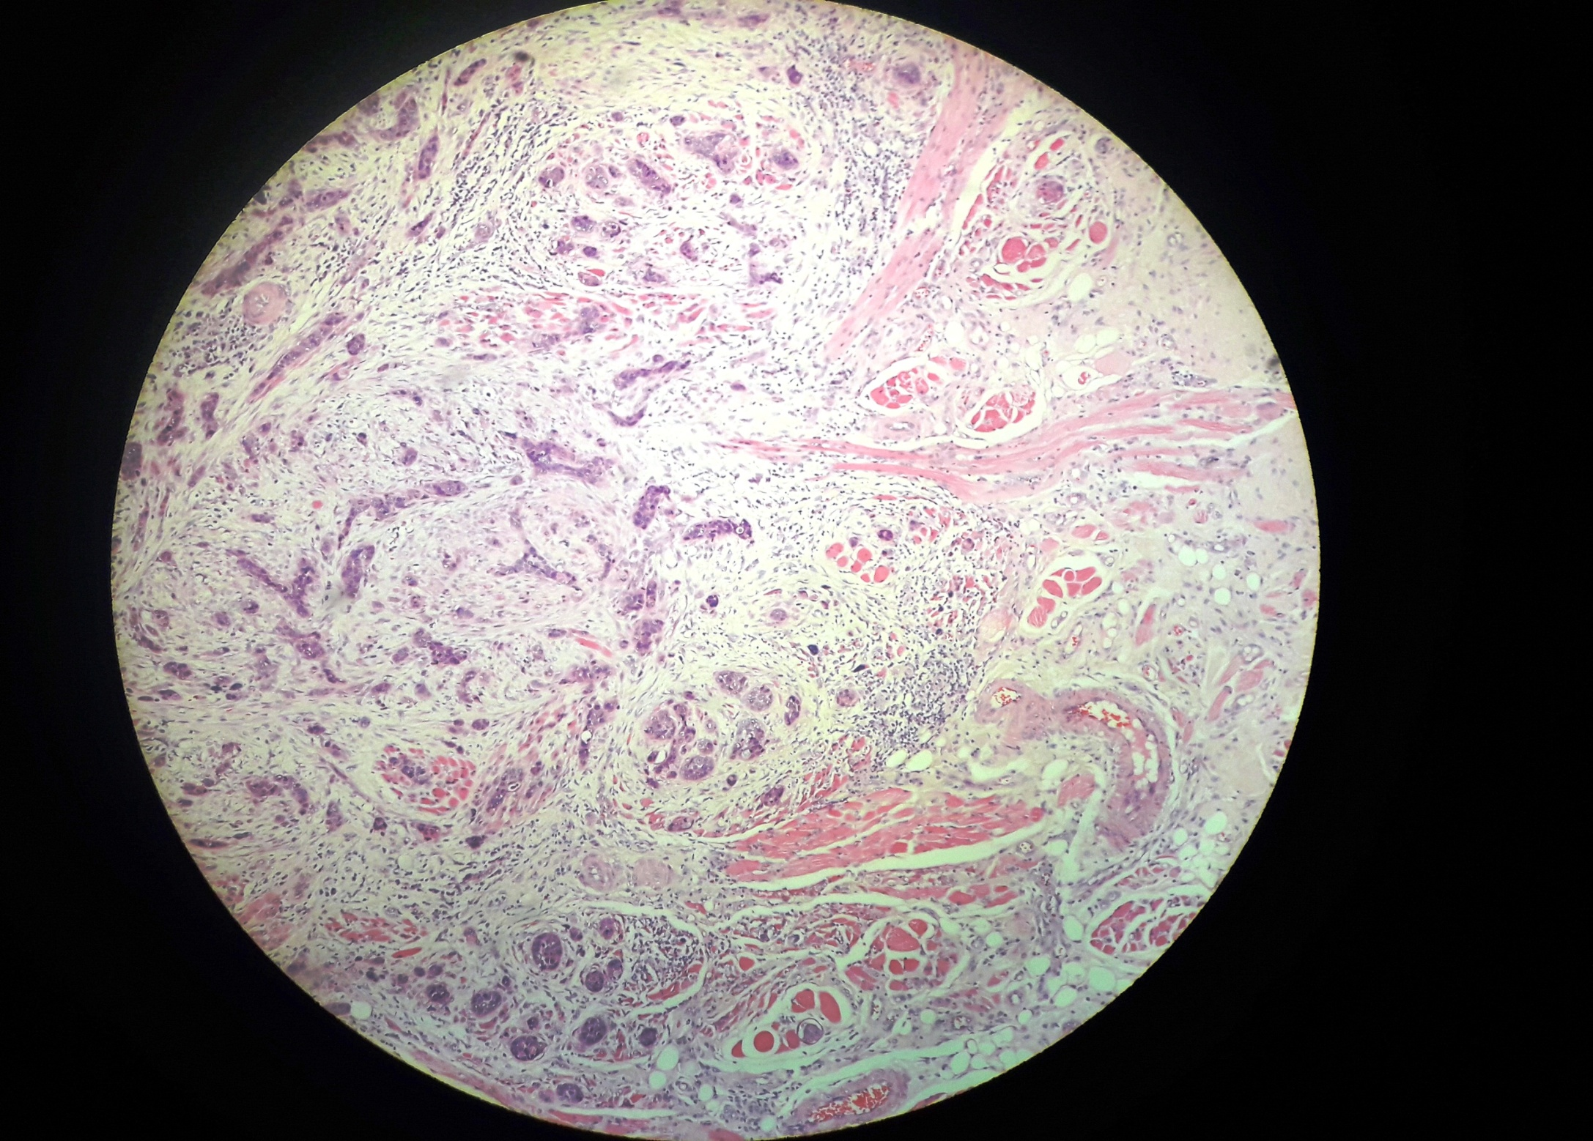
Pattern of Invasion (POI):
POI classify the arrangement of tumour cells at the advancing front:
Type I = Large cohesive tumour islands. Type II =small islands,
Type III= thin strands. Type IV= individual tumour cells.
Type I
Type II
Type III
Type IV

Slide 6
Analysis
Logistic regression modelling to identify predictors of metastases
Ranked combinations of predictors by the corresponding predicted prob of metastases
Produced sensitivity/specificity plot

Slide 7
Descriptive results
Characteristic | Metastases absent, N=434 (69.7%) | metastases present, N=189(30.3%)
Age
40 or below | 18(64) | 10(36)
41 or more | 415(70) | 178(30)
missing | 1(50) | 1(50)
Sex
female | 106(71) | 44(29)
male | 328(69) | 145(31)
Cancer site
BM | 239(76) | 74(24)
Tongue | 195(63) | 115(37)
Pattern of invasion( POI)
I | 1(100) | 0(0)
II | 92(88) | 12(12)
III | 176(78) | 49(22)
Iv | 164(56) | 128(44)
missing | 1(100) | 0(0)
Notes:
70% surgeries were unnecessary.
Complete case analysis dropped 8 cases. Single case in POI=1 also dropped. (dropped <1.5%).

Slide 8
Descriptive results contd
Characteristic | Metastases absent, N=434 (69.7%) | metastases present, N=189(30.3%)
Tstage
T1 | 63(93) | 5(7)
T2 | 160(82) | 36(18)
T3 | 99(60) | 65(40)
T4 | 112(58) | 81(42)
missing | 0(0) | 2(100)
Depth (DOI)
1 to <2mm | 38(76) | 12(24)
2 to <3mm | 59(80) | 15(20)
3 to <4mm | 64(86) | 10(14)
4 to <5mm | 39(75) | 13(25)
5+mm | 233(63) | 135(37)
missing | 1(20) | 4(80)

Slide 9
Nodal metastases risk charts
Notes:
Cutoffs:
Low= Prob < 0.10
Minor= Prob 0.10 to 0.17
Moderate = Prob 0.18 to 0.24
High = Prob 0.25 to 0.34
Severe = Prob 0.35+

Slide 10
Nodal metastases risk charts
Notes:
Cutoffs:
Low= Prob < 0.10
Minor= Prob 0.10 to 0.17
Moderate = Prob 0.18 to 0.24
High = Prob 0.25 to 0.34
Severe = Prob 0.35+

Slide 11
Nodal metastases risk charts
Notes:
Cutoffs:
Low= Prob < 0.10
Minor= Prob 0.10 to 0.17
Moderate = Prob 0.18 to 0.24
High = Prob 0.25 to 0.34
Severe = Prob 0.35+

Slide 12
ROC curve & Sensitivity/specificity plot
Notes:
Eg: Sensitivity will be about 80% even if select a probability cutoff corresponds to 50% specificity.

Slide 13
ROC curve & Sensitivity/specificity plot
Notes:
If select the 0.25 probability of having metastasis as the cutoff probability for selecting neck dissections (ie, combinations of clinical parameters marked in pink or red in risk chart), figure reports corresponding sensitivity and specificity as about 83% and 63% respectively.

Slide 14
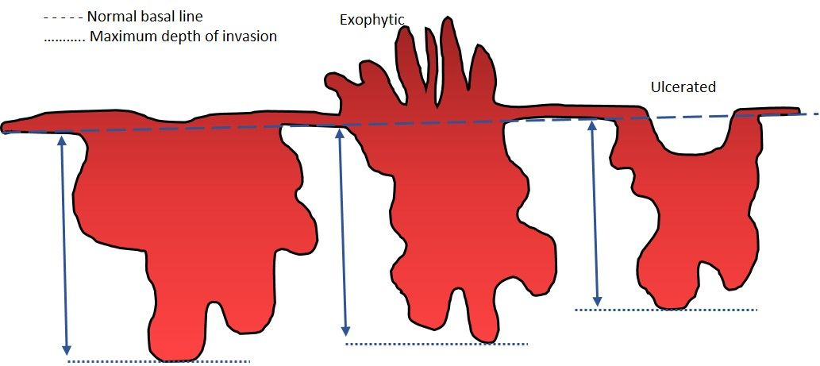
Measuring Depth:
Depth of invasion is from normal baseline to deepest point. Histological sections were prepared for treatment purpose, so whole depth of the tumour not included in a single histological section for one third of people. Their depths were under-measured (ie, censored).

Slide 15
About censored depths
232(37%) depth measurements were censored.
Metastases were more common among censored depths (37% vs 26%, P=0.005).
Used all depths as measured in the model. Possible bias in estimated effect of depth.
Stratified analyses using uncensored and censored depths yield slightly different models, but almost no change in risk charts.
Notes:
3. Histograms and Kolmogorow Smirnov test found length distributions differ between censored and uncensored. ttest found mean depths differ.
4. We may have overestimated the effect of depth.
5. Censored depth model has slightly better sensitivity and slightly poorer specificity. Uncensored model has the opposite.
Despite censored depths were already under-measured, they were generally larger than uncensored measurements

Slide 16
Strengths/weaknesses
Strengths:
Very simple model using easily available data, not requiring ‘expensive’ data.
Large representative sample (compared to other studies and # of parameters in model)
All data were surgically or histopathologically validated.

Slide 17
Strengths/weaknesses
Strengths:
Very simple model using easily available data, not requiring ‘expensive’ data.
Large representative sample (compared to other studies and # of parameters in model)
All data were surgically or histopathologically validated.
Weakness:
Censored depths.
Data came from a single country. No validation using data outside of developing setting.
Notes:
Censored depths: This is a weakness even though interested on the overall effect of combinations of parameters rather than the effect of each individual characteristic.

Slide 18
Strengths/weaknesses
Strengths:
Very simple model using easily available data, not requiring ‘expensive’ data.
Large representative sample (compared to other studies and # of parameters in model)
All data were surgically or histopathologically validated.
Weakness:
Censored depths.
Data came from a single country. No validation using data outside of developing setting.
Implications:
Difficult to implement in ‘open market’ health care settings.

Slide 19
Future research
Validation of the model using independent data
Probability cut-off threshold(s) to select patients for surgery

Slide 20


De Silva et. al. (2018). A model to predict nodal metastasis in patients with oral squamous cell carcinoma. PLoS ONE 13(8): e0201755
ari.samaranayaka@otago.ac.nz
Notes:
More details are available in the open access publication or by emailing me.

Slide 21
Questions?
De Silva et. al. (2018). A model to predict nodal metastasis in patients with oral squamous cell carcinoma. PLoS ONE 13(8): e0201755
ari.samaranayaka@otago.ac.nz
Notes:
More details are available in the open access publication or by emailing me.

