Slide 1




Answering the research questions by identifying balanced embedded factorials in messy combined trials
By Kerry Bell (Queensland Department of Agriculture and Fisheries)
and Rao Rachaputi (QAAFI)

Slide 2
Background
I work at Department of Agriculture and Fisheries (DAF, Queensland) in the biometry group at Toowoomba, working in SAGI project (Statistics for Australian Grains Industry) funded through the Grains Research and Development Corporation (GRDC).
Work collaboratively with field crop researchers on GRDC projects about making crop management decisions.
Over the last 5+ years there has been more emphasis on combining information from many environments defined by sites x years x other factors (e.g. time of sowing, water regime).
This allows the grains industry to see how management practices change with different conditions

Slide 3
Overview of talk
Background of case study
Define the research questions
Explore environment x management embedded factorial
Cluster environments with similar responses
Relate environmental responses to crop conditions

Slide 4
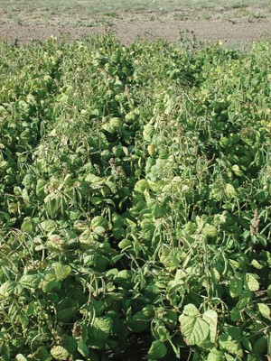
1a. Background: Pulse Agronomy - Mungbean trials
Differences in treatments across mungbean trials was driven by:
What was agronomically appropriate for the location and decisions made by individual researchers.
Addressing shifting ideas what growers / funding bodies wanted investigated.

Slide 5
1b. Trials for analysis (2016-2018) (16 trials)
<------------ Core factors ------------→
<------------ Other factors ------------→
Year | Region | Site | Varieties | Row spacing (cm) | Target plant pop | TOS | Water regime & Other factors
2016 | CQ | Emerald | Jade | 25, 50, 100 | 10, 20, 30, 40 | 1, 2, 3 | Dryland, Irrigated
2017 | CQ | Emerald | Jade, Satin II | 25, 100 | 30 | 1, 2, 3 | (Dryland, Irrigated) * (N0, N1, N2, N3)
2018 | CQ | Emerald | Jade | 50, 100 | 30 | 1, 2 | (Dryland, First Bud, First Flower, Mid pod fill) * (yes/no Foliar N)
2016 | SQ | HRS | Jade | 25, 50, 100 | 10, 20, 30, 40 | 1, 2, 3 | Dryland, Irrigated
2016 | SQ | Kingaroy | Jade | 25, 50 | 10, 20, 30, 40 | 1, 2, 3 | Dryland, Irrigated
2017 | SQ | Hermitage | Jade | 25, 100 | 20, 30, 40 | 1 | Dryland, Irrigated
2017 | SQ | Kingaroy | Jade | 25, 100 | 20, 30, 40 | 1 | Starting moisture: Low, Medium, High
2018 | SQ | Hermitage | Jade | 25, 50, 100 | 30 | 1, 2 | PP+0, PP+1, PP+2, PP+3
2018 | SQ | Kingaroy | Jade | 25, 50, 100 | 30 | 1, 2 | PP+0, PP+1, PP+2, PP+3
2016 | NSW | Narrabri | Jade | 40, 60, 100 | 10, 20, 30, 40 | 1, 2 | Dryland
2016 | NSW | Trangie | Jade | 33, 66, 100 | 20, 30, 40, 50 | 1, 2 | Dryland
2017 | NSW | Narrabri | Jade | 35 | 20, 30, 40, 60 | 1, 2 | Dryland, Flowering (F5), Early Podding
2017 | NSW | Trangie | Jade | 33, 66 | 20, 30, 40, 60 | 1 | Dryland, Incrop, Incrop(x2)
2018 | NSW | Breeza | Jade | 35 | 20, 30, 40, 60 | 1 | PP+0, PP+1, PP+2
2018 | NSW | Narrabri | Jade | 35 | 20, 30, 40, 60 | 1 | PP+0, PP+1, PP+2
2018 | NSW | Trangie | Jade | 25, 50 | 20, 30, 40, 60 | 1 | PP+0, PP+1, PP+2

Slide 6
Categorised into
Narrow, Med
& Wide
Convert to
environments
Only
Jade
Use actual
plant density
Year | Region | Site | Varieties | Row spacing (cm) | Target plant pop | TOS | Water regime & Other factors
2016 | CQ | Emerald | Jade | 25, 50, 100 | 10, 20, 30, 40 | 1, 2, 3 | Dryland, Irrigated
2017 | CQ | Emerald | Jade, Satin II | 25, 100 | 30 | 1, 2, 3 | (Dryland, Irrigated) * (N0, N1, N2, N3)
2018 | CQ | Emerald | Jade | 50, 100 | 30 | 1, 2 | (Dryland, First Bud, First Flower, Mid pod fill) * (yes/no Foliar N)
2016 | SQ | HRS | Jade | 25, 50, 100 | 10, 20, 30, 40 | 1, 2, 3 | Dryland, Irrigated
2016 | SQ | Kingaroy | Jade | 25, 50 | 10, 20, 30, 40 | 1, 2, 3 | Dryland, Irrigated
2017 | SQ | Hermitage | Jade | 25, 100 | 20, 30, 40 | 1 | Dryland, Irrigated
2017 | SQ | Kingaroy | Jade | 25, 100 | 20, 30, 40 | 1 | Starting moisture: Low, Medium, High
2018 | SQ | Hermitage | Jade | 25, 50, 100 | 30 | 1, 2 | PP+0, PP+1, PP+2, PP+3
2018 | SQ | Kingaroy | Jade | 25, 50, 100 | 30 | 1, 2 | PP+0, PP+1, PP+2, PP+3
2016 | NSW | Narrabri | Jade | 40, 60, 100 | 10, 20, 30, 40 | 1, 2 | Dryland
2016 | NSW | Trangie | Jade | 33, 66, 100 | 20, 30, 40, 50 | 1, 2 | Dryland
2017 | NSW | Narrabri | Jade | 35 | 20, 30, 40, 60 | 1, 2 | Dryland, Flowering (F5), Early Podding
2017 | NSW | Trangie | Jade | 33, 66 | 20, 30, 40, 60 | 1 | Dryland, Incrop, Incrop(x2)
2018 | NSW | Breeza | Jade | 35 | 20, 30, 40, 60 | 1 | PP+0, PP+1, PP+2
2018 | NSW | Narrabri | Jade | 35 | 20, 30, 40, 60 | 1 | PP+0, PP+1, PP+2
2018 | NSW | Trangie | Jade | 25, 50 | 20, 30, 40, 60 | 1 | PP+0, PP+1, PP+2
Row spacing treatments vary and not all trials have a range of plant densities.

Slide 7
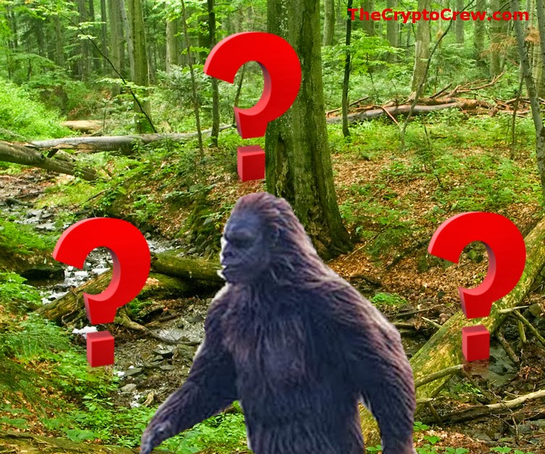
2a. Define the research questions …
“Practices that offer reliable yield potential in regional environments”.
Project
goals
Treatments
available
Crop management practice:
1. Row spacing x Env
2. Plant density x Env
Embedded
factorials:
1a. Narrow
vs Medium
1b. Narrow
vs Wide
2a. Response
curves
2a. Yields predicted
@ 30 plants/m²
Conditions:
Only include target densities of 30 plants/m² (recommended)
Only use trials with both row spacing treatments
Use narrow row spacing only
Only use trials with a reasonable
range of plant densities

Slide 8
2b. How do we address each question, e.g. Narrow vs Wide row spacing at 30 plants/m²?
Year | Region | Site | Varieties | Row spacing | Target plant pop | TOS | Water regime & Other factors
2016 | CQ | Emerald | Jade | 25, 50, 100 | 10, 20, 30, 40 | 1, 2, 3 | Dryland, Irrigated
2017 | CQ | Emerald | Jade, Satin II | 25, 100 | 30 | 1, 2, 3 | (Dryland, Irrig) * (N0ª,N1,N2,N3)
2018 | CQ | Emerald | Jade | 50, 100 | 30 | 1, 2 | (Dryland, First Bud, First Flower, Mid pod fill) * (yes/no Foliar N)
2016 | SQ | Hermitage | Jade | 25, 50, 100 | 10, 20, 30, 40 | 1, 2, 3 | Dryland, Irrigated
2016 | SQ | Kingaroy | Jade | 25, 50 | 10, 20, 30, 40 | 1, 2, 3 | Dryland, Irrigated
2017 | SQ | Hermitage | Jade | 25, 100 | 20, 30, 40 | 1 | Dryland, Irrigated
2017 | SQ | Kingaroy | Jade | 25, 100 | 20, 30, 40 | 1 | Start moist: Low, Medium, High
2018 | SQ | Hermitage | Jade | 25, 50, 100 | 30 | 1, 2 | PP+0, PP+1, PP+2, PP+3
2018 | SQ | Kingaroy | Jade | 25, 50, 100 | 30 | 1, 2 | PP+0, PP+1, PP+2, PP+3
2016 | NSW | Narrabri | Jade | 40, 60, 100 | 10, 20, 30, 40 | 1, 2 | Dryland
2016 | NSW | Trangie | Jade | 33, 66, 100 | 20, 30, 40, 50 | 1, 2 | Dryland
2017 | NSW | Narrabri | Jade | 35 | 20, 30, 40, 60 | 1, 2 | Dryland, Flowering (F5), Early Podding
2017 | NSW | Trangie | Jade | 33, 66 | 20, 30, 40, 60 | 1 | Dryland, Incrop, Incrop(x2)
2018 | NSW | Breeza | Jade | 35 | 20, 30, 40, 60 | 1 | PP+0, PP+1, PP+2
2018 | NSW | Narrabri | Jade | 35 | 20, 30, 40, 60 | 1 | PP+0, PP+1, PP+2
2018 | NSW | Trangie | Jade | 25, 50 | 20, 30, 40, 60 | 1 | PP+0, PP+1, PP+2
6 Env
6 Env
6 Env
2 Env
3 Env
8 Env
8 Env
2 Env
2 Env
Select trials that have Narrow & Wide row spacing.
Embedded factorials use only some of the treatments.
ªOnly N0 was used in embedded factorial.

Slide 9
2b. How do we address each question, e.g. Narrow vs Wide row spacing at 30 plants/m²?
Year | Region | Site | Varieties | Row spacing | Target plant pop | TOS | Water regime
2016 | CQ | Emerald | Jade | 25, 50, 100 | 10, 20, 30, 40 | 1, 2, 3 | Dryland, Irrigated
2017 | CQ | Emerald | Jade, Satin II | 25, 100 | 30 | 1, 2, 3 | (Dryland, Irrig) * (N0ª,N1,N2,N3)
2018 | CQ | Emerald | Jade | 50, 100 | 30 | 1, 2 | (Dryland, First Bud, First Flower, Mid pod fill) * (yes/no Foliar N)
2016 | SQ | HRS | Jade | 25, 50, 100 | 10, 20, 30, 40 | 1, 2, 3 | Dryland, Irrigated
2016 | SQ | Kingaroy | Jade | 25, 50 | 10, 20, 30, 40 | 1, 2, 3 | Dryland, Irrigated
2017 | SQ | Hermitage | Jade | 25, 100 | 20, 30, 40 | 1 | Dryland, Irrigated
2017 | SQ | Kingaroy | Jade | 25, 100 | 20, 30, 40 | 1 | Start moist.: Low, Medium, High
2018 | SQ | Hermitage | Jade | 25, 50, 100 | 30 | 1, 2 | PP+0, PP+1, PP+2, PP+3
2018 | SQ | Kingaroy | Jade | 25, 50, 100 | 30 | 1, 2 | PP+0, PP+1, PP+2, PP+3
2016 | NSW | Narrabri | Jade | 40, 60, 100 | 10, 20, 30, 40 | 1, 2 | Dryland
2016 | NSW | Trangie | Jade | 33, 66, 100 | 20, 30, 40, 50 | 1, 2 | Dryland
2017 | NSW | Narrabri | Jade | 35 | 20, 30, 40, 60 | 1, 2 | Dryland, Flowering (F5), Early Podding
2017 | NSW | Trangie | Jade | 33, 66 | 20, 30, 40, 60 | 1 | Dryland, Incrop, Incrop(x2)
2018 | NSW | Breeza | Jade | 35 | 20, 30, 40, 60 | 1 | PP+0, PP+1, PP+2
2018 | NSW | Narrabri | Jade | 35 | 20, 30, 40, 60 | 1 | PP+0, PP+1, PP+2
2018 | NSW | Trangie | Jade | 25, 50 | 20, 30, 40, 60 | 1 | PP+0, PP+1, PP+2
6 Env
6 Env
6 Env
Embedded factorial
2 Env
3 Env
8 Env
8 Env
2 Env
2 Env
Select trials that have Narrow & Wide row spacing.
Embedded factorials use only some of the treatments.
ªOnly N0 was used in embedded factorial.

Slide 10
3a. Steps to define factors used in embedded factorials (analysing with REML procedure)
1. Are there treatments left out of the embedded factorial/s?
Levels of ‘OtherTrt’
Treatments in an embedded factorial get same level (e.g. 0)
Treatments not in an embedded factorial get unique levels
This accounts for all treatments
yes
Create factor to identify these treatments (e.g. ‘OtherTrt’). Go to step 2.
no
2. Is there more than one embedded factorial? (Remember they should not have overlapping treatments.)
Levels of ‘Group’
Define different embedded factorials (e.g. 1, 2…)
Treatments not in an embedded factorial get missing values
yes
Create factor to define different embedded factorials (e.g. ‘Group’). Go to step 3.
no
3. Define factors and/or continuous variates for each of the embedded factorial/s.
Levels of factor for embedded factorial:
Levels treatments in embedded factorial as per normal.
Treatments not in embedded factorial get missing values

Slide 11
4a. Significant E x M interactions with lots of environments!
Environment | Narrow | Wide
CQ16Emld_DryTOS1 | 1461.1 | 1259.3
CQ16Emld_DryTOS2 | 1270.0 | 1178.0
CQ16Emld_DryTOS3 | 1212.5 | 1173.8
CQ16Emld_IrrigTOS1 | 1852.8 | 1639.3
CQ16Emld_IrrigTOS2 | 2478.3 | 1999.3
CQ16Emld_IrrigTOS3 | 1882.7 | 1582.6
CQ17Emld_TOS1DryN0 | 662.2 | 585.6
CQ17Emld_TOS1IrrigN0 | 1107.7 | 853.2
CQ17Emld_TOS2DryN0 | 1226.5 | 1029.4
CQ17Emld_TOS2IrrigN0 | 1681.1 | 1374.1
CQ17Emld_TOS3DryN0 | 1524.5 | 1019.0
CQ17Emld_TOS3IrrigN0 | 1599.3 | 1105.1
NSW16Nar_TOS1 | 1476.8 | 1304.0
NSW16Nar_TOS2 | 803.4 | 726.7
NSW16Tran_TOS1 | 1302.3 | 1137.5
NSW16Tran_TOS2 | 1072.5 | 895.7
SQ16HRS_DryTOS1 | 1234.4 | 857.6
SQ16HRS_DryTOS2 | 1569.1 | 1040.6
SQ16HRS_DryTOS3 | 1779.3 | 1467.1
SQ16HRS_IrrigTOS1 | 1271.2 | 822.6
SQ16HRS_IrrigTOS2 | 2535.5 | 1740.0
SQ16HRS_IrrigTOS3 | 1865.7 | 1316.9
Environment | Narrow | Wide
SQ17HRS_Dry | 2797.2 | 2332.0
SQ17HRS_Irrig | 3204.5 | 2341.9
SQ17King_High | 1342.6 | 821.4
SQ17King_Low | 1258.0 | 741.0
SQ17King_Med | 1340.5 | 1076.0
SQ18HRS_PP0TOS1 | 2514.6 | 2165.4
SQ18HRS_PP0TOS2 | 1047.9 | 858.2
SQ18HRS_PP1TOS1 | 2232.4 | 1182.7
SQ18HRS_PP1TOS2 | 1171.9 | 649.2
SQ18HRS_PP2TOS1 | 2358.0 | 1543.0
SQ18HRS_PP2TOS2 | 1164.1 | 943.7
SQ18HRS_PP3TOS1 | 2060.6 | 1980.7
SQ18HRS_PP3TOS2 | 1182.3 | 1013.9
SQ18King_PP0TOS1 | 1687.7 | 1179.1
SQ18King_PP0TOS2 | 812.5 | 453.7
SQ18King_PP1TOS1 | 1470.7 | 1253.3
SQ18King_PP1TOS2 | 879.3 | 393.0
SQ18King_PP2TOS1 | 1719.9 | 1013.4
SQ18King_PP2TOS2 | 677.4 | 571.8
SQ18King_PP3TOS1 | 1482.8 | 1192.8
SQ18King_PP3TOS2 | 928.3 | 368.7
Fixed model ~ OtherTrt + Env * RowSpacing
In this example: Significant interactions between 43 environments and RowSpacing (Narrow, Wide)
Not very helpful for summarising for agricultural industry!
Clustering the environments with similar responses can make the task of summarising the results a lot easier for the researcher.
Fixed term | Wald stat | n.d.f. | F statistic | d.d.f. | F pr
OtherTrt | 2417.32 | 280 | 8.22 | 383.5 | <0.001
Env | 915.9 | 42 | 19.12 | 101.9 | <0.001
RowSpacing | 208.4 | 1 | 208.4 | 306.6 | <0.001
Env.RowSpacing | 94.28 | 42 | 2.15 | 215.4 | <0.001

Slide 12
4b. Cluster environments with similar responses
Criteria imposed for clustering environments with similar responses:
Within each cluster -> no significant interaction between environment and management factor (i.e. row spacing: narrow versus wide).
Balance between minimising the number of clusters to satisfy this criteria and have agronomic relevance (e.g. use cut-off points that have economic meaning).
In this case study the yield difference (or yield potential) between narrow and wide row spacing was used to develop five clusters.
Fixed model ~ OtherTrt + Cluster + C1Env*C1RowSpacing + C2Env*C2RowSpacing + C3Env*C3RowSpacing + C4Env*C4RowSpacing + C5Env*C5RowSpacing
No significant interactions between Env and RowSpacing within each of the 5 clusters.

Slide 13
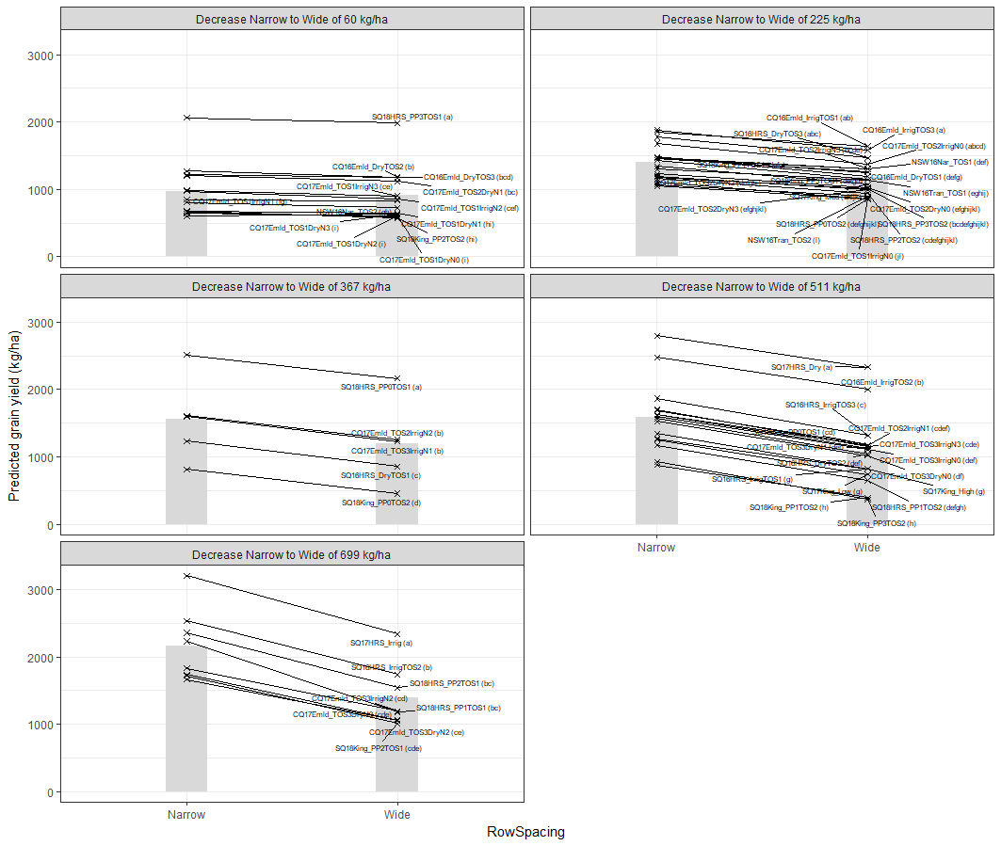
4c. Clustering for narrow vs wide row spacing
The five different clusters can now be more simply described rather than the 43 environments.
Another approach is to relate the yield difference to environmental information.
Some environmental information was available (min and max temperatures, starting moisture, in-crop water, sowing date, crop duration).

Slide 14
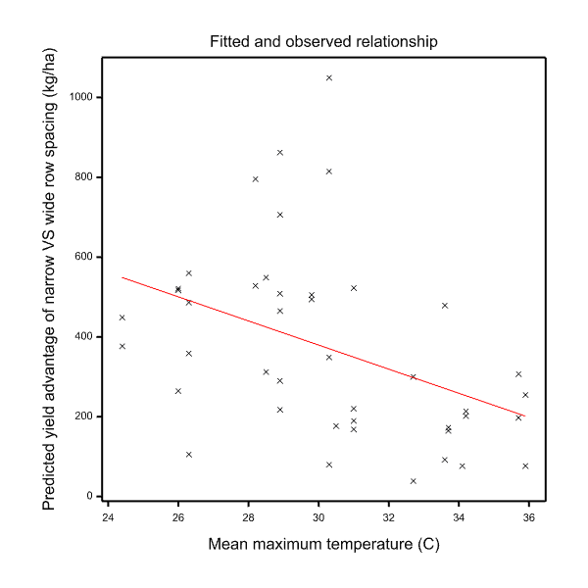
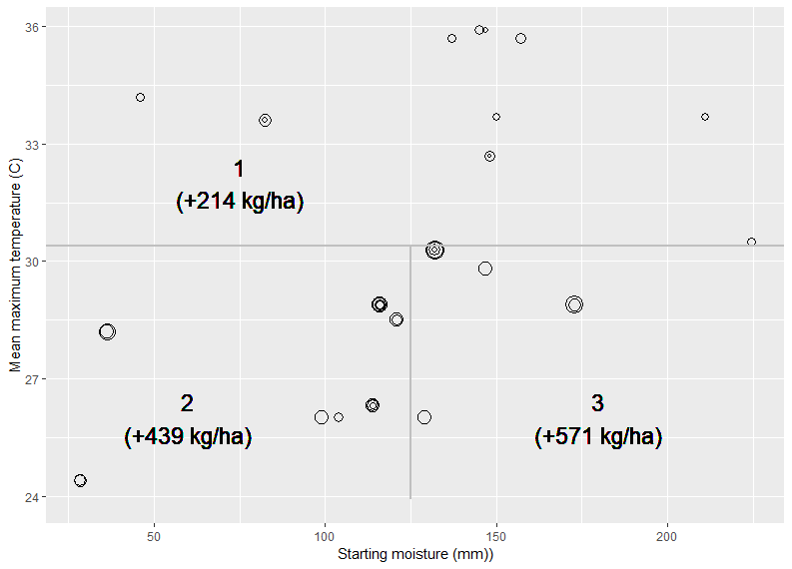
5. Relationship between yield advantage of narrow vs wide with environmental descriptors
Multiple regression results
Both regression trees and multiple regression were used to explore this relationship.
Missing environmental descriptors for some environments.
Lower temperatures increase yield gains
when changing to narrow row spacing
Regression tree results
Maximum temperature (C)
Maximum temperature (C)
May get a better relationship if more variables were planned to be measured at the beginning of the project rather than see what was available at the end of the project!
Starting moisture (mm)

Slide 15
Summary
Defining and refining the research questions has shown to be even more relevant when there are unbalanced treatment structures.
This assists in developing appropriate embedded factorials.
The steps used for defining factors used in the embedded factorials was described:
The steps can also be used for more general embedded factorials (including single trial analyses).
Clustering of environments useful to reduce complexity of environment x management predictions.
Relating results to external environmental descriptors can also be useful for describing the trends in the results.

Slide 16

Acknowledgements
Thanks to the researchers (David Lester, Douglas Lush, Rao Rachaputi, Douglas Sands, Kerry McKenzie, Natalie Moore and researchers from NSW Ag from DAN000171 project) who have provided feedback on the usefulness of these methods and for the use of their research data as examples in this talk.
The authors gratefully acknowledge the Grains Research and Development Corporation for the funding of northern SAGI and the projects used in these case studies.

