Slide 1

Mimicking anova in reml mixed-modelling of comparative experiments using the R-package asremlPlus
Chris Brien
Australian Centre for Plant Functional Genomics, University of Adelaide.
School of Information Technology and Mathematical Sciences, University of South Australia

Slide 2
Outline
A three-factor generalized RCBD on ladybirds.
Principles that grew alongside anova.
Some features of asremlPlus.
Using asremlPlus for reml mixed modelling.
Conclusions.

Slide 3
1. Three-factor generalized randomized complete-block experiment on ladybirds (Welham et al. (2015) Example 8.2)
Will ladybirds transfer fungus to aphids on plants?
2 runs of 36 containers with a plant and aphids.
12 treatments: Host plant (beans, trefoil), infected Cadavers (5, 10, 20), Ladybird (−, +).
2 Host
3 Cadavers
2 Ladybird
2 Run
36 Plant in R
12 treatments
72 plants
Analyse the logit of the proportion of live aphids that were infected.

Slide 4
The anova
(dominant analysis method of 20th Century)
Ladybird.aov <- aov(logitP ~ Host*Cadavers*Ladybird + Error(Run/Plant),
data=Ladybird.dat)
summary(Ladybird.aov)
Error: Run
Df Sum Sq Mean Sq F value Pr(>F)
Residuals 1 0.06766 0.06766
Error: Run:Plant
Df Sum Sq Mean Sq F value Pr(>F)
Host 1 13.599 13.599 59.172 1.82e-10
Cadavers 2 17.027 8.514 37.044 3.78e-11
Ladybird 1 11.091 11.091 48.257 3.33e-09
Host:Cadavers 2 0.308 0.154 0.670 0.5158
Host:Ladybird 1 0.228 0.228 0.992 0.3234
Cadavers:Ladybird 2 1.735 0.867 3.774 0.0287
Host:Cadavers:Ladybird 2 0.200 0.100 0.435 0.6493
Residuals 59 13.560 0.230
  Analysis achieved with a single fit.
  However, could do a second analysis removing the ns terms that would pool these terms with the Residual.
  The Run:Plant Residual MSq (0.230) in this anova is a pure estimate of error, being derived from replicates only.
  The estimate of the
  Run variance component is negative:
  (0.06766 – 0.230) / 36.
  Only significant interaction is C:L & Host is significant.
  Tables of means for C:L and Host examined.

Slide 5
2. Principles that grew alongside anova
Include all unit (recipient) terms as random terms; hypothesis tests for them are not valid.
  Justified by the randomization argument for a valid estimate of error and that there is no randomization test available.
  Dropping terms leads to problematic pooling of terms (Janky, 2000).
Test treatment (allocated) terms by testing their sources, but never remove them from the analysis.
  Ensures a pure estimate of error, in case a Type II error occurs.
Use hypothesis tests to select a marginality-compliant model (Nelder, 1977) and base conclusions on corresponding tables of means.
  If A#B is significant, there is no need to test the marginal terms (Grand mean), A and B: the fitted model is E[Y] = A:B (ab parameters).
  If A#B is not significant (ns), E[Y] = A + B and conclusions should be based on A and B means (increased precision because more obs^{n} per mean).
Notes:
A:B standards for a separate parameter for each combination of the levels of A and B

Slide 6
Difficulties with the principles in mixed modelling
Focus on II and III
Include all unit (recipient) terms as random terms ; hypothesis tests for them are not valid.
  Because of constraints imposed, random unit variance components that are negative are, in effect, omitted because they are estimated as zero.
Test treatment (allocated) terms by testing their sources, but never remove them from the analysis.
  From a modelling perspective, it is natural to remove nonsignificant terms.
Use hypothesis tests to select a marginality-compliant model (Nelder, 1977) and base conclusions on corresponding tables of means.
  Researchers want predictions for all factor combinations. To get these when an additive model is selected, must ns interaction terms be omitted?
    When E[Y] = A + B (A#B is ns), how to get estimates for all combinations A & B without removing A#B?

Slide 7
3. Some features of asremlPlus
Enhances asreml.
Creates an asrtests object that contains (i) the fitted asreml object, (ii) the wald.tab for the fixed terms and (iii) a test.summary data.frame.
Functions:
  setvarianceterms allows one to easily change the bound placed on random terms in the model.
  chooseModel selects the significant terms in model, given the marginality relations between the terms.
  predictPlus enhances predict from asreml, including linear.transformation of the predictions and error.intervals of various types (se, CI, 0.5LSD).
  plotPredictions uses ggplot2 to plot predictions.

Slide 8
4. Using asremlPlus for reml mixed modelling
m <- asreml(logitP ~ Host*Cadavers*Ladybird,
random = ~ Run,
residual = ~ Run:Plant,
data = Ladybird.dat)
Warning in asreml(logitP ~ Host * Cadavers * Ladybird, random = ~Run, residual = ~Run:Plant, : Some components changed by more than 1% on the last iteration.
summary(m)$varcomp #shows bound Run component
component std.error z.ratio bound %ch
Run 2.298309e-08 0.01638903 1.402346e-06 B 93.7
Run:Plant!R 2.271216e-01 0.04156985 5.463612e+00 P 0.0
The Run component was set to allow negative estimates.

Slide 9
The fixed effects analysis
Set up an asrtests object and print out wald.tab (with denominator df calculated using Kenward-Rogers).
current.asrt <- asrtests(m)
Calculating denominator DF
current.asrt$wald.tab
Wald tests for fixed effects.
Response: logitP
Df denDF F.inc Pr
(Intercept) 1 1 1550.00 0.01617
Host 1 59 59.17 0.00000
Cadavers 2 59 37.04 0.00000
Ladybird 1 59 48.26 0.00000
Host:Cadavers 2 59 0.67 0.51581
Host:Ladybird 1 59 0.99 0.32342
Cadavers:Ladybird 2 59 3.77 0.02868
Host:Cadavers:Ladybird 2 59 0.44 0.64932

Slide 10
Use chooseModel to select a marginality-compliant fixed model
Based on the marginality relationships between terms.
It is a property of the column spaces of the incidence matrices for the terms.
  One term is marginal to another if the column space of the first term is a subspace of that of the marginal term.
  This property is independent of the replications of the levels of the factors that make up the term.
  For example, the term for A is marginal to A:B irrespective of the number of values for each combination of the levels of A and B.
  When nesting is explicit, because nested factors are numbered within the nesting factors (e.g. Run & Plant), then a term is marginal to another if its factors are a subset of those in the marginal term.

Slide 11
Use chooseModel to select a marginality-compliant fixed model
Based on the marginality relationships between terms.
One term is marginal to another if the column space of the incidence matrix for the first term is a subspace of that of the marginal term.

Slide 12
The marginality matrix
Ladybird.pstr <- pstructure(~ Host*Cadavers*Ladybird, data = Ladybird.dat)
HCL.marg <- marginality(Ladybird.pstr)
print(HCL.marg)
Host Cadavers Host:Cadavers Ladybird Host:Ladybird Cadavers:Ladybird
Host 1 0 1 0 1 0
Cadavers 0 1 1 0 0 1
Host:Cadavers 0 0 1 0 0 0
Ladybird 0 0 0 1 1 1
Host:Ladybird 0 0 0 0 1 0
Cadavers:Ladybird 0 0 0 0 0 1
Host:Cadavers:Ladybird 0 0 0 0 0 0
Host:Cadavers:Ladybird
Host 1
Cadavers 1
Host:Cadavers 1
Ladybird 1
Host:Ladybird 1
Cadavers:Ladybird 1
Host:Cadavers:Ladybird 1
pstructure is a dae function for forming the projection matrices for a formula, a side effect of which is to produce the marginality matrix.

Slide 13
Choose the model
sigmod <- chooseModel(current.asrt, terms.marginality = HCL.marg)
Calculating denominator DF
Calculating denominator DF
Calculating denominator DF
Calculating denominator DF
Calculating denominator DF
sigmod is a list with two components: asrtests.obj and sig.terms.
current.asrt <- sigmod$asrtests.obj
print(current.asrt$test.summary)
terms DF denDF p action
1 Host:Cadavers:Ladybird 2 59 6.493237e-01 Nonsignificant
2 Cadavers:Ladybird 2 59 2.868479e-02 Significant
3 Host:Ladybird 1 59 3.234182e-01 Nonsignificant
4 Host:Cadavers 2 59 5.158105e-01 Nonsignificant
5 Host 1 59 1.816387e-10 Significant
print(sigmod$sig.terms)
[[1]]
[1] "Cadavers:Ladybird"
[[2]]
[1] "Host"

Slide 14
Use predictPlus to obtain predictions
Will obtain predictions for Host:Cadavers:Ladybird that conforms to the selected model.
Function predictPlus has a linear.transformation argument that can be a formula or a matrix of contrasts.
  For a formula, the projection of the predicted values onto the formula subspace is produced.
diffs <- predictPlus(current.asrt$asreml.obj,
classify = "Host:Cadavers:Ladybird",
linear.transformation = ~Cadavers:Ladybird + Host,
wald.tab = current.asrt$wald.tab,
error.intervals = "halfLeast",
meanLSD.type = "factor.combination",
LSDby = "Host", tables = "predictions")
LSD varies with Host comparison, so use within Host LSD.

Slide 15
An alldiffs.obj from predictPlus
A list consisting of the following components:
  predictions: the predictions, their standard errors and error intervals;
  vcov: the variance matrix of the predictions;
  differences: all pairwise differences between the predictions,
  p.differences: p-values for all pairwise differences between the predictions;
  sed: the standard errors of all pairwise differences between the predictions;
  LSD: the mean, minimum and maximum LSDs, possibly by factors.
All components (except LSD) in standard order and labelled for the classify: "Host:Cadavers:Ladybird"

Slide 16
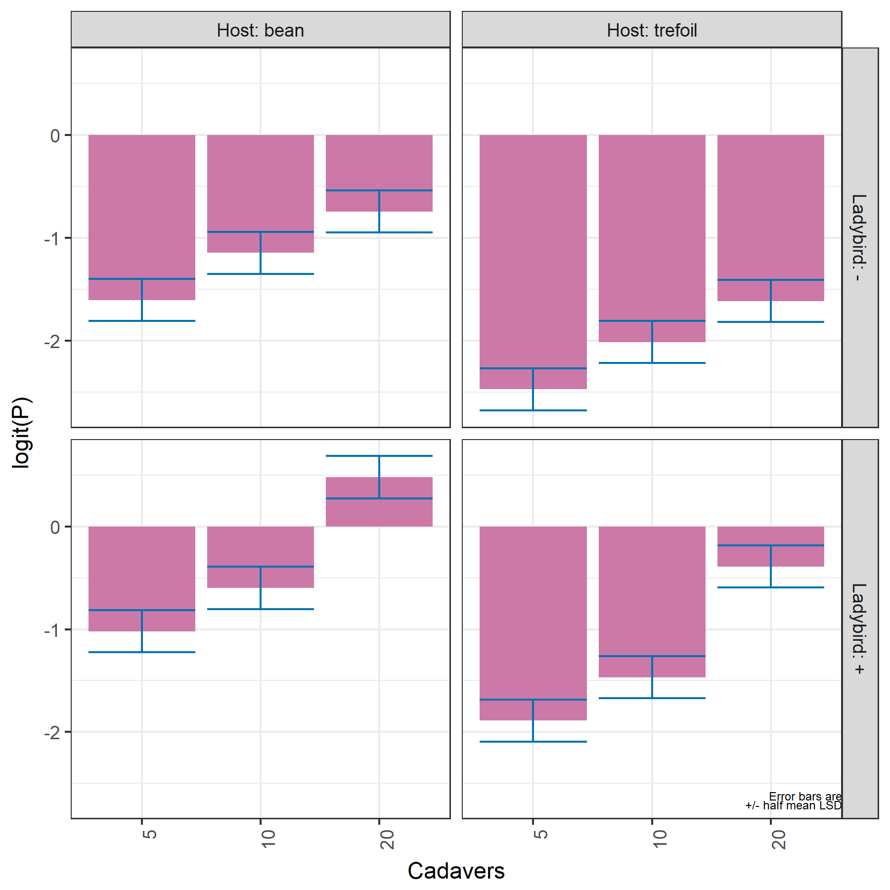
Predictions
Predictions for all combinations of the levels of Host, Ladybird and Cadavers.
But, same pattern in predictions for both Hosts within each Ladybird level (row of the plot).
Error bars are ± 0.5 LSD (5%) (Snee, 1981):
  When overlap within a Host, prediction differences are ns;
  LSD = 0.392; based on 12 values.
  If drop ns terms, same predictions, but s² = 0.223 and LSD = 0.386.
  For a mean based on 6 values,
  LSD = 0.554.
Notes:
LSD (5%) = 2.000 sqrt(2 * 0.230 /6) = 0.554

Slide 17
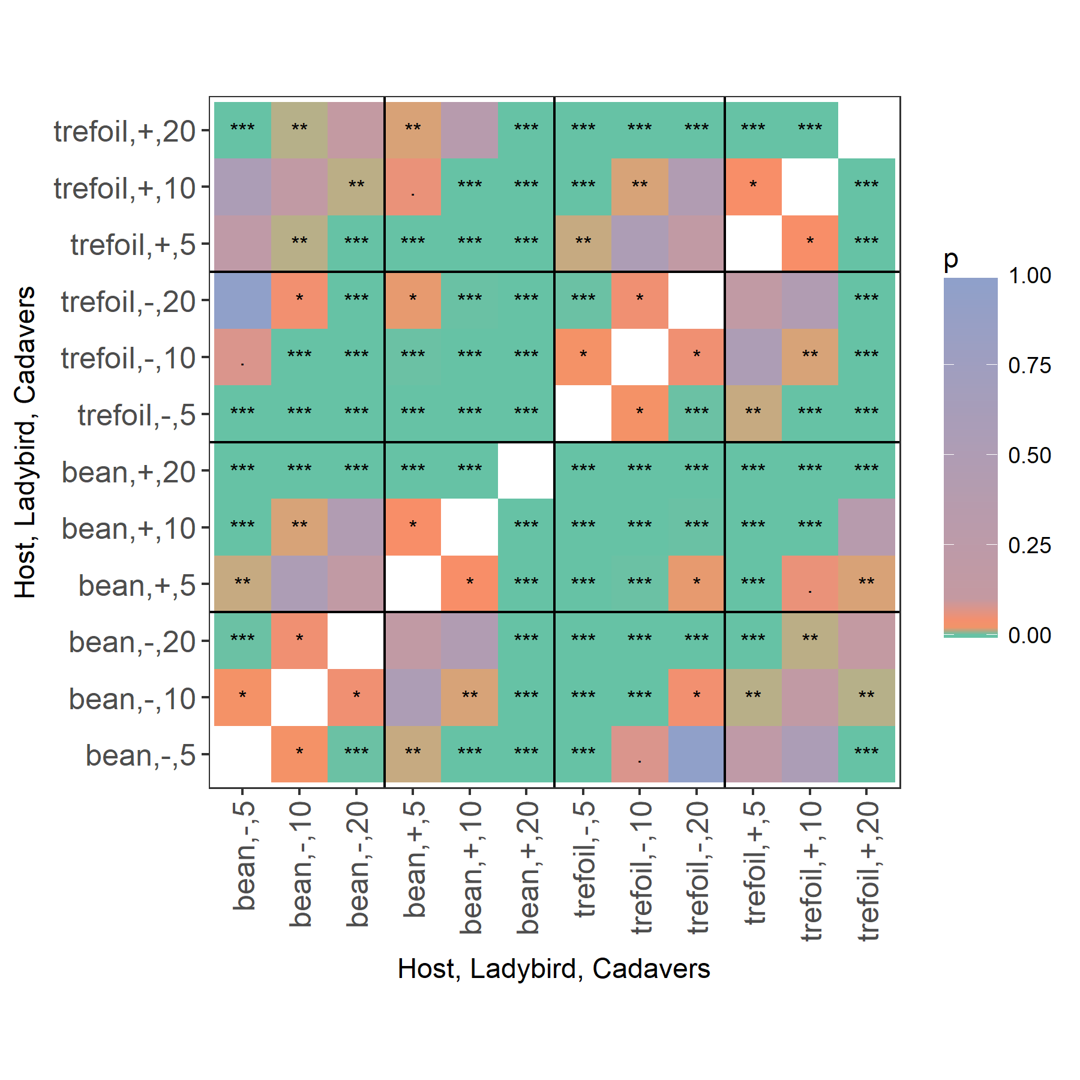
Heat map of p-values for pairwise differences
Based on exact t-tests, so equivalent to LSDs.
The differences within a panel are down the antidiagonal.
All differences within a panel are significant.
Note that the top and the bottom two antidiagonal grid pairs are the same.

Slide 18
5. Conclusions
Properties of the analysis:
  Estimates of variance components are based solely on replicate variation.
  Predictions
    Are for all combinations of the treatment factors.
    Conform to the selected model.
    Have smaller standard errors for the estimated differences, because they are based on lower order terms.
Tricky for quantitative variables with predictions for several values of each (not implemented as yet).
R package asremlPlus assists in fulfilling the principles that originate from anova when doing reml mixed modelling.
  Available from the R repository at http://chris.brien.name/rpackages
  Compatible with asreml-R versions 3 and 4.1.
  The Ladybird.dat data set is available with asremlPlus

Slide 19
References
Brien, C. J. (2018) asremlPlus: augments the use of ASReml-R in fitting mixed models. R package version 4.1-04. http://chris.brien.name/rpackages.
Eisenhart, C. (1947). The assumptions underlying the analysis of variance. Biometrics, 3, 1-21.
Fisher, R. A. (1918). The correlation between relatives on the supposition of Mendelian inheritance. Transactions of the Royal Society of Edinburgh, 52, 388-433.
Janky, D. G. (2000). Sometimes pooling for analysis of variance hypothesis tests: A review and study of a split-plot model. The American Statistician, 54, 269-279.
Littell, R. C. (2002). Analysis of unbalanced mixed model data: A case study comparison of ANOVA versus REML/GLS. Journal of Agricultural, Biological, and Environmental Statistics, 7, 472-490.
Nelder, J. A. (1977). A reformulation of linear models (with discussion). Journal of the Royal Statistical Society, Series A (General), 140, 48-77.
Patterson, H. D., & Thompson, R. (1971). Recovery of inter-block information when block sizes are unequal. Biometrika, 58, 545-554.
Snee, R. D. (1981). Graphical Display and Assessment of Means. Biometrics, 37, 835-836.
Welham, S. J., Gezan, S. A., Clark, S. J., & Mead, A. (2014). Statistical Methods in Biology: Design and Analysis of Experiments and Regression. Boca Raton: Chapman and Hall/CRC.
Thank you for your attention

