Slide 1
Talking to Biologists, by a biologist

Slide 2
My background
BSc Botany
MSc Environmental Science / Ecology
PhD Evolutionary Biology / Ecological Genetics
Lecturer – Victoria University of Wellington
      – University of New Brunswick Canada
  Taught:
  Quantitative Genetics
  Population Genetics
  Evolutionary Ecology
  Hypothesis Testing in Biology (aka Bio-statistics)
  Graduate level Statistics for Biologists
  Plant and Food Research – Data Science Group

Slide 3
My view: Statistics is philosophy of science
The key is what is the question?
How do we ask the question in a way that:
  Contrasts the right things
  Makes sure we are only contrasting those things
How do we collect our data in a way that:
  Minimises bias
  Reduces variation
The better we biologists ask questions the better our science is.

Slide 4
First year undergraduate biology courses teach
t-test
Chi-square test
But most don’t teach why we choose one test or another
And the two are taught as a dichotomy.
- Does it involve Drosophila? – Chi-square test
- Does it measure finger lengths? – t-test

Slide 5
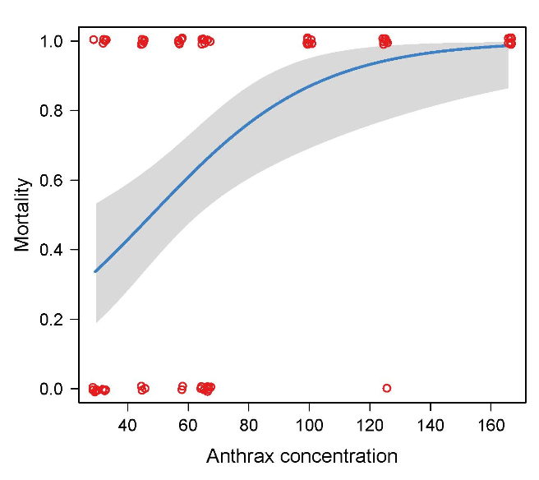
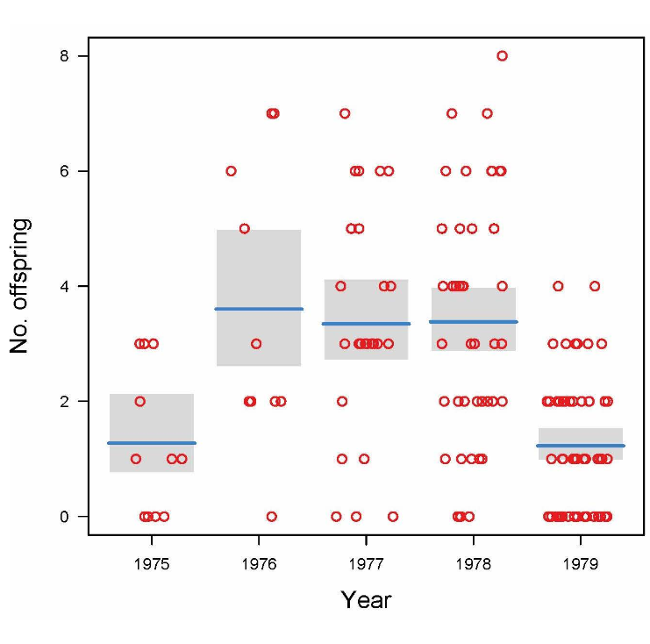
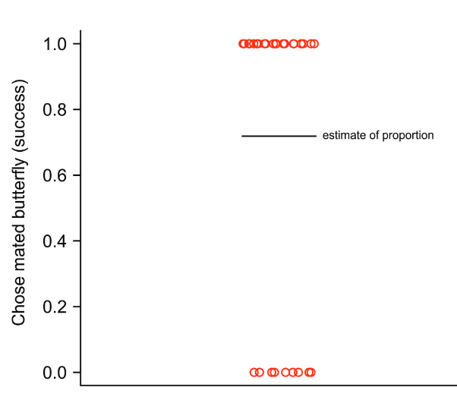
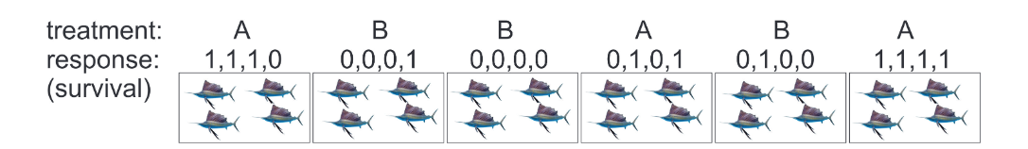
But most biological data is not normal or are counts of Drosophila
So why do we teach the normal distribution as the default?

Slide 6
Hypothesis testing in Biology
(3rd year Bio-Statistics course)
Graduate students has a problem:
  “What I really want to know is …”
  Students design experiments in groups
    Plan to minimize bias
    Plan to reduce variability
    Samples must be independent
  Best design judged by graduate student
  Students analyse data and report back to grad student
Most designs more complicated than simple anova/regression
  Covariates
  Repeated measures
  Lack of independence of samples

Slide 7
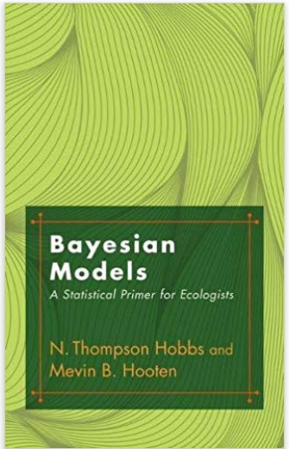
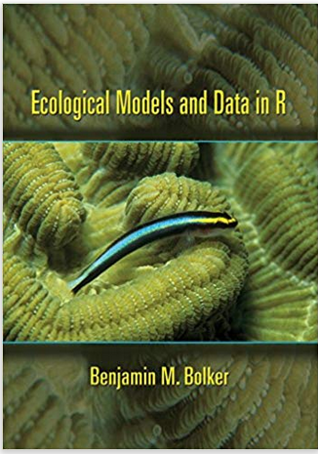
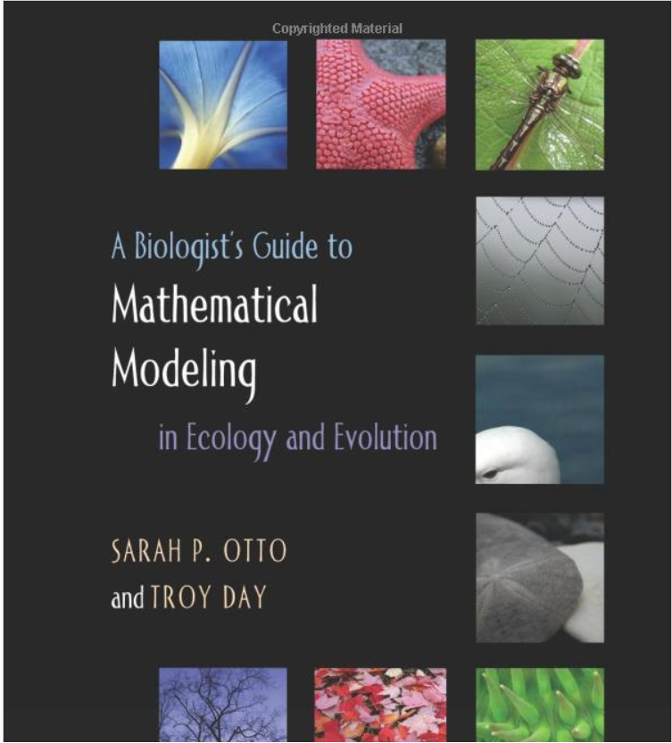
Biology has changed to a data intensive science
Most PhD students spend >1 year analysing data
Datasets are large, complex with complicated structures and correlations between observations and/or variables
Understanding matrix algebra & calculus (at least the principles) is key to many biological disciplines
Generalized linear (mixed) model approach taught in most grad courses

Slide 8
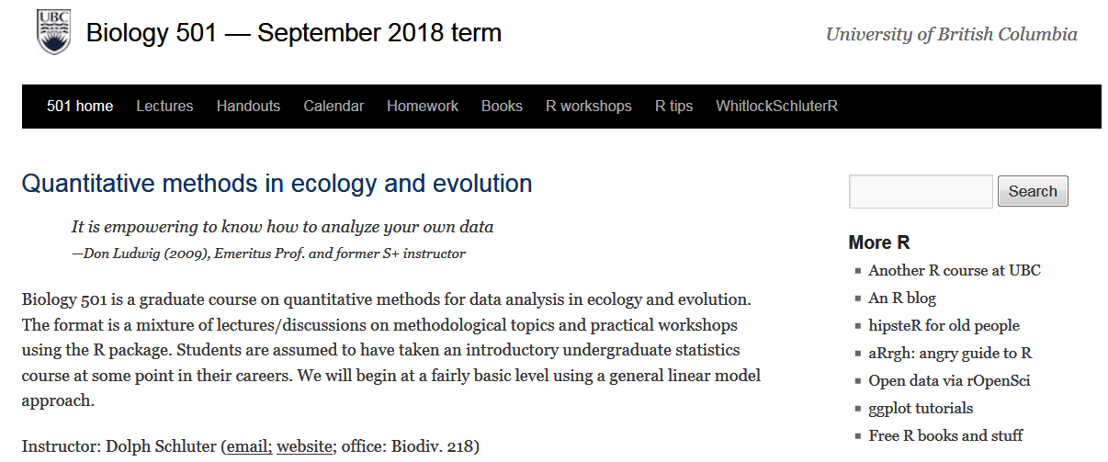
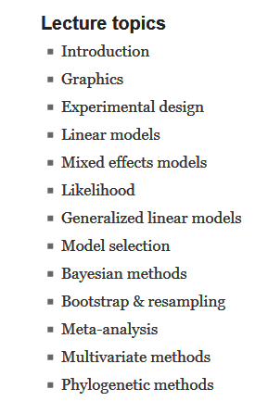
Biology has changed to a data intensive science

Slide 9
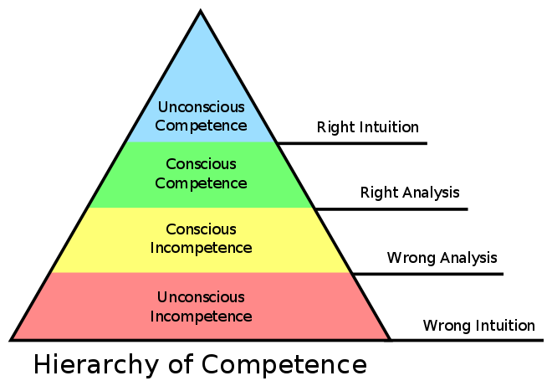
How to move Biologists to Conscious (In)competence?

Slide 10
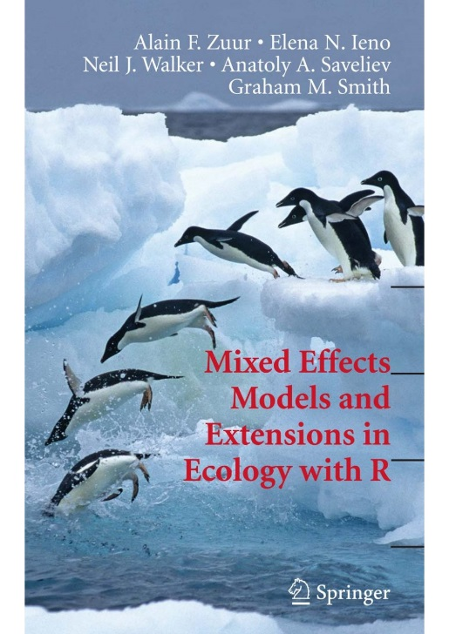
How to know when you need help?
Zuur
Assumptions of linear models
(i) normality,
(ii) homogeneity,
(iii) fixed X (X represents explanatory variables),
(iv) independence, and
(v) a correct model specification
Tried to find a dataset that didn’t violate those assumptions.
Failed

Slide 11
When linear modelling just won’t do
Zuur et al:
Is your response variable heterogeneous?
Does your data have repeated measurements?
Is it nested (hierarchical)?
Is it sampled at multiple locations or sampled repeatedly over time?

Slide 12
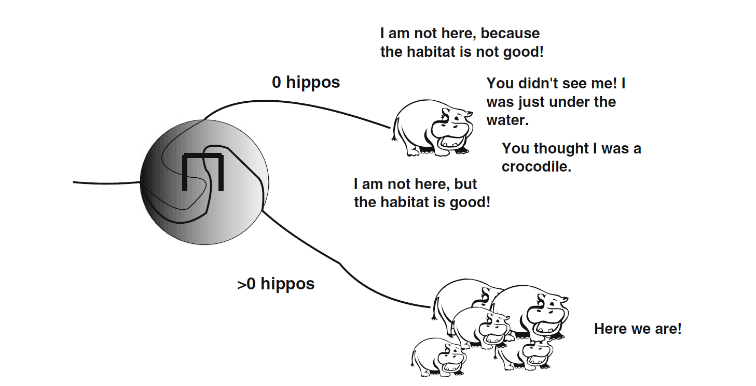
Statistics is philosophy of science (in my view)

Slide 13
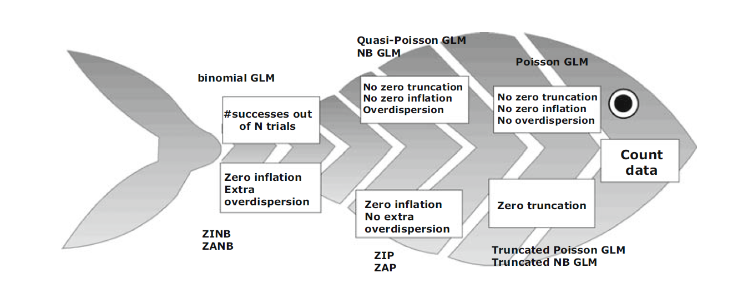
Biologists want a road-map but it doesn’t have to be straight-forward

Slide 14
My key concepts for every Biologist
Design experiments to minimize bias and sampling error
Observational studies are not experiments (the observer does not randomly assign treatments to subjects)
Biological interactions are the interesting parts of biology
“Things” in biology are often confounded
Samples are rarely independent (what is independent in Biology, anyway?)
Time and space are important
Zero does not always mean zero
Unmeasured things can have important effects
Biologically important is the key parameter, not statistically significant

Slide 15
“All models are wrong. Some are useful” - George Box
Key concepts should provide an “oh-oh”
Communication should emphasise checking for model suitability
Emphasis on better models, not right ones

Slide 16
Thank you
Linley.Jesson@plantandfood.co.zn

