Slide 1


The impact of covariates on the grouping structure of a Bayesian spatio-temporal localised model
Authors: Aswi Aswi¹, Susanna Cramb¹, Wenbiao Hu², Gentry White^{3,} Kerrie Mengersen¹
¹ ARC Centre of Excellence for Mathematical and Statistical Frontiers, Queensland University of Technology, Australia; ² School of Public Health and Social Work, Queensland University of Technology, Australia; ³School of Mathematical Science, Queensland University of Technology, Australia
Australasian Applied Statistics (AAS) Conference 2018,
Rotorua, New Zealand, 3-7 December 2018

Slide 2

Context: dengue fever in Makassar, Indonesia
Introduction
Dengue fever affects over 100 million people annually.
One of the world's most important vector-borne diseases.
Epidemic dengue is a major public health problem in several countries including Indonesia.
Indonesia had the highest number of cases in the Southeast Asia region in 2010.
Makassar, the largest city in eastern Indonesia, is one of the major cities in Indonesia where the incidence of dengue fever is still quite high.
Little is known about spatio-temporal patterns of dengue in Indonesia.

Slide 3
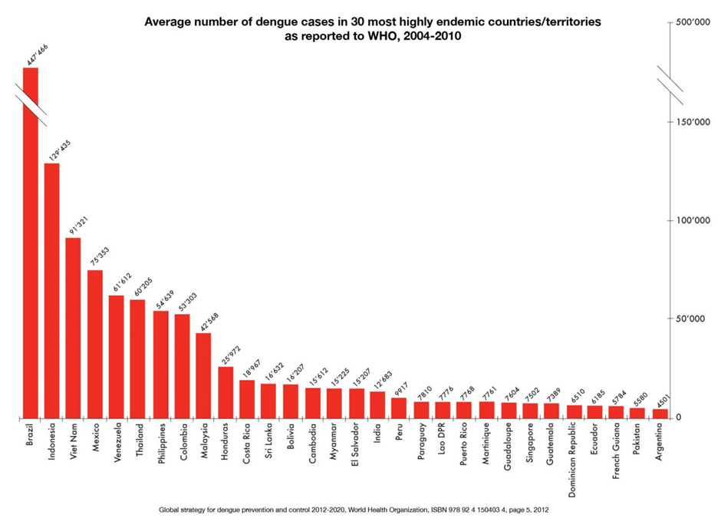
Average number of dengue cases in 30 most endemic countries are reported to WHO, 2004 – 2010
http://www.eliminatedengue.com/our-research/dengue-fever .

Slide 4
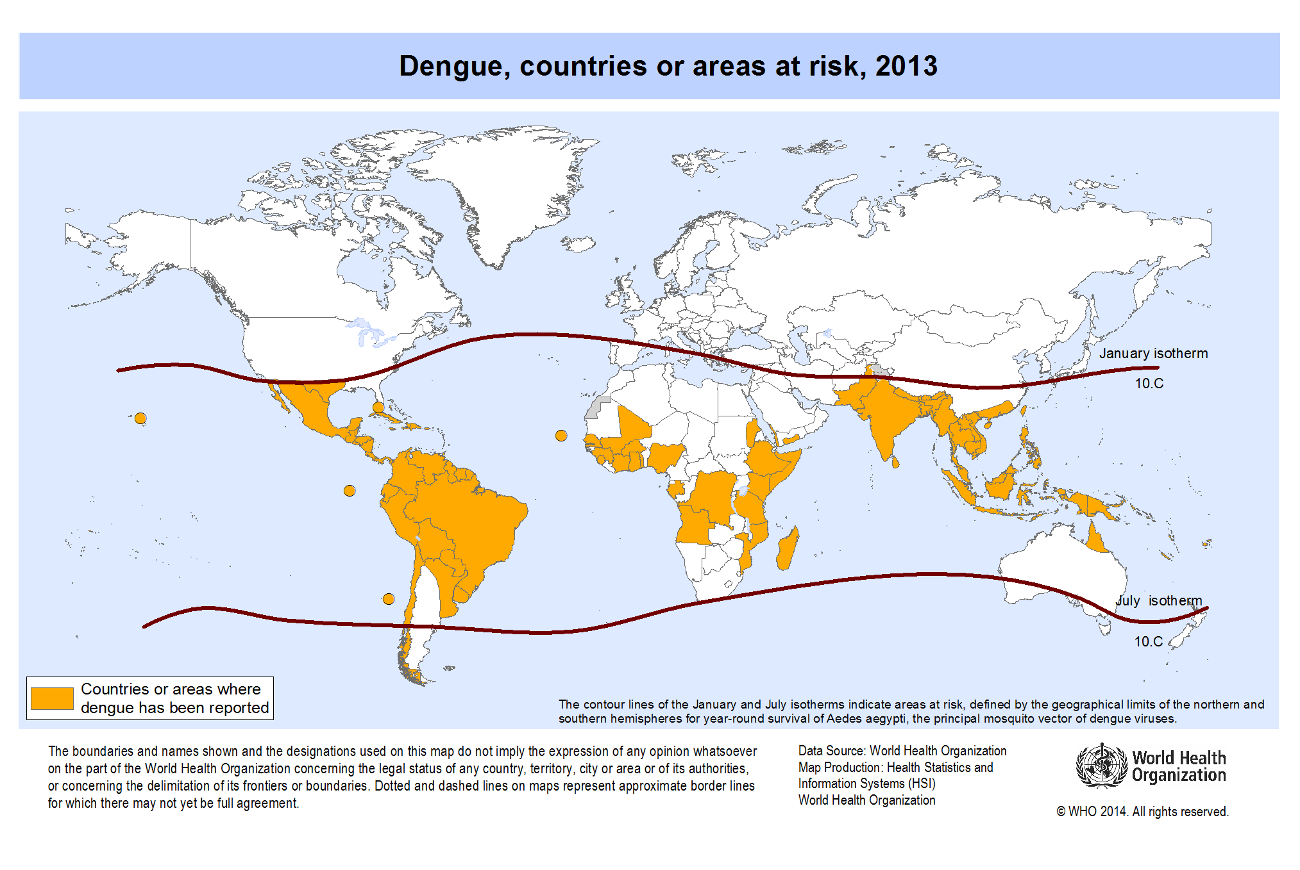
http://gamapserver.who.int/mapLibrary/Files/Maps/Global_DengueTransmission_ITHRiskMap.png?ua=1

Slide 5
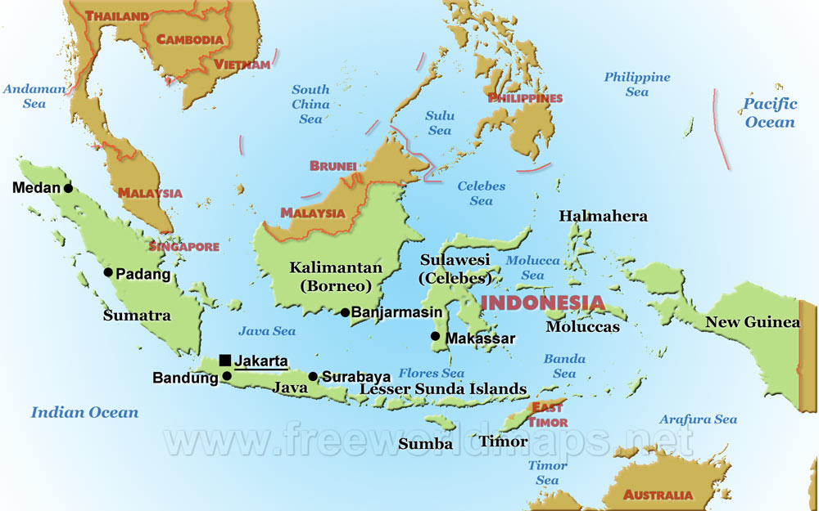
http://www.freeworldmaps.net/asia/indonesia/indonesia-map-political-big.jpg

Slide 6
Mapping and modelling dengue
Introduction
Data: areal counts
Aim: to identify important covariates, and account for spatial and temporal variation.
Approach: Bayesian hierarchical model
It is easy to specify a hierarchical structure on the data and/or parameters.
Use prior distributions to include information from neighbouring regions.
It is easy to specify spatial and temporal structure in prior distributions.

Slide 7
Background literature
Introduction
A variety of Bayesian spatio-temporal approaches have been used to model dengue fever.
A literature search was conducted to find journal articles about Bayesian spatial and spatio-temporal approaches to modelling dengue fever published from January 2000 to November 2017.
Thirty one articles were found.
Most studies used an intrinsic CAR prior structure for spatial and temporal variation.

Slide 8
Bayesian hierarchical models
Model
Linear predictor
Spatial random effects
Temporal random effects
Spatio-temporal random effects
Often represented by a CAR prior
Often represented by a CAR/AR prior
Often represented by a CAR/AR prior

Slide 9

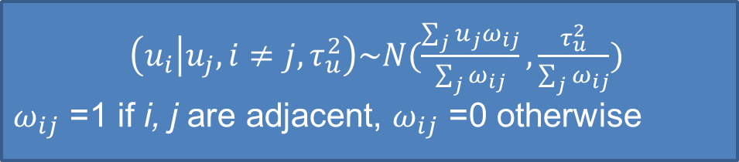
Conditional Autoregressive (CAR) prior
Model
CAR
Value of spatial random effect u_{i} in the ith area depends on its neighbours
Value is normally distributed with mean given by the average of its neighbours
Variance is inversely proportional to the number of neighbours
$$u_{i}$$
9
8
7
$\left(u_{i} | u_{j}, i≠j, τ_{u}^{2}\right)\sim N(\frac{\sum_{j}{u_{j}ω_{ij}}}{\sum_{j}{ω_{ij}}}, \frac{τ_{u}^{2}}{\sum_{j}{ω_{ij}}})$
$ω_{ij}$ =1 if i, j are adjacent, $ω_{ij}$ =0 otherwise
4
5
6
1
2
3

Slide 10

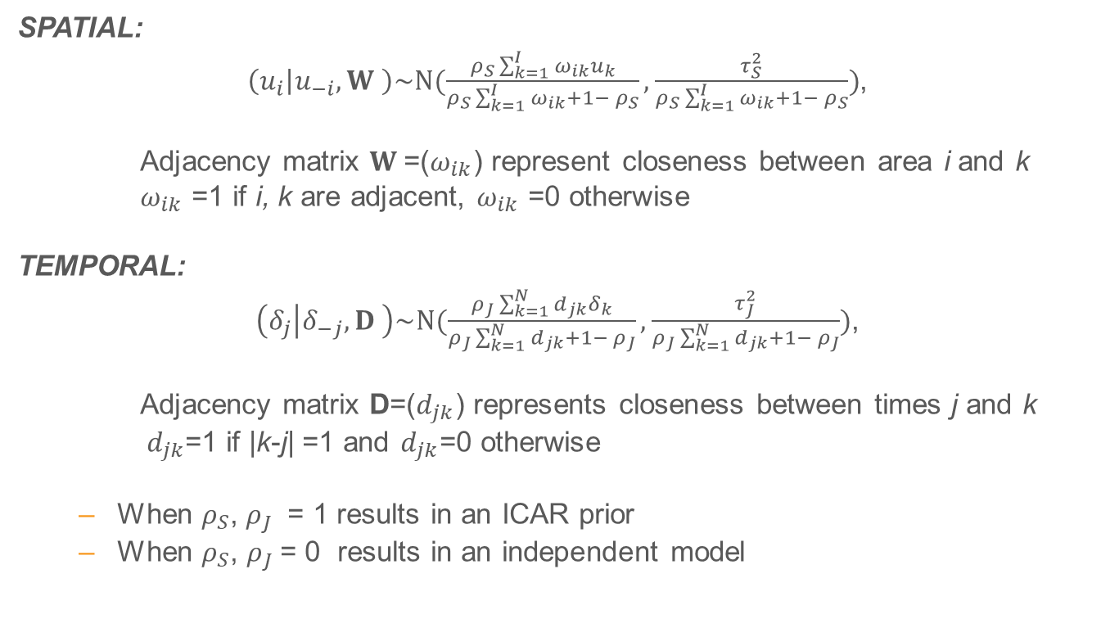
CAR Leroux Prior
Model
SPATIAL:
$\left(u_{i} | u_{−i}, W \right)\sim N(\frac{ρ_{S}\sum_{k=1}^{I}{ω_{ik}}u_{k}}{ρ_{S}\sum_{k=1}^{I}{ω_{ik}}+1− ρ_{S}}, \frac{τ_{S}^{2}}{ρ_{S}\sum_{k=1}^{I}{ω_{ik}}+1− ρ_{S}})$,
Adjacency matrix $W$=($ω_{ik}$) represent closeness between area i and k
$ω_{ik}$ =1 if i, k are adjacent, $ω_{ik}$ =0 otherwise
TEMPORAL:
$\left(δ_{j} | δ_{−j}, D \right)\sim N(\frac{ρ_{J}\sum_{k=1}^{N}{d_{jk}}δ_{k}}{ρ_{J}\sum_{k=1}^{N}{d_{jk}}+1− ρ_{J}}, \frac{τ_{J}^{2}}{ρ_{J}\sum_{k=1}^{N}{d_{jk}}+1− ρ_{J}})$,
Adjacency matrix D=($d_{jk}$) represents closeness between times j and k
$d_{jk}$=1 if |k-j| =1 and $d_{jk}$=0 otherwise
When $ρ_{S}$, $ρ_{J}$ = 1 results in an ICAR prior
When $ρ_{S}\text{, }ρ_{J}$= 0 results in an independent model

Slide 11
CAR Prior
Model
There are many software options that implement CAR prior.
We use CARBayesST in R

Slide 12
Model
6 different Bayesian Spatio-temporal CAR models
Spatio-temporal CAR linear^{[1]}
Spatio-temporal CAR ANOVA^{[2]}
Spatio-temporal separate spatial^{[3]}
Spatio-temporal CAR AR^{[4]}
Spatio-temporal CAR adaptive^{[5]}
Spatio-temporal CAR localised^{[6]}

Slide 13
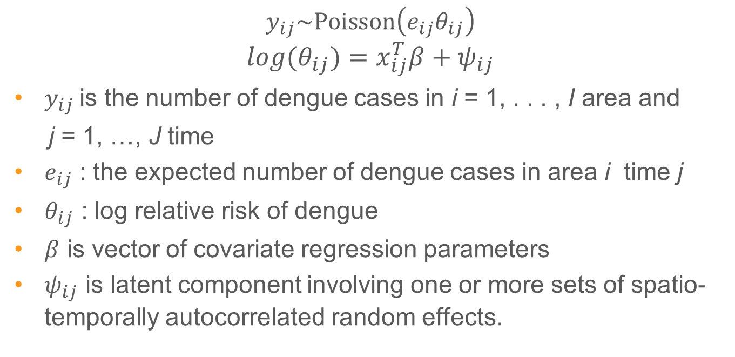
ST CAR localised model
Model
$$y_{ij}\sim Poisson\left(e_{ij}θ_{ij}\right)$$
$$log{(θ}_{ij})=x_{ij}^{T}β+ψ_{ij}$$
$y_{ij}$is the number of dengue cases in i = 1, . . . , I area and
j = 1, …, J time
$e_{ij}$ : the expected number of dengue cases in area i time j
$θ_{ij}$ : log relative risk of dengue
$β$ is vector of covariate regression parameters
$ψ_{ij}$ is latent component involving one or more sets of spatio-temporally autocorrelated random effects.

Slide 14
ST CAR localised model
Model
Suitable to identify clusters of areas that exhibit elevated values of the response compared with their geographical and temporal neighbours.
Similar to ST adaptive : both have no restrictive assumption that two areas close together must have similar estimation.
ST CAR localised: captures any step-changes in the response via the mean function, but
ST CAR adaptive captures any step changes via the correlation structure (via W).

Slide 15
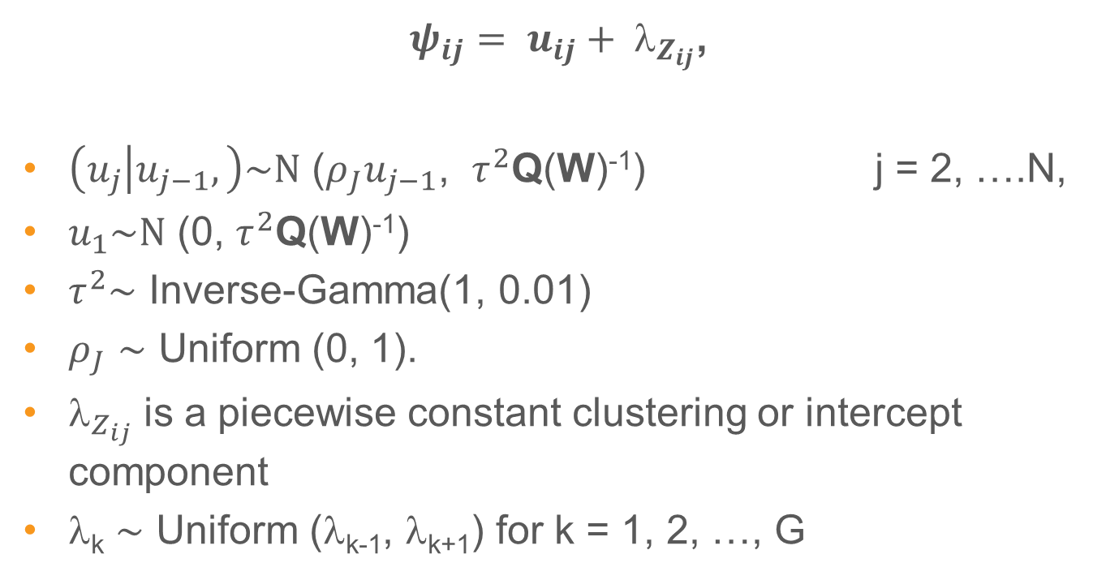
ST CAR localised model
Model
$ψ_{ij}= u_{ij}+ _{Z_{ij}}$,
$\left(u_{j} | u_{j−1},\right)\sim N$ ($ρ_{J}u_{j−1}$, $τ^{2}$Q(W)⁻¹) j = 2, ….N,
$u_{1}\sim N$ (0, $τ^{2}$Q(W)⁻¹)
$τ^{2}\sim$ Inverse-Gamma(1, 0.01)
$ρ_{J}$ $\sim$ Uniform (0, 1).
$_{Z_{ij}}$ is a piecewise constant clustering or intercept component
λ_{k} $\sim$ Uniform (λ_{k-1}, λ_{k+1}) for k = 1, 2, …, G

Slide 16
Back to the case study
Gap: Most analyses of dengue fever use a CAR BYM model which is only spatial, not spatio-temporal.
Data: Annual dengue fever incidence counts in 2002-2017 and monthly dengue in 2013-2017 for 14 areas in Makassar with climatic covariates (minimum, maximum, and average temperature; average humidity; rainfall).
Models: Bayesian spatio-temporal localised models with and without climatic covariates.
Analyses: fitted using CARBayes and compared using goodness-of-fit measures such as WAIC.

Slide 17
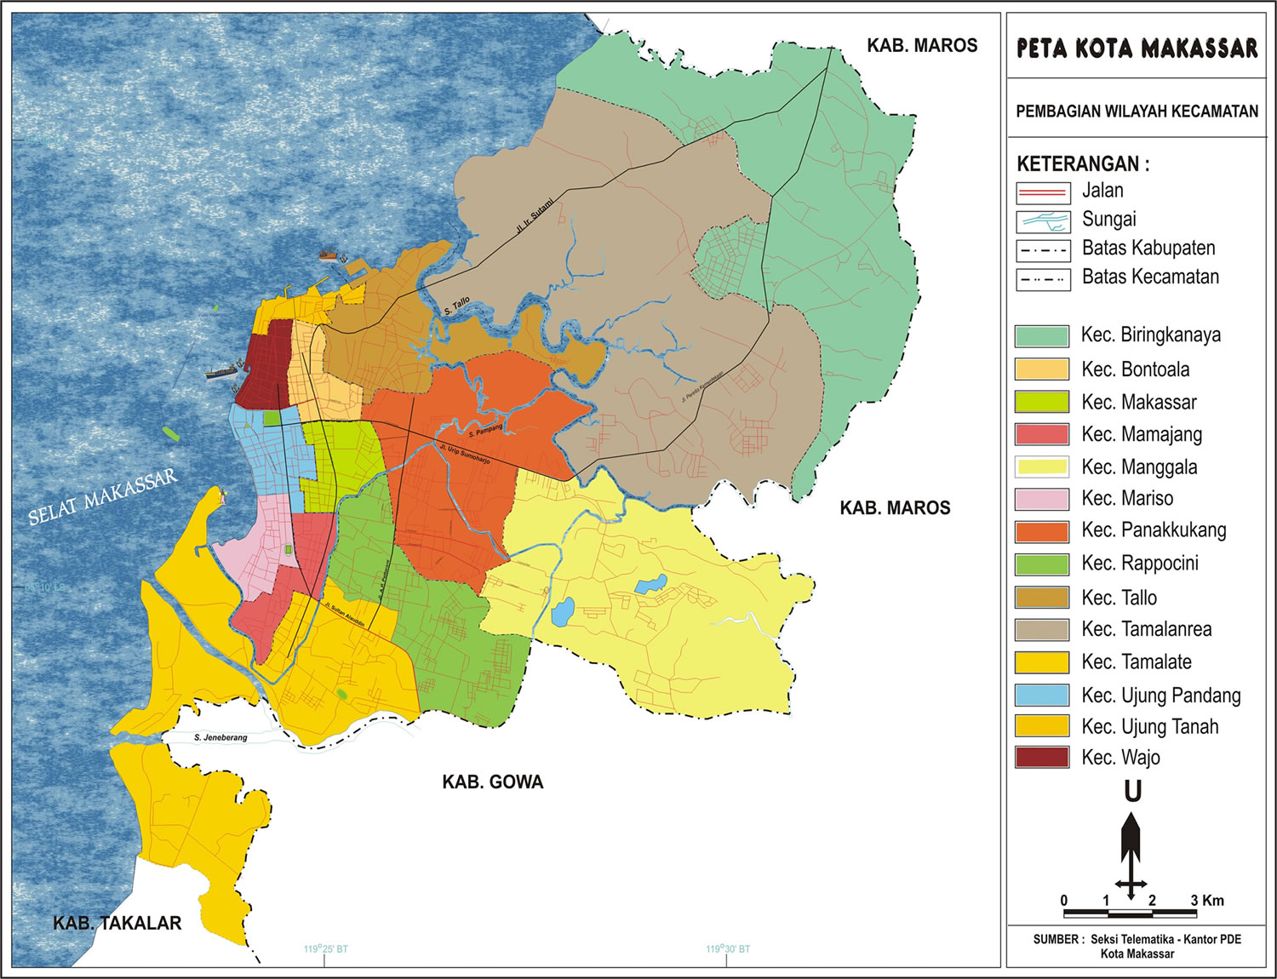
Makassar Map
1
2
9
3
1
8
10
8
7
4
13
11
7
5
12
12
5
13
6
4
14
6
3
2
14
11
9
http://usahaarasy.blogspot.com.au/2012/02/makassar-dalam-peta.html
10

Slide 18
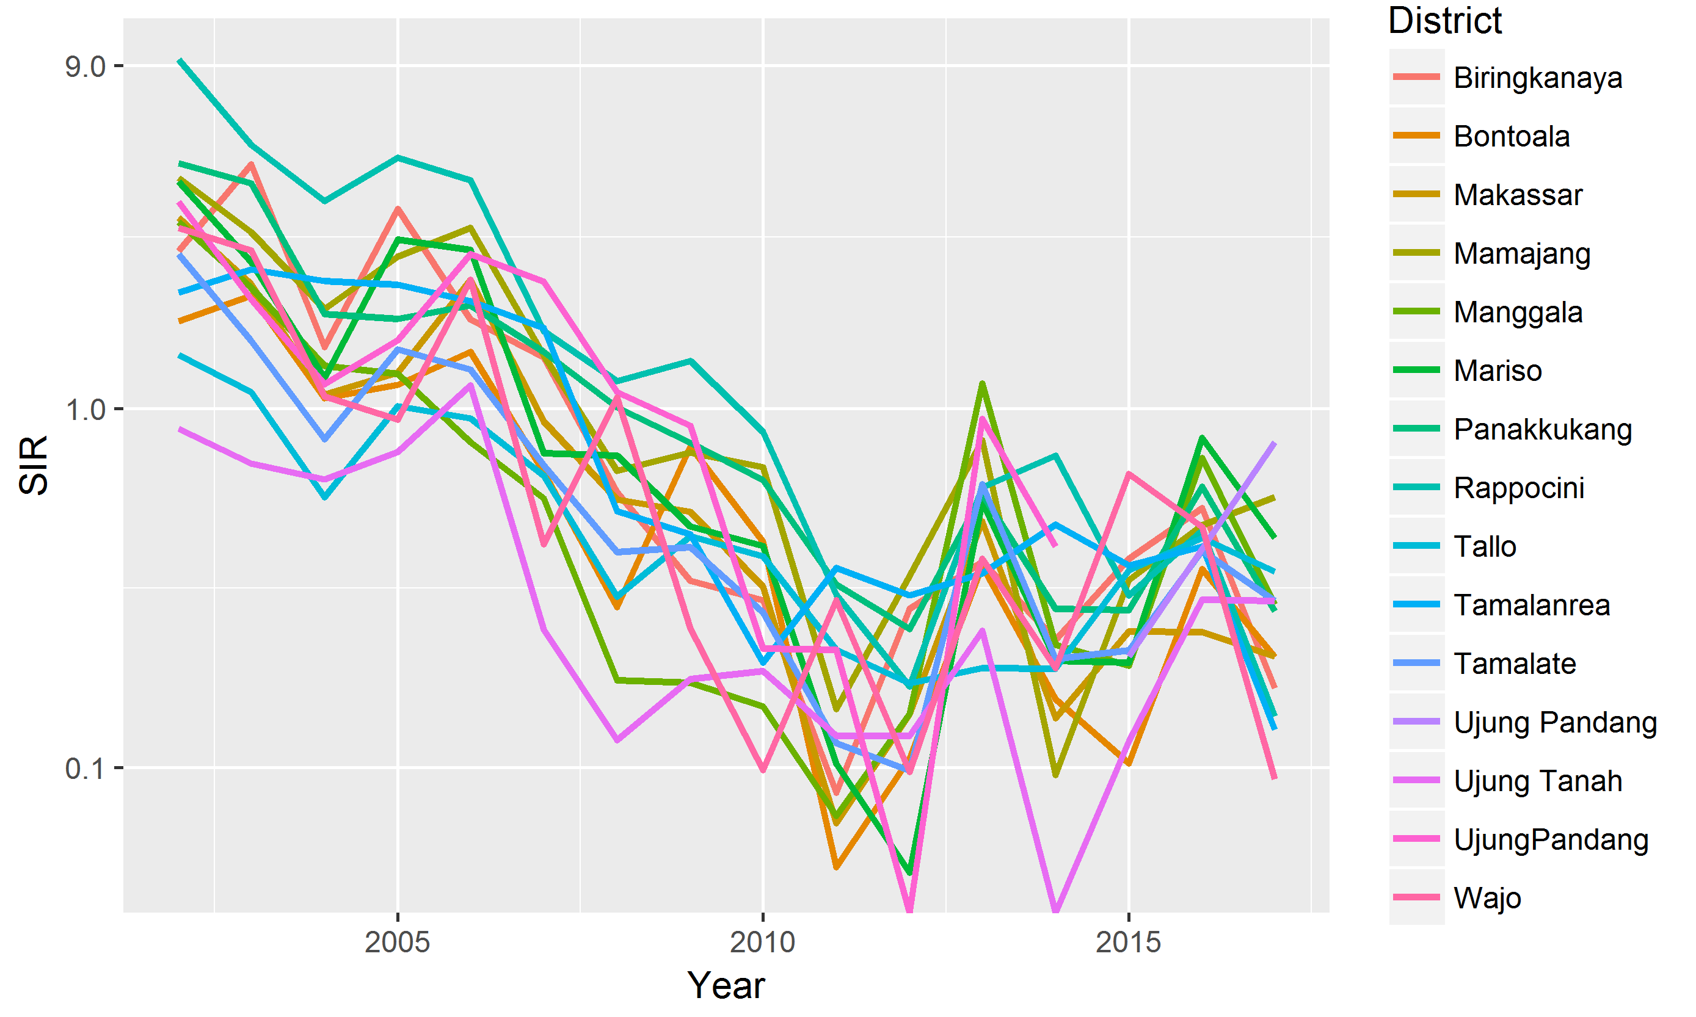
Plot of annual SIR for dengue in Makassar from 2002 to 2017
Spatial and temporal components must be taken into consideration
SIR is the ratio of the observed number of disease cases to the expected number of cases.

Slide 19
Plot of monthly SIR for dengue in Makassar from 2013 to 2017
Manggala has the highest SIR in 2013 (28.5)

Slide 20
Time series plot of min, max and average temperature

Slide 21
Time series plot of average humidity and total rainfall

Slide 22
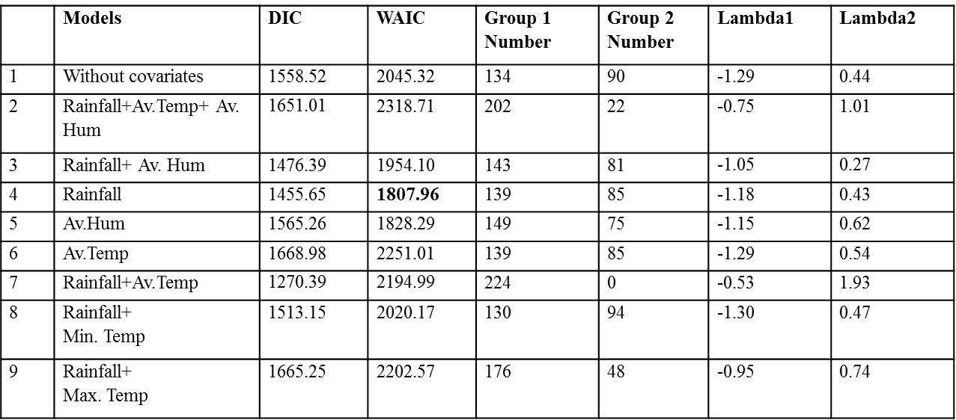
Bayesian Spatio-temporal CAR localised model with G=2 (annual data)
Results

Slide 23
Bayesian Spatio-temporal CAR localised model with G=3 (annual data)
Results
 | Models | DIC | WAIC | Group 1 Number | Group 2 Number | Group 3 Number | L1 | L2 | L3
1 | Without covariates | 1636.49 | 1915.22 | 0 | 165 | 59 | -3.64 | -1.02 | 0.84
2 | Rainfall+ Av.Temp+ Av. Hum | 1568.69 | 2085.11 | 1 | 173 | 50 | -2.63 | -0.97 | 1.05
3 | Rainfall+ Av. Hum | 1578.02 | 1905.19 | 1 | 181 | 42 | -2.71 | -0.89 | 0.97
4 | Rainfall | 1632.43 | 1890.28 | 1 | 160 | 63 | -2.57 | -1.05 | 0.79
5 | Av.Hum | 1560.75 | 1837.85 | 1 | 171 | 52 | -2.76 | -0.96 | 0.88
6 | Av.Temp | 1539.48 | 1862.02 | 1 | 179 | 44 | -2.54 | -0.86 | 0.89
7 | Rainfall+ Av.Temp | 1543.89 | 2034.56 | 1 | 181 | 42 | -3.44 | -0.89 | 1.07
8 | Rainfall+ Min.Temp | 1634.56 | 2038.78 | 1 | 179 | 44 | -2.99 | -0.92 | 1.03
9 | Rainfall+ Max. Temp | 1559.07 | 1773.86 | 1 | 179 | 44 | -5.95 | -0.91 | 0.96

Slide 24
The best model based on annual data
A spatio-temporal CAR localised model with G=3 with incorporation of rainfall and maximum temperature provided the best fit based on WAIC.
The preferred model consists of three clusters
No. data points in each cluster:
Group 1: 1
Group 2: 179
Group 3: 44

Slide 25
Example of the localised structure for model with and without covariates 2009
Year 2009
ST CAR localised G=3 without covariate |  |  |  | ST CAR localised G=3+ Rainfall+Max.temperature
Districts | Dengue cases | Fitted.value | Localised structure | Fitted.value | Localised structure
Rappocini | 68 | 66.62378 | 2 | 73.30964 | 3
Tamalate | 22 | 21.96567 | 2 | 22.11699 | 2
Makassar | 15 | 14.6584 | 2 | 14.49328 | 2
Mariso | 9 | 9.078264 | 2 | 8.807504 | 2
Mamajang | 16 | 15.0618 | 2 | 13.3355 | 2
UjungPandang | 9 | 7.592241 | 2 | 7.313148 | 2
Tallo | 21 | 21.48564 | 2 | 19.90814 | 2
Manggala | 6 | 7.167287 | 2 | 7.798066 | 2
Panakkukang | 38 | 37.72581 | 2 | 36.55309 | 2
Wajo | 3 | 4.732347 | 2 | 3.911177 | 2
Bontoala | 17 | 15.3626 | 2 | 14.06401 | 2
Ujung Tanah | 3 | 4.19556 | 2 | 3.602242 | 2
Tamalanrea | 14 | 14.29144 | 2 | 13.18141 | 2
Biringkanaya | 15 | 15.08086 | 2 | 15.00058 | 2

Slide 26
Example of the localised structure for model with and without covariates 2014
Year 2014
ST CAR localised G=3 without covariate |  |  |  | ST CAR localised G=3+ rainfall+Max.temperature
Districts | Dengue cases | Fitted.value | Localised structure | Fitted.value | Localised structure
Rappocini | 41 | 35.51295 | 2 | 36.38011 | 2
Tamalate | 13 | 13.98324 | 2 | 14.09058 | 2
Makassar | 4 | 4.532122 | 2 | 4.663132 | 2
Mariso | 4 | 4.147462 | 2 | 4.275914 | 2
Mamajang | 2 | 4.383965 | 2 | 4.238841 | 2
UjungPandang | 4 | 3.005296 | 2 | 2.919578 | 2
Tallo | 9 | 9.355468 | 2 | 9.714985 | 2
Manggala | 10 | 10.11582 | 2 | 9.756957 | 2
Panakkukang | 14 | 13.51725 | 2 | 13.50236 | 2
Wajo | 2 | 2.803864 | 2 | 3.123424 | 2
Bontoala | 3 | 3.522545 | 2 | 4.404568 | 2
Ujung Tanah | 0 | 1.337535 | 2 | 0.068481 | 1
Tamalanrea | 18 | 15.65564 | 2 | 15.92064 | 2
Biringkanaya | 15 | 15.09974 | 2 | 14.99471 | 2

Slide 27
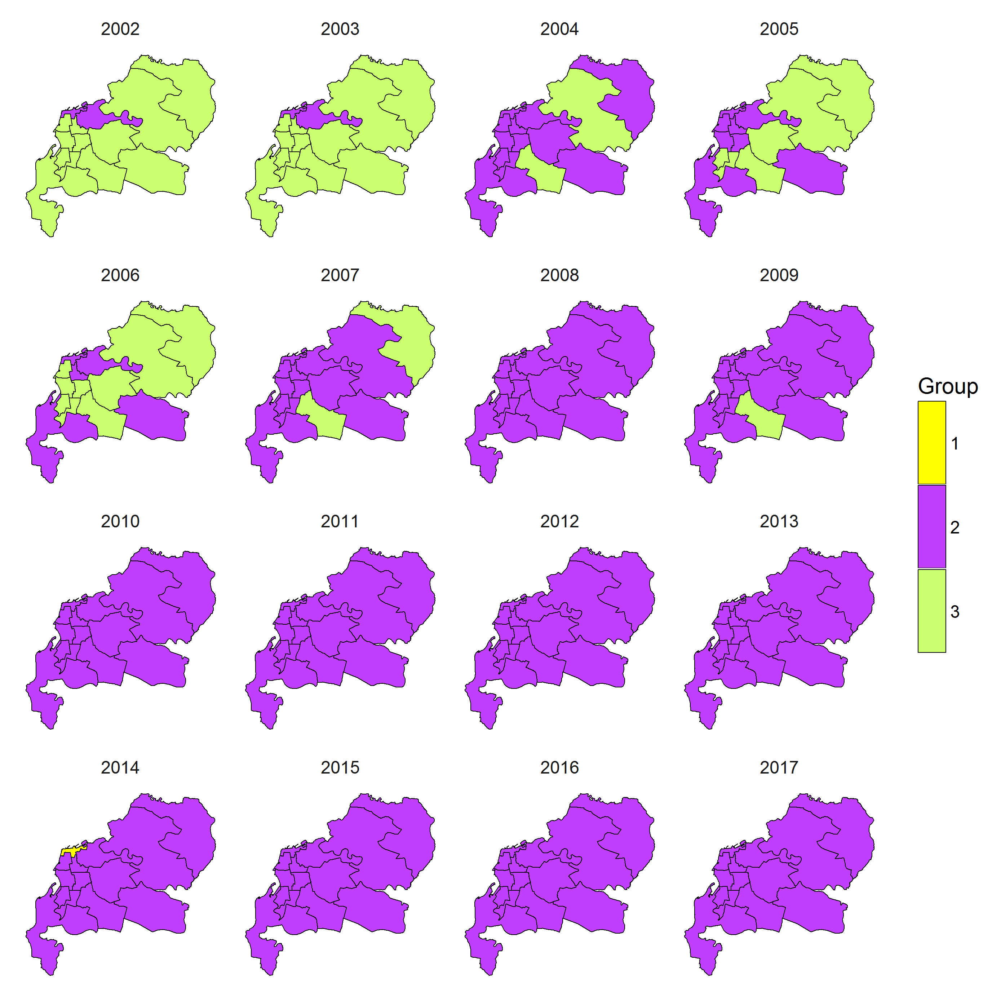
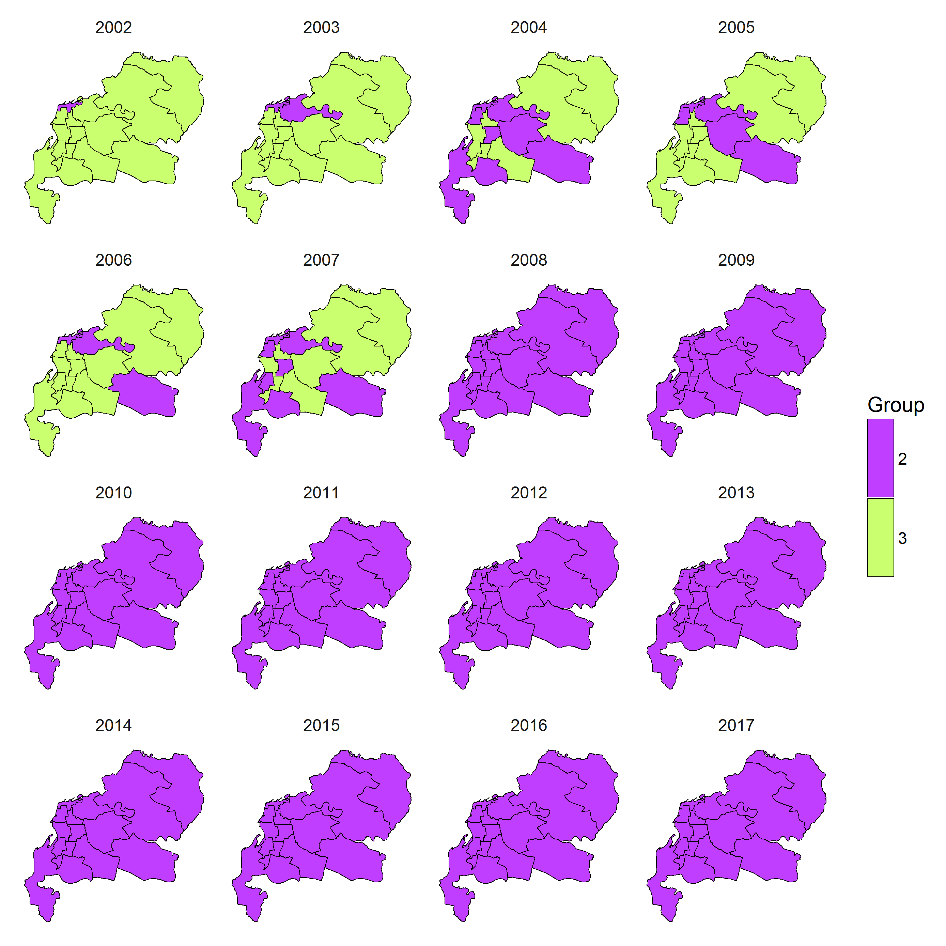
Localised maps obtained under the spatio-temporal CAR localised model for annual data, with G=3 without covariates (Map 1) and with covariates (rainfall and maximum temperature (Map 2)
Resuts
Map 1
Map 2

Slide 28
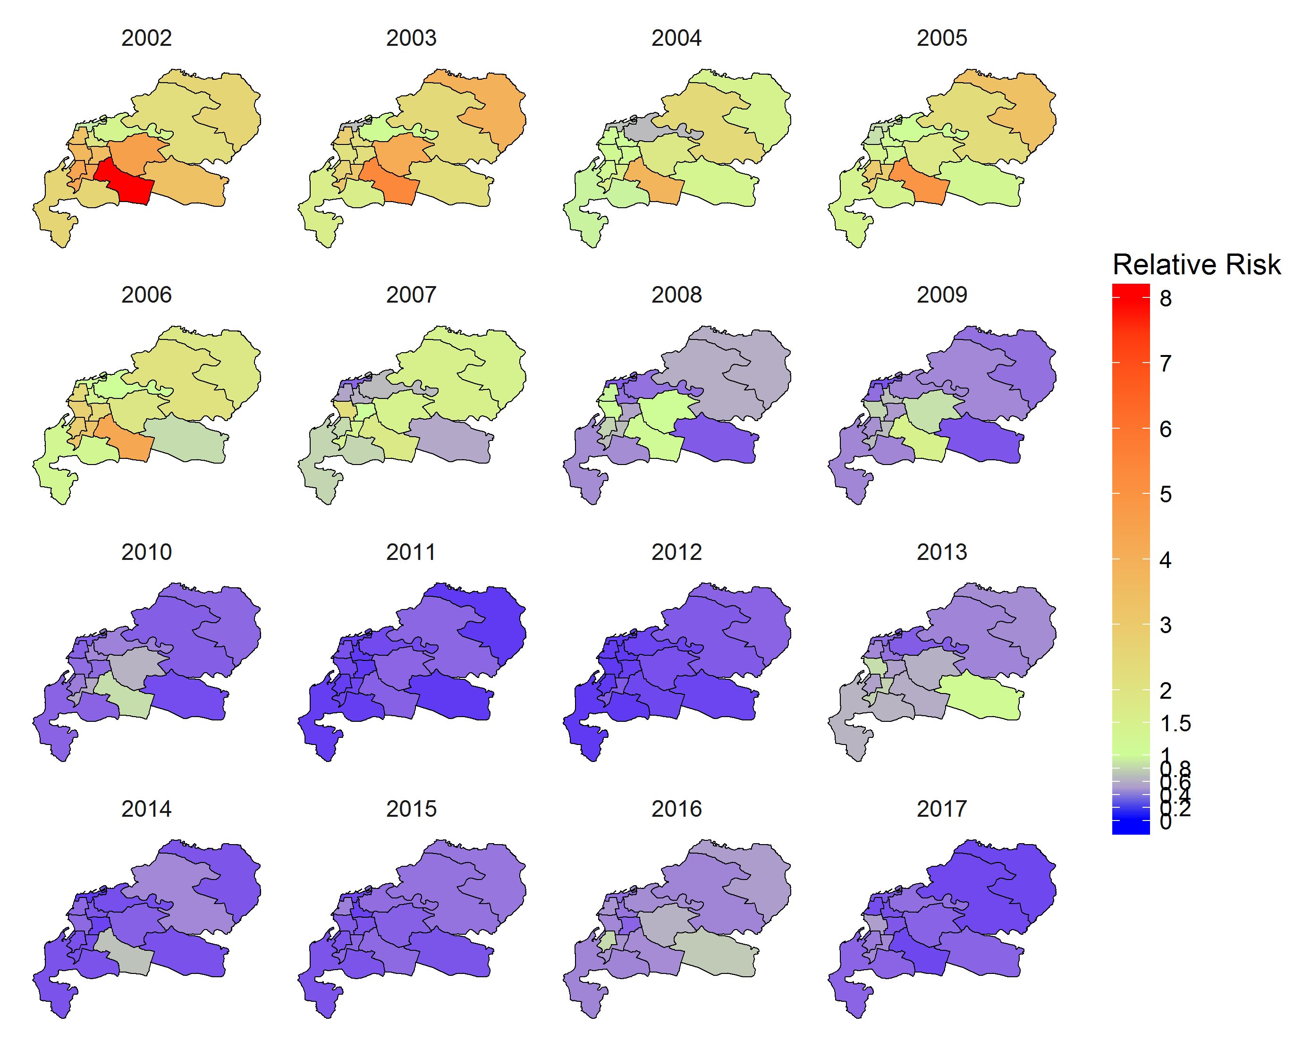
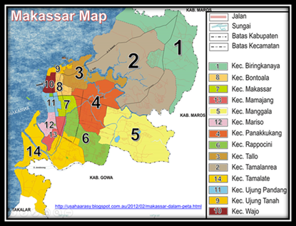
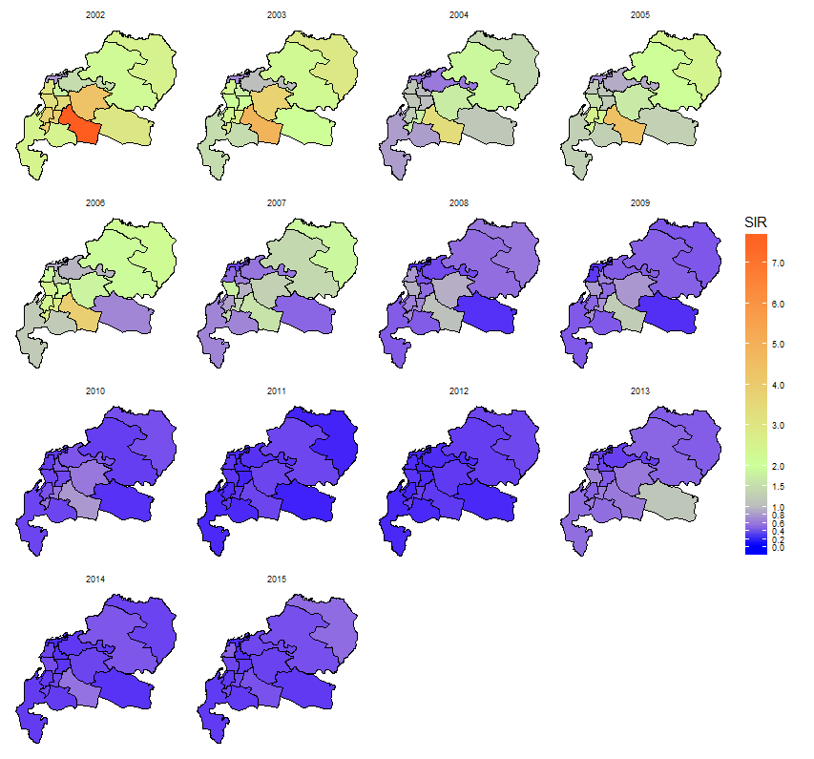
SIR maps obtained under the spatio-temporal CAR localised model with G=3 with rainfall and maximum temperature

Slide 29
Bayesian Spatio-temporal CAR localised model with G=2 (monthly data)
Results
 | Models | DIC | WAIC | Group 1 | Group 2 | Lambda1 | Lambda2
1 | Without covariates | 2090.33 | 2846.39 | 840 | - | -0.68 | 6.49
2 | Rainfall* + Av.Temp*+ Av. Hum | 1977.78 | 2125.841 | 840 | - | -0.69 | 9.33
3 | Rainfall*+ Av. Hum | 1997.17 | 2100.67 | 840 | - | -0.69 | 16.57
4 | Rainfall* | 2043.53 | 2139.017 | 840 | - | -0.69 | 15.02
5 | Av.Hum | 2036.81 | 2126.05 | 840 | - | -0.69 | 14.07
6 | Av.Temp* | 2051.67 | 2282.66 | 840 | - | -0.69 | 2.41
7 | Rainfall+Av.Temp* | 2027.08 | 2085.93 | 840 | - | -0.69 | 29.54
8 | Rainfall*+Min. Temp* | 2035.63 | 2128.841 | 840 | - | -0.69 | 15.73
9 | Rainfall*+Max. Temp | 2148.34 | 2651.92 | 840 | - | -0.66 | 11.19
*Not significant

Slide 30
The best model based on monthly data
A spatio-temporal CAR localised model with G=2 with incorporation of average humidity is the best model based on AIC.
Average humidity is the only climatic covariates that substantive.
The WAIC of ST localised model G=2 with average humidity is much smaller (2126.05) than model without covariate (2846.39)
All model combinations consist of one cluster only

Slide 31
Summary
Results
Bayesian CAR models can allow for different representations of spatial, temporal and spatio-temporal patterns.
Results from the case study showed that all combination models performed differently.
For annual data, a spatio-temporal CAR localised model with G=3 with incorporation of rainfall and maximum temperature provided the best fit based on WAIC.
For monthly data, a spatio-temporal CAR localised model with G=2 with incorporation of average humidity provided the best fit based on WAIC.
Incorporation of covariates influenced the number of local groups. This warrants further investigation in the future.

