Slide 1

Establishing a Biostatistics
Unit at the University of Otago
Presented by
Assoc Prof Robin Turner, Dr Claire Cameron
Co-authors
Dr Ella Iosua, Dr Ari Samaranayaka

Slide 2
History
HRC funded positions at Otago
Changed to health sciences division funded role but managed within a department
Number of positions grew as need increased
Not necessarily as fast as the need
Ever increasing demand for biostatistical advice and collaboration on projects

Slide 3
Biostatistics Unit
Biostatistics Unit based and focused on Dunedin Health Sciences Campus
Established in late 2017
Successfully made it past our first birthday!
First year has been about establishing policies and practices to ensure:
sustainability long term
we address identified issues/challenges

Slide 4
But first the most important part - the people!

Slide 5
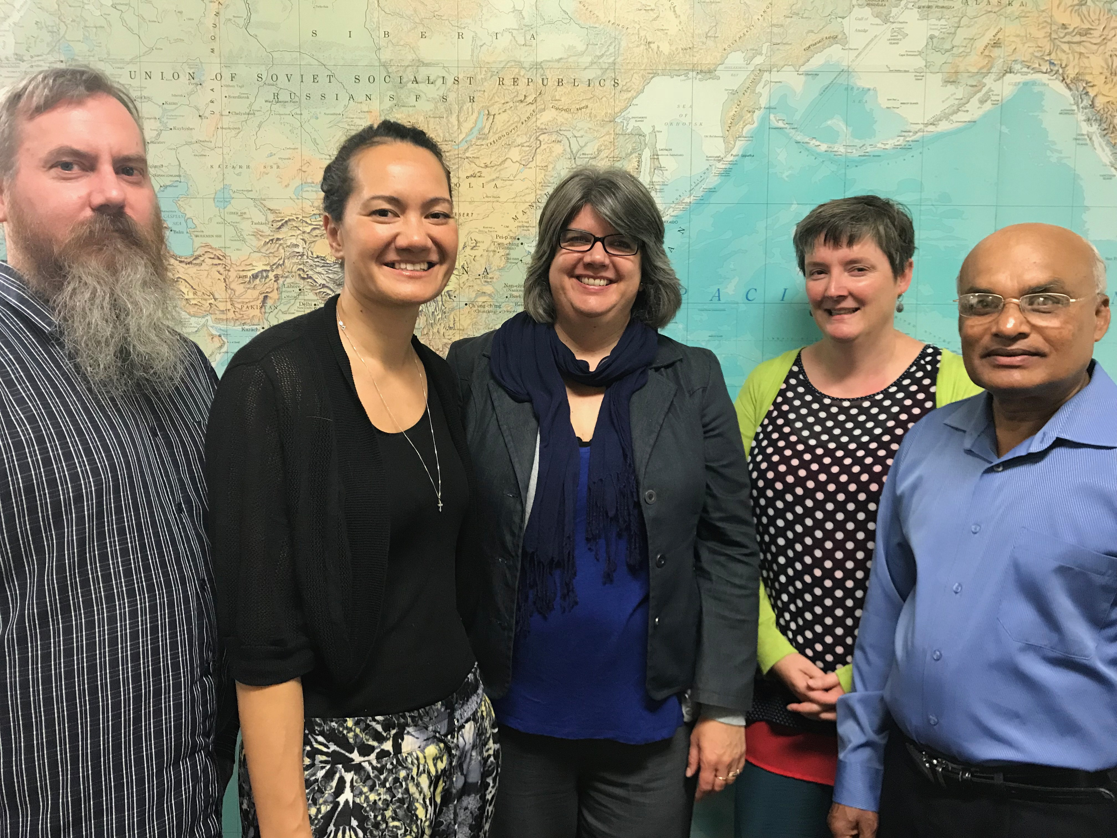
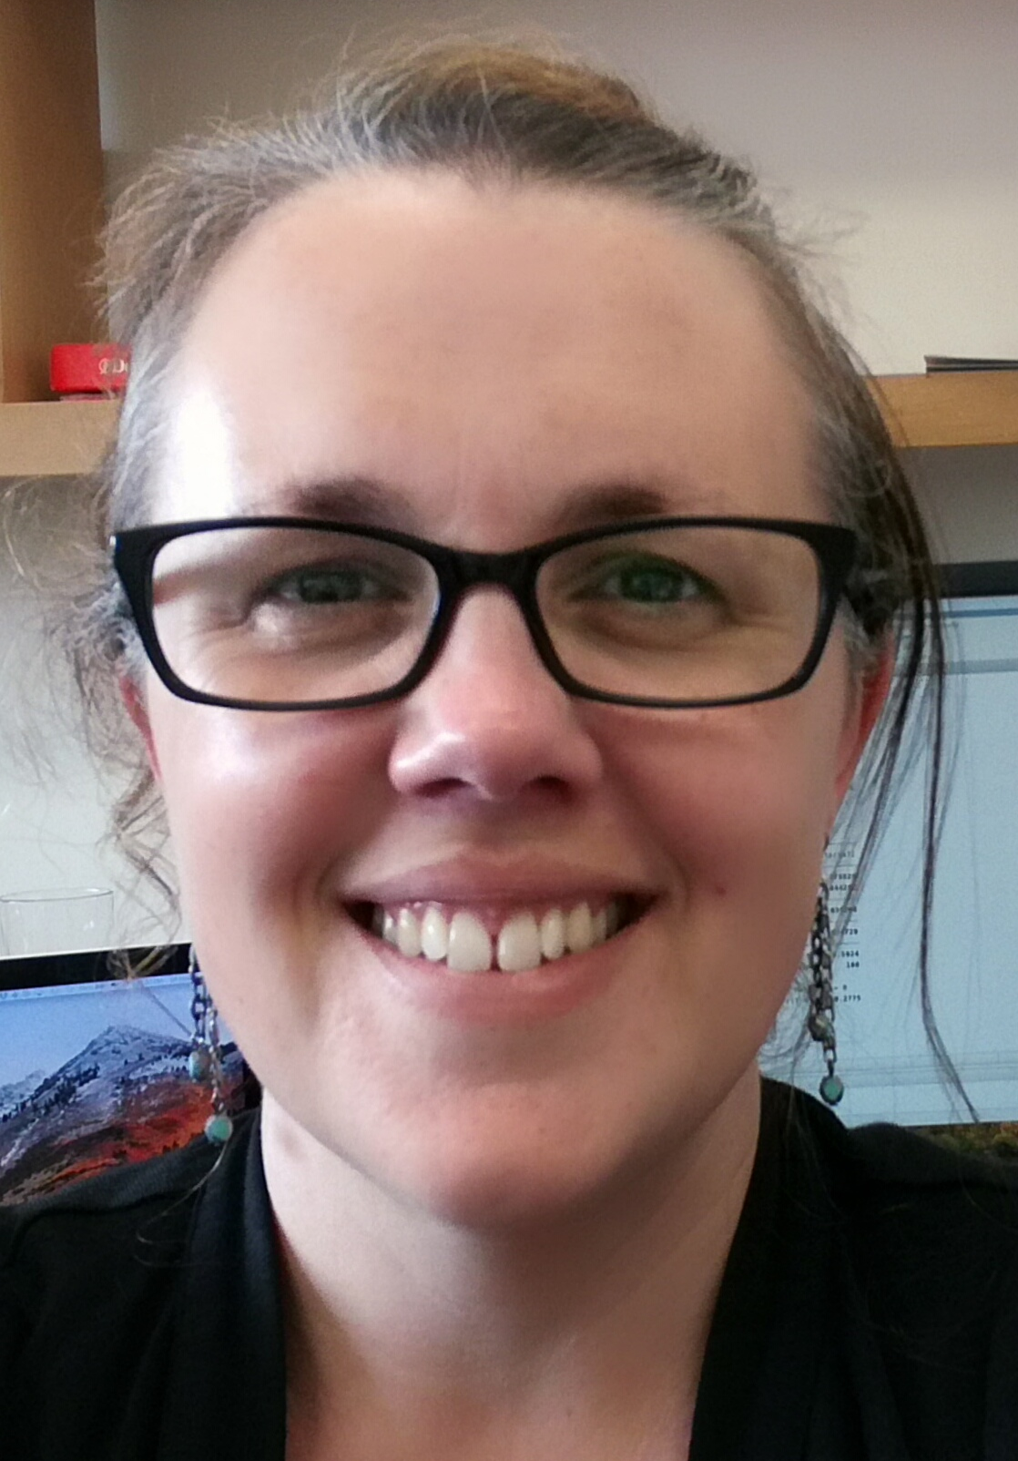
But first the most important part
Mr Andrew Gray
Dr Ella Iosua
Assoc Prof
Robin Turner
Dr Jill
Haszard
Dr Claire Cameron
Dr Ari Samaranayaka
The people!

Slide 6
What we do
Provide advice and collaboration across the Dunedin Health Sciences Campus
This includes a diverse range of departments and research
Also offer workshops and short courses
Policies and practices developed to address the issues identified in qualitative research

Slide 7
Qualitative Study
Box Plot Network
Cameron, C., Iosua, E., Parry, M., Richards, R., & Jaye, C. (2017). More than Just Numbers: Challenges for Professional Statisticians. Statistics Education Research Journal, 16(2)

Slide 8
Legitimacy and Integrity
I work in an organisation and at a location within that organisation that has a long history of valuing input from statisticians, both analytically and from a more general scientific perspective.
Many clients are apologetic about asking you to do something and say they would do it themselves if they had time. I ask them if they know of any weekend course in a particular type of surgery, as I would like to be able to earn some extra money as a locum. They seem to get the point.

Slide 9
Workforce Shortage
There doesn’t appear to be any shortage of people with an interest in biostatistics, but the number who have the combination of skills required to perform in a consulting role is much lower than that required to meet demand, even if funding was not an issue.

Slide 10
Communication with Non-statisticians
[It can be] difficult to understand what they want from us, they also do not understand what we say.
Good communication is essential, and it is something statisticians as a whole are not noted for. When working in an applied area it is up to the statistician to be the one that has to work at their communication skills. There should be some teaching of these in statistics courses.

Slide 11
Professional Isolation
[I] joined [a] biostatistics group where biostatisticians from the university meet. Joined Box Plot. Meet regularly with statisticians from other departments about technical issues and also informally. Created a support group within my department of statistics enthusiasts.

Slide 12
Marginalisation
I think the most important skills of a statistician aren't the number crunching ones, but thinking critically about how to collect the data required to answer certain questions, or to critically assess the usefulness of the data that is available

Slide 13
Other Issues
Being the main PI [Principal Investigator] on a small-scale project is likely viewed as more worthy than being an integral researcher (and major contributor) to really vital work that is being done in a collaborative setting.

Slide 14
Vision Statement
The Biostatistics Unit will be world leaders in providing biostatistical collaboration and advice for health related research and will be internationally recognised for their excellence in improving the quality of research, health knowledge and health outcomes.
Mission Statement
The Unit will provide biostatistical leadership and expertise in a rigorous and timely manner to research conducted in the Division of Health Sciences. We will achieve this goal by actively engaging in and facilitating collaborative research, applying appropriate quantitative methods, keeping abreast of methodological developments in biostatistics, contributing to biostatistical methods, contributing to biostatistics education of researchers and emerging biostatisticians, and promoting a collegial culture.

Slide 15
Legitimacy & integrity
Clarifying how we operate on our website
https://www.otago.ac.nz/dsm/research/otago676637.html
Adopting the ASA ethical guidelines
https://www.amstat.org//ASA/Your-Career/Ethical-Guidelines-for-Statistical-Practice.aspx
Upfront conversations about expectations on projects including authorship and how the collaboration will work

Slide 16
Professional isolation
Unit builds on existing networks
Regular meetings of broader group of biostatisticians
Box Plot
Unit draws together statisticians who may become isolated, e.g. statisticians who are on fixed term grant funded positions
Mentoring

Slide 17
Statistician workforce shortage
Opportunities to encourage and be involved in training biostatisticians
Long term job security
Capturing evidence on amount of work
Communication with non-statisticians
Online information about how we operate
Short courses to upskill non-statisticians
Self improvement, difficult conversations upfront

Slide 18
Marginalisation
Marketing
Visibility
Showcasing our strengths
Other Issues
Sustainable funding
Balancing the importance of others research versus our own

Slide 19
Discussion
Unit evolving to address needs of
biostatisticians
health researchers
Policy and practices implemented
Transparency
Vision and shared goals

Slide 20
Discussion
Questions for everyone
What has worked for you?
How would you set up such a unit?
Long term, where is the discipline heading and how do we support that?
Tips and traps?

Slide 21
Contact Details
Assoc Prof Robin Turner
robin.turner@otago.ac.nz
Dr Claire Cameron
claire.cameron@otago.ac.nz

