Slide 1
Statistical inference and management decisions
Helene H Thygesen
Department of Conservation
New Zealand

Slide 2



Price and cost components ($/unit)

Slide 3
Optimize sample size for cornflakes box premium survey
Loss components ($1000)
Mistake probability (%)
Sample size

Slide 4
In-play soccer betting
HOME ➔ ⬅ AWAY
5
5
6
7
Play $1, guess the next dead-ball event, and win!
3
4
8
8
20
35
For example, play $1 on the home team scoring, and win $35!
6
8

Slide 5
Optimize sample size for soccer study, to get the in-play odds right
Company’s loss components
Sample size

Slide 6
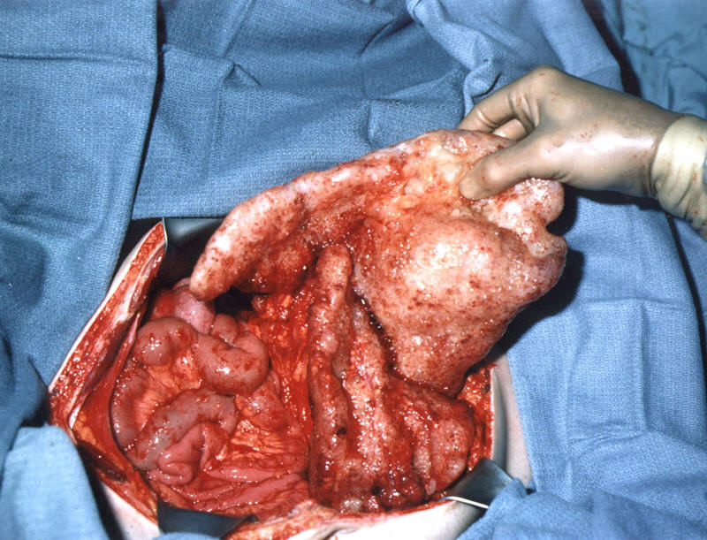

Chemotherapy after surgery?
Weak immune response against the tumour? Chemotherapy is needed
Strong immune response against the tumour? Chemotherapy damages the immune system so better to leave the patient in peace

Slide 7
Recommend chemo
Recommend no chemo

Slide 8


Aim of the study
I have some data. Can you calculate a p-value for me?
Ehh… what is your research question?
I don’t know but my supervisor told me that I need to present a p-value, otherwise it isn’t real science

Slide 9
Quantification of ethical imperatives
To calculate the utility function, I need to know the monetary value of a gained patient life year
Can’t do that!
OK, let’s say we have a fixed budget then. How many years of disability equals one life year?
Can’t do that
Hmmm ….. imagine it was your own child who had a choice between a 30% risk of permanent disability and a 10% risk of death
Now we are talking!

Slide 10




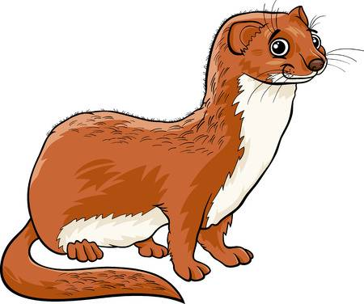





Spatio-temporal confounders
Management options
Ultimate outcomes
Threats

Slide 11
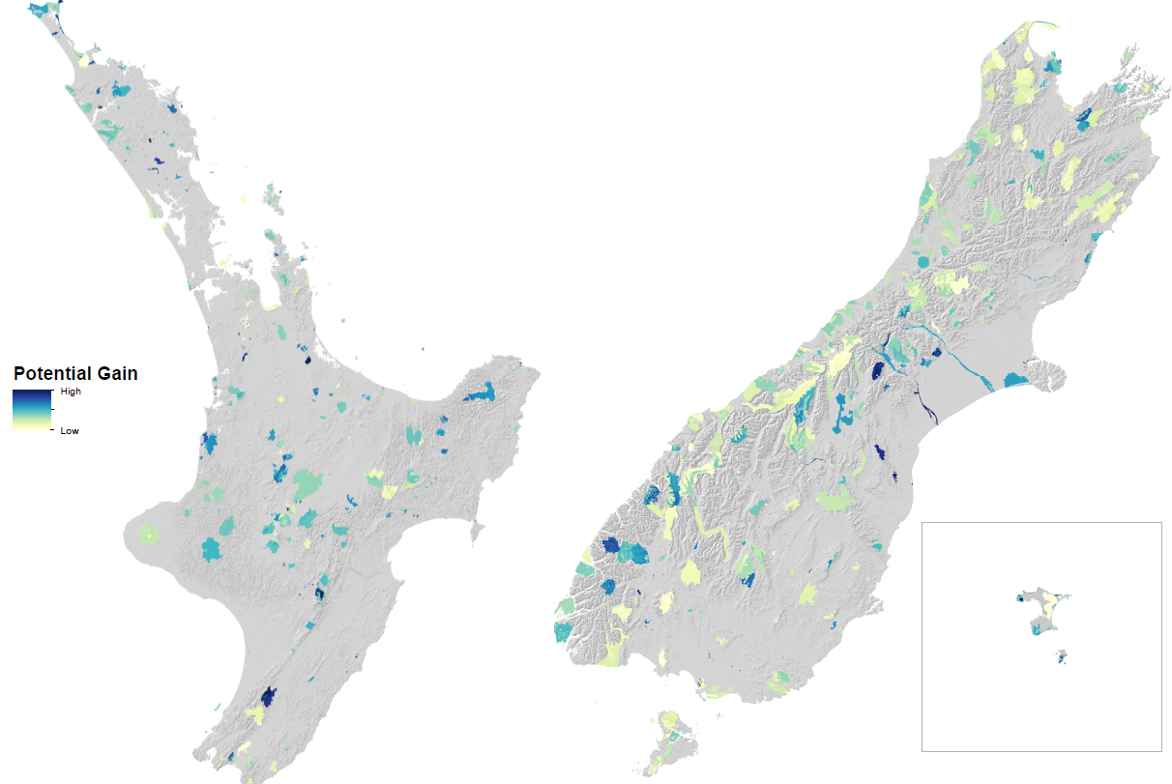
Department of Conservation: Benefits of pest management to ecosystem integrity

Slide 12
When supporting management decisions, you have to be Bayesian
You don’t need an informative prior
You don’t need to use Bayesian tools
You don’t need to report credibility intervals
But you DO need to be able to report expected utility gains under uncertainty ….
…. therefore you DO need to be able to add sampling variance to residual variance

