Slide 1
Rare Event Detection Methods Applied to Forensic Biology
James K¹, Chaseling J¹, Wright K^{1,2,3}, Bernie A³, Gabric A¹
¹ School of Environment and Science, Griffith University, 170 Kessels Road, Nathan, Queensland 4111, Australia
² Royal Australian Air Force (RAAF) No 2 Expeditionary Health Squadron, Williamtown, New South Wales 2318, Australia
³ Unrecovered War Casualties-Army, Australian Defence Force, Russell Offices, 2600, Canberra, Australia

Slide 2




“…her muscle force would probably be great for quick movements like boxing and basketball, and that she has the cardiac output for long endurance bike rides or runs.”

Slide 3


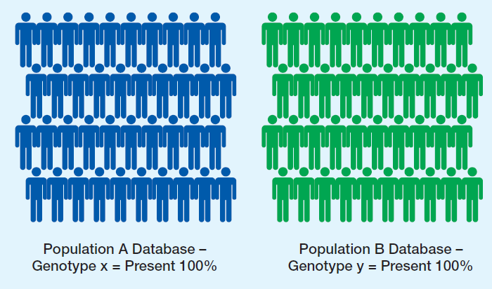


Case Study
Key
= Original sample (40)
= x variant
= y variant
Sample taken from POPULATION A
n = 40
Variant x occurrence = 100%
Variant y occurrence = 0%
Sample taken from POPULATION B
n = 40
Variant x occurrence = 0%
Variant y occurrence = 100%

Slide 4
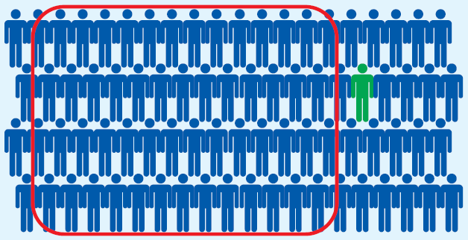
Missing Information
POPULATION A
Variant x occurrence = 99%
Variant y occurrence = 1%
ERROR
Key
= Original sample (40)
= x variant
= y variant

Slide 5
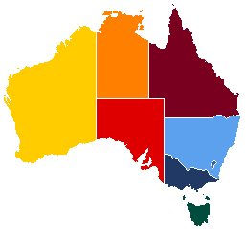

Forensic Biology DNA Database
DNA databases are regularly used in Forensic Biology to assist in casework/research
Database = Sample taken from a population
Constructed using different discriminatory criteria for distinguishing individuals between databases
Geographic location and Ethnicity
Identity -
Ancestry

Slide 6
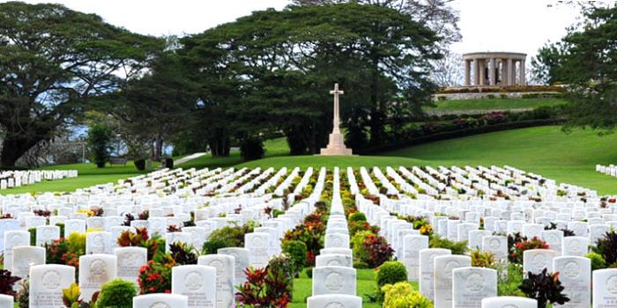
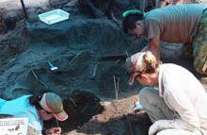
The UWC-A and their Mission
The Unrecovered War Casualties – Army (UWC-A) is a multidisciplinary group within the Australian Defence Force
Goal: Resolve cases of discovered military remains believed to belong to Australian soldiers
Reduce the chance of a soldier being misclassified as much as possible
Applicable to greater Forensic Biology discipline
Notes:
Check UWC-A website, only go to areas where cases have been presented

Slide 7


The Issue – Accurately Predicting Ancestry
Attempting to distinguish between WWII-era European Australians and WWII-era Japanese
Use numerous sections of DNA which have a variant seen nearly exclusively in one population but is uncommon/absent in the other
LARGER/MULTIPLE SAMPLE SIZE!
The Rare Event!

Slide 8
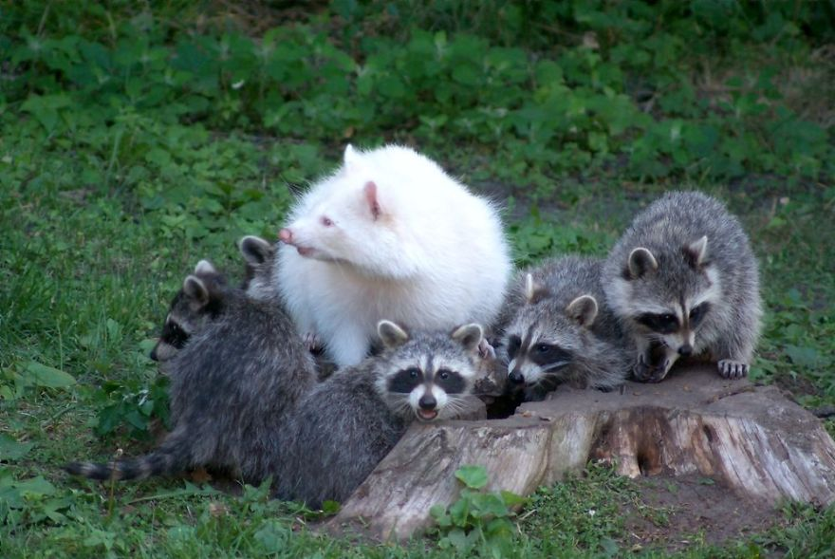
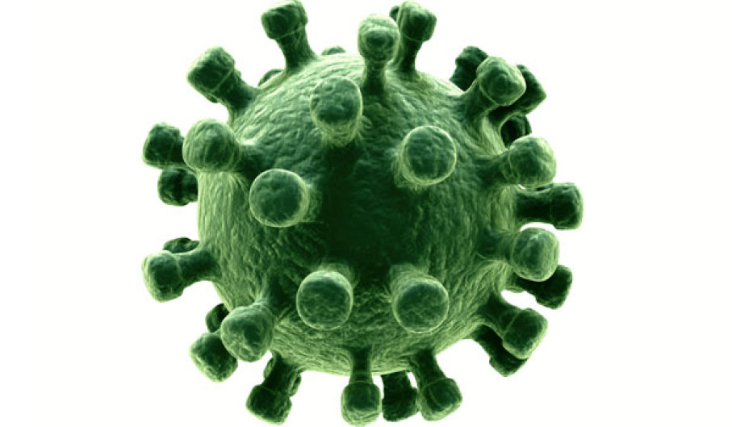
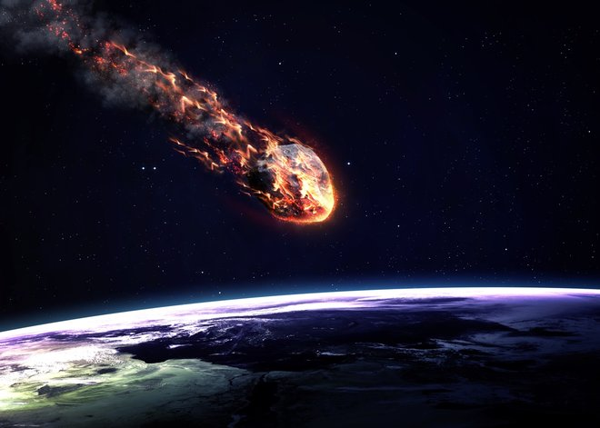
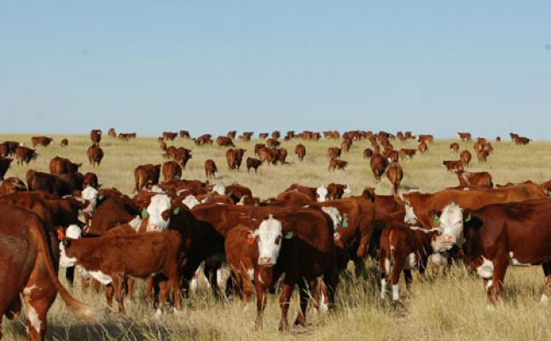
How Large is Large Enough?
Field of Study | Relevant Rare Event
Ecology | Rare species of flora/fauna
Epidemiology | Rare diseases
Veterinary Science | Rare diseased state animal in a herd
Counter-Terrorism | Terrorist attacks
Astronomy | Potential meteorites
Road construction | Vehicular crashes
Forensic Biology | Rare genetic variant not expected in a population
Criteria included…
Notes:
Forensic biologist’s stats background range. Matter of awareness

Slide 9
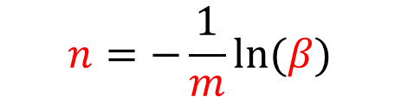
Proposed Application
Ecology study on rare species of molluscs
Green, R. H. and Young, R. C., 1993, “Sampling to detect rare species” Ecological Applications, 3, 351-356.
Minimum sample size required to detect a rare event
$$n=−\frac{1}{m}ln⁡(β)$$
Nominated Type 2 Error, i.e. the chance of not detecting the event when it IS present (Typically 20%, but Forensics prefer 5% or 1%)
Minimum Sample Size
The event’s rate of occurrence

Slide 10
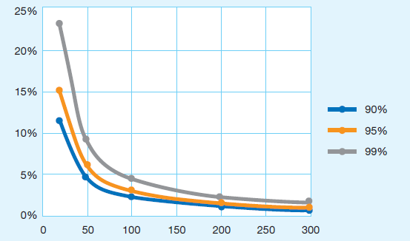
Reliability of a Database
Type II Error = Not detecting the rare event when it is actually present
Type II
Error
Rate of Occurrence
10%
5%
1%
Sample Size

Slide 11
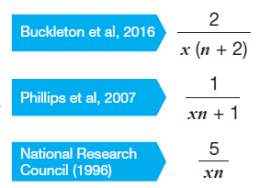
When the Rarity is Unknown
An estimate of the rate of occurrence is required
Undetected/Minimum DNA variant frequency
When a genetic variant of interest is not observed, or observed in low proportions in the sample
Buckleton, Phillips, and Committee on Identifying the Needs of the Forensic Sciences Community, National Research Council (USA)
2
2
2n
n = Primary sample size
Buckleton, J. S., Bright, J. A. and Taylor, D. eds., 2016, “Forensic DNA evidence interpretation”, CRC press.
National Research Council (NRC) Committee on DNA Forensic Science, 1996, “The Evaluation of Forensic DNA Evidence”, Washington, DC, National Academies Press.
Phillips, C., Salas, A., Sanchez, J. J., Fondevila, M., Gomez-Tato, A., Alvarez-Dios, J., Calaza, M., de Cal, M. C., Ballard, D., Lareu, M. V. and Carracedo, A., 2007, “Inferring ancestral origin using a single multiplex assay of ancestry-informative marker SNPs”, Forensic Science International: Genetics, 1, 273-280.

Slide 12
Primary Sample
n = 104
Buckleton
NRC
Phillips
m
$$n=−\frac{1}{m}ln⁡(β)$$
𝑛=−1/𝑚 ln⁡(𝛽)
To compare:
Primary sample of 104 Japanese individuals living in Tokyo (data obtained from the 1000Genomes Project)
The estimated Undetected/Minimum DNA variant frequency for each method was then used in Green and Young’s formula to calculate the required secondary sample size
n = 104

Slide 13

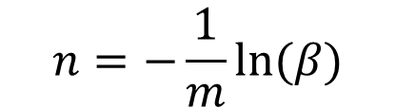
m = Event’s rate of occurrence
Where m is unknown
Post-sampling
2
m
$$n=−\frac{1}{m}ln⁡(β)$$
2
Where m is known
Primary Sample
Pre-sampling
Secondary Sample
$$n=−\frac{1}{m}ln⁡(β)$$

Slide 14
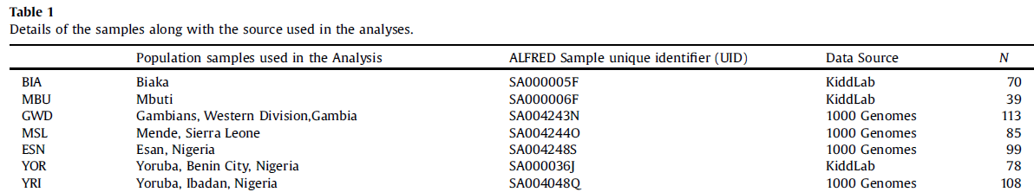
Shocking Sample Sizes!
Soundararajan, U., Yun, L., Shi, M., Kidd, K. K., 2016, “Minimal SNP overlap among multiple panels of ancestry informative markers argues for more international collaboration”, Forensic Science International: Genetics, 23,25-32.

Slide 15
Shocking Sample Sizes!
Soundararajan, U., Yun, L., Shi, M., Kidd, K. K., 2016, “Minimal SNP overlap among multiple panels of ancestry informative markers argues for more international collaboration”, Forensic Science International: Genetics, 23,25-32.
Sample Size | Number of Observations
1 – 20 | 6
21 – 50 | 27
51 – 100 | 29
101 – 200 | 15
Total | 77
e.g. 6 populations that are represented by 1 – 20 individuals
Notes:
Intelligence vs evidence

Slide 16



Recommendations
Collaborative Approach
Correctly pool previous published data to create larger, more accessible sample data
Updated Reporting Guideline Approach
Where sufficient samples are not available, report the limitations of the small sample
e.g. “This sample of n = 40 is only able to reliably detect an event as rare as 7%...”
Updated Database Construction Guideline Approach
Utilise rare event detection methodology when creating DNA databases for Forensic casework and research
Notes:
Updated database size guidelines

Slide 17
Acknowledgements
Funding – Australian Army Research Centre
Unrecovered War Casualties – Army
Principle Supervisor – Associate Professor Albert Gabric
Secondary Supervisors – Adjunct Associate Professor Janet Chaseling & Dr. Kirsty Wright
Forensic Research Team Members – Andrew Ghaiyed, Jasmine Connell, Melinda Mitchell
Griffith University
Institute of Health and Biomedical Innovation, Queensland University of Technology
Genomic Research Centre
Dimitrios Vagenas

