Slide 1
Www.MixedModel.Academy as a SaaS learning tool
Donghui Ma & Darren Murray

Slide 2
Content
1
Objectives
2
Service components
3
Current stage

Slide 3
Objectives

Slide 4
Objectives
Facilitate the paradigm shift from ANOVA to Mixed Model
Introduce ASReml to more market sectors outside agriculture/breeding
Provide online support for ASReml-R user with syntax generator
Provide matrix algebra associated with real data for deep learner
Provide future technical platform to move VSN software online

Slide 5
Objectives
  Challenge is to design a new product to:
    support (not to compete with) existing software
    introduce ASReml and related service to win new users from new market segments (for example, medicine, social science, etc.)
    invite and educate more ANOVA users to the REML world and increase the overall demand for Mixed Model Analysis (bigger TAM)

Slide 6
Service Components

Slide 7
Service Components
  Features (free services)
  Free membership and registration
  Data/code hosting
  Syntax generator from GUI for major mixed model tools
  Mixed Model Anatomy (Matrix Algebra) for mixed model theory learners
  VSN knowledge base as well as user generated cases
  Videos relevant for each step of the analysis

Slide 8
Service Components
  Products (Chargeable)
  Member subscription for privacy and REML results
  Software migration from other software to ASREML (W/R)
  Training/Certification
  Data management solutions
  Existing VSN products
  ….
  More opportunities will emerge as the member number grows

Slide 9
Current Stage

Slide 10


Slide 11
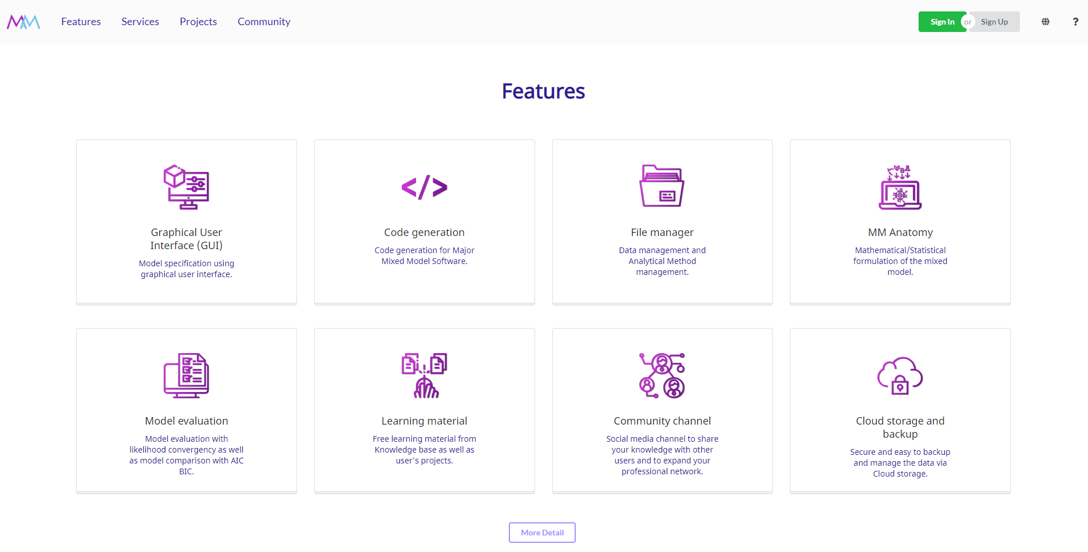

Slide 12
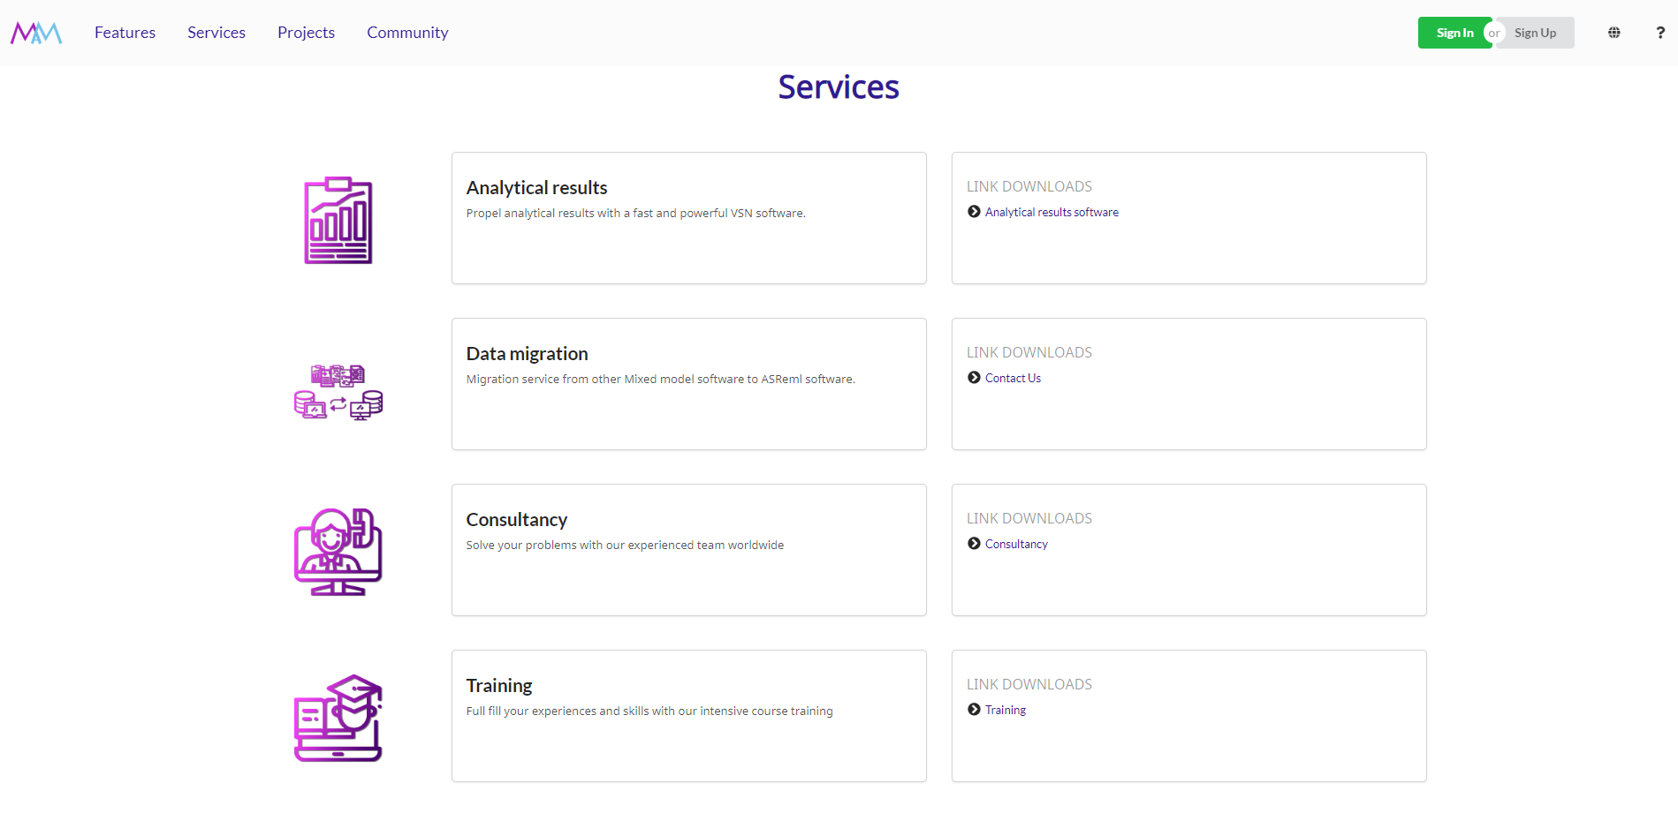

Slide 13
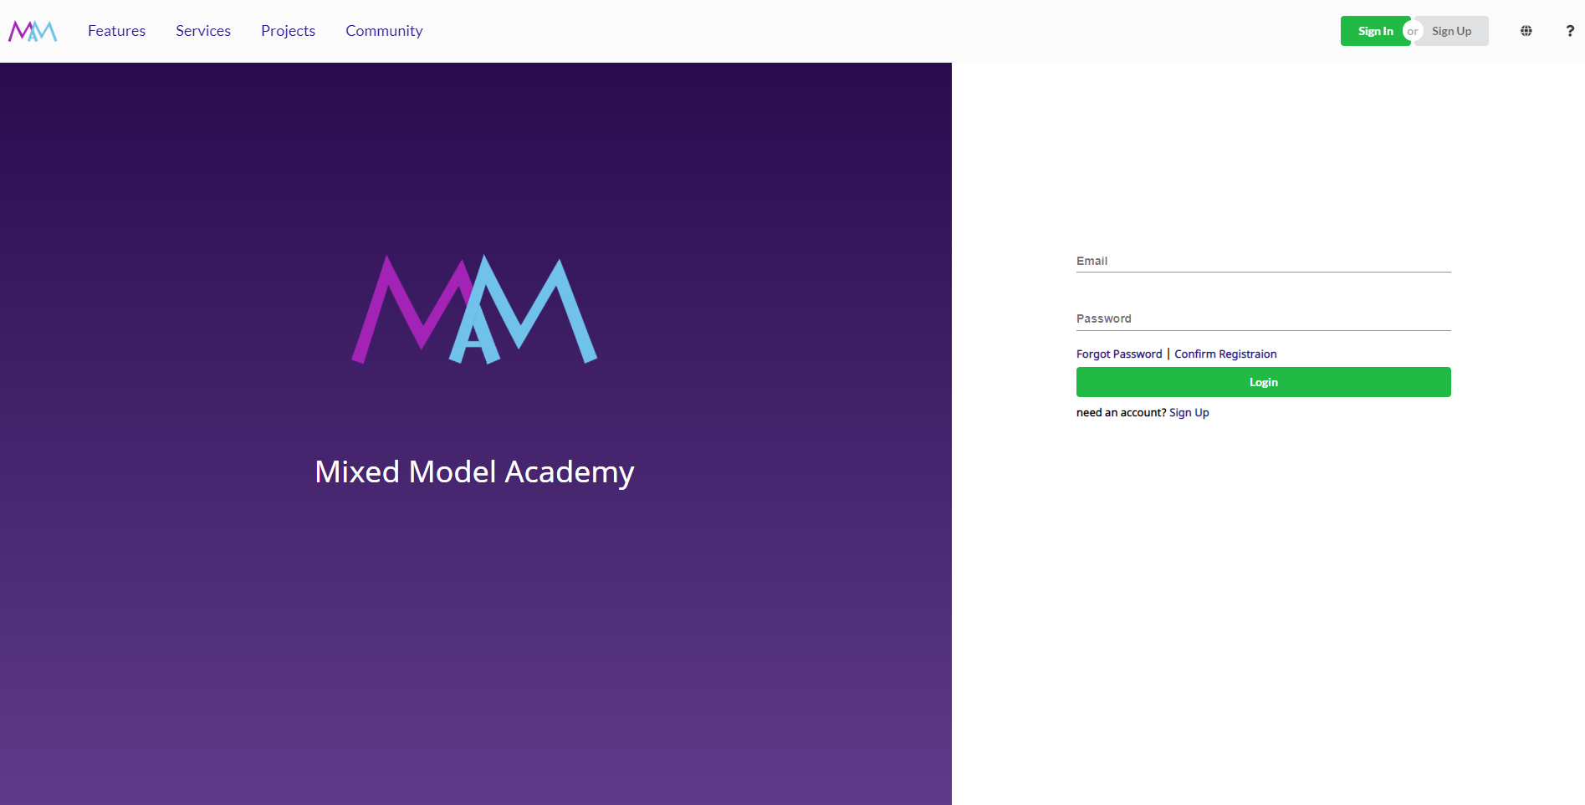

Slide 14
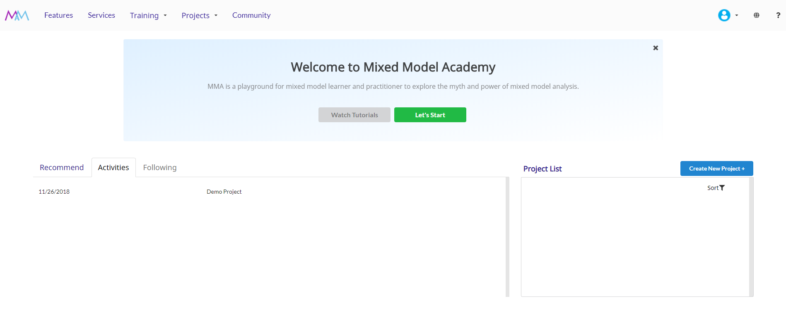


Slide 15
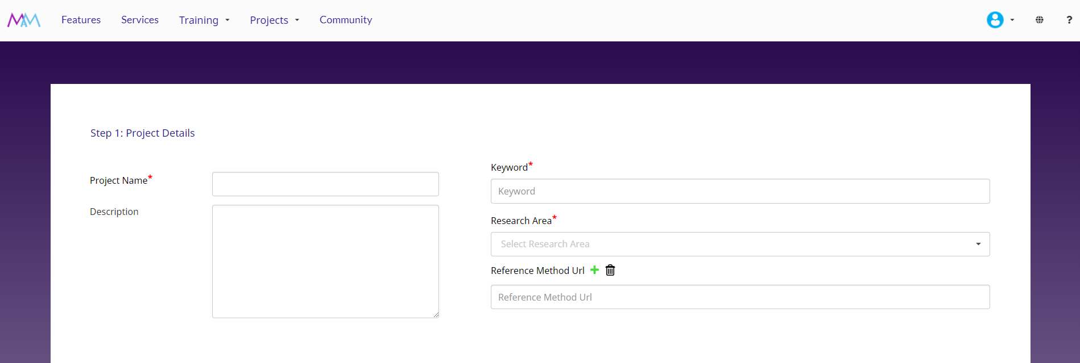

Slide 16
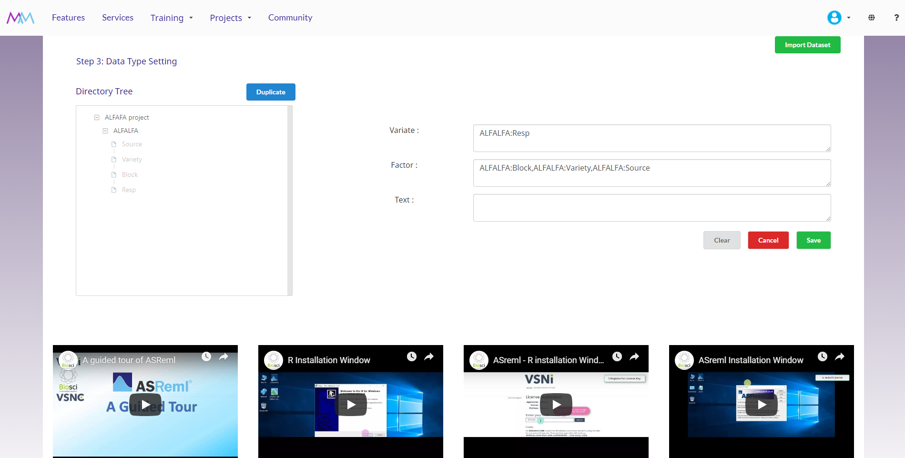

Slide 17
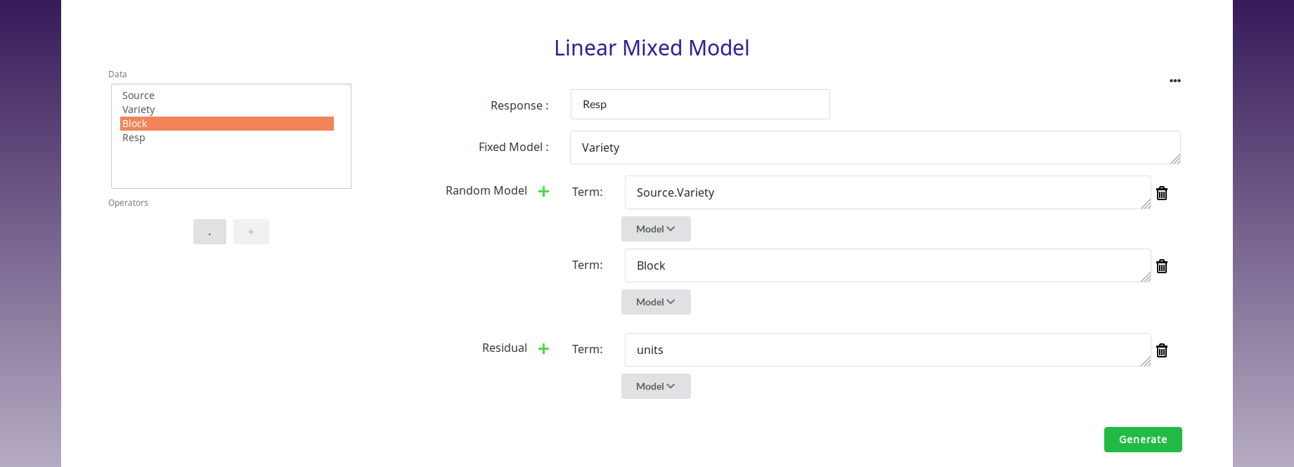

Slide 18
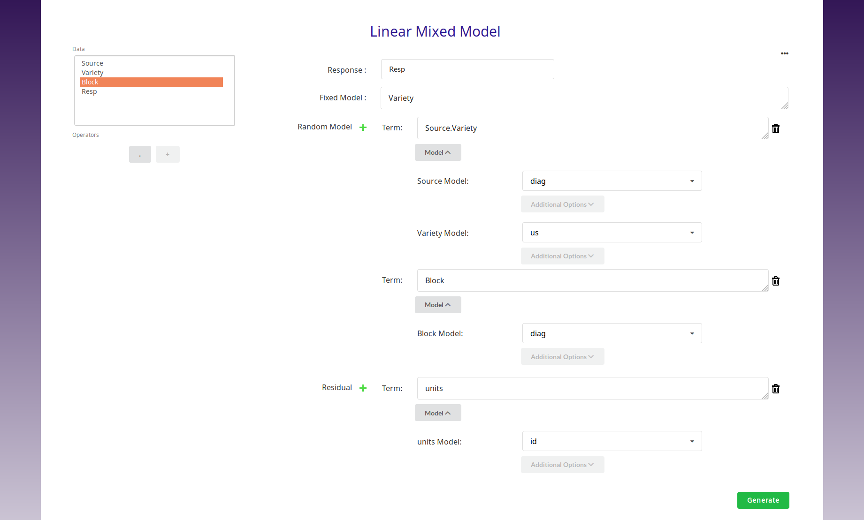

Slide 19
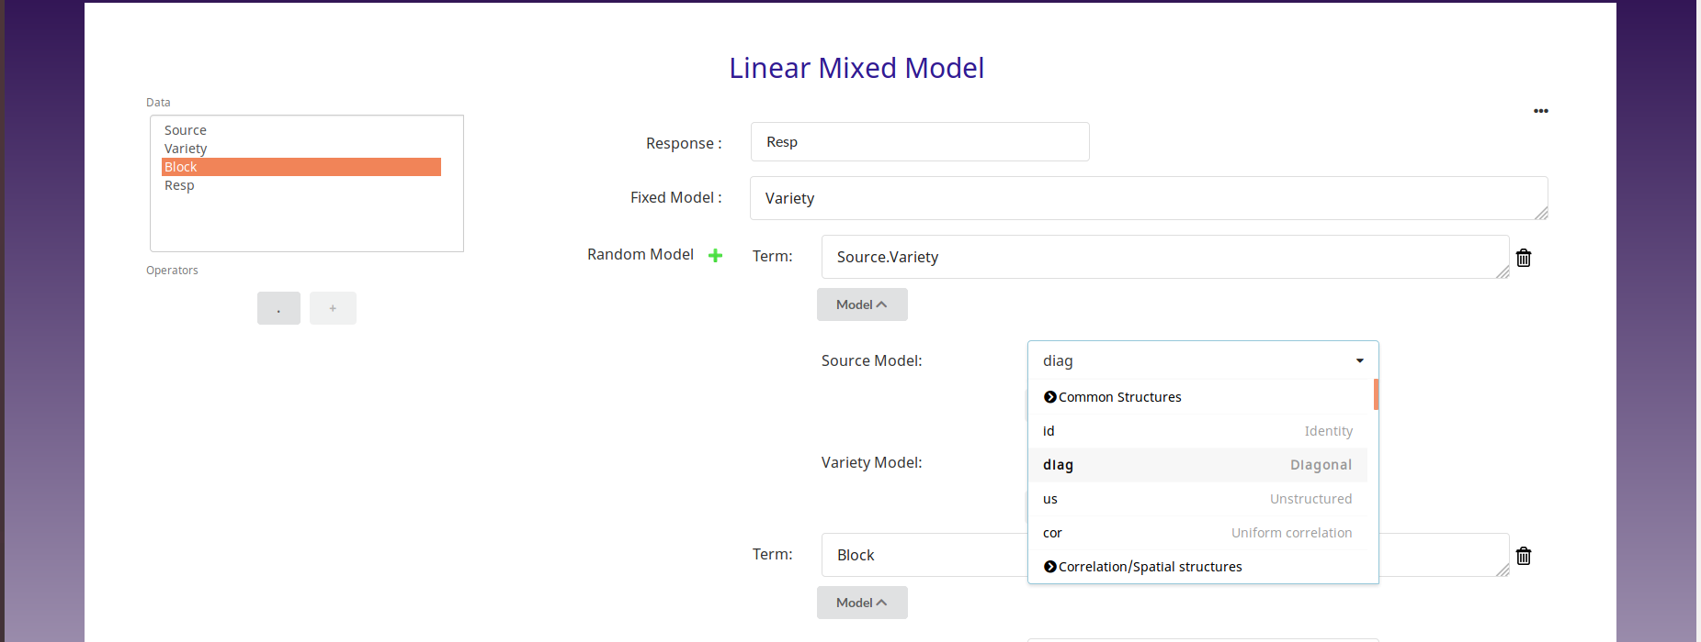

Slide 20
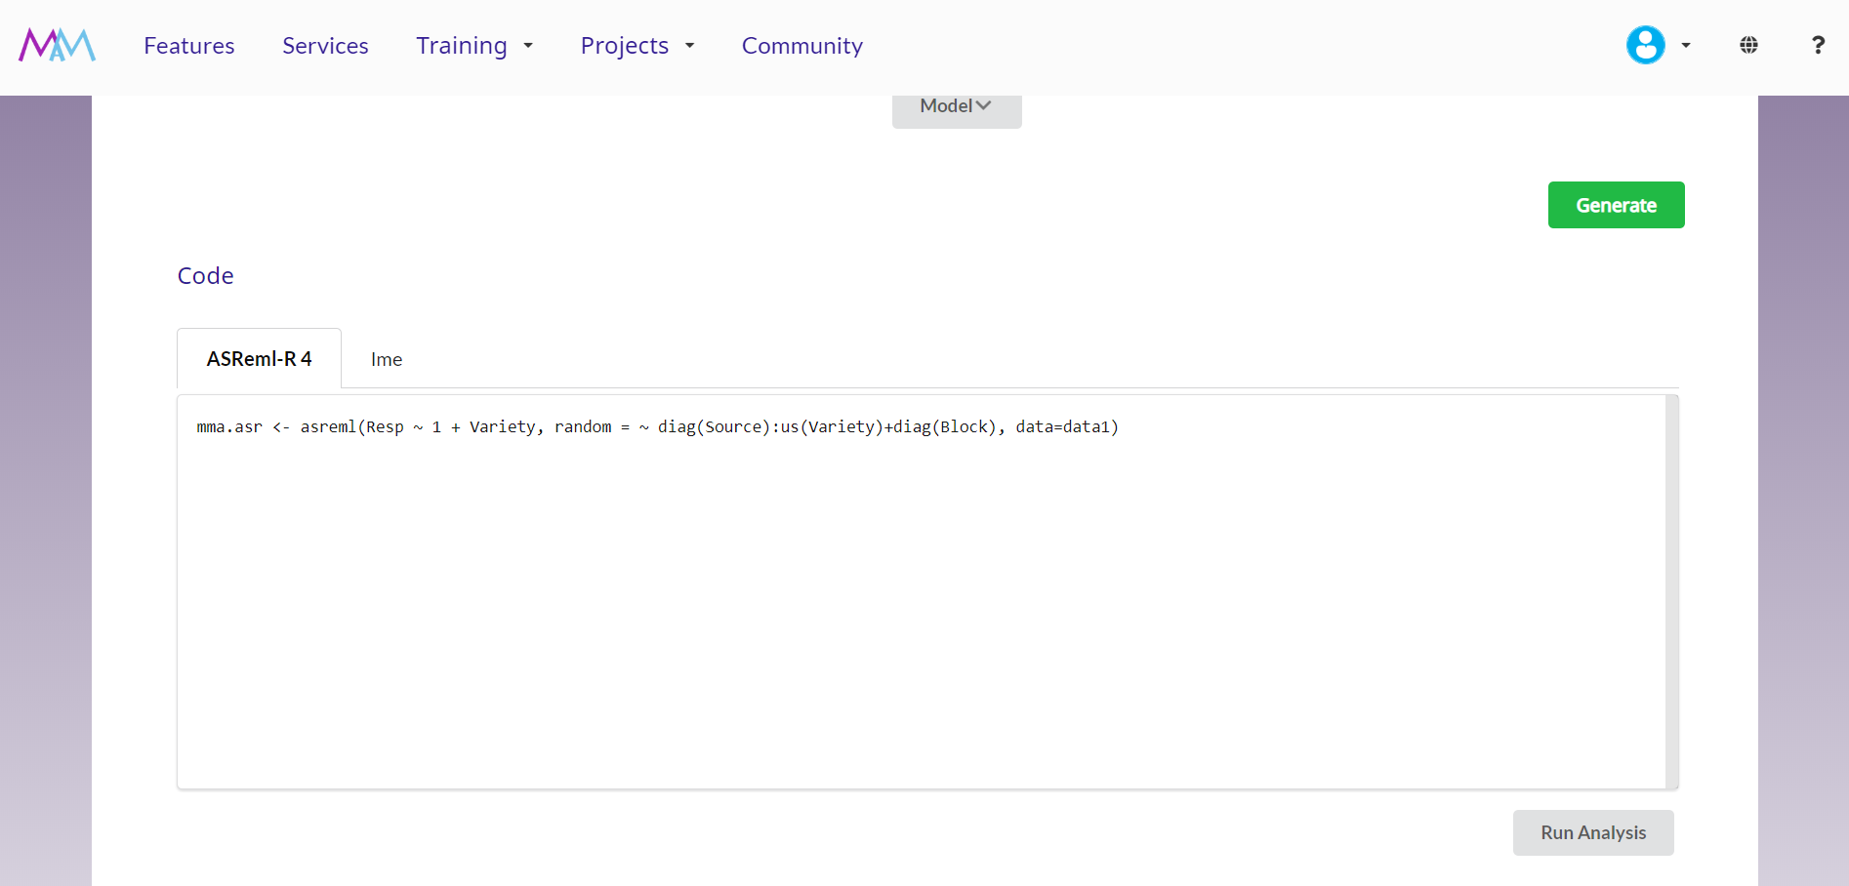

Slide 21
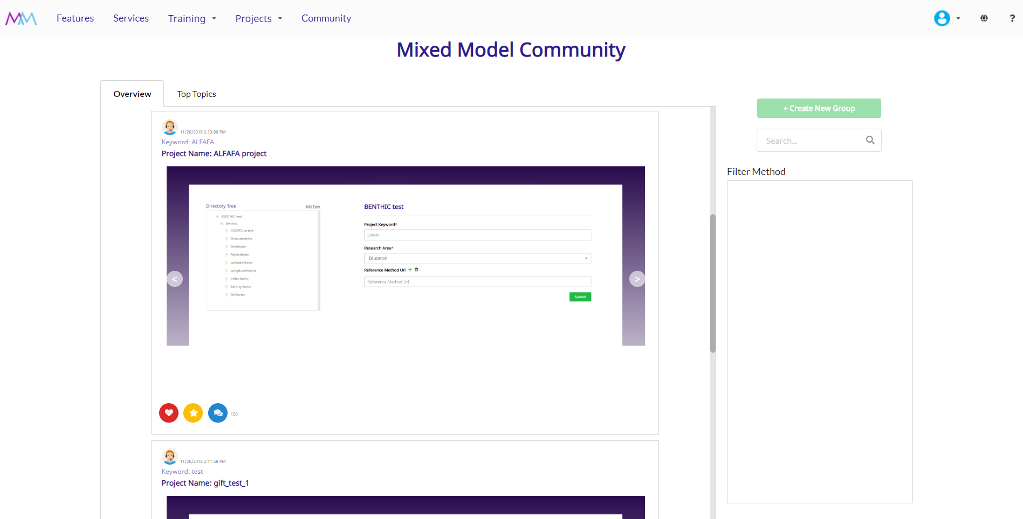

Slide 22
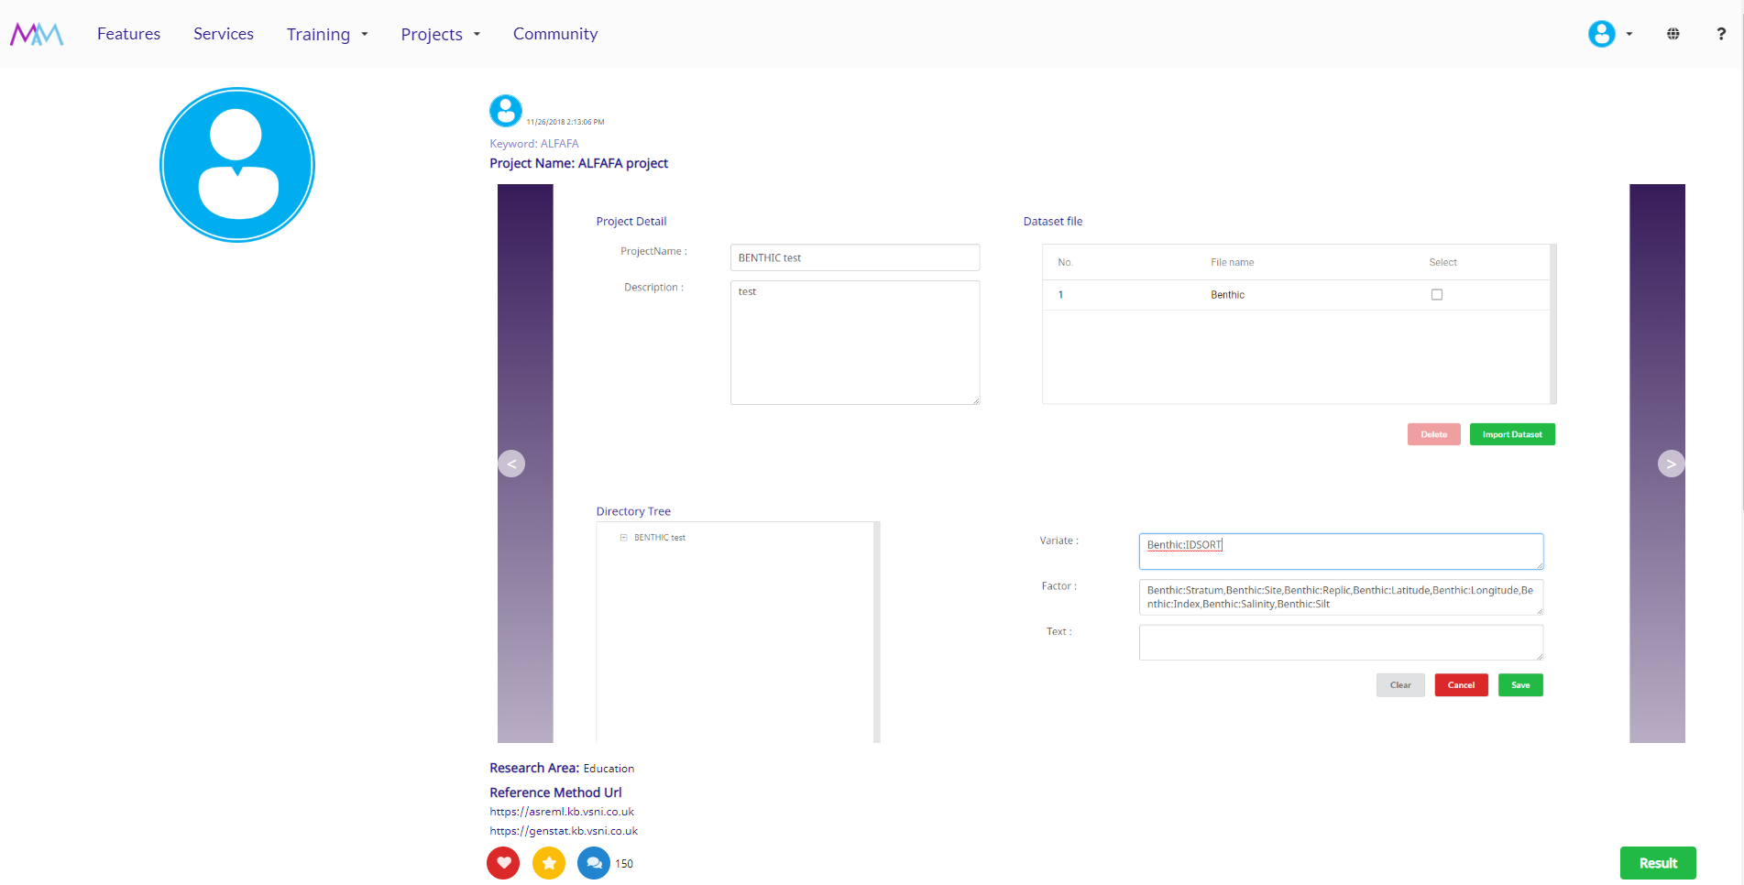

Slide 23
Next Steps
Adding other features into MMA
  Syntax generator for more mixed model packages
  Mixed Model Anatomy (Matrix Algebra) for mixed model theory learners
  VSN knowledge base as well as user generated cases
  Create or recommend videos relevant for each step of the analysis
Adding contents into MMA
  Examples from influential mixed model literature
  Design new way of providing results/reports to users

Slide 24
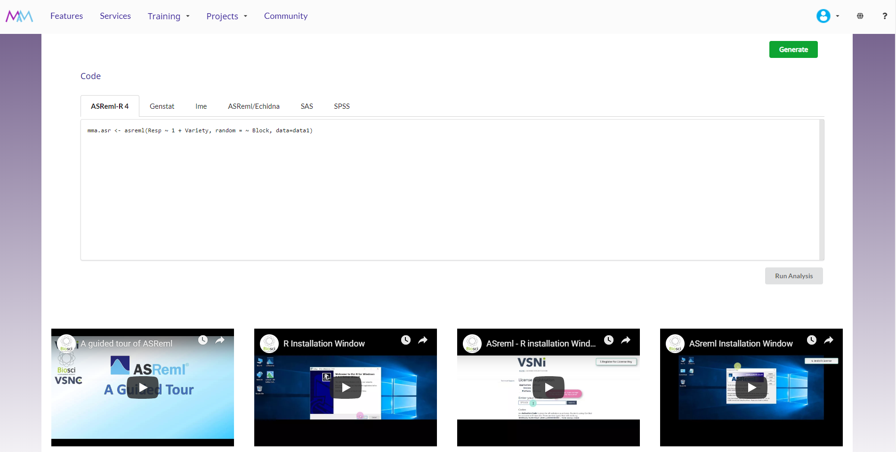

Slide 25
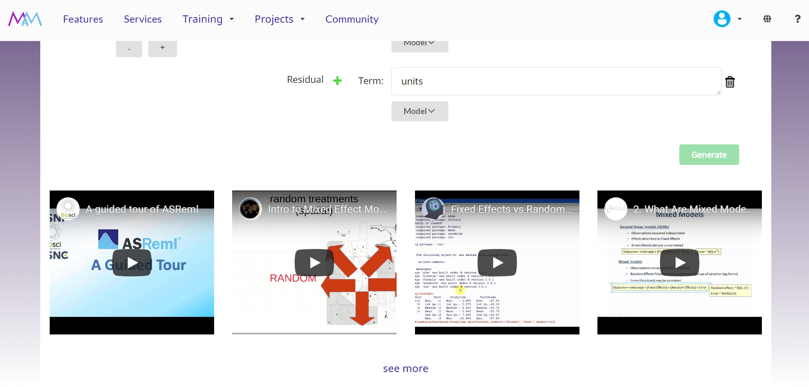

Slide 26
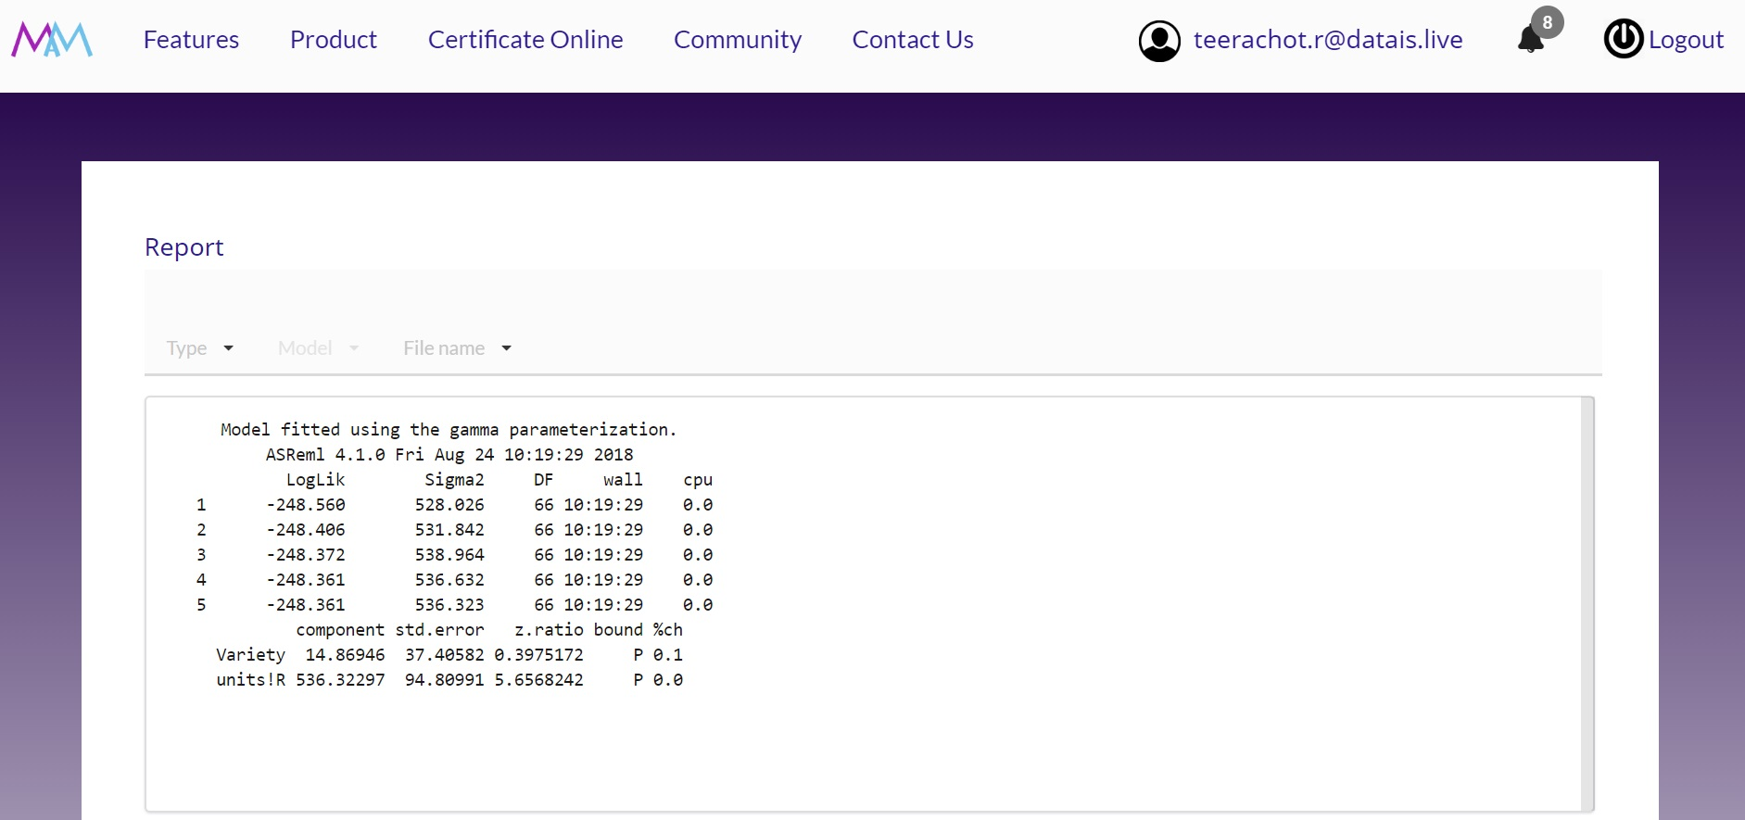
Performance needs improvement

