Slide 1
Beyond Statistical Consulting
Addressing Cargo-Cult Statistics
1
Janet Chaseling¹, Kyle James¹ and Kirsty Wright^{1,2,3}
¹ School of Environment and Science, Griffith University
² Royal Australian Air Force No 2 Expeditionary Health Squadron
³ Unrecovered War Casualties-Army, Australian Defence Force
AASC 2018

Slide 2
What role should statisticians play in ensuring good practice in the application and interpretation of statistics by disciplinary practitioners?
2

Slide 3
Seminar Overview
3
Cargo-Cult Statistics Explained
The Frequentist Cargo-Cult
The Bayesian Cargo-Cult
Case study 1 – Travel Insurance Premiums
Case Study 2 – Forensic DNA Interpretation
Concluding Comments

Slide 4
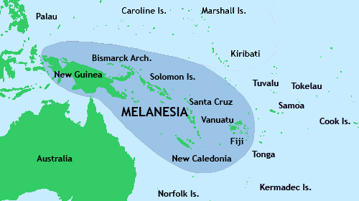
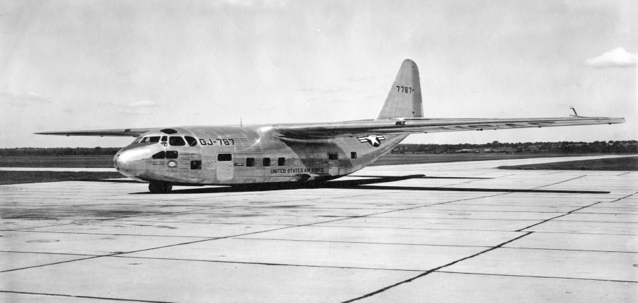
Cargo-Cult Science
4
Richard Feynman (Nobel physicist) in 1974 ‘work that has some formal trappings of science but does not practice the scientific method’
An Anthropological Story During World War II Melanesian Islands
USA Cargo planes landed Brought clothes, medicine, food, weapons, gifts
Notes:
Caltech’s 1974 commencement address.

Slide 5
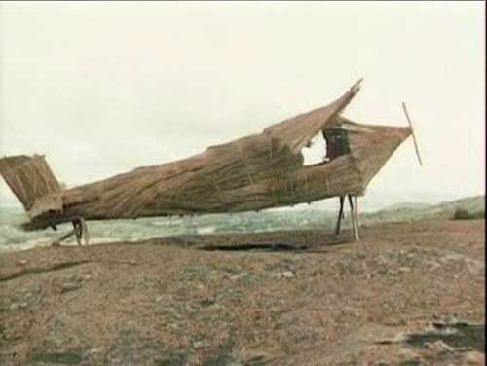
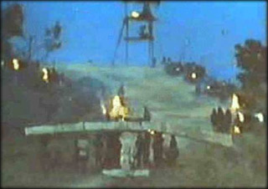
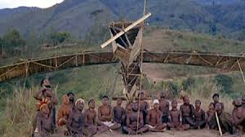
Cargo-Cult Science
5
To bring back the planes islanders built:
Straw planes & wooden headphones with bamboo antennas
Runways with fires for lights and control towers of sticks
Carried out rituals like the soldiers did to worship their deities
Then they waited for the planes to come back
NO PLANES CAME
Notes:
wooden hut for a man to sit in, with two wooden pieces on his head like headphones and bars of bamboo sticking out like antennas — he’s the controller

Slide 6
Cargo-Cult Statistics
6
The Melanesian natives practiced the motions of landing aircraft without understanding the significance of those motions.
Users of statistics invoke statistical terms and procedures as incantations with scant understanding of the assumptions or relevance of the calculations or even the meaning of the terminology
Stark & Saltelli (2018) Significance 15(4)

Slide 7
Cargo-Cult Statistics
7
Going through the motions of:
  fitting models
  computing p-values
  computing confidence or credible intervals
  simulating posterior distributions
  defining prior distributions
  applying formulae (pressing buttons)
Without understanding and addressing assumptions, limitations or meaning

Slide 8
Cargo-Cult Statistics
Stark & Saltelli (2018) p 41
8
This demotes statistics from a way of thinking about evidence avoiding self deception to a formal ‘blessing’ of claims
Gives support to the dogma:
Statistics can prove anything

Slide 9
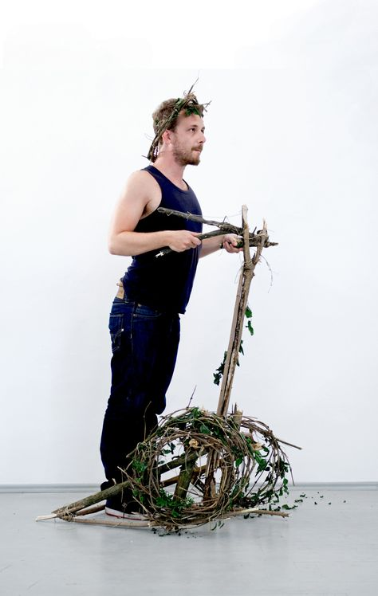
Cargo-Cult Segway
9

Slide 10
Real Life Areas Identified as ‘At Risk’ from Cargo-Cult Statistics
10
Politics
Banks
Medical Areas - Orthopaedics, Biomedical, Pharmaceutics, etc
Climate
Environment
Legal – criminal matters, civil matters
Safety – cars, transport, toys, etc
High-energy particle physics & cosmology
Notes:
WHO HRT report, side effects of drugs
Great Barrier Reef
Air bags

Slide 11
Typical Cargo Cult Activities in Statistics
11
FREQUENTIST
p- values
Hypothesis tests
Confidence intervals
ANOVAs and models
Multiple regression
Variable – definition/use
Assumptions
Limitations
Interpretation
Communication
BAYESIAN
Priors chosen for convenience
Priors chosen out of habit
Priors chosen after looking at data
Trying several priors and looking at the results (to get required result)
Failure to acknowledge variation
Lack of genuine validation
Assumptions
Limitations
Interpretation
Communication
Notes:
How Cargo Cult Bayesians encourage Deep Learning Alchemy
author: Carlos E Perez
Author of Artificial Intuition and the Deep Learning Playbook — Intuition Machine Inc.
Nov 16, 2017
‘…a practice in science of not working from fundamentally sound first principles.’

Slide 12
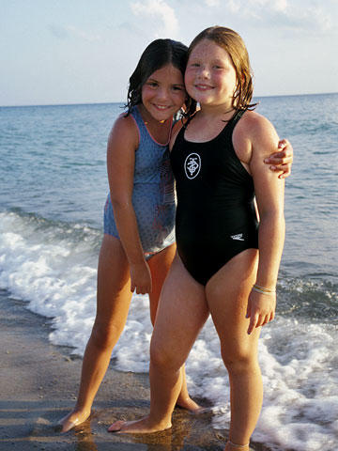

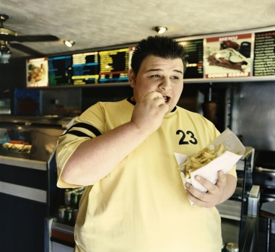

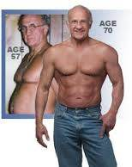
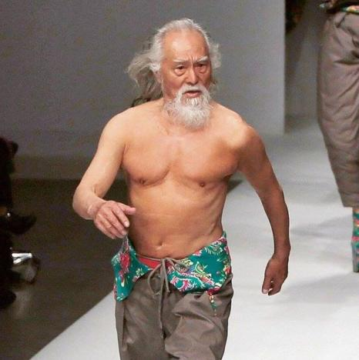
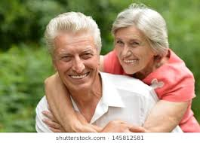
Case Study 1: Travel Insurance Premiums for Seniors
12
10
19
24
45
$191
$191
$191
$191
57
70
75
80
$215
$272
$498
$647

Slide 13



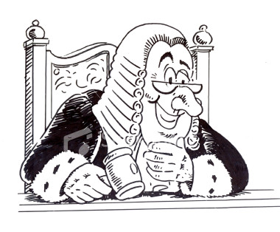
I challenge these premiums!!
13
There is a case to answer
Queensland Anti-Discrimination Board
We must justify our actions
First hearing 2016
Settlement 2018
QCAT: Qld Civil Administrative Tribunal

Slide 14
CS1 – Travel Insurance Premiums
14
Section 74 of the Queensland Anti-Discrimination Act 1991
It is not unlawful for a person to discriminate on the basis of age or impairment …if the discrimination -
(a) is based on reasonable actuarial or statistical data from a source on which it is reasonable for the person to rely; and
(b) is reasonable having regard to the data and any other relevant factors.
Notes:
with respect to a matter that is otherwise prohibited under subdivision 1

Slide 15
Expert Statements Provided to QCAT
15
TWO ACTUARIES EMPLOYED BY COMPANY
Separate reports both using same Appendix of data analysis
Only analysis, descriptive cross-tables with age & single factor
No sample sizes provided - # policies? #claims?
Mention in one report of GLM Analysis being carried out
EXTERNAL EXPERT ACTUARY
Comments on GLM
Comments on previous expert reports
Adds own comments on original data (subsection of??)
Refers to variables not in original and counts do not match

Slide 16
CS1: Initial Data Provided
3 years summary (or was it 7 years?)
16
Written in Original Expert’s Statement
A list of the data points collected at the time of the claim for this period (September 2009 to June 2016) is annexed to this Statement … Anexure A
Annexure A
Set out below is data which represents the culmination of data gathered by … between 1 July 2013 and 30 June 2016 … approximately 1.2 million policies
Written in Third Expert’s Statement
Suppressed by QCAT at request of respondents
Notes:
None of the summary figures in third expert’s statement agree with what is found from Annexe A tables.
Restricted paragraph 43

Slide 17

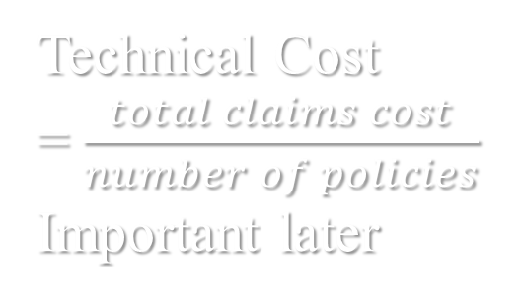
CS1: Contents of Initial Data Provided
17
RISK FACTORS
Destination – 7 regions
Duration – 5 groups
Age – 6 groups
VARIABLES
(were there others?)
Claims frequency (%) *
Average claim size ($) *
Technical Cost
Incurred
Loss ratio = $\frac{claims incurred}{net premium}$ *
* Provided as two way tables across
(age x destination) & (age x duration)
Others age summary only
Technical Cost
= $\frac{total claims cost}{number of policies}$
Important later
Notes:
But in statement says data considered was from september 2009 to June 2016

Slide 18
Classification of Age
18
AGE
0-49
50-59
60-70
71-75
76-80
81+
CLAIM%
6.2
5.5
6.6
7.5
8.1
10.8
The claims frequency for a 70 year old is almost 6.5% higher than that of a 49 year old

Slide 19
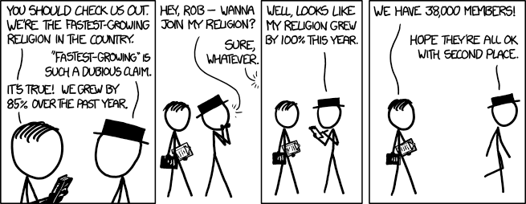
Comparisons of proportions with unknown sample sizes?
19

Slide 20
Variables of ‘Interest’
20
AGE
0-49
50-59
60-70
71-75
76-80
81+
CLAIM%
6.2
5.5
6.6
7.5
8.1
10.8
ESTMTD NO. POLICIES
803779
177139
142872
29223
14360
7333
TECHNCL COST
81
105
157
230
272
441
NUMBER OF POLICIES??

Slide 21
GLM ANALYSIS
21
Data from different company
Analysis carried out by different actuary – unavailable for QCAT
Age groups used
  (0-39), (40-49), (50-54), (55-59), (60-69), (70-74), and (75-79)
Additive Univariate Model used
Interpretation by analyst – hidden but correct
Interpretation by expert actuary – incorrect

Slide 22
GLM Conclusion by Third Expert
22
Suppressed by QCAT at request of respondents

Slide 23
AGE GROUPS
23
Original Expert (original data)
0-49, 50-59, 60-70, 71-75, 76-80, 81+
GLM Analysis (using different data)
0-39, 40-49, 50-54, 55-59, 60-69, 70-74, 75-79, 80+
Actuarial Expert (using 1/3 of original data??)
0-17, 18-24, 25-29, 30-34, 35-39, 40-44, 45-49, 50-54, 55-59, 60-64, 65-69, 70-74, 75-79, 80+
Notes:
Only 24 people in 80+ of GLM analysis data – see output in Excel files provided

Slide 24
Is this analysis a cargo cult problem?
24
Criticism of Original Data as Provided
‘The categories used to classify age appear to be misleading … ’
Response
I am not sure of the reasoning or conclusion behind the observation that the age groupings are misleading. I do not agree.

Slide 25
25
Second criticism of original data
‘Summaries alone are not informative- the sample sizes within each cross classification grouping are required for an informed assessment (imbalance at this point can give extremely biased results).’
Response
While it is correct that summaries generally do not provide a full explanation to allow a third party to validate the results, they are useful in presenting the conclusions of more detailed analysis. The views expressed by … appear to be based on consideration of a statistical validation of all the results. This is one way, but not a necessary way, to establish the reasonableness and reliability of the data to support the use of age discrimination.

Slide 26
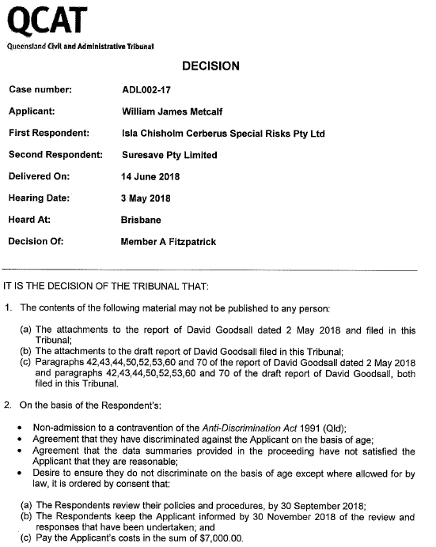
26
Notes:
Director of Age Discrimination, within the Australian Human Rights Commission, seeking more information about our case.

Slide 27
Bayesian Cargo Cult Statistics
27
  The practice of cargo-cult statistics cause Bayesian data analysis to become a rote, conventional calculation rather than a circumspect application of probability theory and Bayesian philosophy.
Notes:
How Cargo Cult Bayesians encourage Deep Learning Alchemy
author: Carlos E Perez
Author of Artificial Intuition and the Deep Learning Playbook — Intuition Machine Inc.
Nov 16, 2017
‘…a practice in science of not working from fundamentally sound first principles.’

Slide 28
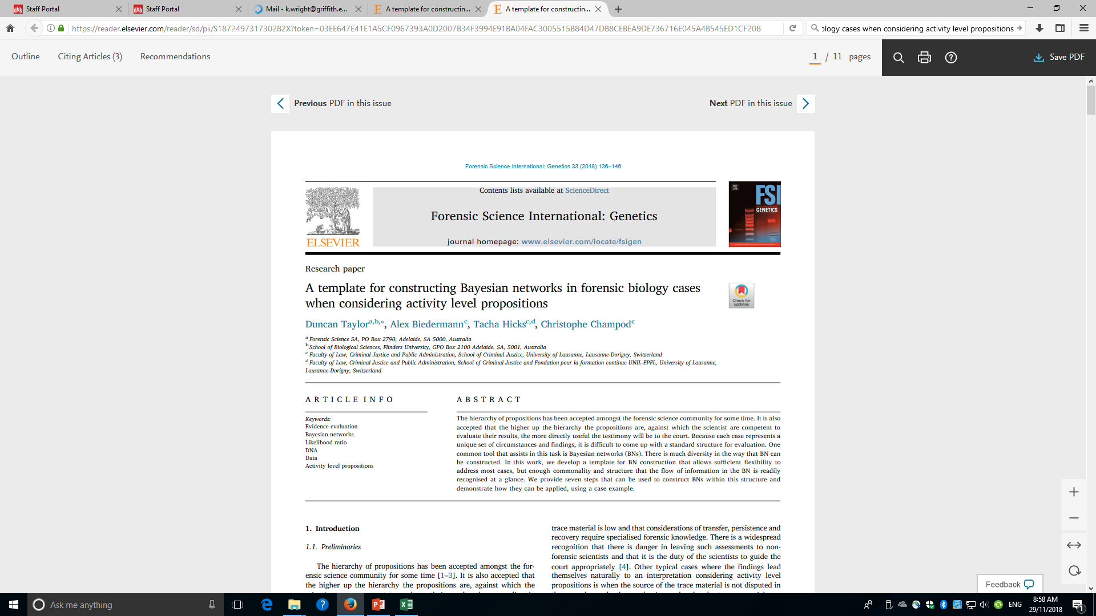
Cargo-Cult Statistics in Forensic DNA
28
Based on Supplementary Material: Example Report provided with:

Slide 29
Bayesian Cargo Cult in Forensic DNA
29
The case
  Girl claims bitten twice on outside of crutch of undies by brother
  She was visiting the brother
  She had been living in the family house with parents
  Saliva found on undies
  Low level Y-DNA matching brother obtained from saliva

Slide 30
Questions for the forensic scientist
30
Y-DNA handed down from father so accused son and his father are the same
How did the DNA get onto the undies?
Suggestions from forensic analyst:
  From the bite
  From cohabitation with father
  From cohabitation with accused brother (son)

Slide 31
Issues for the Forensic Analyst
31
Can/should the forensic scientist provide expert testimony on how the DNA got there? Activity Level
Proposal is that this activity level be included as 1 of 12 nodes in a Bayesian network with MCMC simulation.
Competing hypotheses established for this node as:
‘DNA came from the bite’ versus
‘DNA came from cohabitation’
Priors are required for each of these

Slide 32

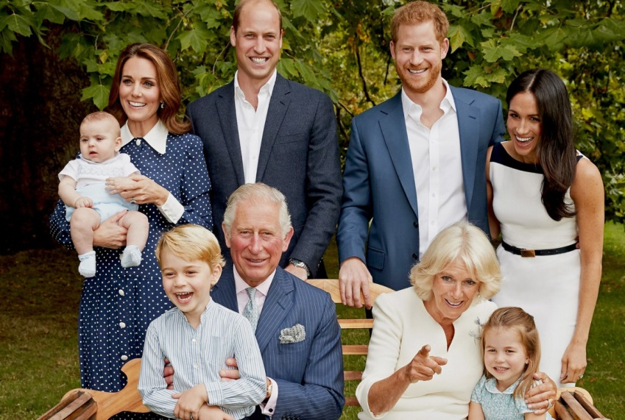
Constructed Priors – Biting v Co-habit
32
Pr(DNA transferred to undies)
High Level DNA | 0.84 | 0.09
Low level DNA (the observed) | 0.08 | 0.43
Nil DNA | 0.08 | 0.48
The results … are about five times more probable given the defence proposition rather than prosecution’s. (Page 4 Example Report)

Slide 33
Problems with the Forensic Evidence
33
The forensic scientist has limited statistical knowledge and understanding
Vulnerable to manipulation
Too little knowledge to question or ask for clarification
Presented to the court (Barrister, Jury and Judge) as a fait accompli
Is this evidence misleading the courts
Trust me I’m a forensic statistician

Slide 34
Statistical Concerns not Addressed
34
Prior distributions – are they legitimate?
Assumptions – what are they?
Assumptions – are they met?
Complexity – is it warranted?
Complexity – can it be understood by the user?
Limitations – what are they?
Is the evidence prejudicial?

Slide 35
Philosophical Issues
35
How can the deliberations of the jury be replaced by mathematical formulae?
Should the deliberations of the jury be replaced by mathematical formulae?
How are the assumptions fundamental to Bayesian Networks and Artificial Intelligence addressed?
What effect on the verdict & judgement could incorrect/misunderstood assumptions, limitations have?
Would the court audiences understand?

Slide 36
Why are these problems occurring?
Education –who teaches statistics?
Software – commercial advantage if user friendly
Publishing
  Increased volume suggests quality must suffer
  Editor bias – no criticism of previous published work, no rejection of ‘mates’ or reviewer’s papers
Employment/promotion requirements – metrics!
  (do impact factors, citations, etc really measure importance and correctness?)
Refer to: Stark and Saltelli’s article in Significance
Notes:
Service courses – user friendly avoids thorough checks of assumptions

Slide 37
Accountability in Other Professions
37
A doctor carries out bad practice – struck from medical register
An engineer builds a bridge badly – struck from institute of engineers (and maybe taken to court)
A teacher performs inappropriately – plenty of avenues for appeal
People check that builders, plumbers, electricians are registered
The practitioner who engages in cargo cult statistics is rarely challenged

Slide 38
Final Comments
38
In the words of Stark and Saltelli, as statisticians:
We should be vocally critical of cargo-cult statistics
We should be critical even when the abuses involve politically charged issues
We can insist that ‘service’ courses foster statistical thinking, deep understanding and appropriate scepticism instead of encouraging cargo-cult statistics

Slide 39
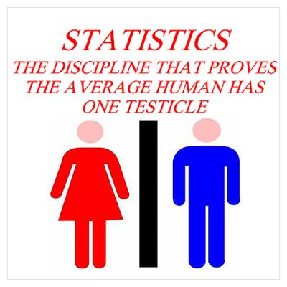
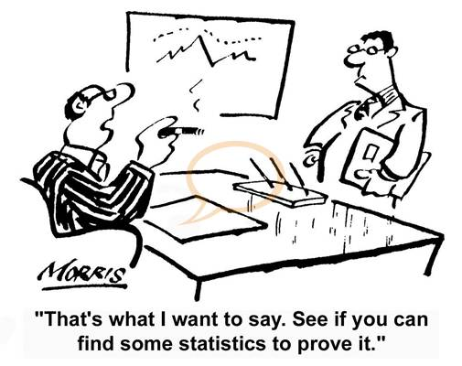
And Finally
39
We can be of service. Direct involvement of statisticians on the side of citizens in societal and environmental problems can help earn the justified trust of society . (Page 43)

Slide 40
Acknowledgements
40
My partner in life who claims to be a nong-nong but sees many of the errors using basic logic and common sense – he also cooks and cleans while I battle on with statistical whimsy
My past and present PhD students who encourage me to ignore ‘retirement’
My colleagues who keep me involved

Slide 42
