Slide 1
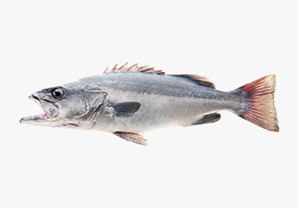

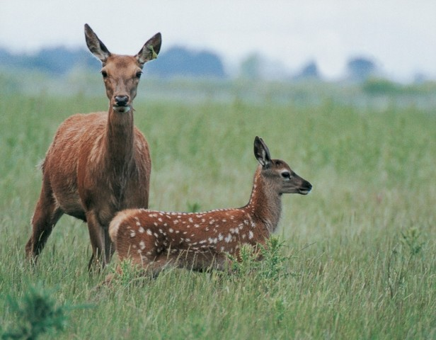
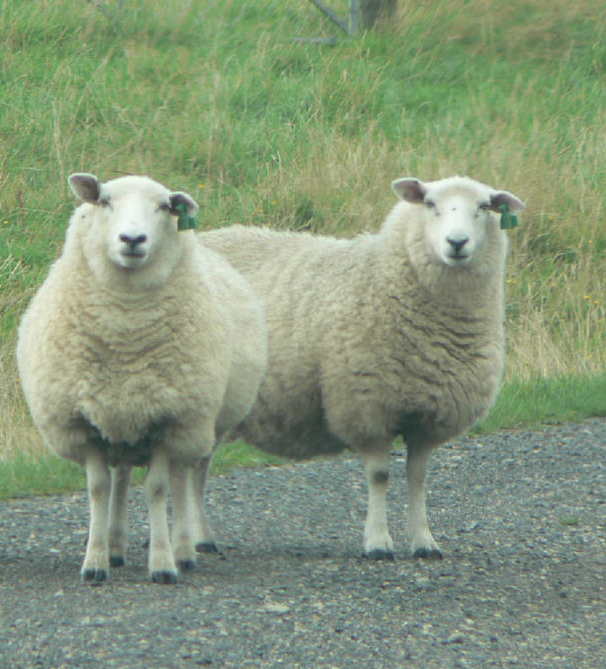
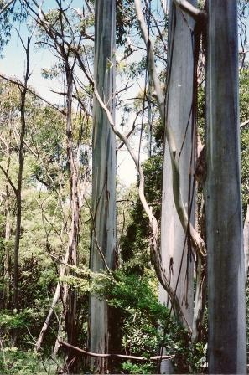

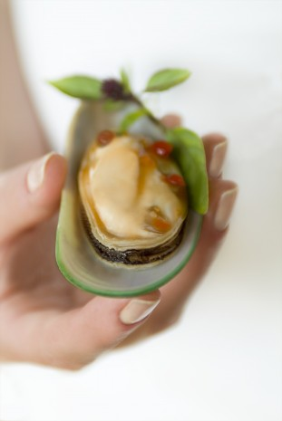
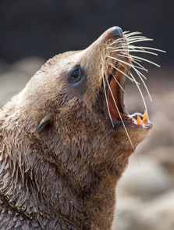
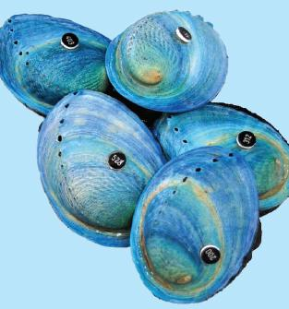
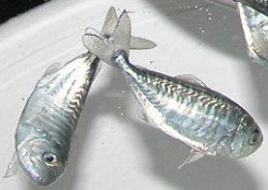
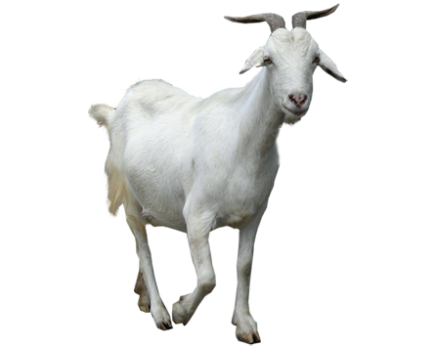
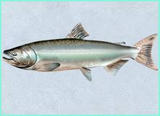
A depth-adjusted Hardy-Weinberg test for low-depth sequencing data
Ken Dodds, John McEwan, Timothy Bilton, Rudiger Brauning, Shannon Clarke
AgResearch, Invermay, Mosgiel, New Zealand
Australasian Applied Statistics Conference Rotorua NZ, 3-7 December 2018
Notes:
11.20am Weds 5 Dec

Slide 2
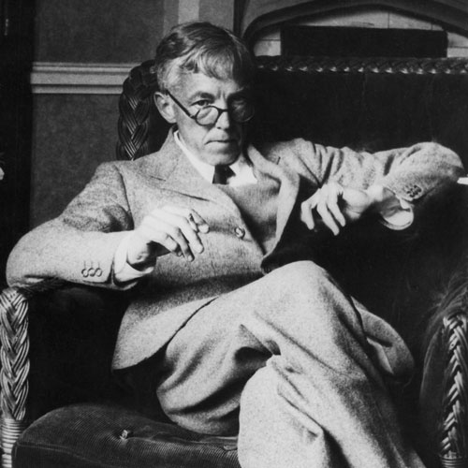
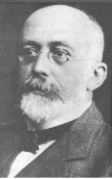
Hardy-Weinberg Equilibrium
Independence of alleles at a genotype
Disrupted by
Mutation
Selection
Migration
Genetic drift (small populations)
Non-Mendelian loci
Genotype | AA | AB | BB | Total
Frequency | p² | 2pq | q² | 1
p = p(A)
p + q = 1
G H Hardy 1908
English mathematician
W Weinberg 1908
German physician
Notes:
Independently derived

Slide 3
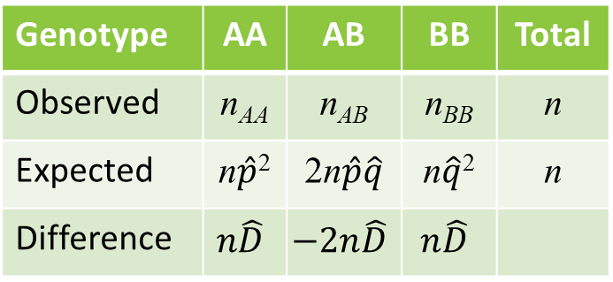

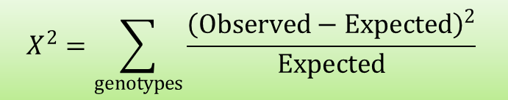
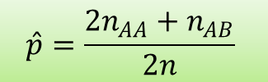
Hardy-Weinberg Test
HW disequilibrium
$D=P_{AA}−p^{2}$
Goodness of fit test
Likelihood ratio test
Genotype | AA | AB | BB | Total
Observed | n_{AA} | n_{AB} | n_{BB} | n
Expected | n$\hat{p}$² | 2n$\hat{p}\hat{q}$ | n$\hat{q}$² | n
Difference | $$n\hat{D}$$ | $$−2n\hat{D}$$ | $$n\hat{D}$$
$$\hat{p}=\frac{{2n}_{AA}+n_{AB}}{2n}$$
$$X^{2}=\sum_{genotypes}{\frac{{\left(Observed−Expected\right)}^{2}}{Expected}}$$

Slide 4

Hardy-Weinberg Goodness of Fit Test
Alternative forms
$X^{2}=\frac{n{\hat{D}}^{2}}{{\hat{p}}^{2}{\hat{q}}^{2}}$
$X^{2}=n{\left(1−\frac{H_{O}^{ }}{H_{E}^{ }}\right)}^{2}$
$H_{O}$ is the observed heterozygosity
$H_{E}$ is the expected (HW) heterozygosity

Slide 5
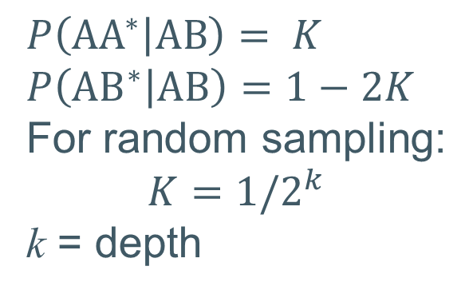
Genotypes with sequencing
True heterozygote (AB)
Observation probabilities (random model)
# reads (k) | Only A’s | A’s and B’s | Only B’s
1 | 0.5 | 0 | 0.5
2 | 0.25 | 0.5 | 0.25
3 | 0.125 | 0.75 | 0.125
4 | 0.0625 | 0.875 | 0.0625
⁞ | ⁞ | ⁞ | ⁞
∞ | 0 | 1 | 0
Observed genotype | AA* | AB* | BB*
$$P\left({AA}^{∗} | AB\right)= K$$
$$P\left({AB}^{∗} | AB\right)=1−2K$$
For random sampling:
$$K=1/2^{k}$$
k = depth
* denotes observed

Slide 6
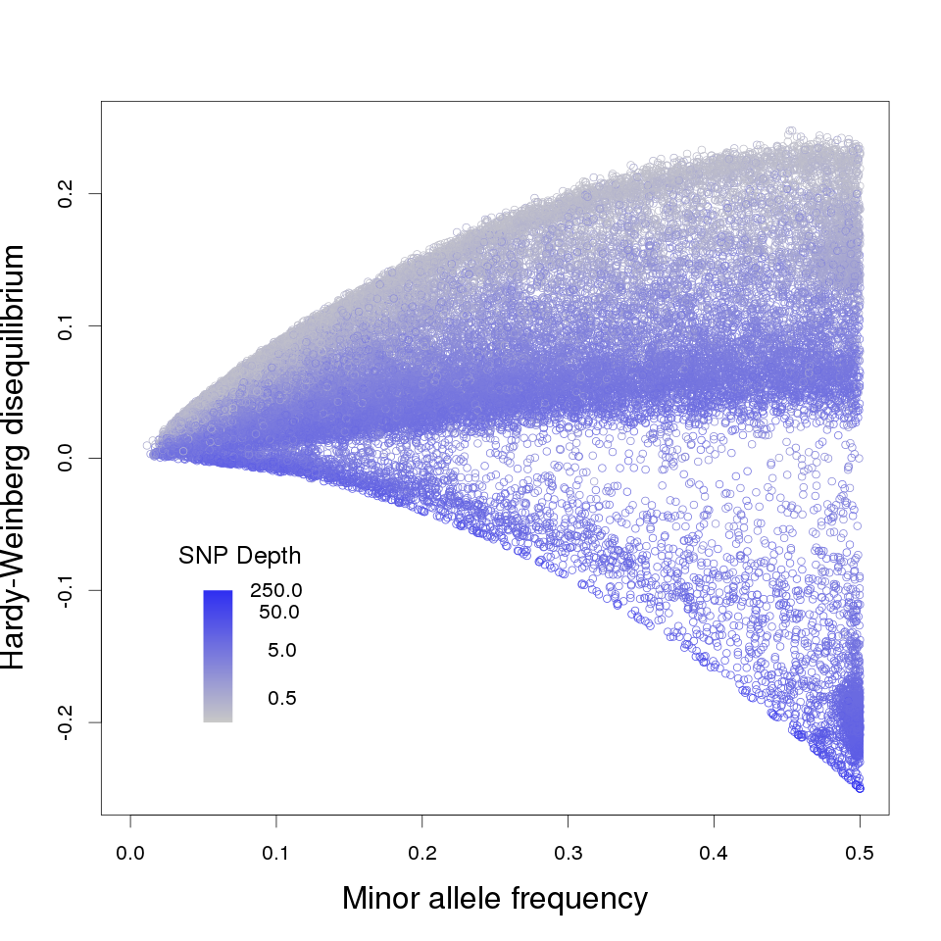
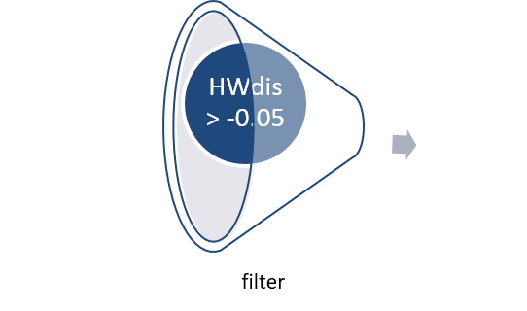
Fin plots
Low depth
Appear homozygous
Intermediate depth
In HWE
High depth
Maximum heterozygosity
Many have high MAF
Possibly duplication regions
HWdis = P_{AA} – p²
# SNPs: 42,938
Mean depth: 3.8
# SNPs: 40571
Mean depth: 3.3
Notes:
NZ Chinook 2356 individuals Callrate: 0.70
Filtered: Callrate: 0.68

Slide 7

Hardy-Weinberg X² test for sequence genotypes
$X^{∗2}=n_{E}{\left(1−\frac{H_{O}^{∗ }}{H_{E}^{∗ }}\right)}^{2}$
Notes:
Use p\hat calculated from observed genotypes – there are other possibilities

Slide 8
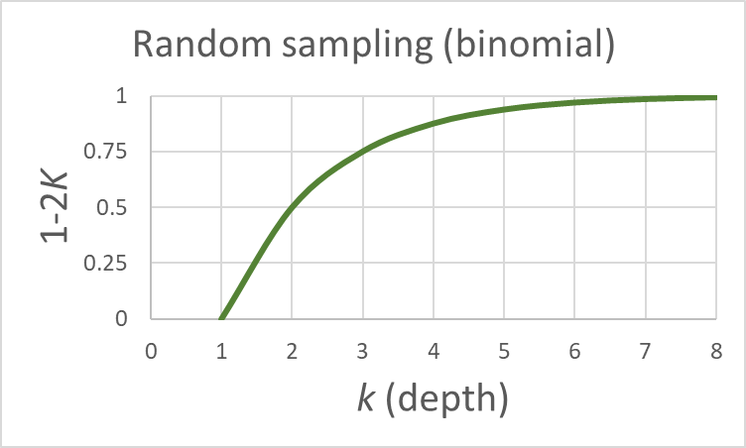
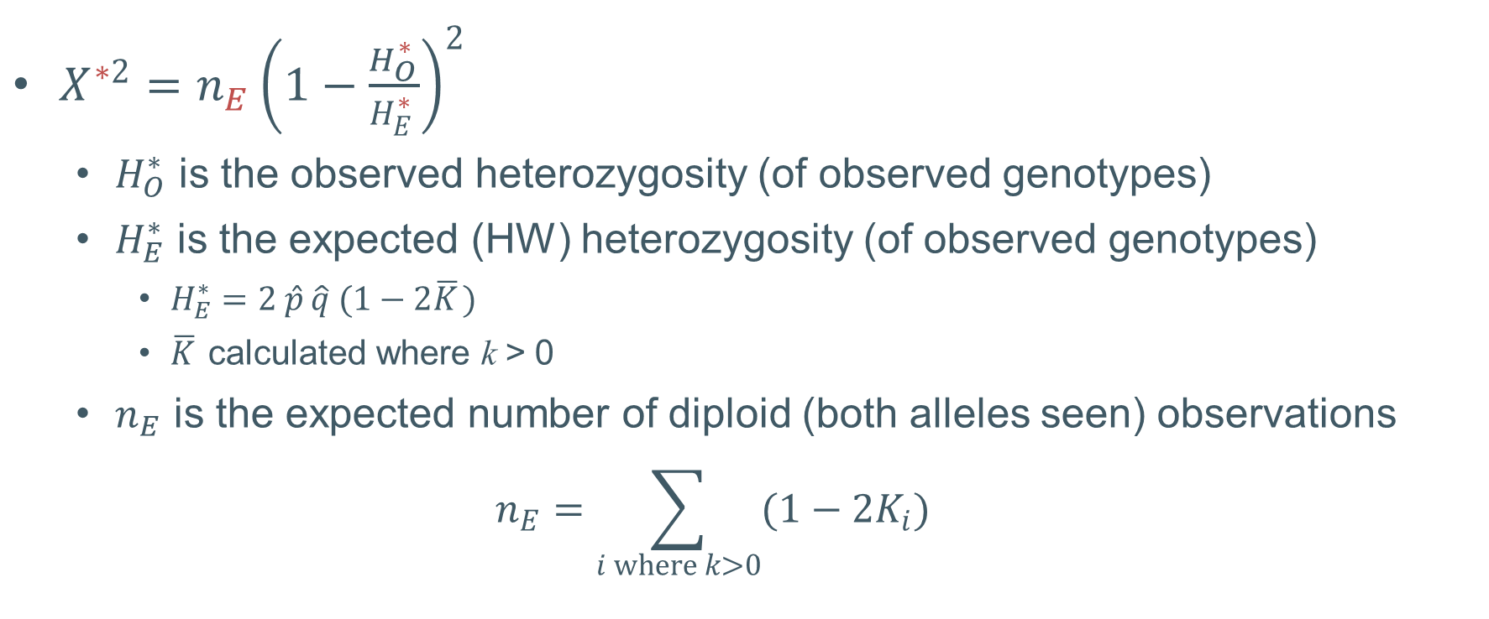

Hardy-Weinberg X² test for sequence genotypes
$X^{∗2}=n_{E}{\left(1−\frac{H_{O}^{∗ }}{H_{E}^{∗ }}\right)}^{2}$
$H_{O}^{∗}$ is the observed heterozygosity (of observed genotypes)
$H_{E}^{∗}$ is the expected (HW) heterozygosity (of observed genotypes)
$H_{E}^{∗}=2 {\hat{p}}_{ }\hat{q} (1−2{\overline{K}}_{ })$
${\overline{K}}_{ }$ calculated where k > 0
$n_{E}$ is the expected number of diploid (both alleles seen) observations
$$n_{E}=\sum_{i where k>0}{(1−2K_{i})}$$
$$P\left({AB}^{∗} | AB\right)=1−2K$$
Notes:
Use p\hat calculated from observed genotypes – there are other possibilities

Slide 9
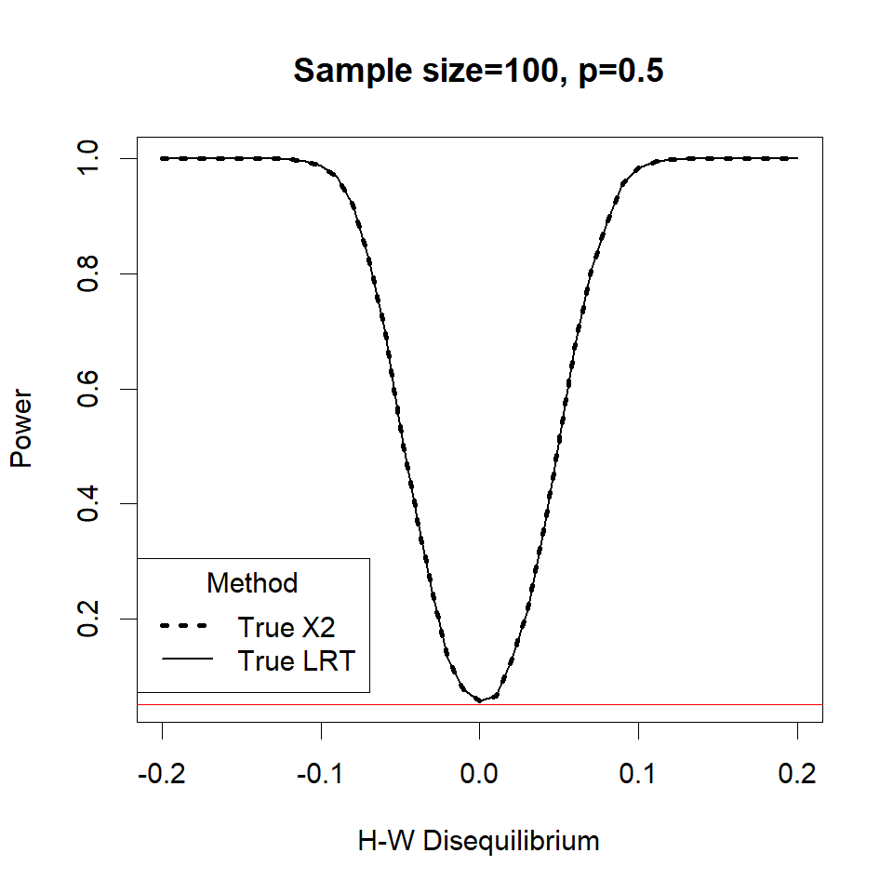
Hardy-Weinberg Simulations
True genotypes
Power is probability of significant result at given D
Red line is nominal significance level (α =0.5)
Notes:
4000 reps

Slide 10
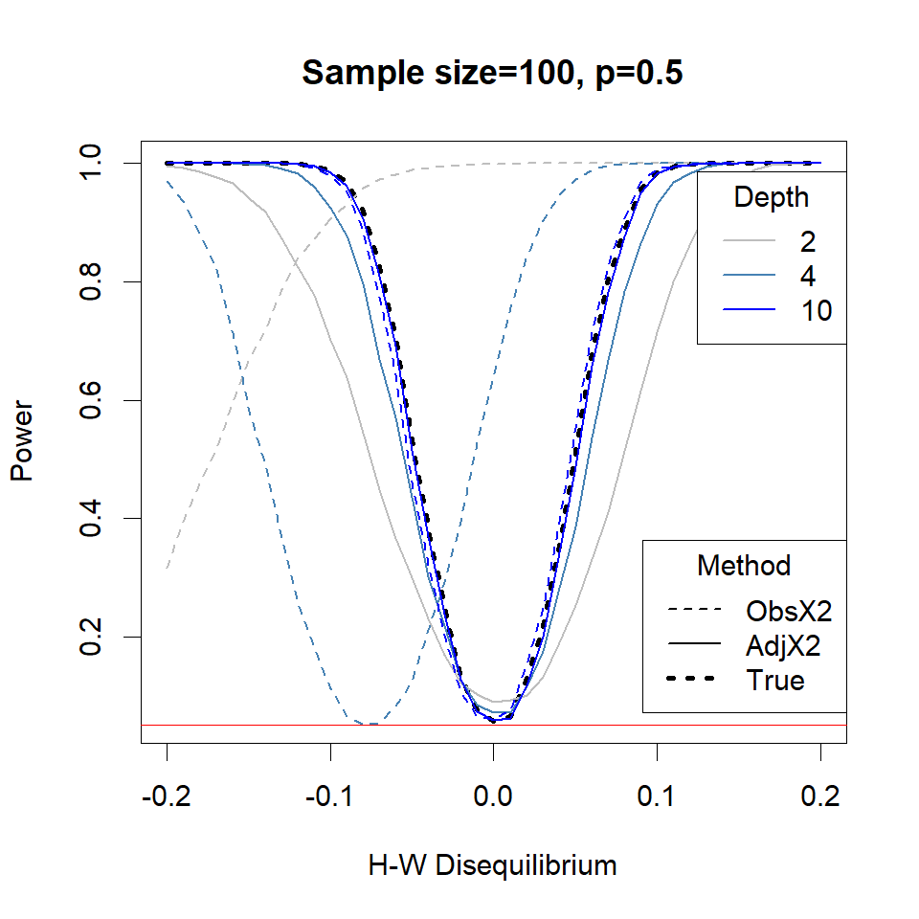
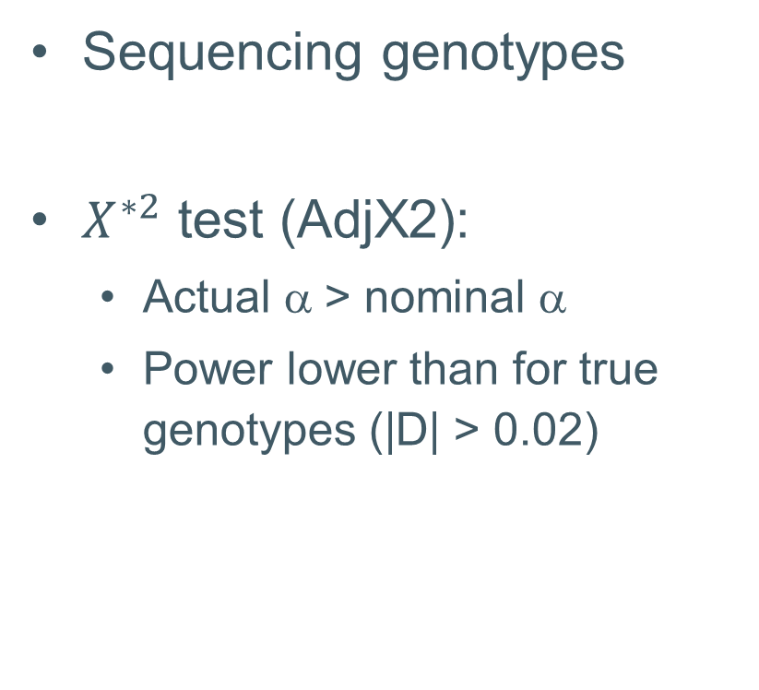
Hardy-Weinberg Simulations
Sequencing genotypes
$X^{∗2}$ test (AdjX2):
Actual α > nominal α
Power lower than for true genotypes (|D| > 0.02)

Slide 11
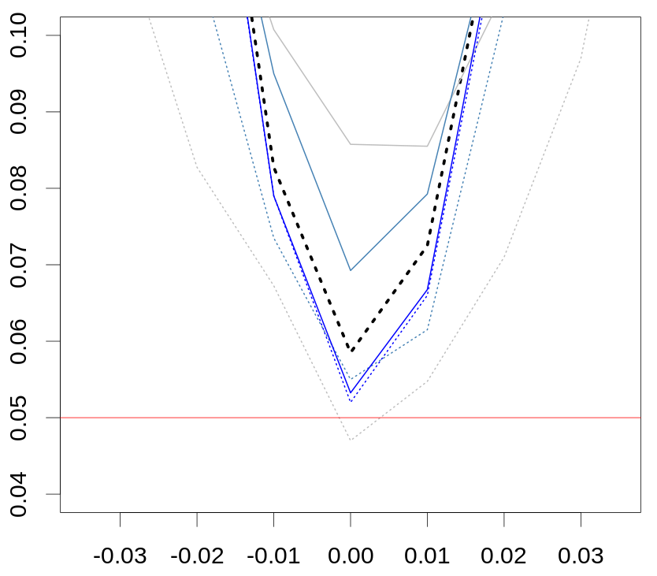
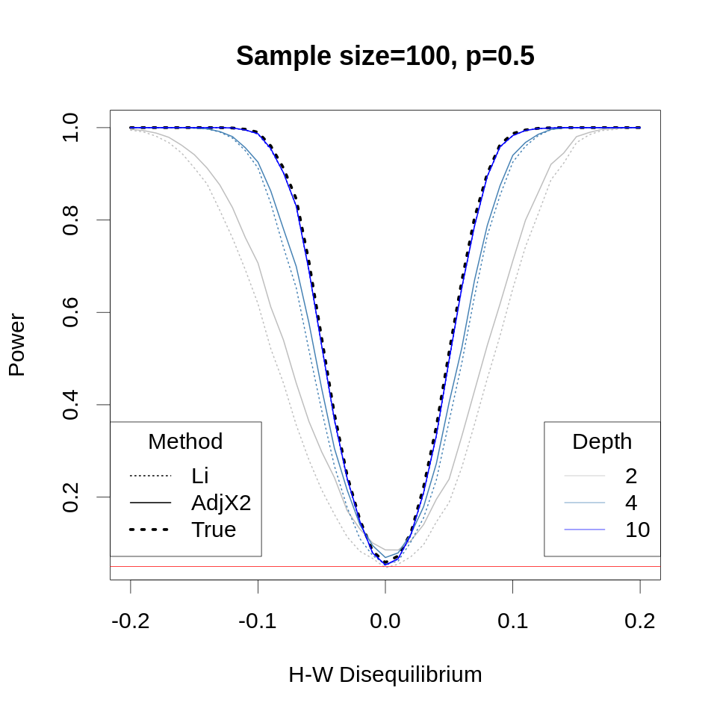
Hardy-Weinberg Simulations - LRT
Likelihood Ratio Test using depths
Li, Bioinformatics, 2011
EM method
GUSbase (Bilton)
Simulation time (4000 reps)
69s without Li method
533s with Li method
Notes:
LRT ~ unbiased (correct size)
Li doi:10.1093/bioinformatics/btr509
Vol. 27 no. 21 2011, pages 2987–2993
Part of SAMTools

Slide 12
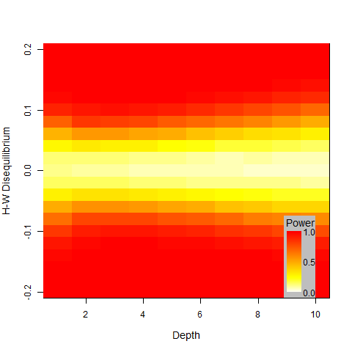

Hardy-Weinberg Simulations – optimal depth
Constant sequencing effort
$X^{∗2}$ test
Optimal depth 2-3

Slide 13
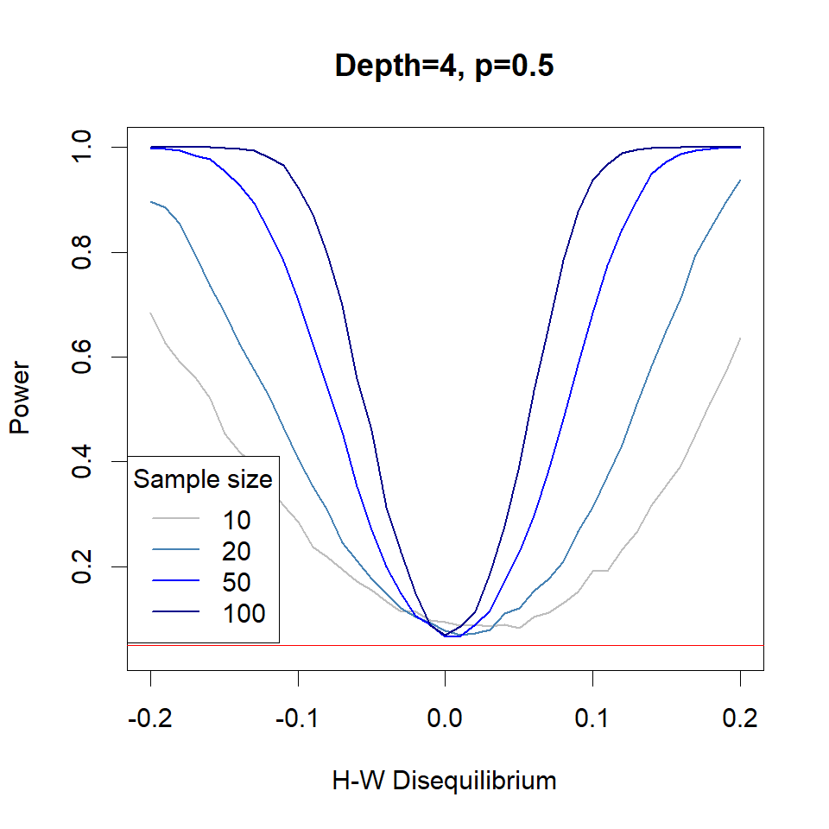
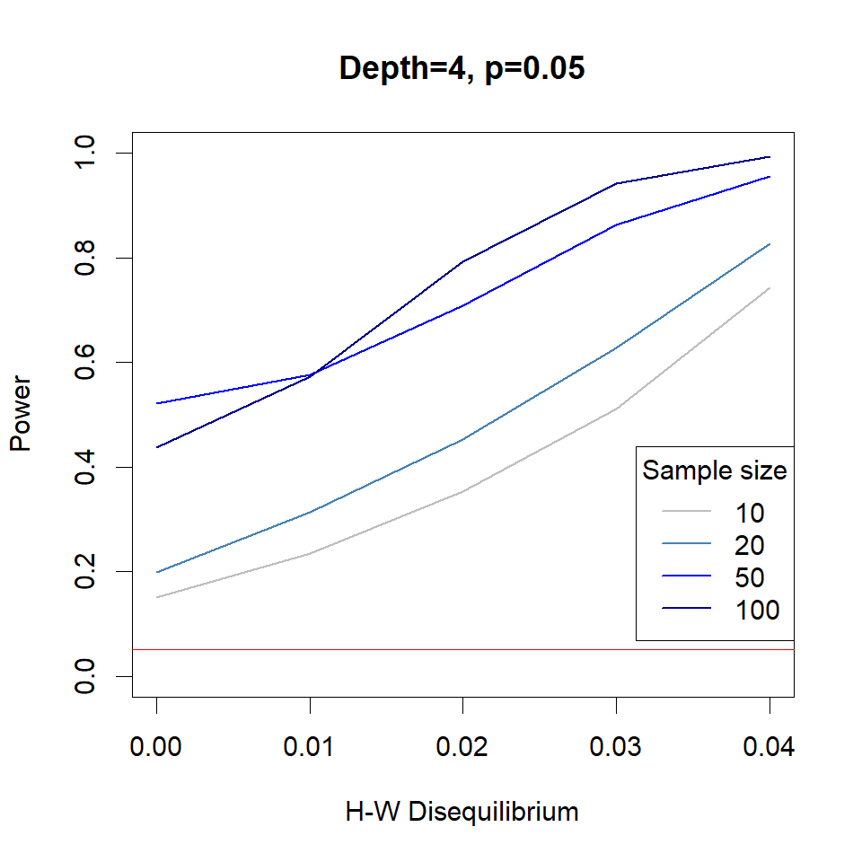

Hardy-Weinberg Simulations – sample size
$X^{∗2}$ test

Slide 14
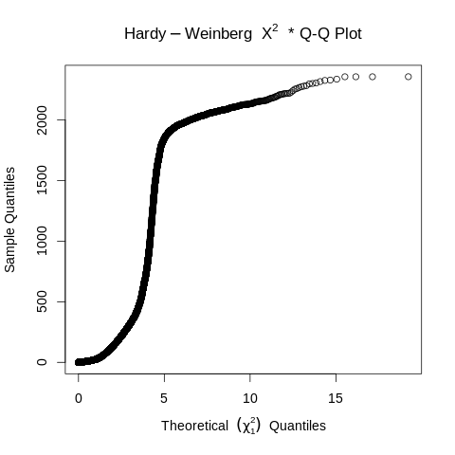
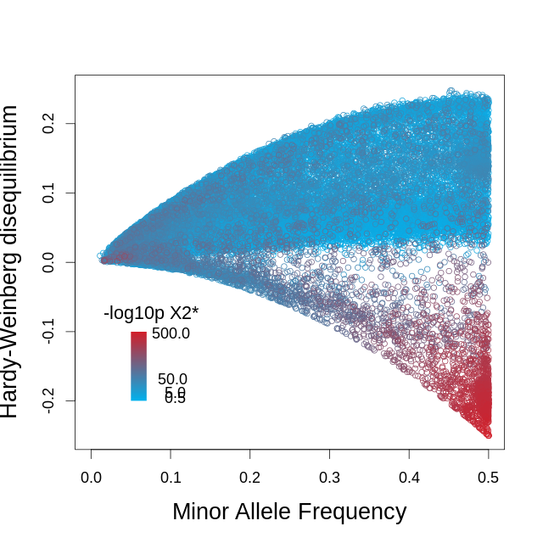

Chinook example
HWE test with depth adjustment
Above $χ_{1,0.01}^{2}$ : 68%
# SNPs: 42,938
Mean depth: 3.8
Notes:
NZ Chinook 2356 individuals Callrate: 0.70
Filtered: Callrate: 0.68
\chi 1% = 6.63

Slide 15
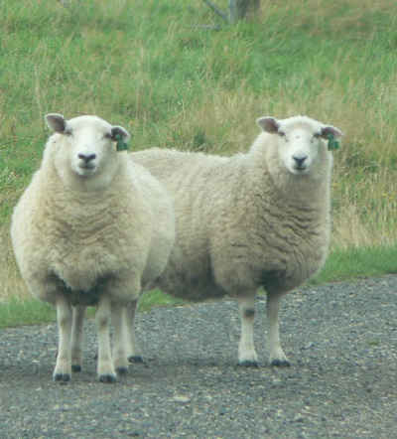
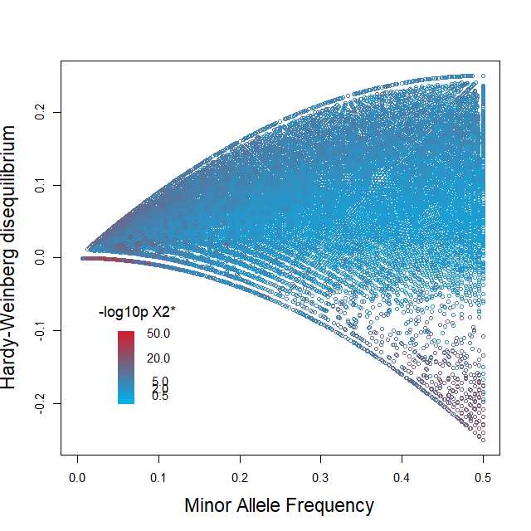
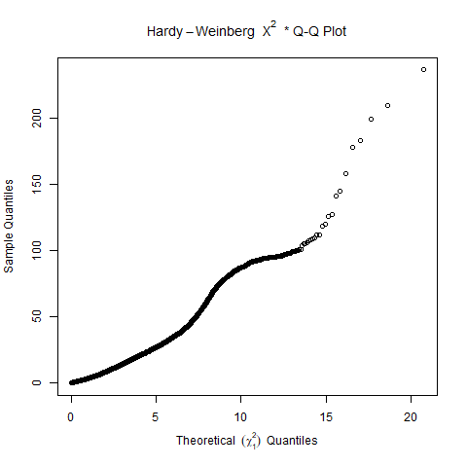
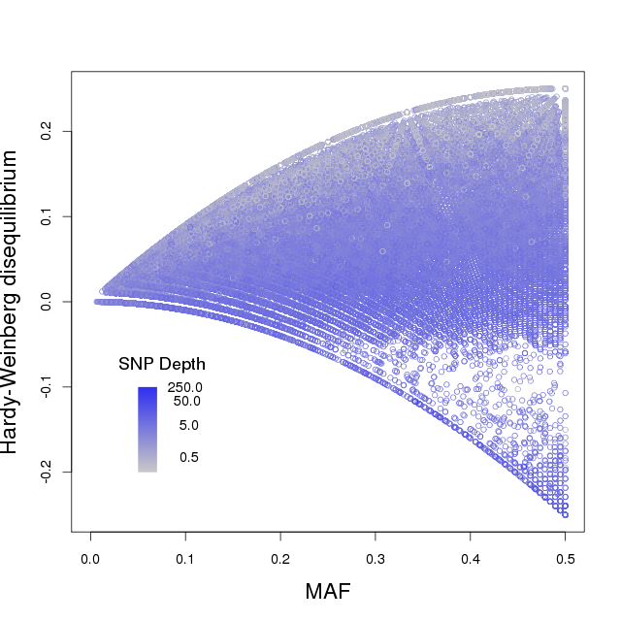

Sheep (96/lane)
HWE test with depth adjustment
Above $χ_{1,0.01}^{2}$ : 19%
# SNPs: 95,390
Mean depth: 3.5
Notes:
Positions: Fin 1.5, 4.5, HW* 12.3, 3.7 QQ 23, 3.95 Widths 11.15, 11.15, 11.1
160219_D00390_0245_AC89NRANXX SQ0178
# SNPs: 95,390
Mean depth: 3.5

Slide 16
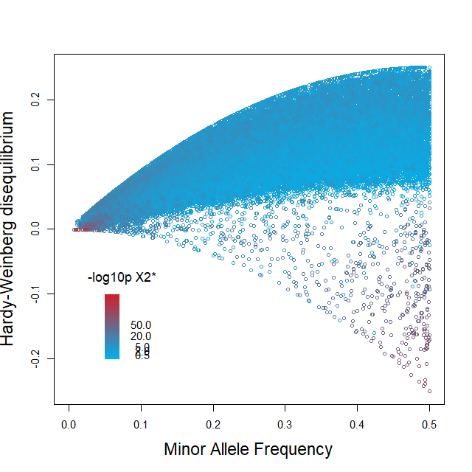
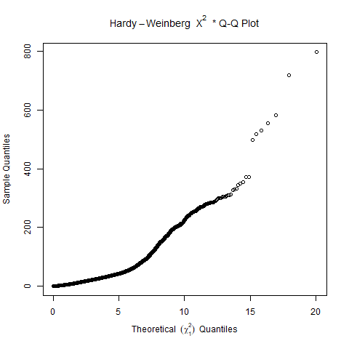
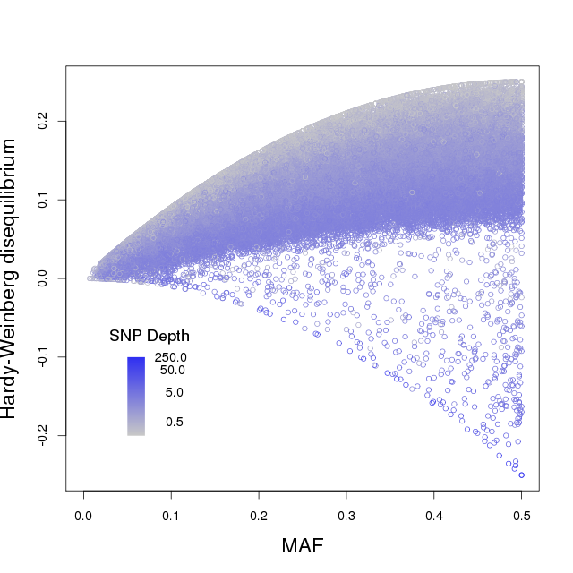

Sheep (384/lane)
HWE test with depth adjustment
Above $χ_{1,0.01}^{2}$ : 27%
# SNPs: 66,385
Mean depth: 1.8
Notes:
Positions: Fin 1.5, 4.5, HW* 12.3, 3.7 QQ 23, 3.95 Widths 11.15, 11.15, 11.1
151113_D00390_0239_BC808AANXX SQ0143
# SNPs: 66,385
Mean depth: 1.8

Slide 17

Conclusions
Genotyping using sequencing is an attractive tool for genetic studies
Filter data for biological reasons
E.g. non-Mendelian
Finplots and/or Adjusted HW test
Need to model the data generation process (e.g. allele sampling instead of genotype calls)
GitHub
AgResearch/KGD
Notes:
GitHub Agresearch/KGD v0.8.0

Slide 18



Acknowledgements
AgResearch GBS Team
Genomics for Production & Security in a Biological Economy C10X1306

