Slide 1
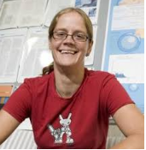
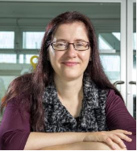
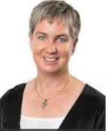
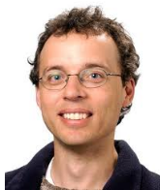
Developing methods to reduce uncertainty with citizen science data
Julie Mugford
Ph.D student – University of Canterbury
Supervisors:
Alex James
Elena Moltchanova
Andrea Byrom
Jon Sullivan

Slide 2
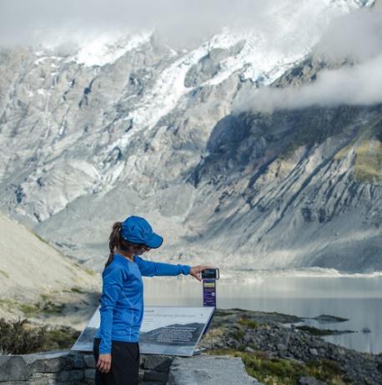
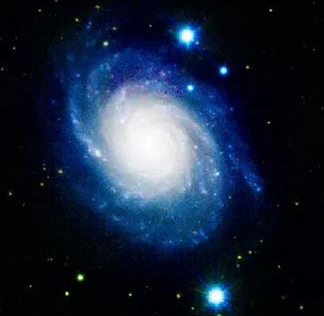
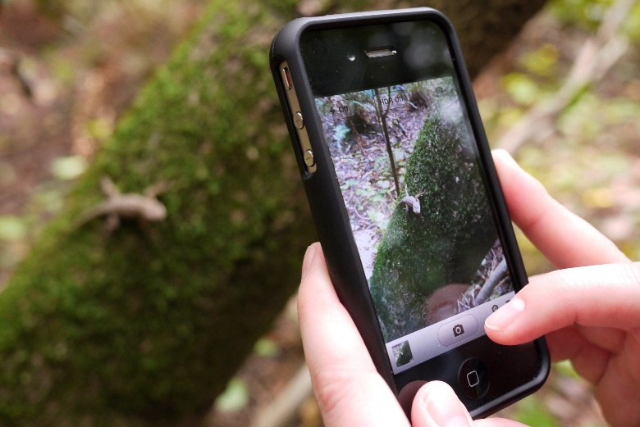
What is citizen science?
Notes:
CS is where volunteers who are not normally scientists help scientists collect and analyse information.
CS has been growing rapidly in recent times mostly due to how easy it is now for volunteers to share their information with the scientist through the internet and mobile phone apps.
Some examples of common CS projects are
- trampers taking photos of glaciers from a specific pole. The scientists can then make timelapses from all the photos
Users sharing photos of animals or plants they have seen. Other users can then help them identify the critter in the photo and the citizen science project builds up a database about species in an area
- Astronmy CS projects are very popular, with users identying images of objects in space. For example identying if an image has a galaxy in it

Slide 3
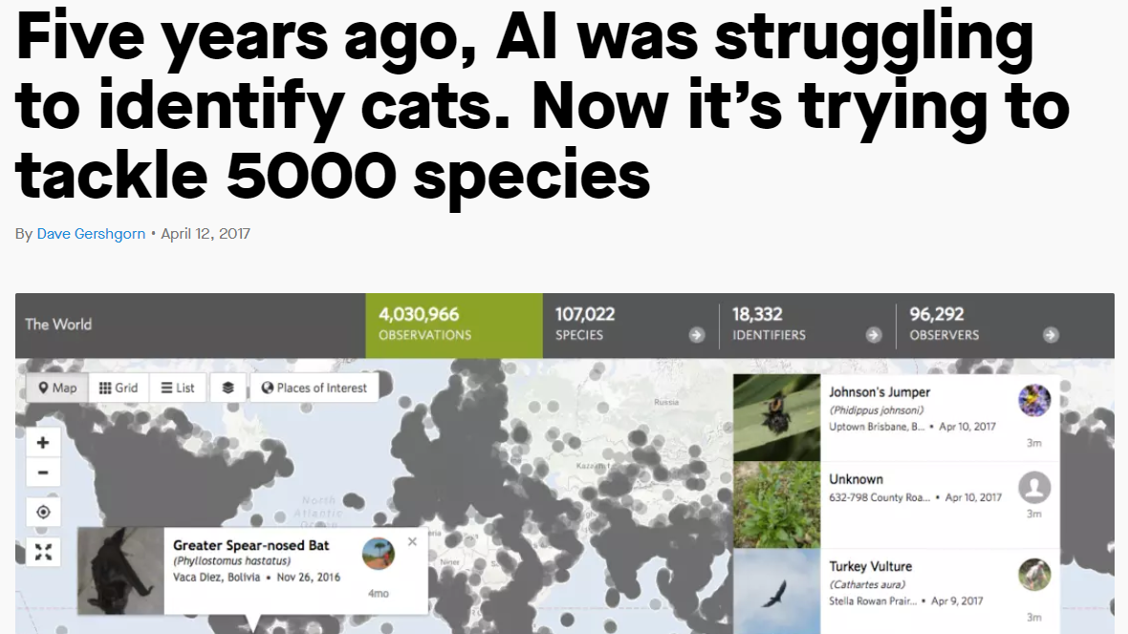
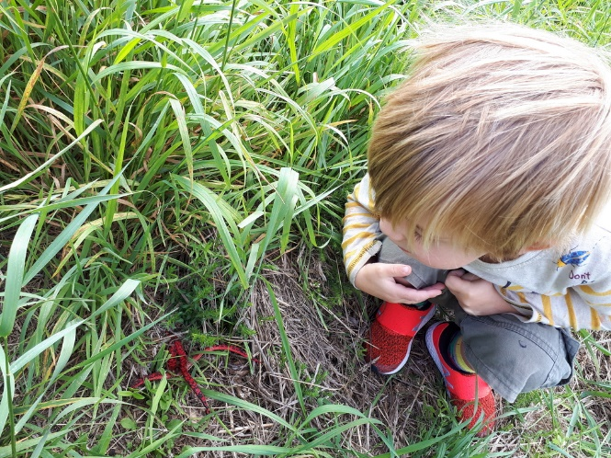
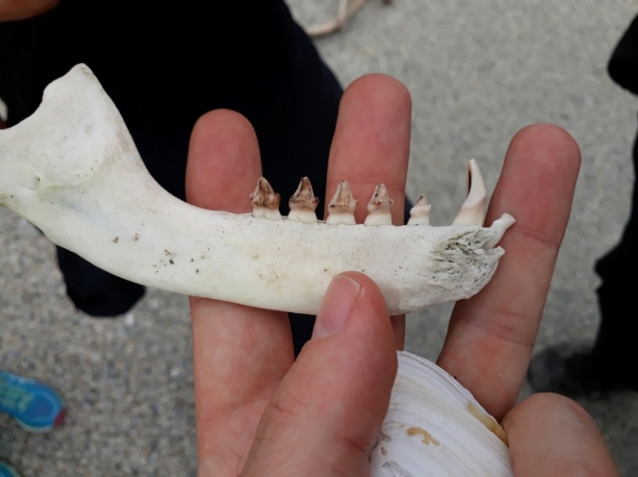
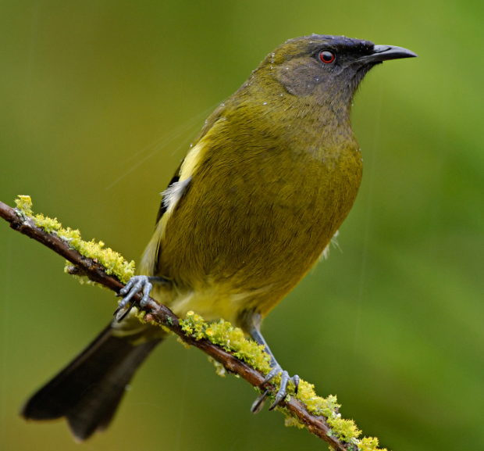
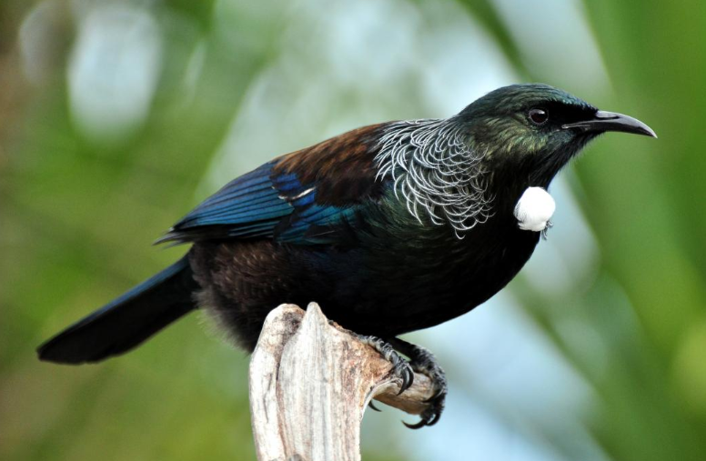
Why can't computers do these tasks?
  Need training datasets
    Overtime the human classified datasets can be used as training datasets
  May miss interesting features
  Some objects are hard to identify for computers (& humans)
  AI can be used as a ‘super user’
Notes:
AI could be used as a ‘super user’ with for example 80% accuracy – then with human input we may be able in increase the accuracy… as we will see.

Slide 4
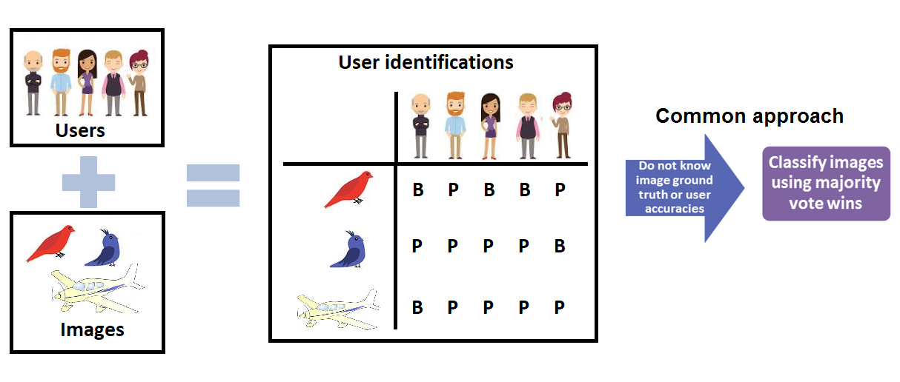
Image classification process
Notes:
The image classification process normally involves users viewing images and indicating what they believe the identity of each image is. The result is a database of user identifications for each image. The citizen project then combines the user identifications per image to decide a collective classification for the image and therefore relies on the wisdom of the crowd to identify images rather than the opinion of an expert.
A common method for combining individual user identifications is with majority vote wins.

Slide 5
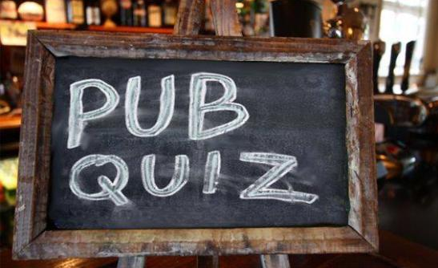
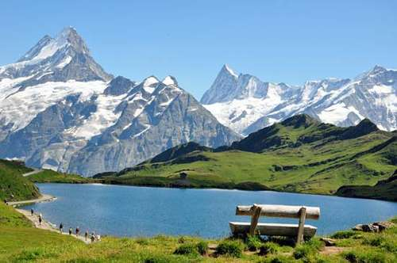
What is the capital of Switzerland?
Bern
Zurich
Geneva

Slide 6
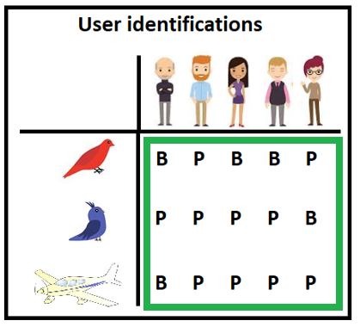
Majority vote
  Simple – we only need to know user identifications
  Accurate if average user identification accuracy is higher than 50% and enough users identify an image
  Does not account for differences in user accuracies
  Does not account for differences in class prevalence
  Inaccurate if the average user accuracy is less than 50% or not enough users identify an image
Notes:
Majority vote wins is good because it is simple – you don’t need to know anything about the users.
It is accurate if users are on average correct.
But it has many drawbacks
It does not account for difference in user accuracies. So expert opinions are treated that same as someone that is always incorrect.
If there are more than two categories it is not guaranteed there will ever be a majority
It doesn’t account for differences in species prevalences
And it is inaccurate if users are on average incorrect.

Slide 7
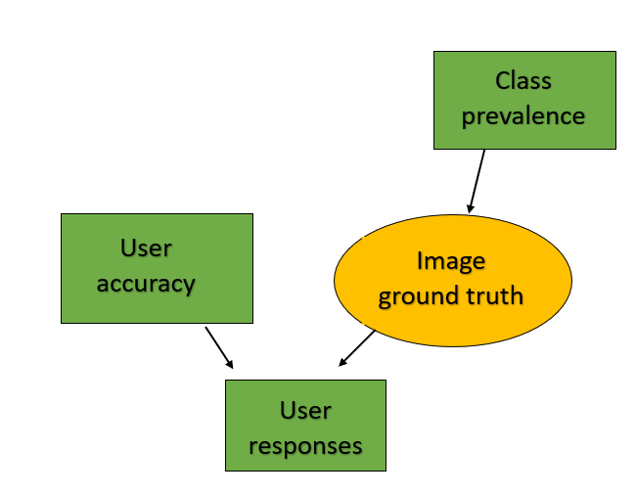
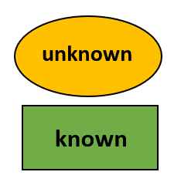
Including more decision parameters
Notes:
Explain diagram
User responses depend on user accuracy and the image ground truth
Image ground truth depends on class prevalences
Yellow circles are unknow and what we are trying to estimate
Green boxes are known

Slide 8
Including more decision parameters
Majority vote

Slide 9
Including more decision parameters
Let’s use all the information!

Slide 10
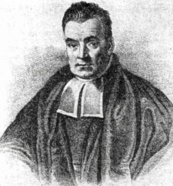
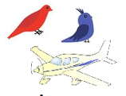
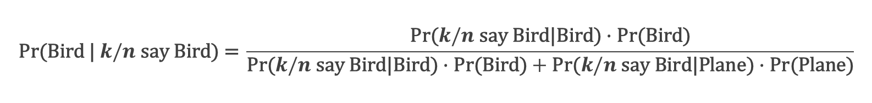
Bayes’ formula
$$\text{Pr}\text{(}\text{Bird}\text{ | }k/n \text{say} \text{Bird}\text{) = }\frac{\text{Pr}\text{(}k/n \text{say} \text{Bird}\text{|}\text{Bird}\text{)}∙\text{Pr}\text{(}\text{Bird}\text{)}}{\text{Pr}\text{(}k/n \text{say} \text{Bird}\text{|}\text{Bird}\text{)}∙\text{Pr}\text{(}\text{Bird}\text{)}+\text{Pr}\text{(}k/n \text{say} \text{Bird}\text{|}\text{Plane}\text{)}∙\text{Pr}\text{(}\text{Plane}\text{)}}$$
Notes:
This is where Bayes formula comes in…

Slide 11
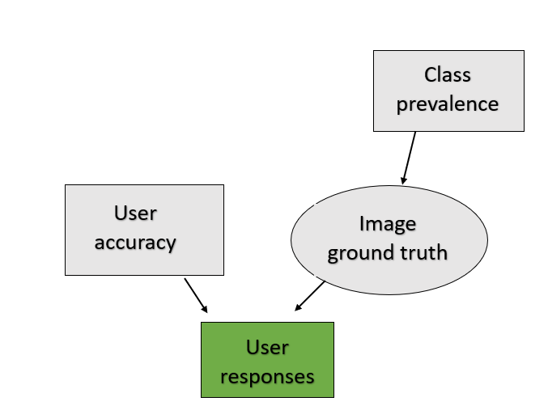
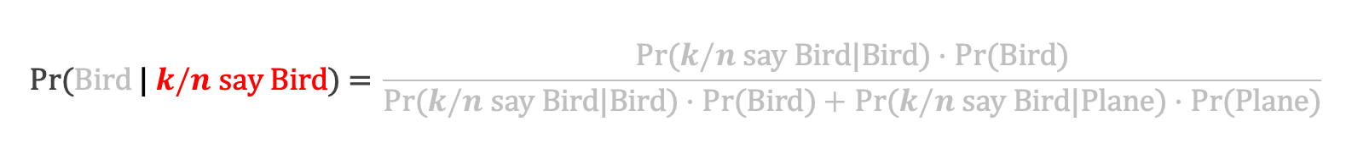
Bayes’ formula
$$\text{Pr}\text{(}\text{Bird} \text{| }k/n \text{say} \text{Bird}\text{) = }\frac{\text{Pr}\text{(}k/n \text{say} \text{Bird}\text{|}\text{Bird}\text{)}∙\text{Pr}\text{(}\text{Bird}\text{)}}{\text{Pr}\text{(}k/n \text{say} \text{Bird}\text{|}\text{Bird}\text{)}∙\text{Pr}\text{(}\text{Bird}\text{)}+\text{Pr}\text{(}k/n \text{say} \text{Bird}\text{|}\text{Plane}\text{)}∙\text{Pr}\text{(}\text{Plane}\text{)}}$$
Notes:
This is where Bayes formula comes in…

Slide 12
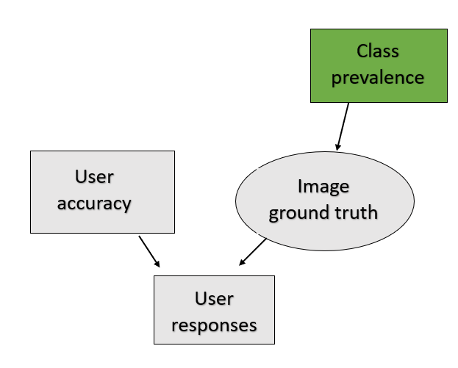
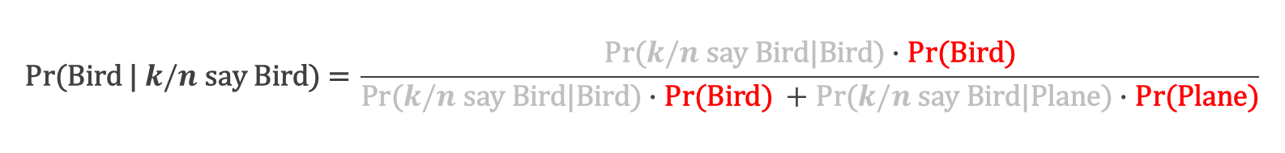
Bayes’ formula
$$\text{Pr}\text{(}\text{Bird}\text{ | }k/n \text{say} \text{Bird}\text{) = }\frac{\text{Pr}\text{(}k/n \text{say} \text{Bird}\text{|}\text{Bird}\text{)}∙\text{Pr}\text{(}\text{Bird}\text{)}}{\text{Pr}\text{(}k/n \text{say} \text{Bird}\text{|}\text{Bird}\text{)}∙\text{Pr}\text{(}\text{Bird}\text{) }+\text{Pr}\text{(}k/n \text{say} \text{Bird}\text{|}\text{Plane}\text{)}∙\text{Pr}\text{(}\text{Plane}\text{)}}$$
Notes:
Bayes formula combines prior information, which in our case is known bird and plane prevalances

Slide 13
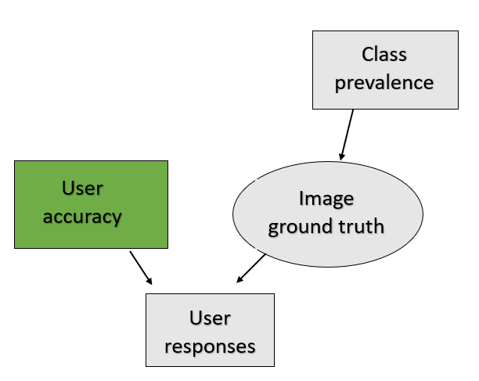
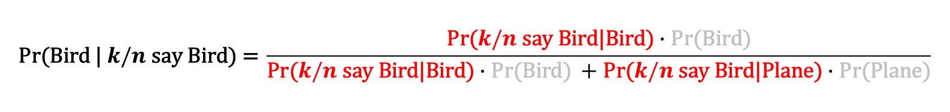
Bayes’ formula
$$\text{Pr}\text{(}\text{Bird}\text{ | }k/n \text{say} \text{Bird}\text{) = }\frac{\text{Pr}\text{(}k/n \text{say} \text{Bird}\text{|}\text{Bird}\text{)}∙\text{Pr}\text{(}\text{Bird}\text{)}}{\text{Pr}\text{(}k/n \text{say} \text{Bird}\text{|}\text{Bird}\text{)}∙\text{Pr}\text{(}\text{Bird}\text{) }+\text{Pr}\text{(}k/n \text{say} \text{Bird}\text{|}\text{Plane}\text{)}∙\text{Pr}\text{(}\text{Plane}\text{)}}$$
Notes:
And user accuracy to find the probability an image is a bird given the user responses.

Slide 14

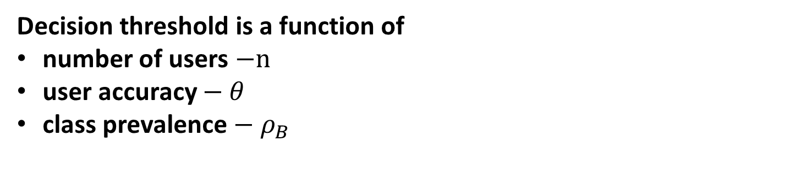
Special case 1– all users have the same accuracy
  Classify an image as a bird if $\text{Pr}\text{(}\text{Bird}\text{ | }k/n \text{say} \text{Bird}\text{)}≥\text{0.5}$ or
  $$k ≥\frac{n}{2}− \frac{1}{2}\frac{\text{log}\left(\frac{ρ_{B}}{1−ρ_{B}}\right)}{\text{log}\left(\frac{θ}{1−θ}\right)}$$
Majority vote decision threshold
Decision threshold is a function of
number of users $−n$
user accuracy $− θ$
class prevalence ${− ρ}_{B}$
Notes:
We can see that this formula turns out to be the majority vote formula minus this second term that is a function of species prevalence and user accuracy.
Obviously when the second term is zero using bayes formula and majority vote are the same

Slide 15
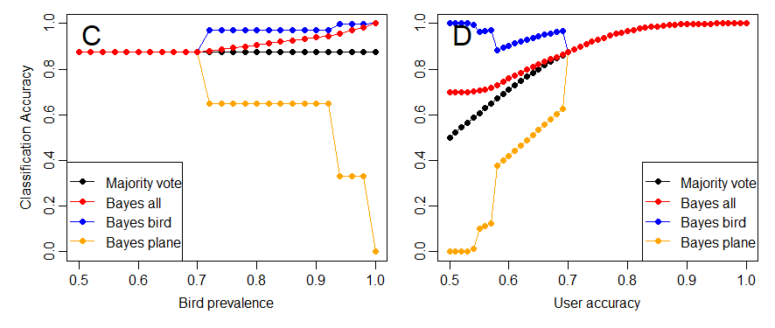
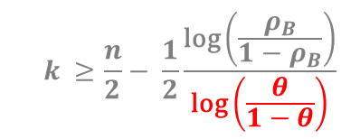
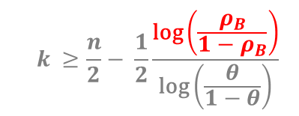
Bayes vs. Majority vote classification accuracy
  $$k ≥\frac{n}{2}− \frac{1}{2}\frac{\text{log}\left(\frac{ρ_{B}}{1−ρ_{B}}\right)}{\text{log}\left(\frac{θ}{1−θ}\right)}$$
  $$k ≥\frac{n}{2}− \frac{1}{2}\frac{\text{log}\left(\frac{ρ_{B}}{1−ρ_{B}}\right)}{\text{log}\left(\frac{θ}{1−θ}\right)}$$
Notes:
A: theta =0.7, n =7
B: rho_B =.7, n=7
However, there are a lot more times when the two methods are the same as the number of uses always has to be rounded to an integer
In figure A here we look at how the Bayes decision threshold varies as we change bird prevalence. The majority vote threshold is shown in black and is fixed at 4 users. Whereas the Bayes decision threshold is 4 users when bird prevalence is close to 0.5 but as the bird prevalence increases the number of users from the 7 total that need to say the image is a bird in order to classify it as a bird decreases. So as birds become more prevalent the decision rule tends towards always selecting the dominate species
In figure b we look at how the decision threshold varies over a range of user accuracies. When user accuracy is 100% or near, in this case the near range is quite large, bayes formula has the same threshold as majority vote. However as user accuracy falls closer to 50% the decision threshold falls. In this figure birds are the dominant species so as user accuracies tend towards random guessing bayes formula tends towards always selecting the dominant species.
We can then look at how the accuracy of all the classified images varies as we change either species prevalence or user accuracy. Clearly when the two methods have the same decision threshold they have the same classification accuracy.
But when the thresholds are different using bayes formula always out preforms majority vote. When we break down the classification accuracy by species we can see that the accuracy of bird species which is the dominant species in both these figures is high whereas the accuracy of the minority species is lower than majority vote. So Bayes formula is achieving a higher overall accuracy than majority vote by scraficing the accuracy of the minority species. For example if birds were 99% prevalent and you always classified an image as a bird you would be correct 99% of the time but you would never correctly identify a plane. So it is important to be aware of this feature if you want to accurately classify minority classes.

Slide 16
Conclusion so far
Bayes formula always has the same or higher classification accuracy compared to majority vote
But…
We need to know
  Class prevalence
  User accuracy
Notes:
So we have seen that Bayes formula is always equal or more accurate than majority vote at classify images. But it requires extra information – the species prevalence and user accuracies
Species prevalence is not really a problem as there is lots of prior information on this
However, finding user accuracy is another whole problem.

Slide 17
Conclusion so far
Bayes formula always has the same or higher classification accuracy compared to majority vote
But…
We need to know
  Class prevalence Assume we know this
  User accuracy
Notes:
So we have seen that Bayes formula is always equal or more accurate than majority vote at classify images. But it requires extra information – the species prevalence and user accuracies
Species prevalence is not really a problem as there is lots of prior information on this
However, finding user accuracy is another whole problem.

Slide 18
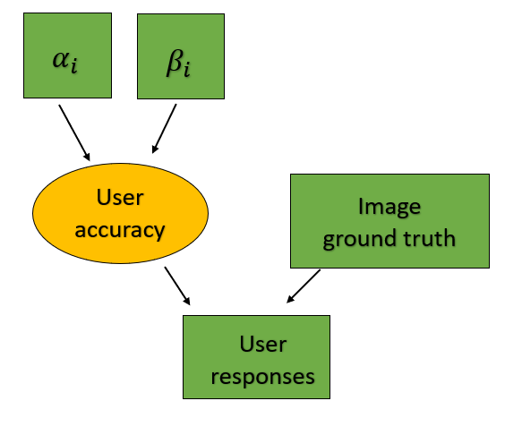

Estimating user accuracy – testing stage
${\hat{θ}}_{i}=\frac{α_{i} + \#\text{correct}}{{α_{i}+β}_{i} + \#\text{images}}$
Prior
User responses

Slide 19
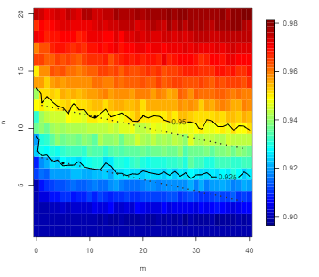
Trade-off between estimating user accuracy and classifying images
Classification accuracy
User responses per image – in classification stage
Images per user – in testing stage

Slide 20
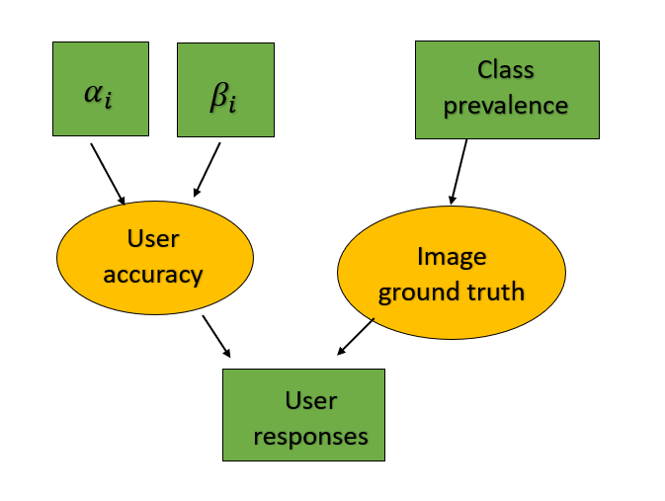
What happens if we remove the testing stage?

Slide 21
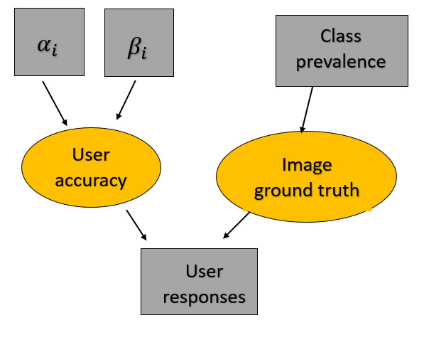
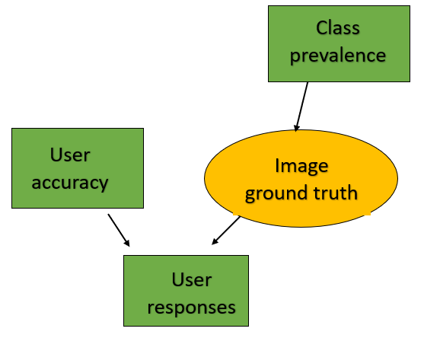
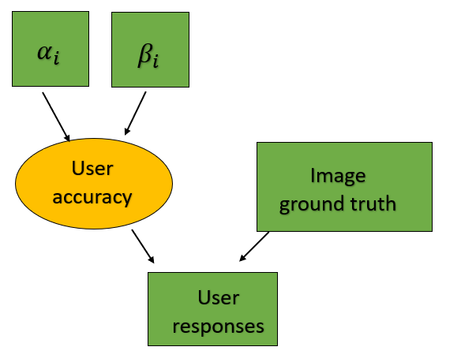
Gibbs sampling
WinBUGS
R – write own Gibbs sampler algorithm
Step 1
Initialise user accuracy and image GT
Step 2 – Bayes’ formula
Sample GT from distribution with probabilities calculated using Bayes’ rule using current user accuracy and user responses.
Replace current values of GT with new values
Step 3 – Beta distribution
Sample user accuracy from Beta distribution using current GT and user responses.
Replace current values of user accuracy with new values

Slide 22

Application to iNaturalist NZ

Slide 23
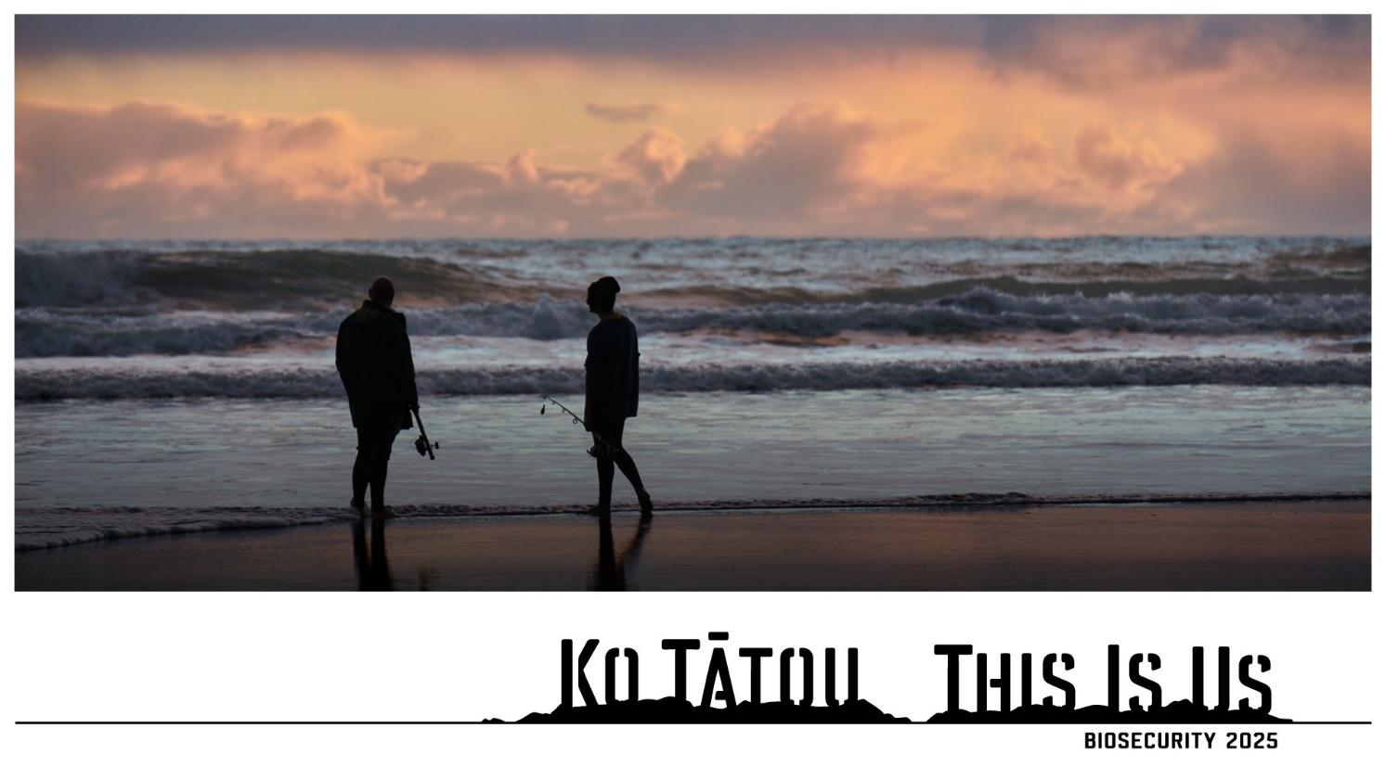
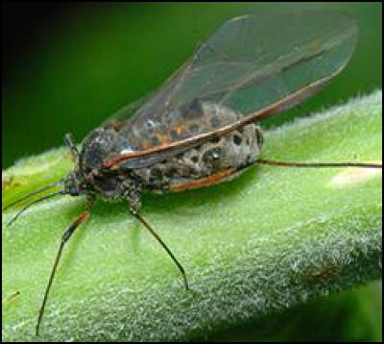

1st observation of Giant Willow Aphid in NZ

Slide 24
Performance on iNaturalist NZ data
iNaturalist features:
  Many classes
  Few users have done a large number of IDs and most users have done a small number of IDs
 | Plants | Birds Mammals | Insects Arachnids | Fungi | Amphibians Ray-finned fish Reptiles Mollusks | Protozoans Chromista
Images | 82,268 | 20,682 | 17,472 | 6,683 | 6,015 | 1,085
Classes | 4,533 | 1,027 | 2,081 | 979 | 1,029 | 86
Users | 1,375 | 1,888 | 1,325 | 510 | 560 | 157

Slide 25
Performance on iNaturalist NZ data
iNaturalist features:
  Many classes
  Few users have done a large number of IDs and most users have done a small number of IDs
 | Plants | Birds Mammals | Insects Arachnids | Fungi | Amphibians Ray-finned fish Reptiles Mollusks | Protozoans Chromista
Images | 82,268 | 20,682 | 17,472 | 6,683 | 6,015 | 1,085
Classes | 4,533 | 1,027 | 2,081 | 979 | 1,029 | 86
Users | 1,375 | 1,888 | 1,325 | 510 | 560 | 157
~ 6 days

Slide 26
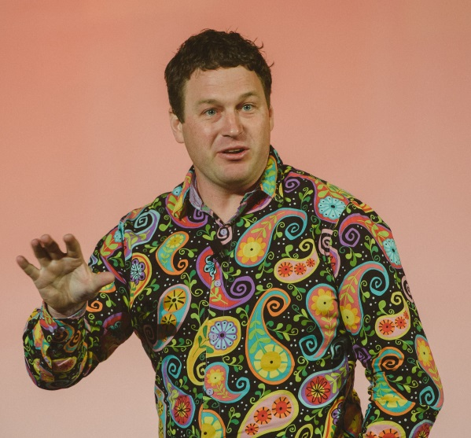
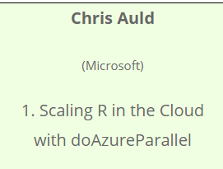
Performance on iNaturalist NZ data
iNaturalist features:
  Many classes
  Few users have done a large number of IDs and most users have done a small number of IDs
 | Plants | Birds Mammals | Insects Arachnids | Fungi | Amphibians Ray-finned fish Reptiles Mollusks | Protozoans Chromista
Images | 82,268 | 20,682 | 17,472 | 6,683 | 6,015 | 1,085
Classes | 4,533 | 1,027 | 2,081 | 979 | 1,029 | 86
Users | 1,375 | 1,888 | 1,325 | 510 | 560 | 157

Slide 27
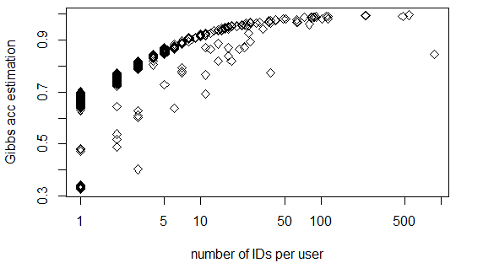
iNaturalist NZ Mammal data
Accomplished NZ ecologists
Accuracy estimation
Number of identifications per user

Slide 28
Future work
Improving our Gibbs sampling algorithm efficiency
Running algorithm on other data subsets
Comparing two stage accuracy estimation method to Gibbs sampling approach for Geo-wiki dataset → a citizen science project with 5 classes and testing data.
Answering the question: Did we improve the accuracy of citizen science?

Slide 29



Acknowledgements

