Slide 1
PREAMBLE
Invited to give seminar on fifty years of REML
Gave a talk on my career recently
Based on radio Programme
Desert Island Discs -eight record tracks
Desert Island library -ten papers-include references colour-coded blue

Slide 2
          5 Topics
A)REML
B)Canonical Variates
C)AIREML
D)ASReml
E)Sampling
Attempt to acknowledge mentors and colleagues and present a coherent story

Slide 3
Patterson, H.D. & Thompson, R. (1971). Recovery of inter-block information when block sizes are unequal.
Cunningham & Henderson (1968).
Sent correction note to David Finney, came back next day turned into paper !!
Blue biro description,red biro algebra (for checking)
Comment in black” Robin cannot write “ !!!
Thompson, R. (1969). Iterative estimation of variance components for non-orthogonal data
Submitted December 50 years ago !!

Slide 4
Mixed Models
Fixed Random Variance
effects effects components
Animal Contemporary Sires Sire
groups
Plant Treatment Blocks Block

Slide 5
Plant
Interest in treatment estimates
Intrablock information
Treatment effects correcting for blocks
Interblock information
block totals -need to down weight as depend on block variance
Block effects and variance nuisance en route

Slide 6
Animal
Interest in sire variance- gives heritability
Interest in predicted sire effects- needs heritability

Slide 7
Maximum likelihood- according to Desmond Patterson
Asymptotically efficient
Too ‘clever’ ?
Difficult to calculate ?

Slide 8
ML equations
Some terms easy -sums of squares of terms in mixed model equations
Others difficult -differentials of log determinants and traces of matrices
Follow paradigm of Henderson’s methods
Equate sum of squares to expectation.

Slide 9
Variances of estimates
Derived formulae functions of traces of matrices.
Patterson(1964) had formulae in terms of eigenvalues that I did not understand.
Numerical example show formulae agreed to 4 decimals
Explained using ‘just’ error contrasts-comparisons that had no treatment component
Similar tp ANOVA
What Frank Yates would do

Slide 10
Why is this a success ?
Ubiquity of correlated data
Flexibility of mixed models
Reduces to ANOVA in balanced cases
Provides
estimates of fixed effects
random effect predictors
variance parameters
All used in a coherent way

Slide 11
Other justification
Rao (1972). Iterative MINQUE
LaMotte (1973). Iterative MIVQUE
Harville (1974).Bayesian argument
Verbyla, A. (1990). Conditional likelihood.
Lee. and Nelder (1996). Penalty function argument
Robertson (1962) Weighted analysis in single classification

Slide 12
Champions
Influential review by Harville (I977)
Dorothy Robinson wrote program for British variety trials
Sue Welham extended this program into Genstat
partly through Emlyn Williams persuasion
Karin Meyer wrote several programs (REMLPK,DFREML,Wombat) suitable for animal breeding problems
Terry Speed suggested the name residual maximum likelihood as residuals were used in the analysis

Slide 13
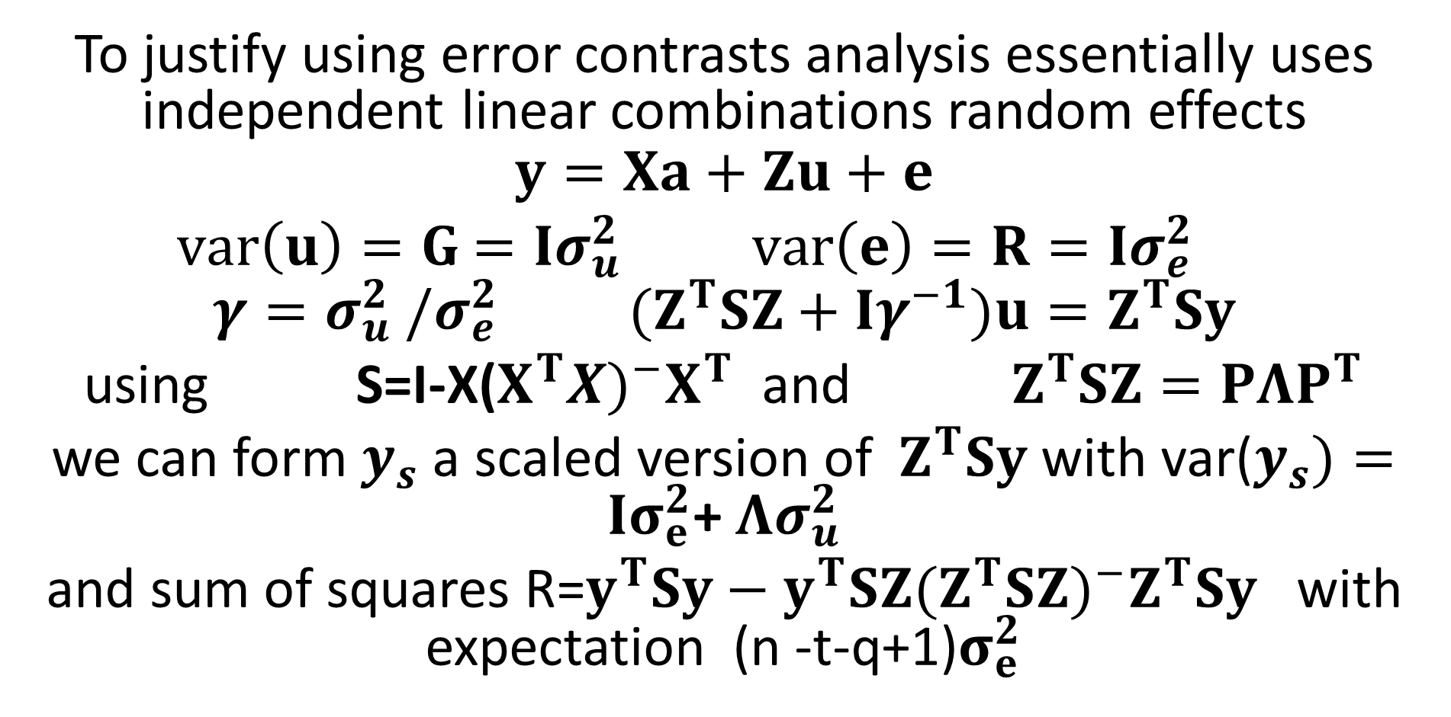
Spectral decomposition
To justify using error contrasts analysis essentially uses independent linear combinations random effects
$$y=Xa+Zu+e$$
$var\left(u\right)=G$ $=Iσ_{u}^{2} var\left(e\right)=R=Iσ_{e}^{2}$
$$γ=σ_{u}^{2} /σ_{e}^{2} {(Z}^{T}SZ+Iγ^{−1})u=Z^{T}Sy$$
using S=I-X($X^{T}X)^{−}X^{T}$ and $Z^{T}SZ=PΛP^{T}$
we can form $y_{s}$a scaled version of $Z^{T}Sy$ with var($y_{s})=Iσ_{e}^{2}$+$Λσ_{u}^{2}$
and sum of squares R=$y^{T}Sy−y^{T}SZ(Z^{T}SZ)^{−}Z^{T}Sy$ with expectation (n -t-q+1)$σ_{e}^{2}$

Slide 14
Nelder and Wedderburn (1972) Generalized linear models,
They introduced generalized linear models allowing variables distributed in the exponential family (normal, gamma, Poisson, binomial)and also allow a non-linear link between the observation and the linear predictor. All fit into a weighted least squares algorithm.

Slide 15
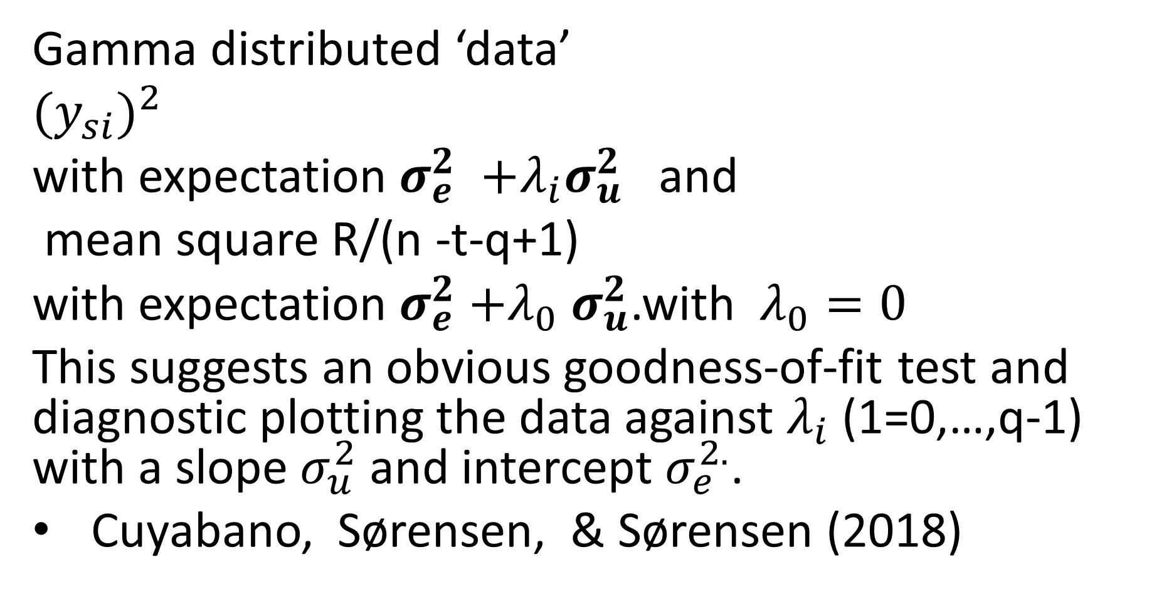
The REML likelihood is a special case of this.
Gamma distributed ‘data’
$(y_{si})^{2}$
with expectation $σ_{e}^{2}$ $+λ_{i}σ_{u}^{2}$ and
mean square R/(n -t-q+1)
with expectation $σ_{e}^{2}{+λ}_{0}σ_{u}^{2}$.with $λ_{0}=0$
This suggests an obvious goodness-of-fit test and diagnostic plotting the data against $λ_{i}$ (1=0,…,q-1) with a slope $σ_{u}^{2}$ and intercept $σ_{e}^{2.}$.
Cuyabano, Sørensen, & Sørensen (2018)

Slide 16
Thompson (1976a,b) discussed extension to the
multivariate case of sums of squares and cross-products distributed as Wishart distributions used to model data on parents and offspring and estimate maternal genetic variances in Tribolium. Not very useful apart from discussion of iterative schemes and designs.
Cullis,Smith & Thompson (2004) Perspectives of ANOVA, REML and a General linear mixed model.
extended this to made more explicit the relationship between REML and ANOVA especially for generally balanced designs, and discussed a choleski transformation to give a simple quantitative interpretation of the information on the variance parameters.

Slide 17
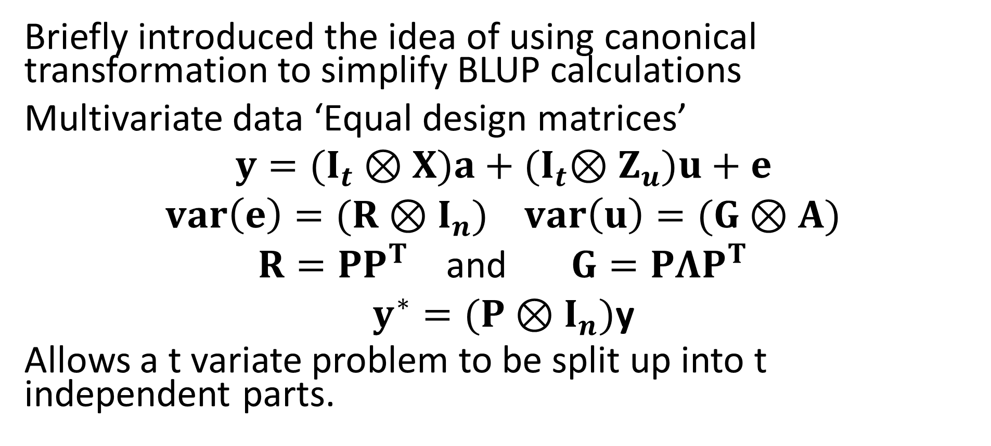
Thompson, R. (1977). Estimation of quantitative genetic parameters.
Briefly introduced the idea of using canonical transformation to simplify BLUP calculations
Multivariate data ‘Equal design matrices’
$$y=(I_{t}⊗X)a+{(I}_{t}⊗Z_{u})u+e$$
$var\left(e\right)=(R⊗I_{n})$ $var\left(u\right)=(G⊗A)$
$R=PP^{T}$ and $G=PΛP^{T}$
$y^{∗}=(P⊗I_{n})$y
Allows a t variate problem to be split up into t independent parts.

Slide 18
Motivation was BLUP
.
Hill & Thompson (1978) used result to consider probability of non positive definite estimates of G
Meyer(1985) used result for simplified REML estimation of R and G
Furlotte, Eskiny, (2015) rediscovered this 30 years later !!!

Slide 19
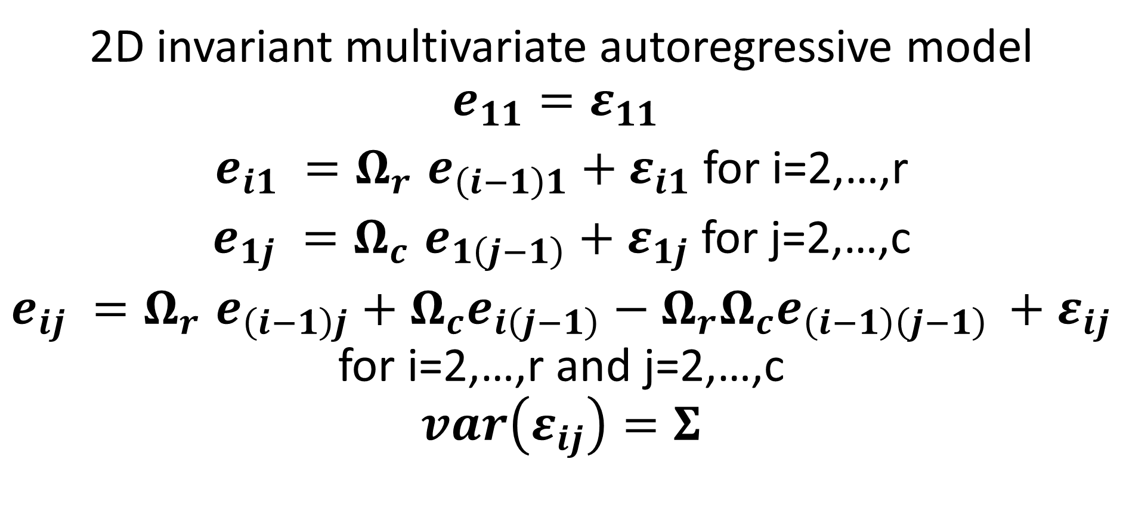
De Faveri, J., Verbyla, A.P., Cullis, B.R, Pitchford, W.S., & Thompson R. (2017). Residual Variance–Covariance Modelling in Analysis of Multivariate Data from Variety Selection Trials
2D invariant multivariate autoregressive model
$$e_{11}=ε_{11}$$
$e_{i1} {=Ω}_{r}e_{\left(i−1\right)1}+ε_{i1}$ for i=2,…,r
$e_{1j} {=Ω}_{c}e_{1\left(j−1\right)}+ε_{1j}$ for j=2,…,c
$e_{ij} {=Ω}_{r}e_{\left(i−1\right)j}+Ω_{c}e_{i\left(j−1\right)}−{Ω_{r}Ω}_{c}e_{\left(i−1\right)\left(j−1\right) }+ε_{ij}$ for i=2,…,r and j=2,…,c
$$var\left(ε_{ij}\right)=Σ$$

Slide 20
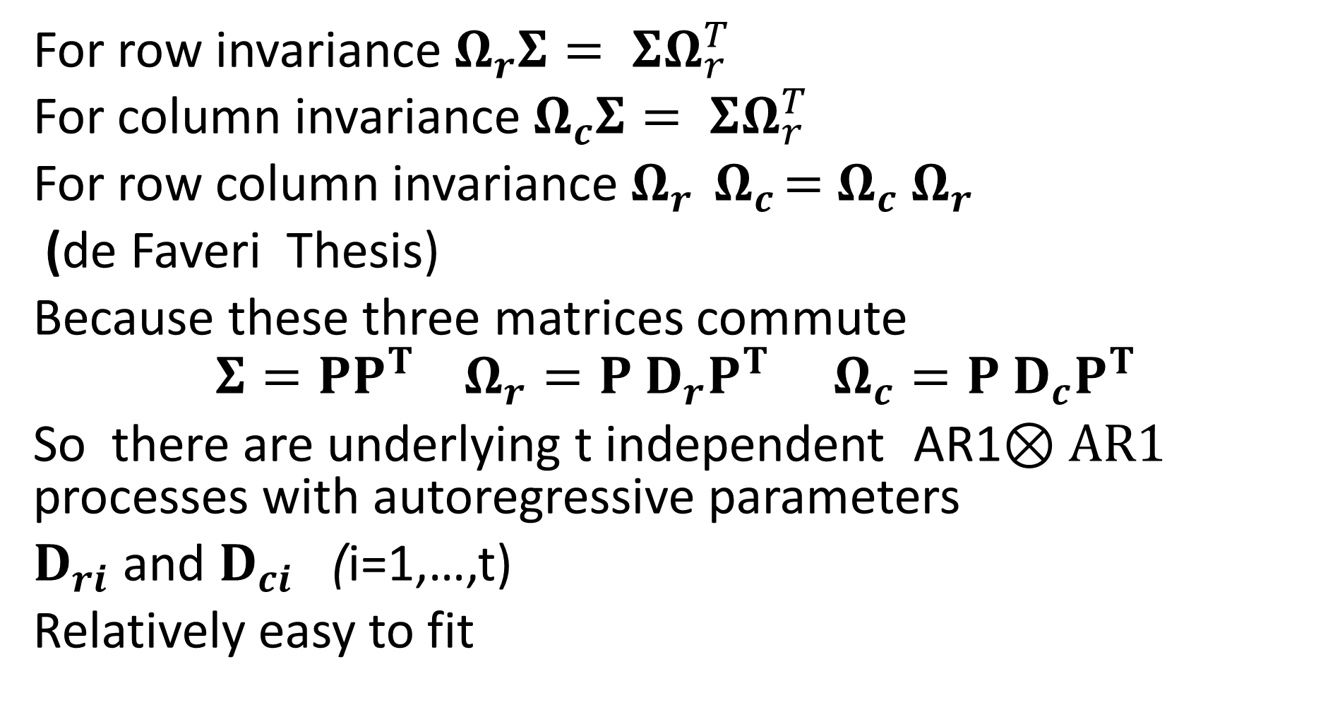
Invariance conditions
For row invariance${ Ω}_{r}Σ= ΣΩ_{r}^{T}$
For column invariance $Ω_{c}Σ= ΣΩ_{r}^{T }$
For row column invariance $Ω_{r}{ Ω}_{c}={ Ω}_{c}{ Ω}_{r}$
(de Faveri Thesis)
Because these three matrices commute
$$Σ=PP^{T} Ω_{r}=P D_{r}P^{T }Ω_{c}=P D_{c}P^{T }$$
So there are underlying t independent AR1$⊗AR1$ processes with autoregressive parameters
$D_{ri}$and $D_{ci}$ (i=1,…,t)
Relatively easy to fit

Slide 21
Gilmour, Thompson, & Cullis. (1995). Average Information REML, an efficient algorithm for variance parameter estimation in linear mixed models.
Initial discussions with Arthur and Brian
Johnson, & Thompson, (1995). Restricted maximum likelihood estimation of variance components for univariate animal models using sparse matrix techniques and a quasi-Newton procedure.
Discussion at Biometrics conference at Hamilton !!!
Jensen, Mantysaari, Madsen, and Thompson. (1997). Residual maximum likelihood estimation of (Co) variance components in multivariate mixed linear models using average information.
Multivariate case- relationship between EM and AI

Slide 22
Henderson, Kempthorne, Searle, and Von Krosigk (1959).The estimation of genetic and environmental trends from records subject to culling.
Dairy cattle records on cows in closed herd with culling on milk yield, fixed effects of year and cows. Lead to biased environmental trend.
Henderson suggested random cows and mixed models
Kempthorne suggested sequential approach likelihood of first lactation record., likelihood of second lactation record given first lactation record etc.
Searle showed the methods were equivalent.
Von Krosigk did the calculations?
Good to have paper from three eminent statisticians.

Slide 23
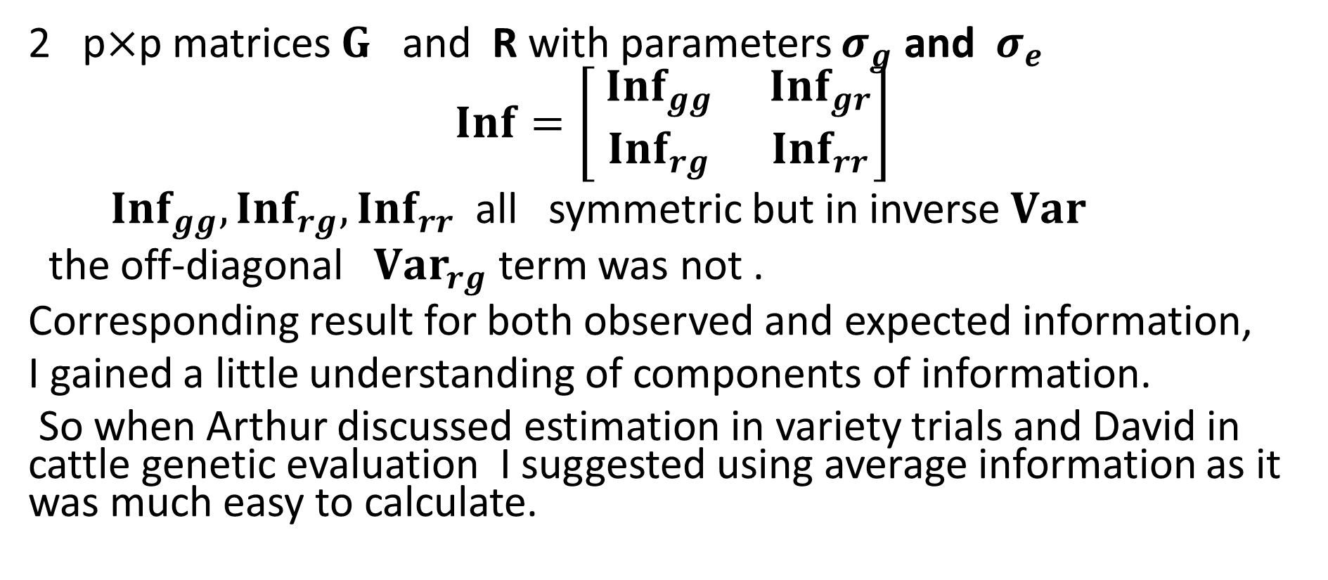
Thompson, R. (1973)
Estimation of multivariate parent -offspring regression
2 p$×$p matrices $G$ and R with parameters $σ_{g}$ and$σ_{e}$
$$Inf=\left[\begin{matrix}{ Inf}_{gg} & {Inf}_{gr} \\ {Inf}_{rg} & {Inf}_{rr}\end{matrix}\right]$$
${Inf}_{gg}, {Inf}_{rg},{Inf}_{rr}$all symmetric but in inverse $Var$
the off-diagonal ${Var}_{rg}$ term was not .
Corresponding result for both observed and expected information,
I gained a little understanding of components of information.
So when Arthur discussed estimation in variety trials and David in cattle genetic evaluation I suggested using average information as it was much easy to calculate.

Slide 24
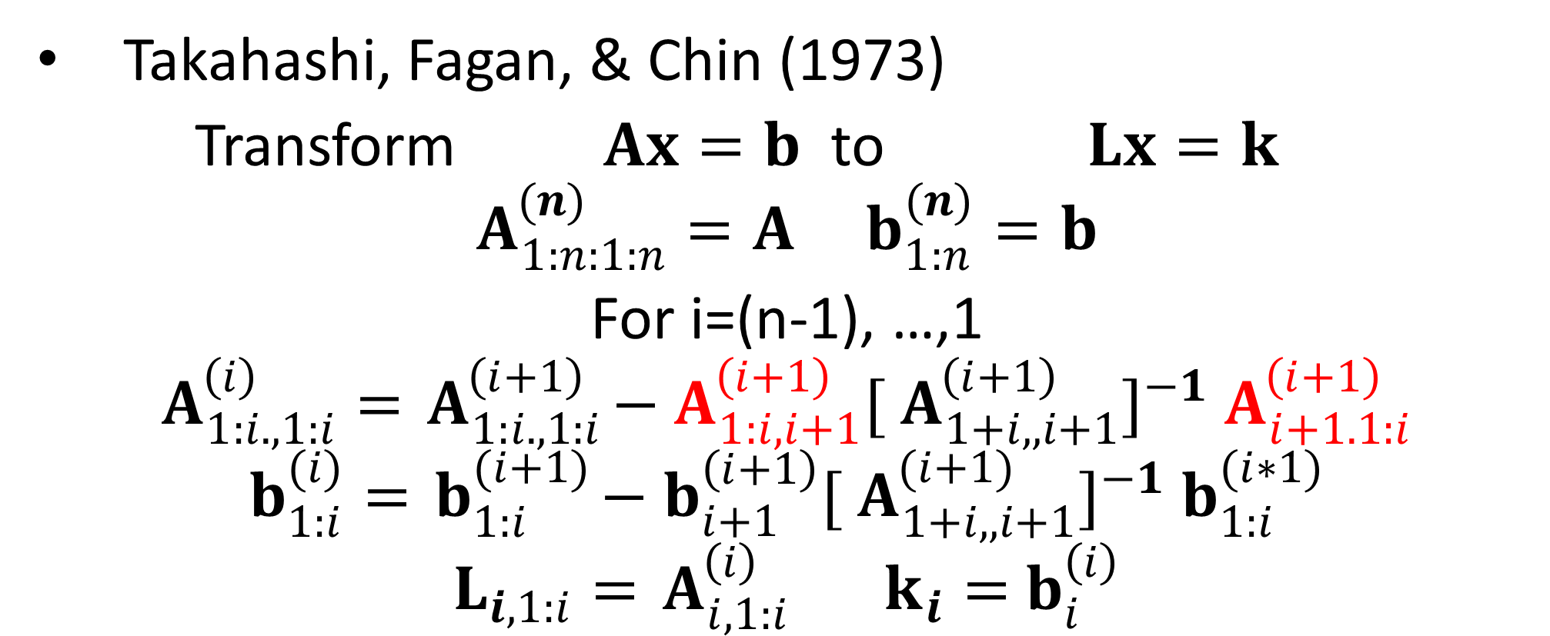
Thompson, Wray & Crump (1994) Calculation of prediction error variances using sparse matrix methods.
Takahashi, Fagan, & Chin (1973)
Transform $Ax=b$to $Lx=k$
$$A_{1:n:1:n}^{(n)}=A b_{1:n}^{(n)}=b$$
For i=(n-1), …,1
$$A_{1:i.,1:i}^{\left(i\right)}={ A}_{1:i.,1:i}^{\left(i+1\right)}−{ A}_{1:i,i+1}^{\left(i+1\right)}[{ A}_{1+i,,i+1}^{\left(i+1\right)}]^{−1}{ A}_{i+1.1:i}^{\left(i+1\right)}$$
$$b_{1:i}^{(i)}={ b}_{1:i}^{(i+1)}−{ b}_{i+1}^{\left(i+1\right)}[{ A}_{1+i,,i+1}^{(i+1)}]^{−1}{ b}_{1:i}^{(i∗1)}$$
$$L_{i,1:i}={ A}_{i,1:i}^{\left(i\right)} k_{i}={ b}_{i}^{\left(i\right)}$$

Slide 25
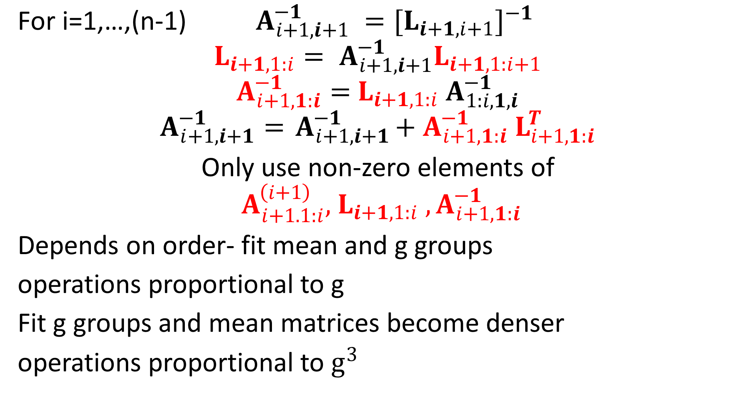
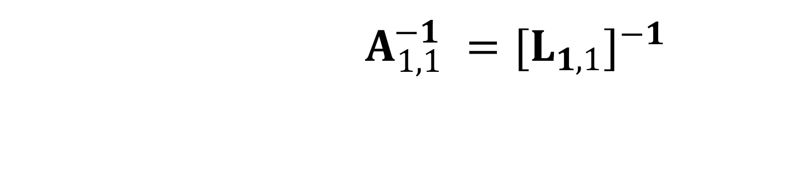
$$A_{1,1}^{−1} =[L_{1,1}]^{−1}$$
$${\text{For} \text{i}\text{=1,…,(}\text{n}\text{−1)} A}_{i+1,i+1}^{−1} =[L_{i+1,i+1}]^{−1}$$
$${L_{i+1,1:i}= A}_{i+1,i+1}^{−1}L_{i+1,1:i+1}$$
$$A_{i+1,1:i}^{−1}={ L_{i+1,1:i} A}_{1:i,1,i}^{−1}$$
$$A_{i+1,i+1}^{−1}={ A}_{i+1,i+1}^{−1}+{ A}_{i+1,1:i}^{−1}{ L}_{i+1,1:i}^{T}$$
Only use non-zero elements of ${ A}_{i+1.1:i}^{\left(i+1\right)},{ L_{i+1,1:i} , A}_{i+1,1:i}^{−1}$
Depends on order- fit mean and g groups
operations proportional to g
Fit g groups and mean matrices become denser
operations proportional to $g^{3}$

Slide 26
Butler, Cullis, Gilmour ,Gogel, and Thompson (2018).ASReml-R Reference Manual Version 4
Culmination of twenty six years of collaborative work.
Agreement by Gilmour, Cullis, Welham and Thompson in New Zealand to collaborate and pool resources on producing software based on AIREML algorithm.

Slide 27
Program and model experience
REG,BVEST Arthur Gilmour
additive relationships
TWOD Arthur Gilmour, Brian Cullis
spatial, separable
GENSTAT Sue Welham
variety trial program, repeated measures
DFREML,REMLPK Robin Thompson

Slide 28
Beniwal, Hastings, Thompson & Hill (1992)
Crump, Thompson, Haley & Mercer (1997).
Heath, Bulfield, Thompson & Keightley (1995)
Koerhuis & Thompson (1997)
Mrode, Smith & Thompson (1990)
Visscher & Thompson R (1992)
Mostly non standard analyses fitted with ingenuity in DFREML. I wanted ability to estimate more parameters and a more user friendly specification.
Just about achieved with the functional specification in ASReml-R v4

Slide 29
Initially no intention to write stand alone program !!
Kernel for Genstat !!
Genstat could /would not keep up with Arthur !!

Slide 30
Throughout Arthur Gilmour has taken responsibility for
programming i.e. the code Sue and I provided was commented out without discussion.
He has also supported users.
His AAABG citation for fellowship and Helen Newton Turner Medal states
A discussion group has also been set up that is better described as ‘ask Arthur a question’. His generosity in time to individually answer and his resistance to describing perhaps 50% of the questions as stupid are exemplary

Slide 31
Careful design (John Nelder)
Welham, Thompson & Gilmour (1998)
Gilmour, Cullis, Frensham & Thompson (1998)
Gilmour & Thompson (1998)
Thompson (2009)
Consideration of correlated variance structures
AR, MA, antedependence, separable, repeated measures, plant breeding models. singular, relationships etc.

Slide 32
Improved theory
Thompson, Cullis, Smith & Gilmour (2003)
Kelly, Cullis, Gilmour, Eccleston, & Thompson (2009)
Sparse factor analysis and reduced rank variance models.
Gilmour, Cullis, Welham, Gogel, & Thompson (2004)
Welham, Cullis, Gogel, Gilmour. & Thompson (2004)
Prediction -Forming linear combinations of linear estimates

Slide 33
Welham, Cullis, Kenward & Thompson (2006,2007)
Analysis of Splines
Cullis, Jefferson, Thompson & Smith (2014)
Multi-environment reduced tree model
de Faveri, Verbyla, Cullis,Pitchford, Thompson (2017)
2D invariant multivariate autoregressive model

Slide 34
Improve user experience
Focus in developing ASReml was initially on its kernel
It was freely acknowledged that its user interface was not to the level of other packages.
Other packages such as Genstat and R allow the data preparation, analysis, post-processing to be carried out within a single framework
‘Standalone’ is a pejorative term
Pipeline from ‘plots and paddocks’ to publications No No No
Against the trade description act!!
Surprise VSN not sued !!

Slide 35
Improve user experience
Not sufficient to be negative!!!
Sue Welham ported kernel into Genstat
We recruited widely !!
Bev Gogel improved the draft documentation
Challenge to make syntax more consistent and user-friendly
Dave Butler and Brian Cullis built on kernel to write ASReml-R
Simon Harding built ASReml-W

Slide 36
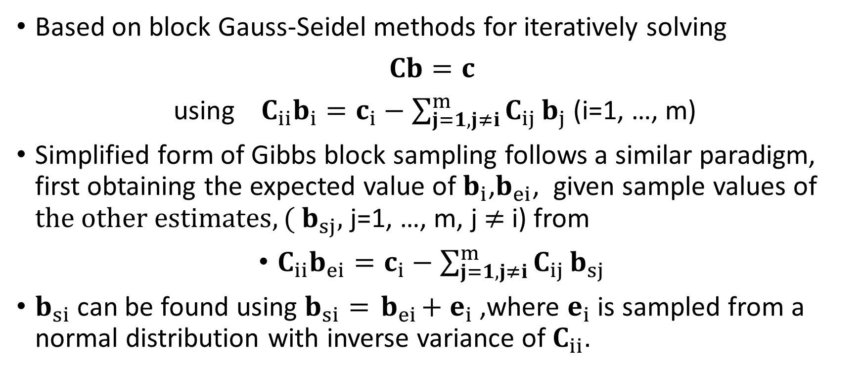
Thompson, R. (1994). Integrating best linear unbiased prediction and maximum likelihood estimation
Based on block Gauss-Seidel methods for iteratively solving
$Cb=c$
$\text{using} {C_{ii}b}_{i}={c_{i}−\sum_{j=1,j≠i}^{m}{C_{ij}}b}_{j}$ (i=1, …, m)
Simplified form of Gibbs block sampling follows a similar paradigm, first obtaining the expected value of $b_{i}$,$b_{ei}$, given sample values of $the other estimates,( b_{sj},$ j=1, …, m, j $≠$i) from
${C_{ii}b}_{ei}={c_{i}−\sum_{j=1,j≠i}^{m}{C_{ij}}b}_{sj}$
$b_{si}$ can be found using $b_{si}={ b}_{ei}+{ e}_{i}$ ,where $e_{i}$is sampled from a normal distribution with inverse variance of $C_{ii}$.

Slide 37
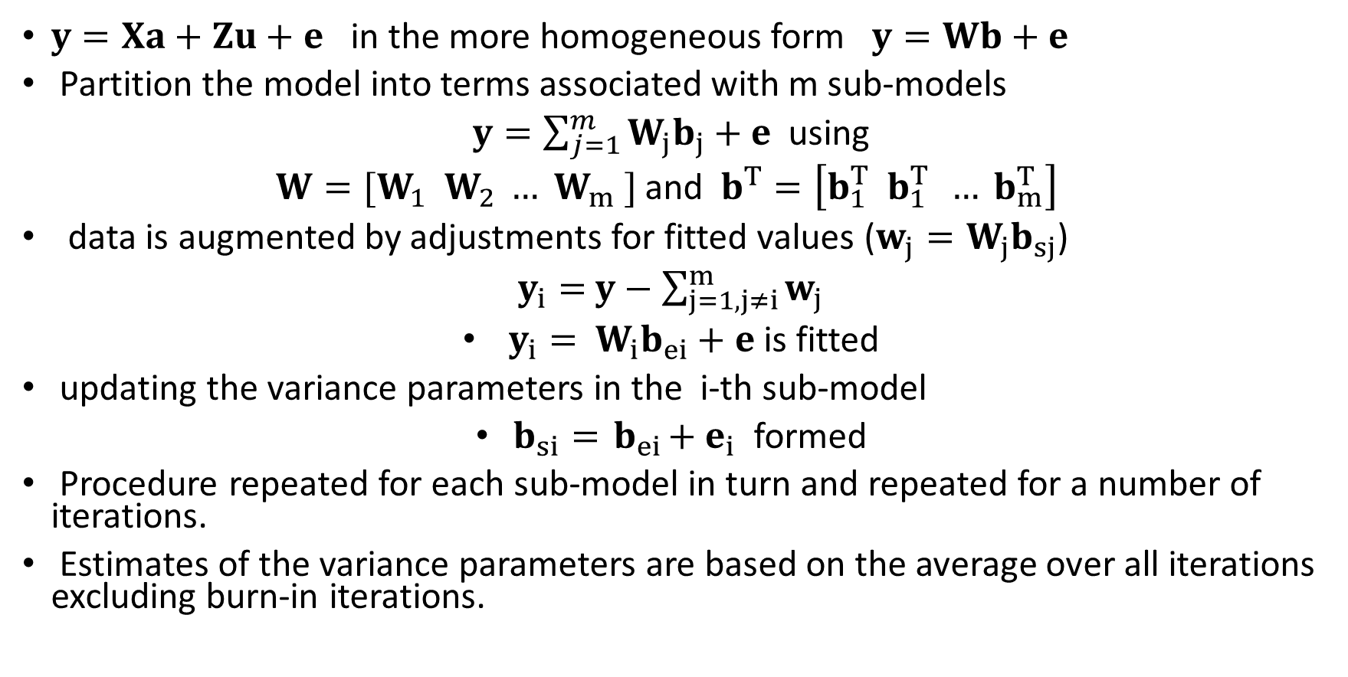
Alternative interpretation in terms of sub-models and augmented data
$y=Xa+Zu+e$ in the more homogeneous form $y=Wb+e$
Partition the model into terms associated with m sub-models
$y=\sum_{j=1}^{m}{W_{j}b_{j}}+e$ using
${W=[W}_{1} W_{2} … W_{m} ]$ and $b^{T}=\left[b_{1}^{T} b_{1}^{T } … b_{m}^{T}\right]$
data is augmented by adjustments for fitted values ($w_{j}=W_{j}b_{sj}$)
$y_{i}=$ $y−\sum_{j=1,j≠i}^{m}{w_{j}}$
$y_{i}=$ $W_{i}b_{ei}+e$ is fitted
updating the variance parameters in the i-th sub-model
$b_{si}={ b}_{ei}+{ e}_{i}$ formed
Procedure repeated for each sub-model in turn and repeated for a number of iterations.
Estimates of the variance parameters are based on the average over all iterations excluding burn-in iterations.

Slide 38
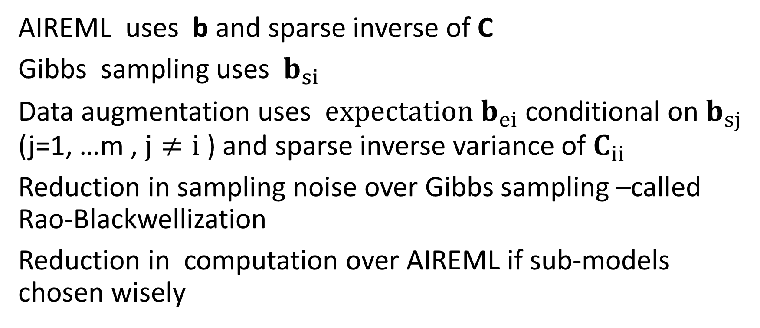
Comparison
AIREML uses b and sparse inverse of C
Gibbs sampling uses ${ b}_{si}$
Data augmentation uses $expectation b_{ei}$ conditional on $b_{sj}$ (j=1, …m , $j≠i$ ) and sparse inverse variance of $C_{ii}$
Reduction in sampling noise over Gibbs sampling –called Rao-Blackwellization
Reduction in computation over AIREML if sub-models chosen wisely

Slide 39
Clayton & Rasbash (1999)
Cross-classification uncorrelated errors
‘Obvious’ improvement would be to fit s samples reusing information in fitting process .
Not so obvious would be to used noise based on
Sampling from the s quantiles of the distribution
(Kinghorn -Hickey conjecture)

Slide 40
MC-AI-REML
Matilainen,Mäntysaari, Lidauer, Strandén, & Thompson, (2013) Employing a Monte Carlo algorithm in Newton-type methods for restricted maximum likelihood estimation of genetic parameters
Score equations equate sum of squares of predicted values to their expectation.
Generate data with variance V get sum of squares of predicted values from this sample data.
Use preconditioned conjugate gradient (PCCG) methods to get predicted values and predicted values from working variables to get AI terms.

Slide 41
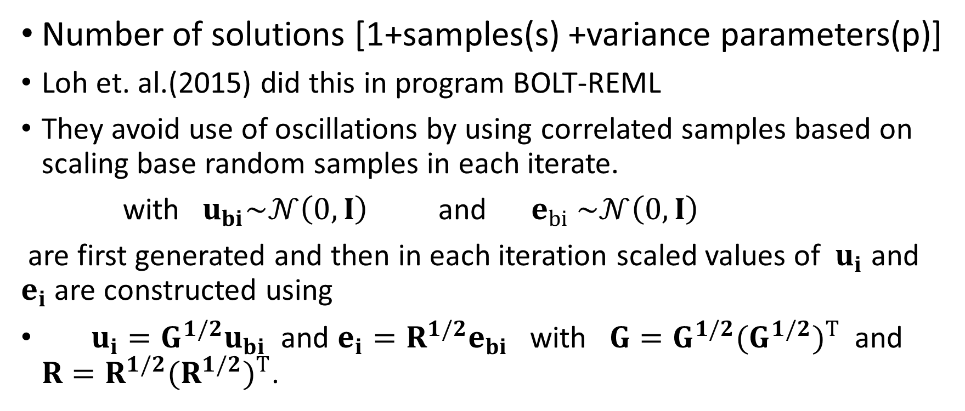
MC-AI-REML
Number of solutions [1+samples(s) +variance parameters(p)]
Loh et. al.(2015) did this in program BOLT-REML
They avoid use of oscillations by using correlated samples based on scaling base random samples in each iterate.
with $u_{bi}\sim 𝒩\left(0,I\right)$ and $e_{bi} \sim 𝒩\left(0,I\right)$
are first generated and then in each iteration scaled values of $u_{i}$ and $e_{i}$ are constructed using
$u_{i}=G^{1/2}u_{bi}$and $e_{i}=R^{1/2}e_{bi}$ with $G=G^{1/2}(G^{1/2})^{T}$and $R=R^{1/2}(R^{1/2})^{T}$.

Slide 42
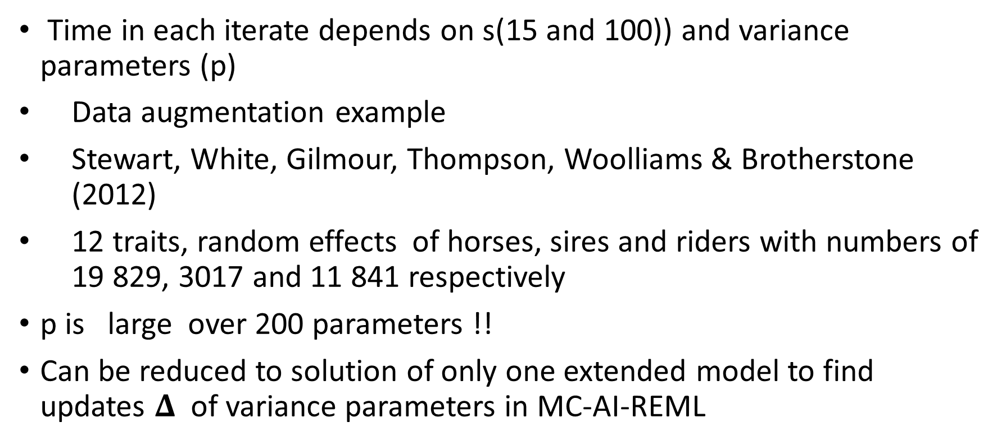
MC-AI-REML
Time in each iterate depends on s(15 and 100)) and variance parameters (p)
Data augmentation example
Stewart, White, Gilmour, Thompson, Woolliams & Brotherstone (2012)
12 traits, random effects of horses, sires and riders with numbers of 19 829, 3017 and 11 841 respectively
p is large over 200 parameters !!
Can be reduced to solution of only one extended model to find updates $Δ$ of variance parameters in MC-AI-REML

Slide 43
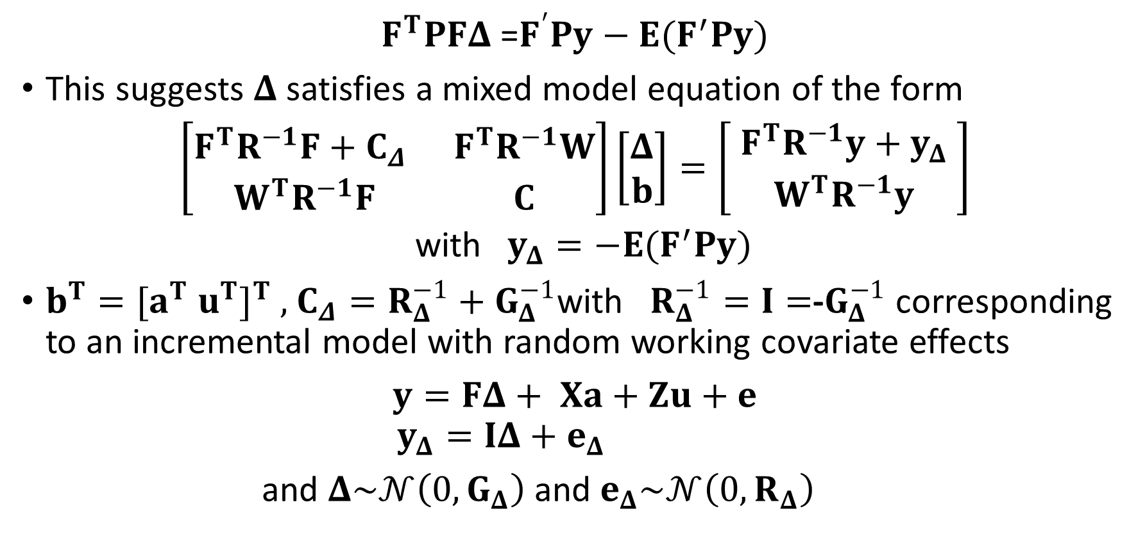
MC-AI-REML
$F^{T}PFΔ$ =$F^{′}Py−E(F^{′}Py)$
This suggests $Δ$ satisfies a mixed model equation of the form
$\left[\begin{matrix}F^{T}R^{−1}F+C_{Δ} & F^{T}R^{−1}W \\ W^{T}R^{−1}F & C\end{matrix}\right]\left[\begin{aligned}Δ \\ b\end{aligned}\right]=\left[\begin{aligned}{ F}^{T}R^{−1}y+y_{Δ} \\ W^{T}R^{−1}y\end{aligned}\right]$
with $y_{Δ}=−E(F^{′}Py)$
$b^{T}=[a^{T} u^{T}]^{T} ,$ $C_{Δ}=R_{Δ}^{−1}+G_{Δ}^{−1}$with $R_{Δ}^{−1}=I=$-$G_{Δ}^{−1}$ corresponding to an incremental model with random working covariate effects
$y=FΔ+ Xa+Zu+e$
$$y_{Δ}=IΔ+e_{Δ}$$
and $Δ\sim 𝒩\left(0,G_{Δ}\right)$ and $e_{Δ}\sim 𝒩\left(0,R_{Δ}\right)$

Slide 44
SciLMM- variant on MC-AI-REML
Converts C to triangular form using supernodal and BLAS methods on large (13M) pedigrees to avoid using PCCG methods
Supernodal methods use matrix operations instead of vector operations when rows have same sparsity pattern
Literature suggests speed up of factor 8 over vector methods
Confirmed by Luke Mazur (Ph. D. student University of Wollongong)
comparing limited set of examples with ASReml

Slide 45
Open questions
can the data augmentation method be easily adapted to give REML estimates ?
Can AI-MC-REML be improved by generating dependent noise based on the s quantiles of the noise distribution?
Which method, data augmentation or MC-AI-REML, is the more computationally efficient? Is there a hybrid scheme that takes advantage of the strengths of the data augmentation method in reducing sampling variation and the strengths of the MCAIREML scheme in reducing the effort in calculating solutions?
Roger’s homework- how do the noiseless versions of these schemes
(Gauss-Seidel and PCCG) relate to the Genstat ANOVA algorithm ?

Slide 46
Acknowledgements
Wise counsel in person or publication
David Finney, John Nelder, Chuck Henderson, Shayle Searle, Oscar Kempthorne, Bill Hill
Generosity
Desmond Patterson –REML his idea I ‘just’ related to other computational strategies
AIREML project team
Especially Arthur Gilmour and Brian Cullis

Slide 47
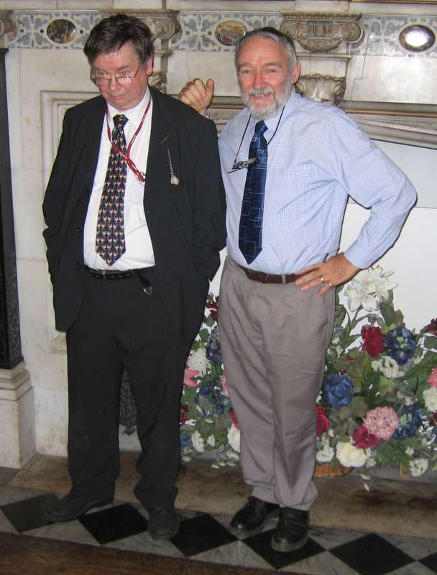

Slide 48
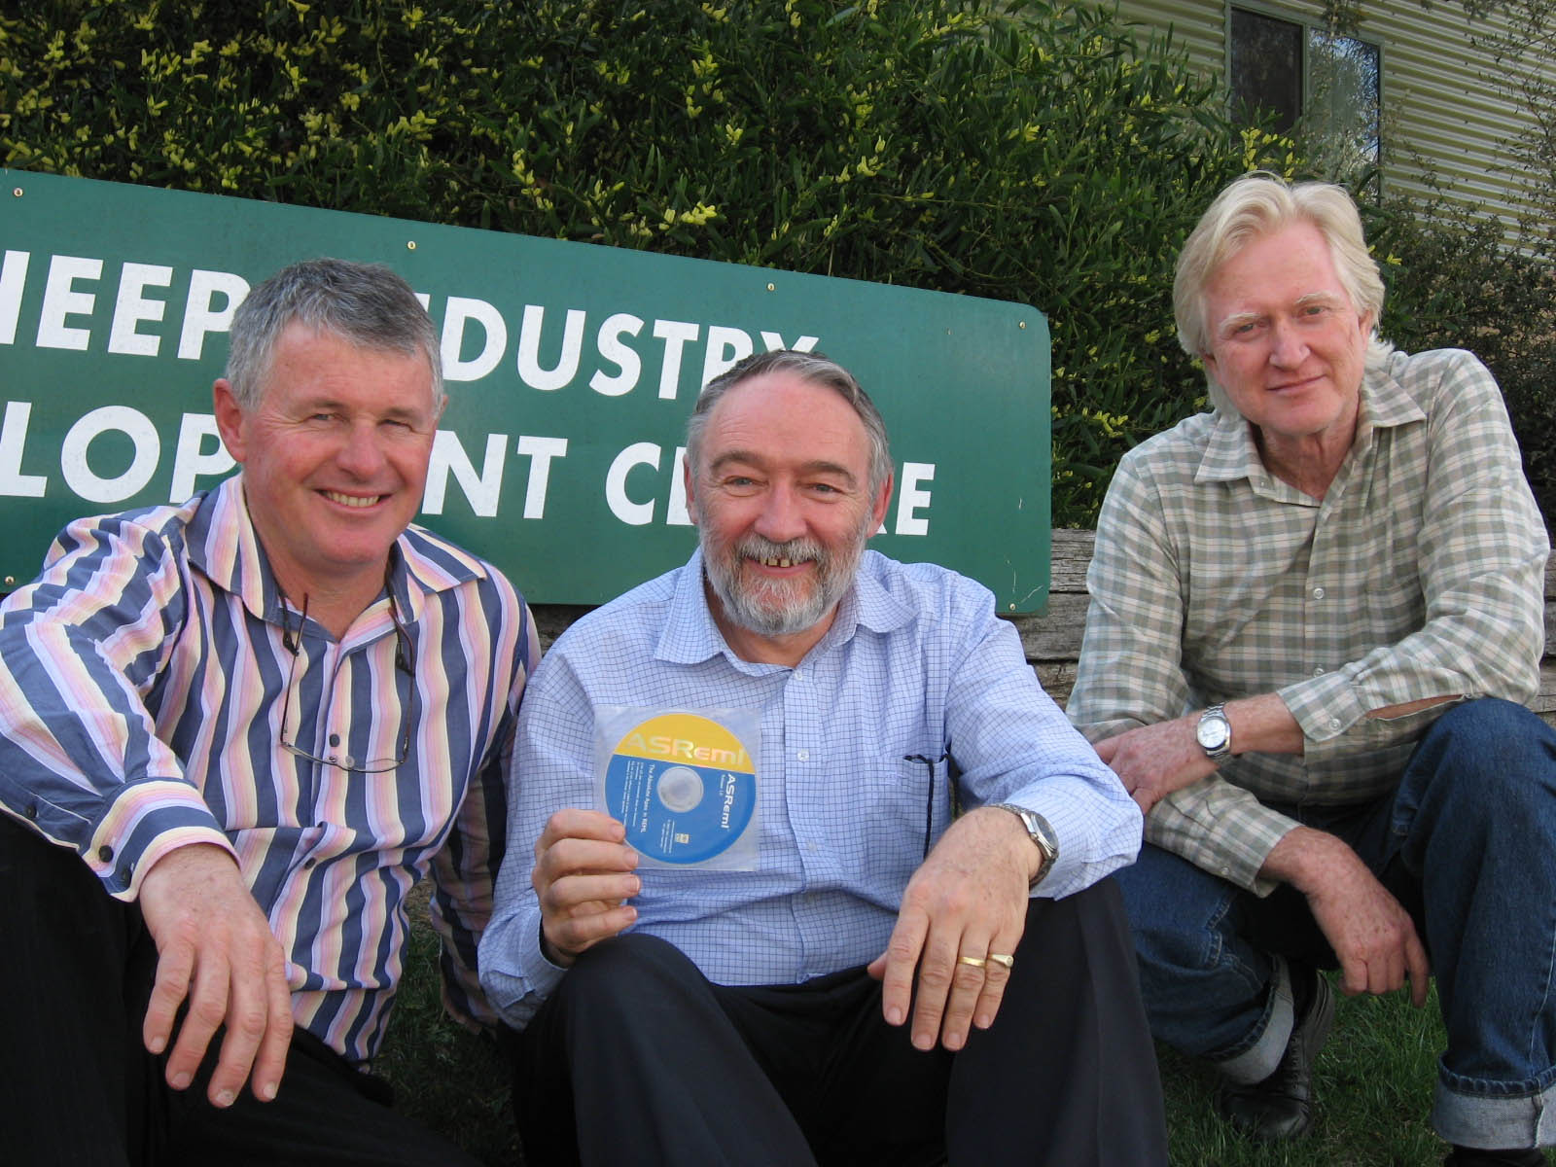

Slide 49
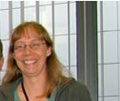
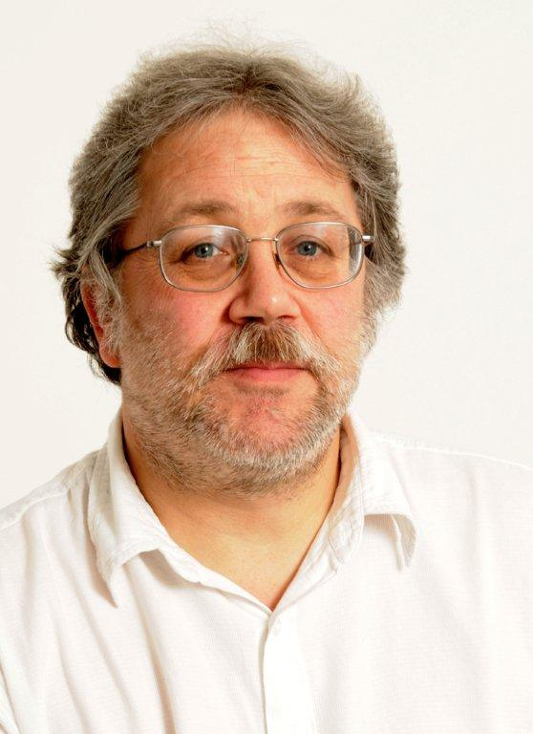
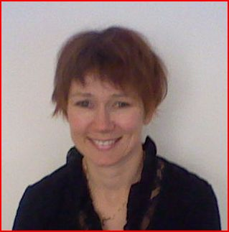
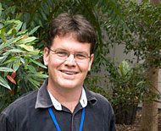

Slide 50
John Hickey
What advice do you have for students based on your career ?
Choose mentors who give wise counsel
Work in a happy team that has a team ethic, generates synergy, has mutual trust and respect, respect for sponsors and users and has a shared vision
Get rigorous grounding -Bill Hill Brian Cullis
Appropriate challenges –easier with applied data analysis to adapt to students skills than with developing new statistical methods –more discrete
Careful planning –model specification evolved- difficult to shoehorn functional specification into core
Adapt to new methods- I was slow to adapt to sampling methods
Do things two ways to get comparison of results –better understanding Not got the confidence to believe I have got correct results
Beta testers from hell –Arthur does not see need

Slide 51
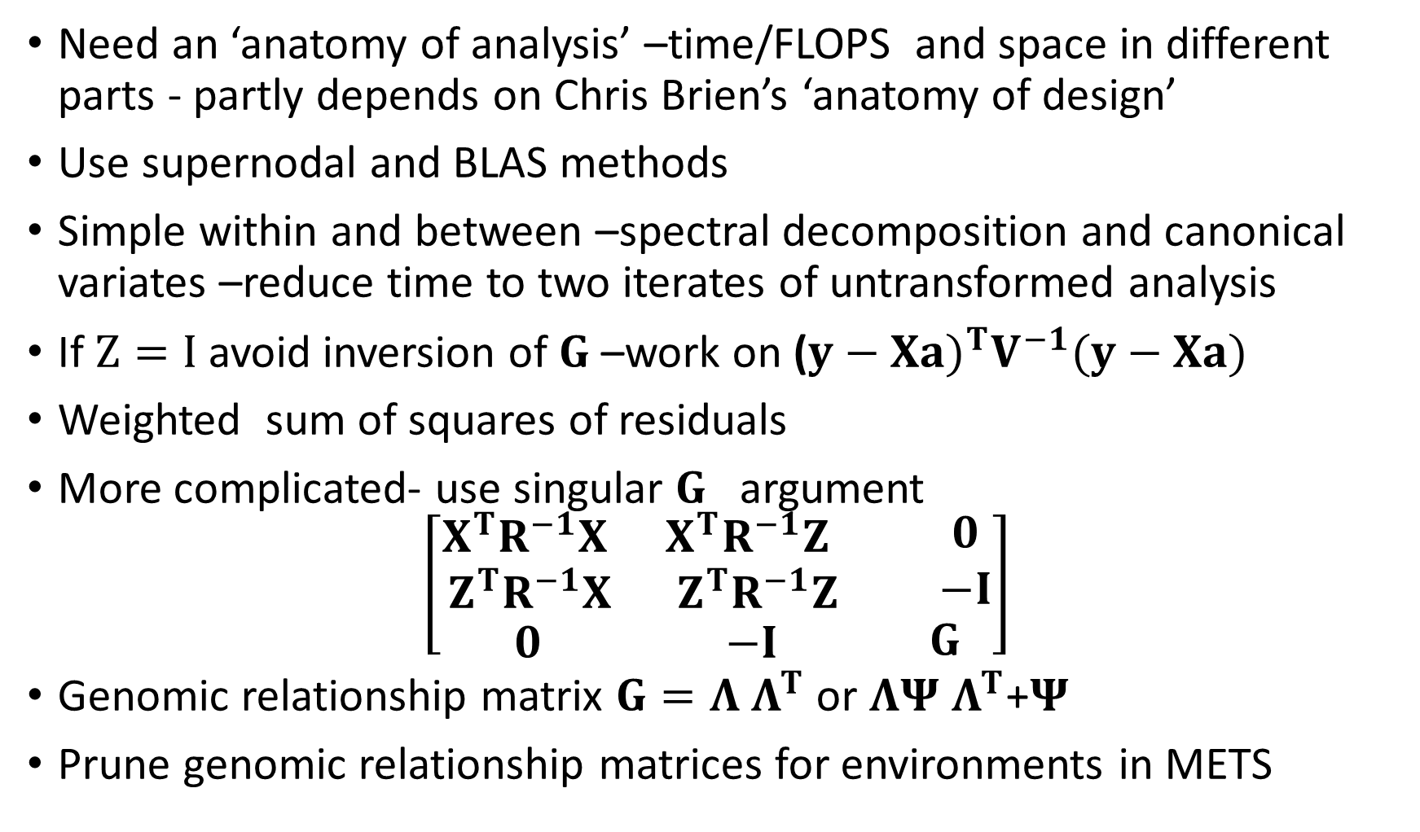
The way forward
Need an ‘anatomy of analysis’ –time/FLOPS and space in different parts - partly depends on Chris Brien’s ‘anatomy of design’
Use supernodal and BLAS methods
Simple within and between –spectral decomposition and canonical variates –reduce time to two iterates of untransformed analysis
If $Z=I$avoid inversion of $G$ –work on ($y−Xa)^{T}V^{−1}(y−Xa)$
Weighted sum of squares of residuals
More complicated- use singular $G$ argument
$$\left[\begin{matrix}\begin{matrix}X^{T}R^{−1}X & X^{T}R^{−1}Z \\ Z^{T}R^{−1}X & Z^{T}R^{−1}Z\end{matrix} & \begin{matrix}0 \\ −I\end{matrix} \\ \begin{matrix}0 & −I\end{matrix} & G\end{matrix}\right]$$
Genomic relationship matrix $G=Λ$ $Λ^{T}$ or $ΛΨ$ $Λ^{T}$+$Ψ$
Prune genomic relationship matrices for environments in METS

Slide 52
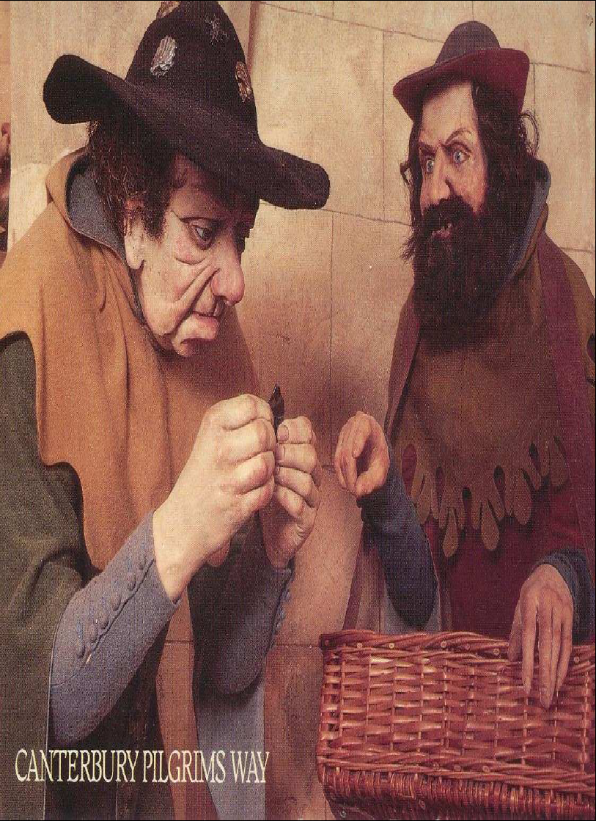

Slide 53
Students 1)with Bill Hill
Mohammed Ahmed (Sudan)
Kevin Atkins (Australia)
Baldev Beniwal , Vijay Chauhan, Pander (India)
Florence Jaffrezic (France)
Alphonse Koerhuis, Roel Veerkamp, Peter Visscher (Holland)
Karin Meyer (Germany)
Gulan Mohiuddin (Pakistan)
Raphael Mrode (Nigeria),
John Ruane (Ireland)
Youping Gu (China)
Sarah Blott, Sue Brotherstone, Neil Cameron, Ron Crump, Sara Knott,Geoff Simm,Jennie Pryce, Naomi Wray

Slide 54
All able -all passed
International diversity
Applied data analysis -tailor to student skills
I learnt more than the students
2)Other students
Mehmet Firat (Turkey)
Connie Mcmanus (Ireland)
Jarmo Juga ,Kaarina Matilainen (Finland)
Luc Janss (Holland)
Freedom Gundze (Swazi)
Colin Alexander, Chris Glasbey, Sue Welham
Most more statistical
Took longer two of later ones took over eight years

Slide 55
3) With Brian Cullis
Damian Collins, Simon Diffey, Joanne de Favori, Alison Kelly, Luke Mazur, Alison Smith
Less involvement -suggest ideas on the back of boarding pass
Very through grounding

Slide 56
