Slide 1
Statistical issues arising from the Australian Royal Commission into Institutional Responses to Child Sexual Abuse
Graham Hepworth
Statistical Consulting Centre
The University of Melbourne

Slide 2


JUNE 2017
ANALYSIS OF CLAIMS OF CHILD SEXUAL ABUSE MADE WITH RESPECT TO CATHOLIC CHURCH INSTITUTIONS IN AUSTRALIA

Slide 3
Issues arising:
1. Reporting of proportions
2. Double counting

Slide 4
Issues arising:
1. Reporting of proportions
2. Double counting

Slide 5
Table 3: Overall proportion of members who were alleged perpetrators
Religious institute – weighted average | Percent
Dominican Friars | 2.1%
Franciscan Friars | 4.7%
Jesuits - Society of Jesus | 5.7%
Marist Fathers - Society of Mary | 13.9%
Missionaries of the Sacred Heart | 5.3%

Slide 6
Table 3: Overall proportion of members who were alleged perpetrators
Religious institute – weighted average | Percent
Dominican Friars | 2.1%
Franciscan Friars | 4.7%
Jesuits - Society of Jesus | 5.7%
Marist Fathers - Society of Mary | 13.9%
Missionaries of the Sacred Heart | 5.3%

Slide 7
“. . . . calculation of the proportion who were alleged perpetrators”
453 Jesuit priests in 1950–2010
5.7% = . . . out of 453 ?

Slide 8
“. . . . calculation of the proportion who were alleged perpetrators”
453 Jesuit priests in 1950–2010
5.7% = 26 out of 453 ?

Slide 9
“. . . . calculation of the proportion who were alleged perpetrators”
453 Jesuit priests in 1950–2010
5.7% = 16 out of 453 ?

Slide 10
Average length of ministry:
Alleged perpetrators: 34.4 years
Others: 20.7 years

Slide 11
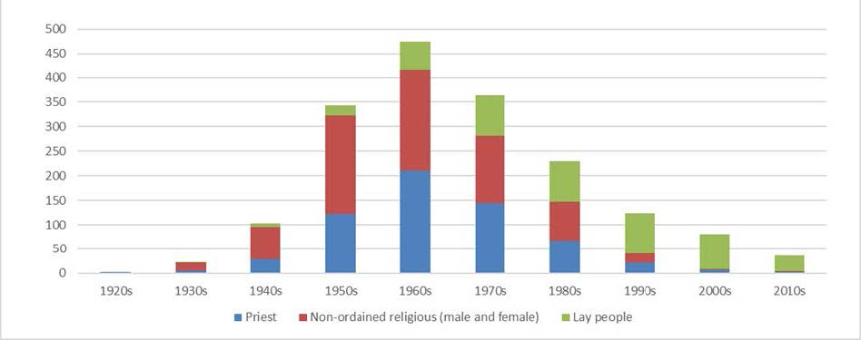
Figure 4: Number of alleged perpetrators by decade of alleged first incident of child sexual abuse for each religious status group
1960s
1950s
1970s

Slide 12
Tour de France:
What proportion of Tour de France riders have been found to take performance-enhancing drugs?

Slide 13
In drawing attention to the likely misunderstanding arising from the reporting, we are not suggesting that the Royal Commission has in any way attempted to distort the results, or to exaggerate the extent of the problem. Their documents explain the weighted average methodology in detail, and give both unweighted and weighted figures for each proportion calculated. However, the problem of misunderstanding remains. It would have been better if the Royal Commission had used an expression containing the term “risk” rather than “proportion” in its reports.

Slide 14
Issues arising:
1. Reporting of proportions
2. Double counting

Slide 15
Society of Jesus (Jesuits)
non-ordained
priests

Slide 16
Society of Jesus (Jesuits)
non-ordained
priests

Slide 17
Society of Jesus (Jesuits)
non-ordained
priests

Slide 18
Society of Jesus (Jesuits)
non-ordained
priests

Slide 19
Actual status of Jesuit members
non-ordained
priests

Slide 20
Status as counted by the Royal Commission
non-ordained
priests

Slide 21
Status as originally counted by the Royal Commission
non-ordained
priests

Slide 22
Actual status of Jesuit members
non-ordained
priests

Slide 23
Tour de France: riders in teams with
American vs Australian lead riders
American
Australian

Slide 24
Jesuit priests moving diocese
Sydney
Melbourne

Slide 25
Tour de France: team riders vs lead riders
team riders
lead riders

Slide 26
Tour de France: team riders vs lead riders
team riders
lead riders

