Slide 1


Genstat 19/20 updates
David Baird
Roger Payne
VSN International, New Zealand & UK
Rotorua 3rd December 2018

Slide 2
Contents
Unicode and UTF-8 support
New server facilities
Themes and window positioning control
Residual and homogeneity checks in ANOVA menus
and new results summary
Integration of new REML procedures in menus
Producing multi-paged PDF files directly from batch jobs
Landscape and portrait support for printing/PDFs
New Graphics facilities
Support for World Met Office GRIB2 file format

Slide 3

Unicode Video

Slide 4
New server facilities
FACGETLABEL – creates a text containing the factor’s labels
FACEXCLUDEUNUSED excludes unused levels
TX2VARIATE – reads numbers and dates from texts (READ [C=Text] exhausted buffer memory)
TXINTEGERCODES – converts characters to numbers and back – so you can specify UNICODE symbols programmatically
TXPROGRESSION – generate character strings
ABOXCOX for Box-Cox transforms in ANOVA
AGRCRESOLVEABLE for doubly resolvable row-column designs

Slide 5
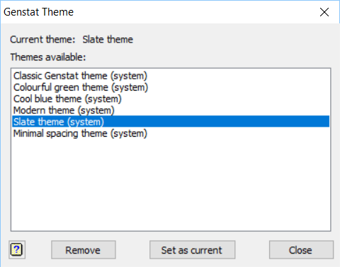
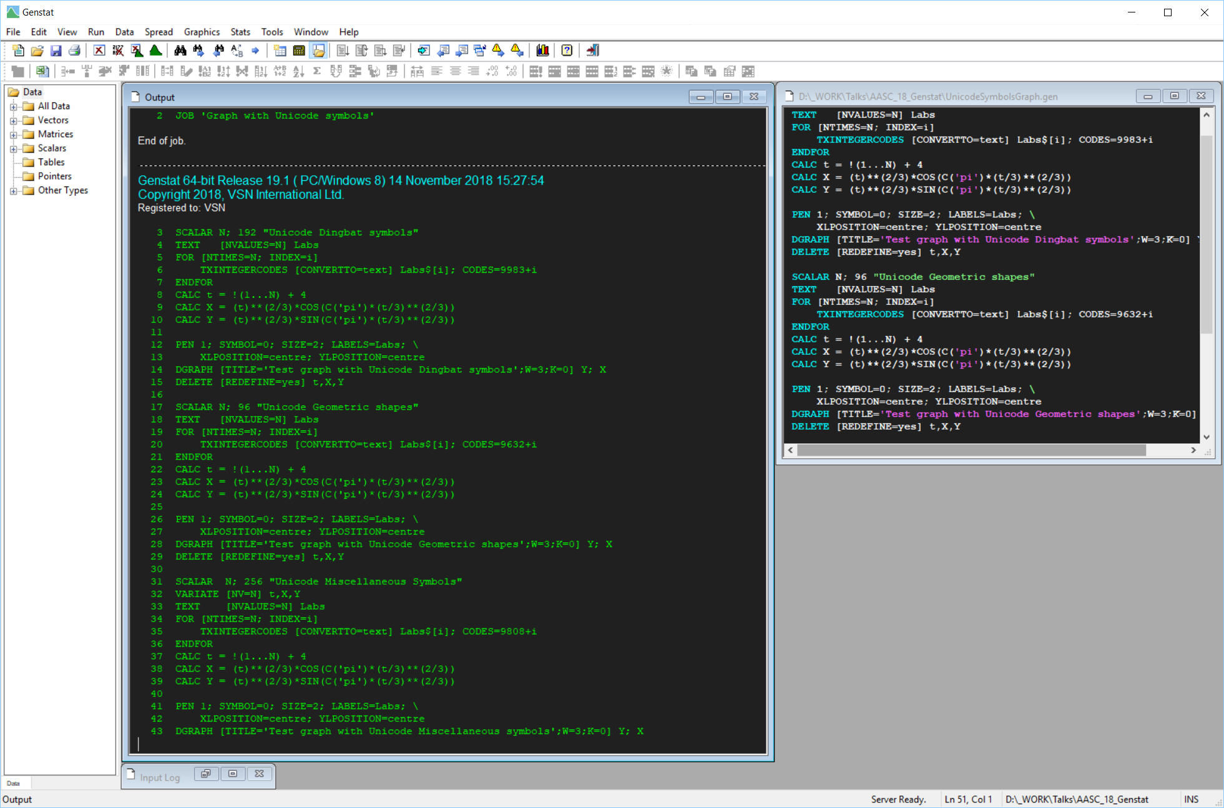
Themes
Tools | Theme menu

Slide 6
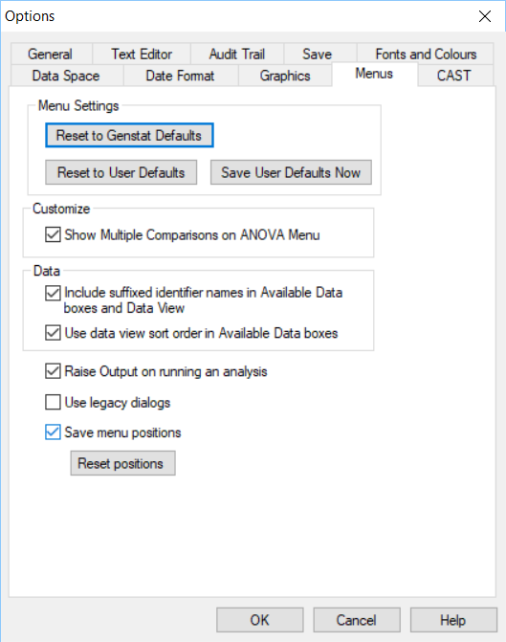
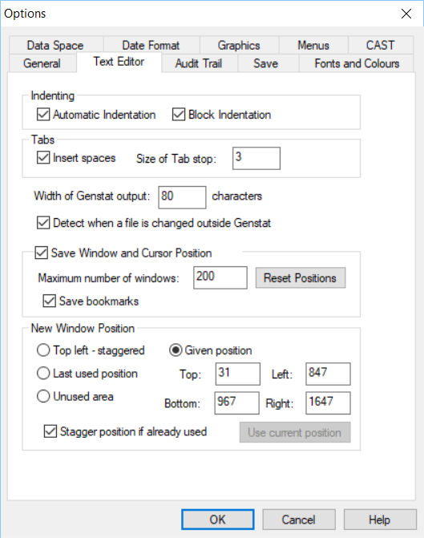
Window placement

Slide 7
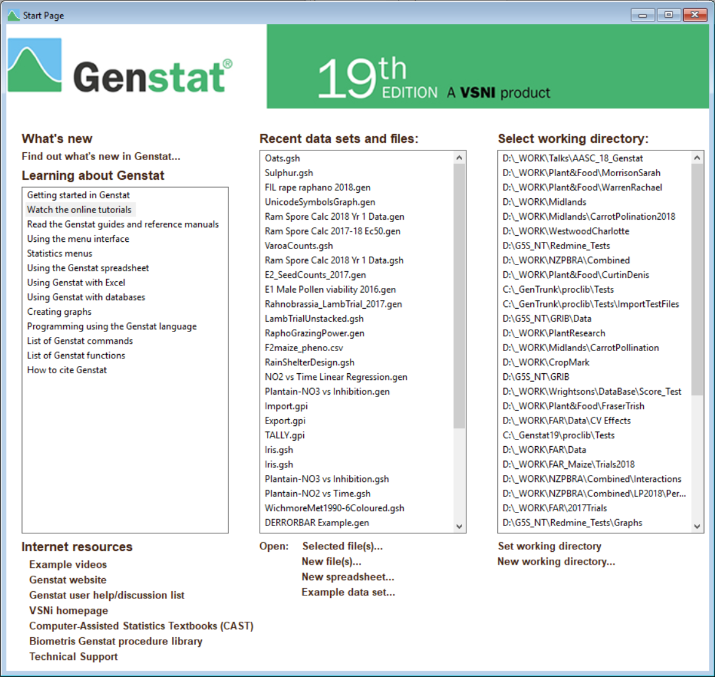
Updated Start Page/Tutorials

Slide 8
ANOVA menu additions
Assumption tests
Summary of results
Saving Excel file of results
Demo using Oats.gsh

Slide 9
REML menu additions
Assumption tests (VRCHECK ands VSOM)
Saving Excel file of results
Tests of random effects (VRPERMTEST)
Power analysis (VPOWER)
Demo using Oats.gsh

Slide 10
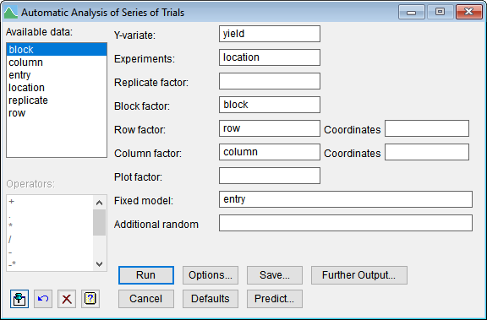
Menu for series of trials
specify Block, Row and Column factors
  block design if experiment contains >1 block
Row and Column coordinates default to Row and Column factor levels
..

Slide 11
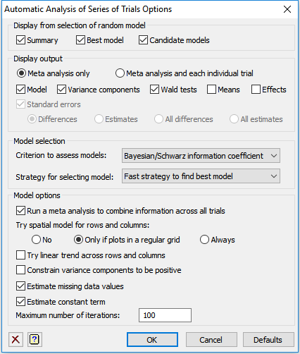
Options for series of trials
find best random model (using SBIC)
fast strategy omits unlikely models (e.g. column effects as well as spatial correlation model across columns)
try spatial models if plots in a regular grid
estimate missing values (to provide a regular grid)
but not linear trends
..

Slide 12
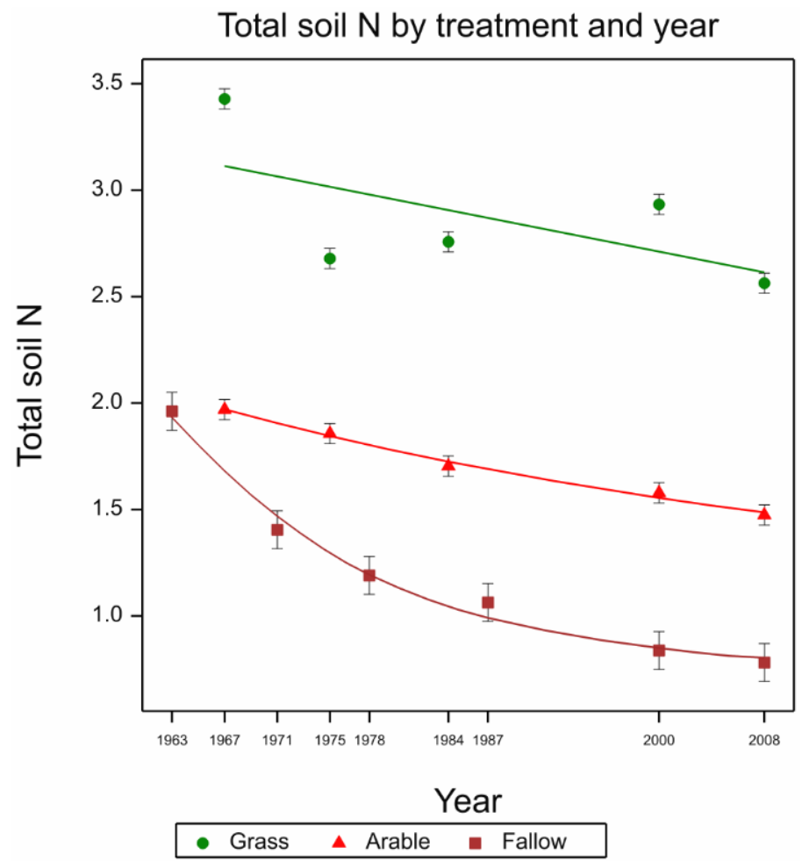
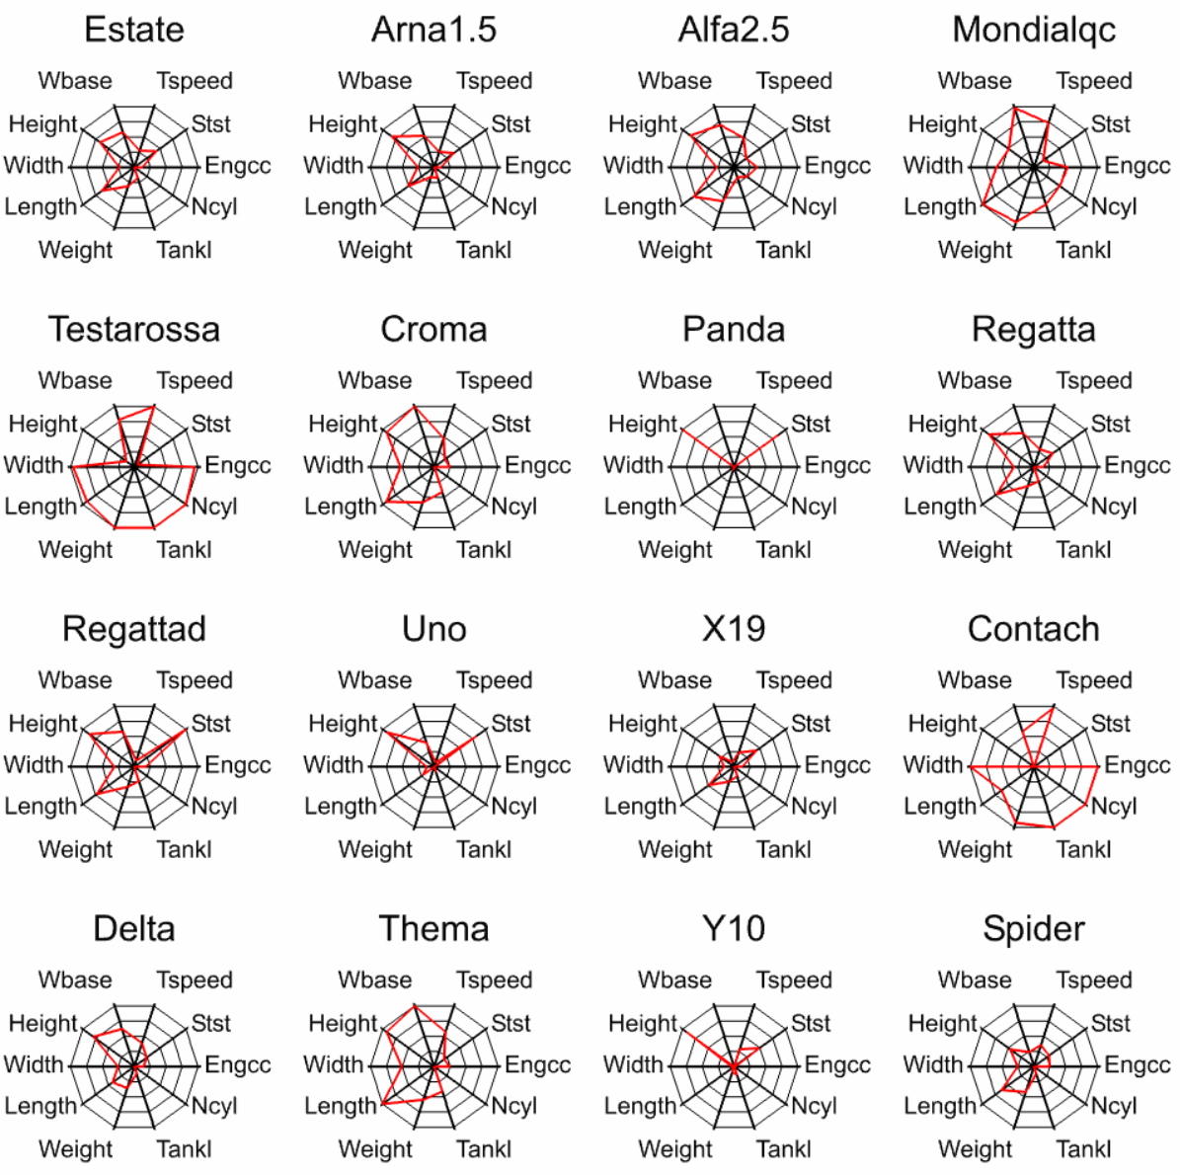
New Graphics facilities
DKEY for multiple column keys
DERRORBAR to add an error bar to existing graph
DSPIDERWEB to show multivariate attributes by groups

Slide 13
Multi-paged PDF files
Open graphics channel 4 or 13 and set DEVICE to that channel
Output graphs
New options in Graphics viewer to automatically orientate graphs in PDF
Close channel
PDF is created

Slide 14
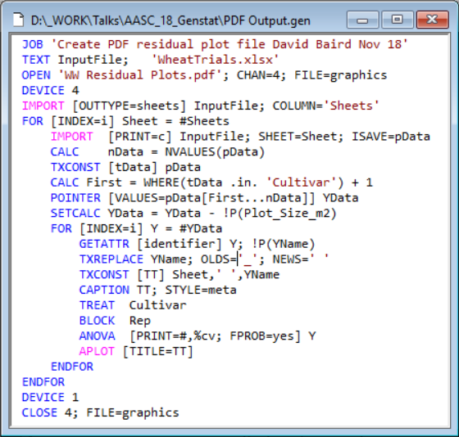
Multi-paged PDF files Example 1

Slide 15
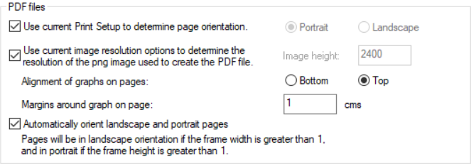
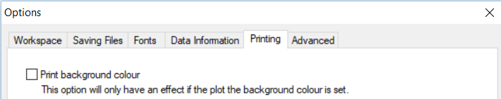

Automatic orientation of landscape pages

Slide 16
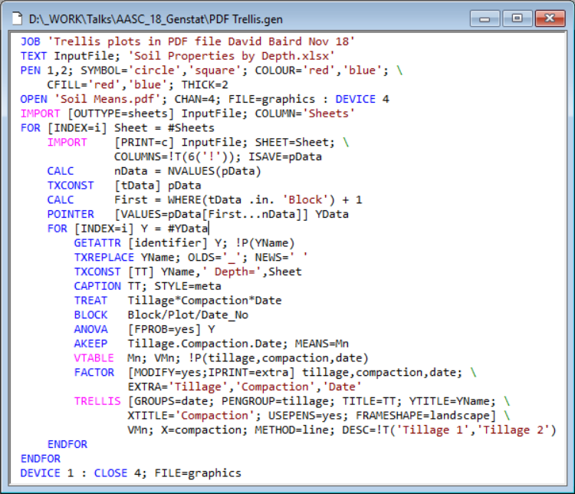
Multi-paged PDF files Example 2

Slide 17
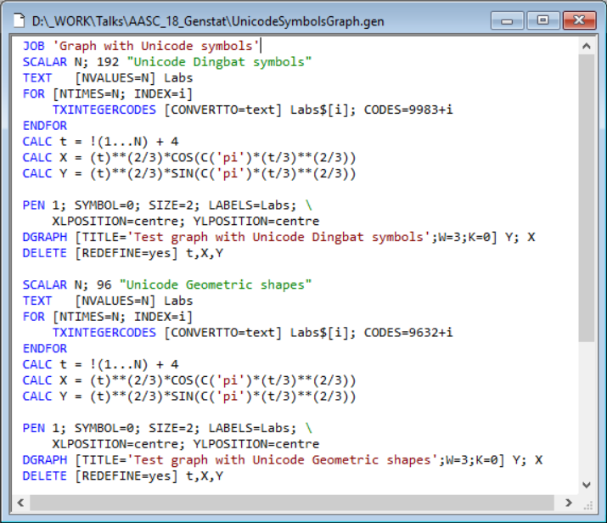
Using TXINTEGERCODES for symbols

Slide 18
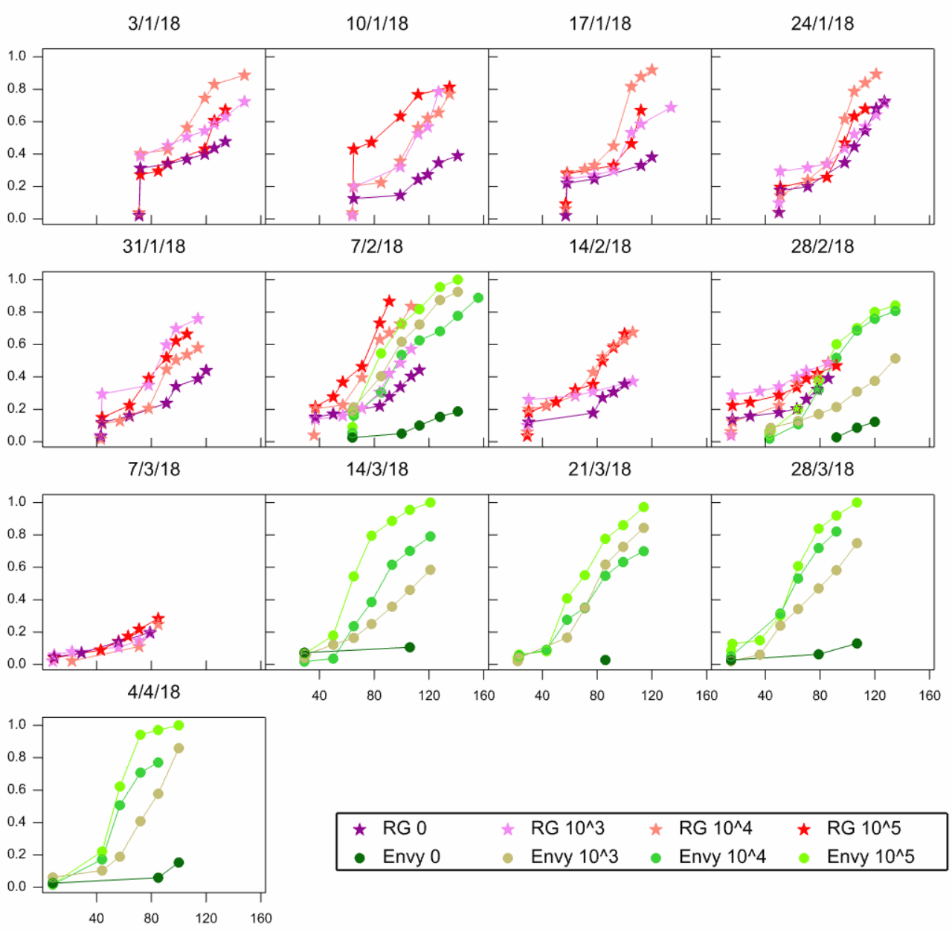
DSTART/DFINISH speed up multiple graphs
When DSTART is used output is not sent until DFINISH is meet, or SCREEN=clear.
Graphs can now be added after DFINISH (e.g. adding DKEY to a TRELLIS plot).
Use FFRAME to setup multiple graph frames when not using TRELLIS etc.

Slide 19
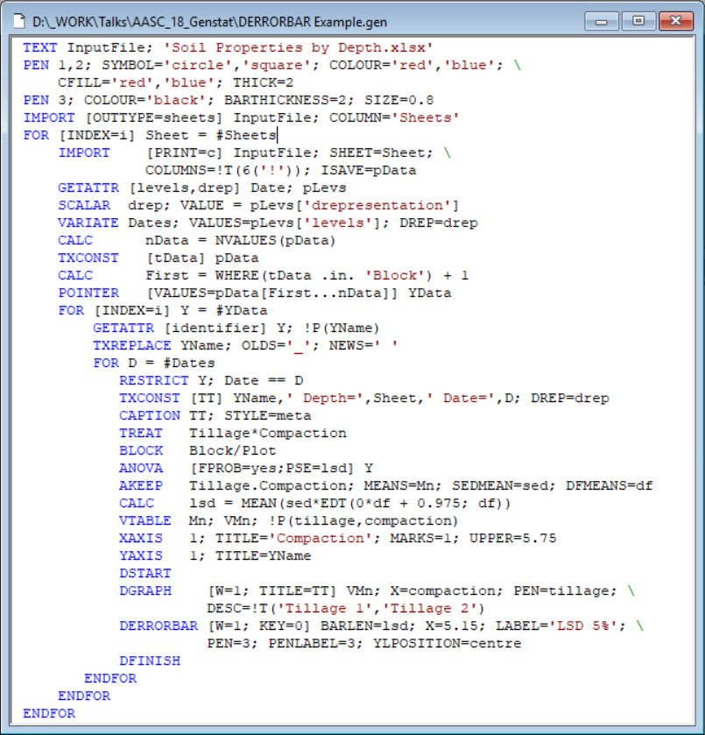
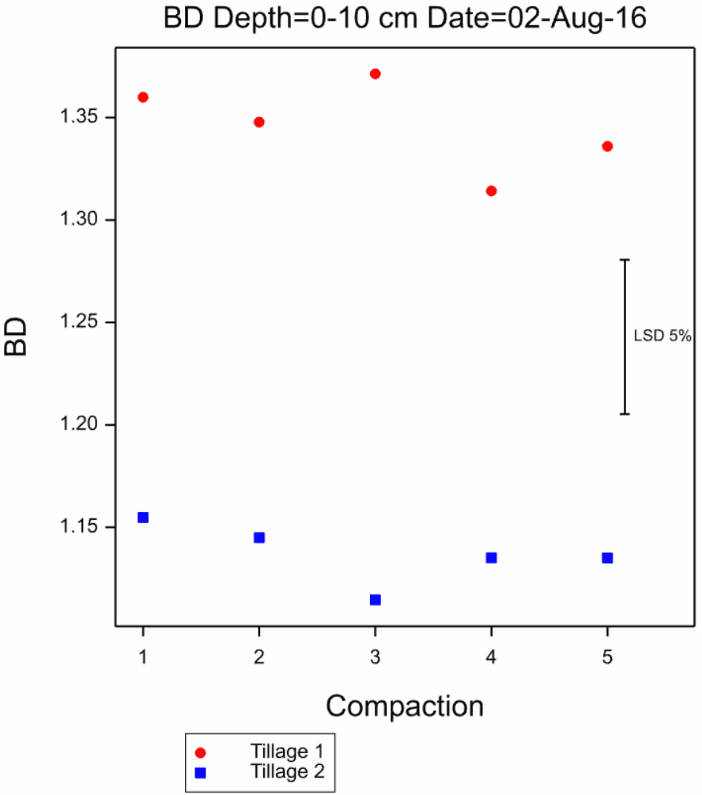
DERRORBAR Example

Slide 20
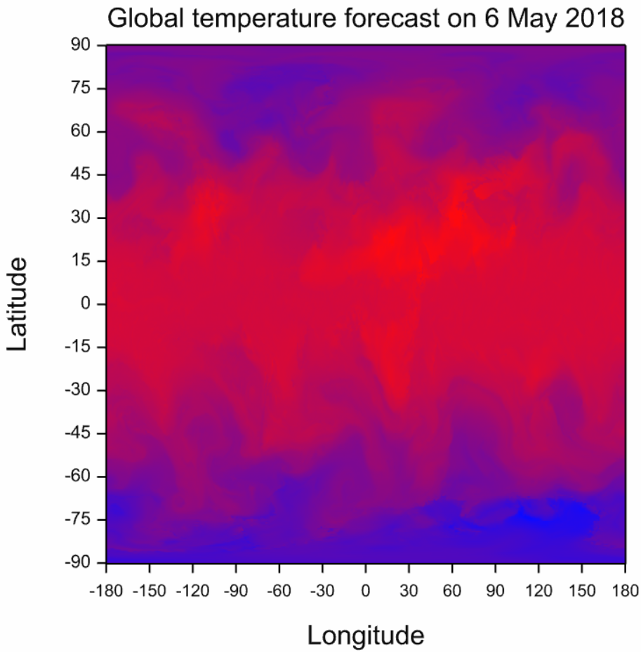
GRIBIMPORT example

Slide 21
Possible additions
Code insert in editor
IMPORT- more control over missing values from Excel (* as text, multiple missing values)
Automatic date formats on graphs

