Slide 1
“From cradle to grave”: making an impact from conception to publishing
Ruth Butler

Slide 2
Collaboration: the Core of Consulting
My major annual objective:
Collaborate in science projects at a high level throughout the duration of the project.
Consulting:
Consulting
Collaboration
Other…..
Training
‘Support’
Research, Development….

Slide 3


Statistical aspects at all stages of a research project
Planning
Study Aims
Design
How/What to Measure
Do the study
Modelling
What ‘treatments’
Data manipulation
Data collection/ storage
How many replicates?
Analysis
Formal Analysis
Reporting
How/what to Sample
Testing
Data summary/ graphing
Archiving
Interpretation & presenting
Notes:
Statistical Aspects to every part of the research process

Slide 4
Developing a Collaborative Relationship
Develop good relationships with scientists (lots of chatting!)
Be their ‘statistical go to person’
-> Work with the same people/ groups over the long term
Become familiar with the scientist’s discipline, tools and methods
Be flexible: adapt advice and practices to the project and project team’s needs
Be good at the ‘basics’
-> Enhances acceptance of higher-level methods
Provide easy to use/ accessible materials and outputs
Aim: Become a full and default member of the project team
Notes:
Basics: Design, ANOVA, the ‘usual’ stuff scientists do.
Enhances trust and facilitaes ability to explain things

Slide 5
Ways of working
Planning/ Design:
Discuss research projects at an early stage (not just trial design, treatments, but research aims)
Provide easy-to-use trial plans and data sheets
Discuss what data is going to be collected
Input during a study:
When things go wrong
Advice on sampling…
Advise on Data entry and basic exploration
Analysis
Summarised in a report complete with suggested figures and tables
AND interpretation
Notes:
Some people I work with contact me even from the field when things go wrong!
Report writing: USUALLY, some exceptions
Interpretation is potentially the major science contribution from the biometrician

Slide 6
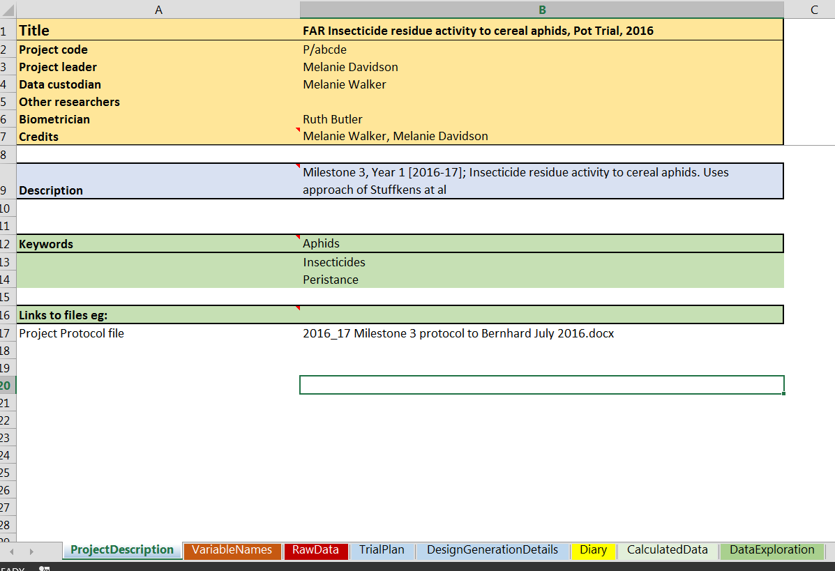
PFR Excel Templates
Template sheets:
Project Description: Overall summary
VariableNames: Describes RawData Columns
RawData
TrialPlan
DesignGenerationDetails
Diary
CalculatedData: Separated from RawData
DataExploration: PivotTables, Figures…
Metadata
Calculations & Explorations
Data Sheet
Notes:
Templates developed as part of special data management project, along with other tools such as Excel skills workshops
We are happy to share our materials if anyone is interested (email me).
Three types of sheet: Metadata, Raw data, initial explorations & calculations
Planning parts: Somewhat come from practice I have developed over the years

Slide 7
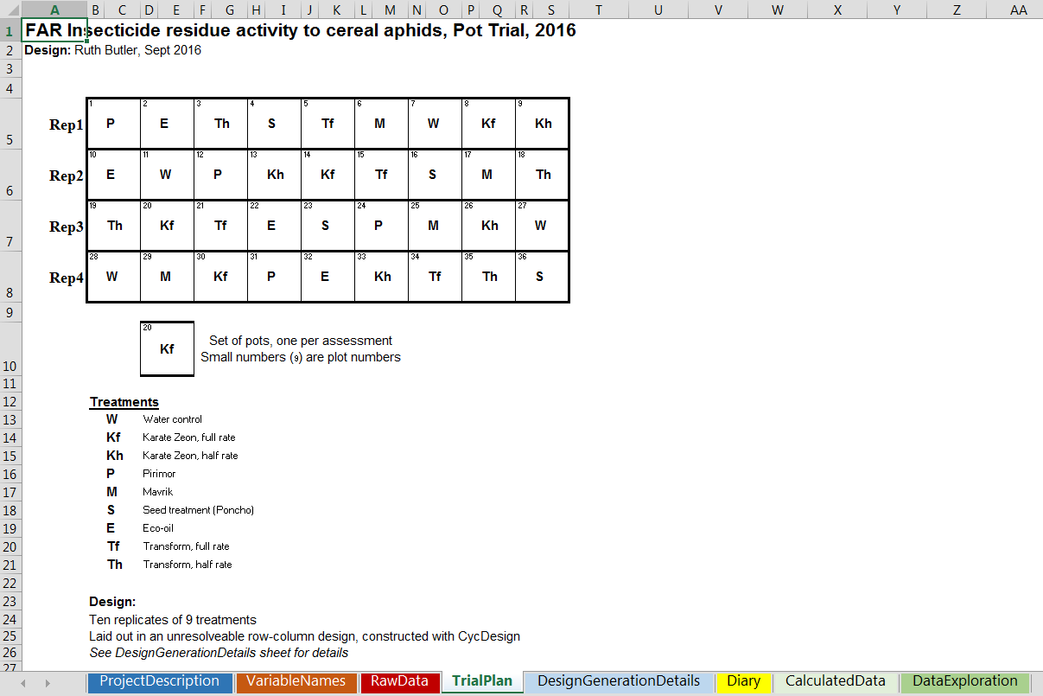
Templates: Trial Design
Visual layout facilities laying out trial
Includes ‘plot’ numbers
Brief treatment description
Brief description of design
Notes:
Frequently people print this page off, laminate it and take to Lab/GH/ Field

Slide 8
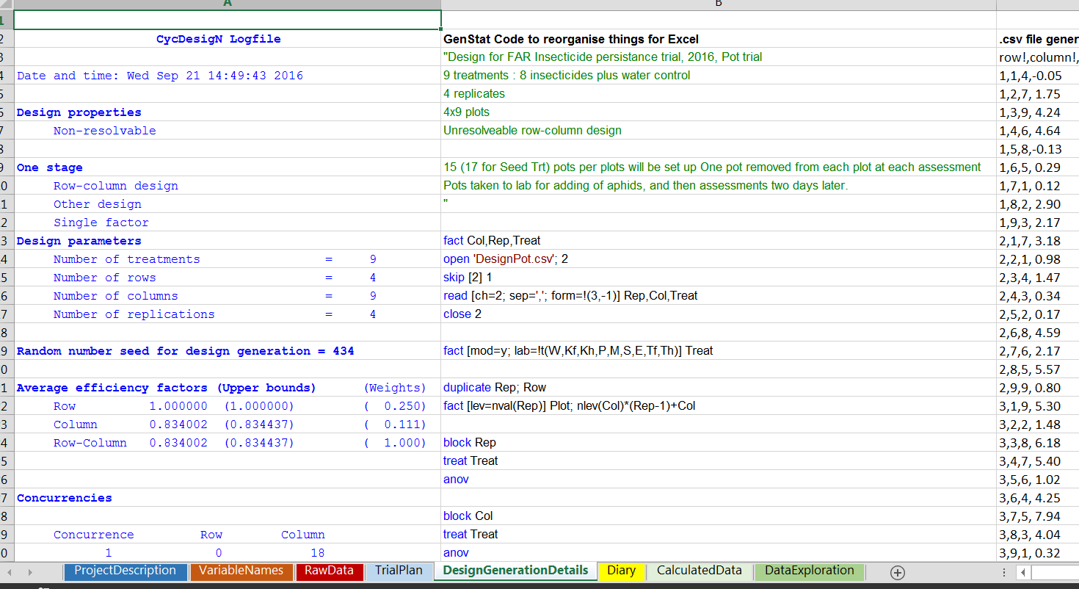
Templates: Design generation info
-integral part of experimental process
-useful for analysis stage
Notes:
- Analysis by someone other than me is facilitated

Slide 9
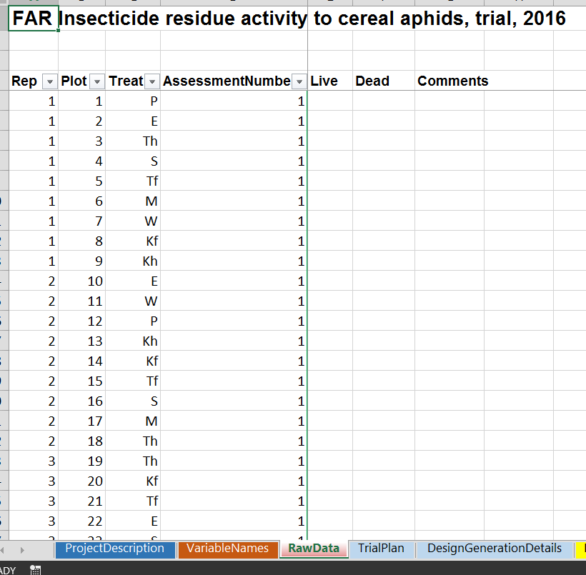
Templates: Skeleton DataSheet
Gives strong guidance on ‘best’ practice
Notes:
Also we have written guidelines, for eg missing values

Slide 10
Writing a report: Not just annotating output!
>20 years ago:
Print output on line-printer paper
Annotate, hand draw figures,
Maybe print graphs, cut out & paste onto output (real glue!)
Notes:
No particular tools for use During trials….

Slide 11
Writing a report: Not just annotating output!
Code not linearly related to report!
It includes stuff :
For data manipulation, checks
To help make good tables, graphs
Complex methods poorly understood
-> possible confusion from output
Now:
Rarely give people output
Write full reports
Reports:
Initial sections: Describe what (I think!) was done, what I did
Good aide-memoir when looking back
Focus: interpretation of analysis results
Especially useful: when more than ‘basic’ analyses done
Enhances chances of getting an authorship!
Parts of report → Cut & Paste into Science Report/ Paper

Slide 12
Sections in my reports
1. Experiment and Data
Description of what I think was done, and description of trial design
2. Methods of Analysis
Description of statistical analysis methods.
Includes references for methods & software
3. Results
Summary of analysis results- interpretation in words, plus tables and figures
4. References
5. Appendices
Might contain output or code. Or else further figures and tables

Slide 13
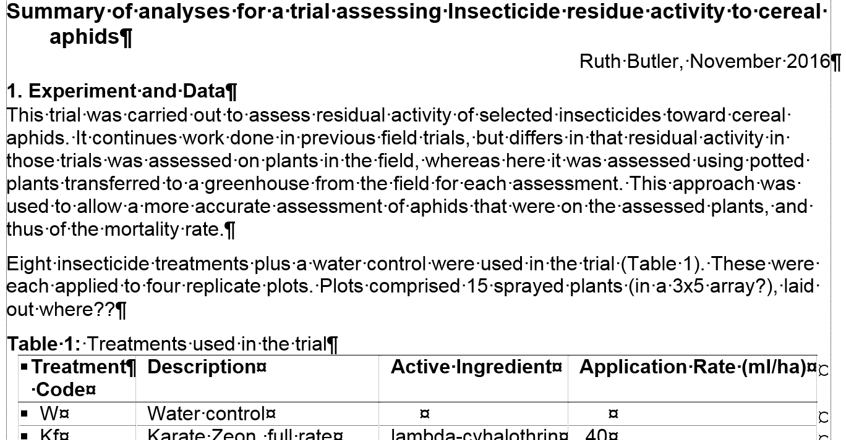
Trial/ Study Description
Useful for looking back
Check: my understanding = what was done
Notes:
Always a lot of typos…!

Slide 14
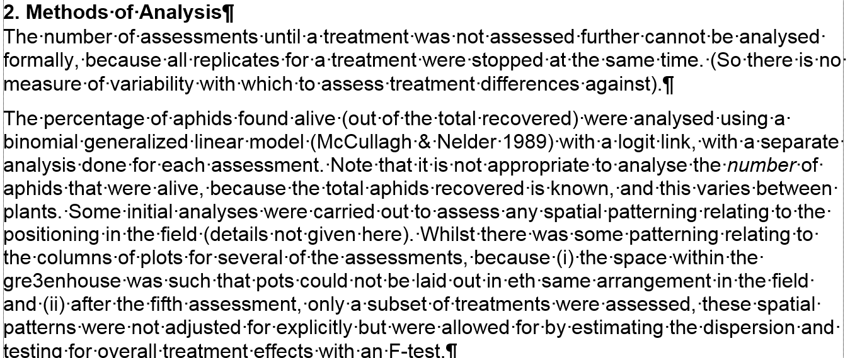
Analysis Methods
A useful record
Easily adapted for a publication

Slide 15
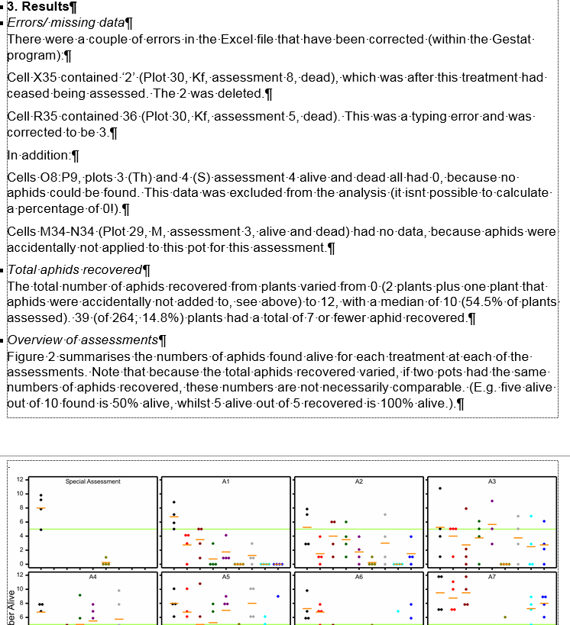
Results part 1
Stuff to do with data problems
Exploratory summaries
Notes:
Gives guidance on good practice

Slide 16
… Results
For the first five assessments (Table 4, Figure 5), when all treatments were being assessed, there were significant differences between the treatments at the 1st, 2nd and 4th assessments (p<0.001, p=0.007, 0.211, 0.048, 0.075 for the five assessments respectively).
At each of these dates, the %Alive for the Water control was highest or second-highest (but similar to the highest). Conversely, the %Alive was zero or close to zero for the Seed treatment at each of these assessments. The %Alive for treatment Tf was also low at each of these assessments
Summary of ‘test’ results/ formal analysis
Interpretation
Notes:
Interpretation should be a major role for statisticians

Slide 17
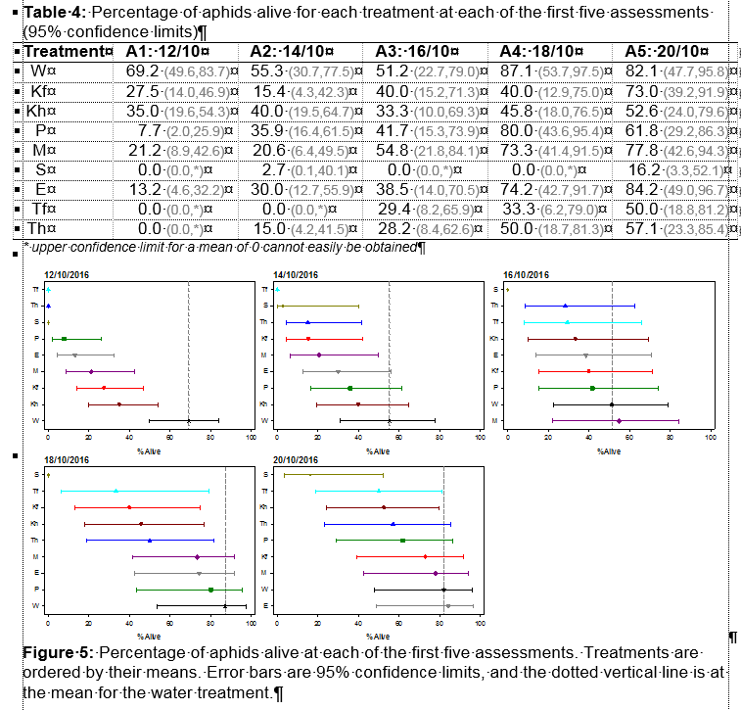
…Results
Tabular AND graphical version of same results
Figures made in SigmaPlot
Scientist:
- Can edit easily
- Has ‘ownership’
(Genstat used for complex figures)
Notes:
Table and graph-> differing preferences, allows flexibility
Re-creating a figure in SigmaPlot takes a bit of etra time, but this often pays off later

Slide 18
Conclusion…
A bit of extra effort early on and to develop tools/ methods saves time and pays dividends
Acknowledgements for templates:
Linley Jesson, Duncan Hedderley, Andrew McLachlan, Peter Alspach

Slide 19
Thank you
Ruth.Butler@plantandfood.co.nz

Slide 20
Biological research has statistical aspects from initial conception through all stages to final publication and sometimes beyond. Good foundations – trial planning and design – are the bed-rock for quality science results, thus requiring good statistical input from the very beginning. Over my time as a biometrician, I have increasingly been involved at all stages of a project, developing approaches that facilitate that, leading to increases in efficiency and efficacy of the research through good statistical practice. I will present some approaches that I use, from trial design, to data management, through to presentation of results.

